Slide 1
Software Engineering
Paulo Borba
Informatics Center
Federal University of Pernambuco
pauloborba.cin.ufpe.br

Slide 2
Code review

Slide 3
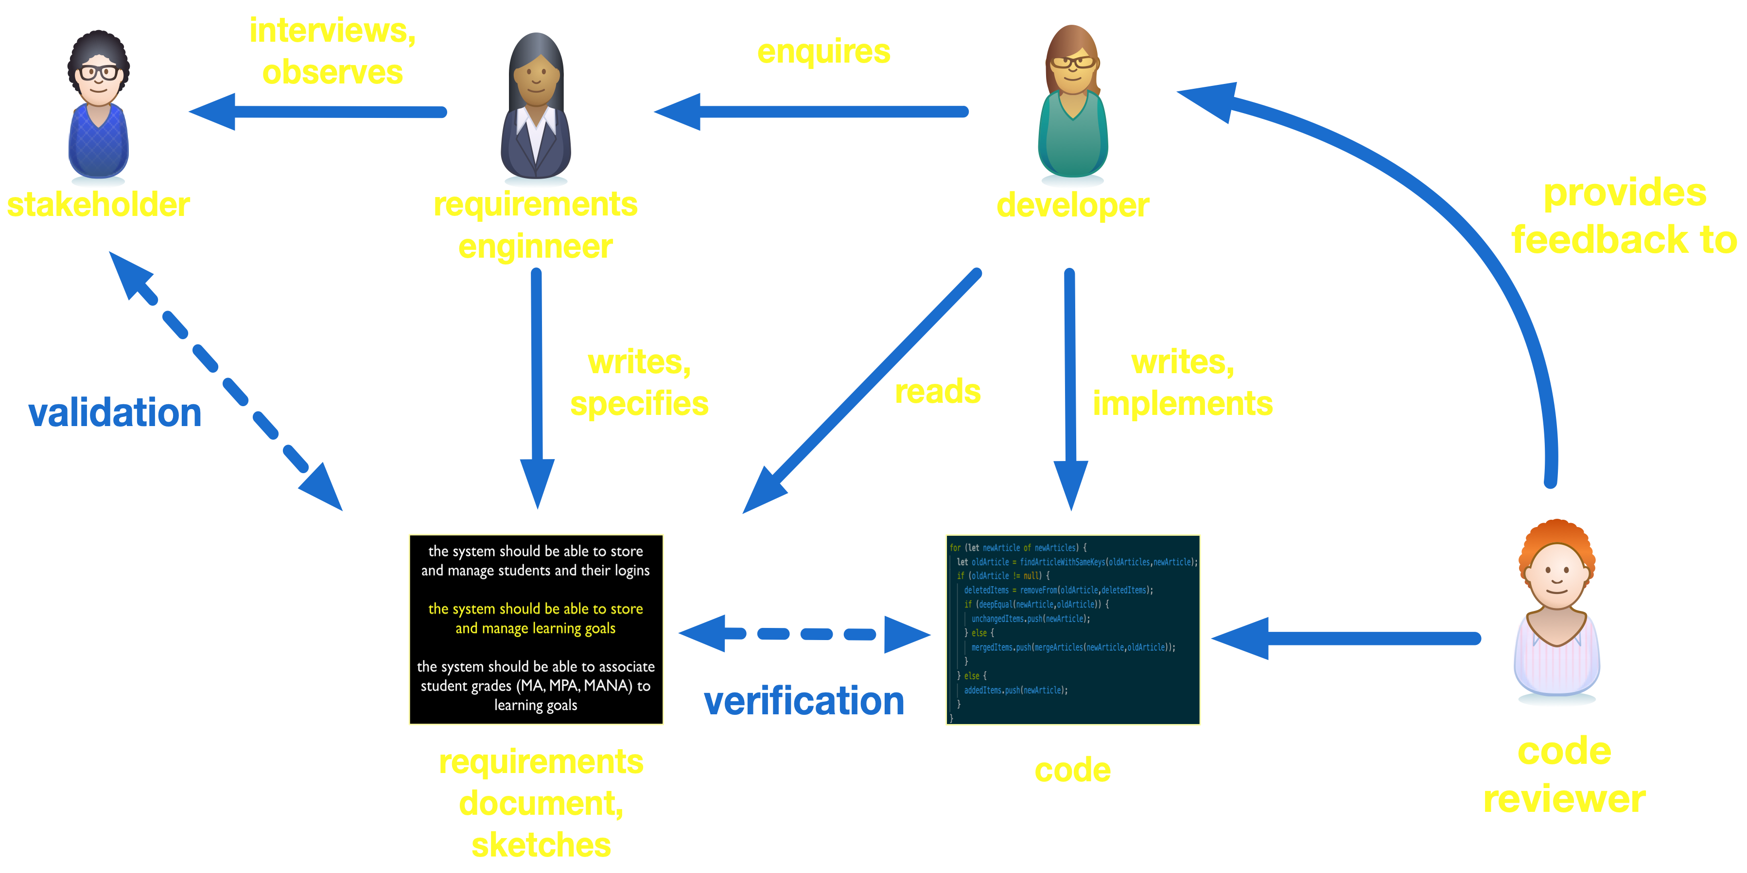

Slide 4
Code review snippets
maybe rename to getTypeName?
extract as dropFirstLine?
avoid duplication here
better to handle exceptions that will
be raised if diffj output format is changed
shoulnd’t this be a parameter?
please add provides and requires
interface for each service
if you are assuming that, it's safer to add
an assert stating it
the regular expression should be slightly more
complicated see reference manual, pg 23

Slide 5
Code review aspects
focus on different needs
fixing, improving external quality factors (correctness, robustness, performance, security, etc.)
refactoring, improving internal quality factors (readability, modularity, reusability, etc.)
adding or refining documentation
assuring coding styles and practices are adopted

Slide 6
Goes beyond verification, and quality assurance and conformance in general
Static Analysis
Code review
Testing

Slide 7
Review code and make notes
the addFilesToDirectory function
https://is.gd/34Zqz3
Notes:
https://github.com/pauloborba/academic-kickstart/blob/master/personal/scripts/jsonToSite/jsonToSite.ts

Slide 8
Code review report
the addFilesToDirectory function
Large function, many functions could be extracted, revealing intention and improving readability
Small code duplication, lines 54-62
Directory structure is hardcoded, lines 104-115
137-151 could be a loop based on a map previously created
No exception handling for file operations, lines162-168
Poor documentation
Legibility is OK
Variable names are OK

Slide 9
How is code review actually done in practice?

Slide 10
Code reviewing in the trenches
Laura MacLeod et al. IEEE Software 2018.
Four teams at Microsoft
Ethnography-style observations (1 week)
Semistructured contextual (firehouse) interviews with 18 developers
Survey of 911 developers to validate initial findings
best practices
motivation
challenges
Notes:
1 week per team

Slide 11
Code review is important
Reviewer feedback is useful
Review pressure makes developers more attentive
Increases confidence
Notes:
Our study revealed that Microsoft developers recognize code reviews’ value and importance. They appreciate reviewer feedback and are more thorough when they know their code will be reviewed. Whether they’re a code author or reviewer, the process also increases their confidence.

Slide 12
Code review life cycle
not all teams have explicit rules or policies
Preparation
Selection of reviewers
Notification of selected reviewers and stakeholders
Feedback
Iteration
Check-in
order can vary
Notes:
- Preparation (by the authors) of the code to be reviewed.
• Selection of reviewers (automatically or manually), with varying requirements for whom to select and how.
• Notification of the selected reviewers and other stakeholders, with team policy dictating whom to inform and how.
• Feedback provided by reviewers to authors and other stakeholders.
Iteration involving communication between authors and reviewers and further work by both.
Check-in of the code change to the target system (in some teams, before review).

Slide 13
~90% review code at least once a week
~40% review daily
most teams require code review before integration

Slide 14
Motivations for code review
Improve internal quality factors
Improve external quality factors (find defects)
Transfer knowledge
Explore alternative solutions
Improve the development process
Avoid breaking builds
Increase team awareness and integration
Share code ownership
Team assessment

Slide 15
Code review challenges for the author
Receiving timely feedback
Receiving insightful feedback
Finding reviewers
Documenting changes to be reviewed
Managing multiple communication channels (code review system, chat, face-to-face)
Dealing with rejections
Reaching consensus (bikeshedding)
Notes:
Another challenge concerned obtaining insightful feedback. Five participants mentioned that reviewers sometimes focus on insignificant details rather than looking for larger issues.
finding appropriate or willing reviewers is difficult, and they said that knowing whom to ask is challenging.
Participants said that when preparing for a review, they’re unsure how to document changes. Fewer than one-third of the survey respondents write descriptions of the change when they prepare code for review, but many more recognize they should do it more often and more thoroughly.
Bikeshedding (disputing minor issues while overlooking more serious ones)

Slide 16
Code review challenges for the reviewer
Large (tangled?) changeset
Finding time for properly reviewing code
Understanding the motivation for the change
Understanding how the change was implemented
Understanding change history and decisions
Insufficient training
Reaching consensus (bikeshedding)
Notes:
Reviewers said they struggle with large reviews. Participants discussed how they have difficulty finding time to perform all the code reviews requested of them, as well as understanding the code’s purpose, the motivations for the
change, and how the change was implemented. Regarding large, difficult-to-understand code changes, one developer expressed frustration about the value of his review:
Regarding comprehension, finding relevant documentation about changes was another frequently reported challenge
Our interviews revealed that understanding the history of comments was an issue. Other challenges that survey respondents reported include a lack of training on the review process and their perception that their reviewing activities aren’t valued enough. Some mentioned that they lack insights into how their code review activities impact job evaluations.

Slide 17
Code review practices

Slide 18
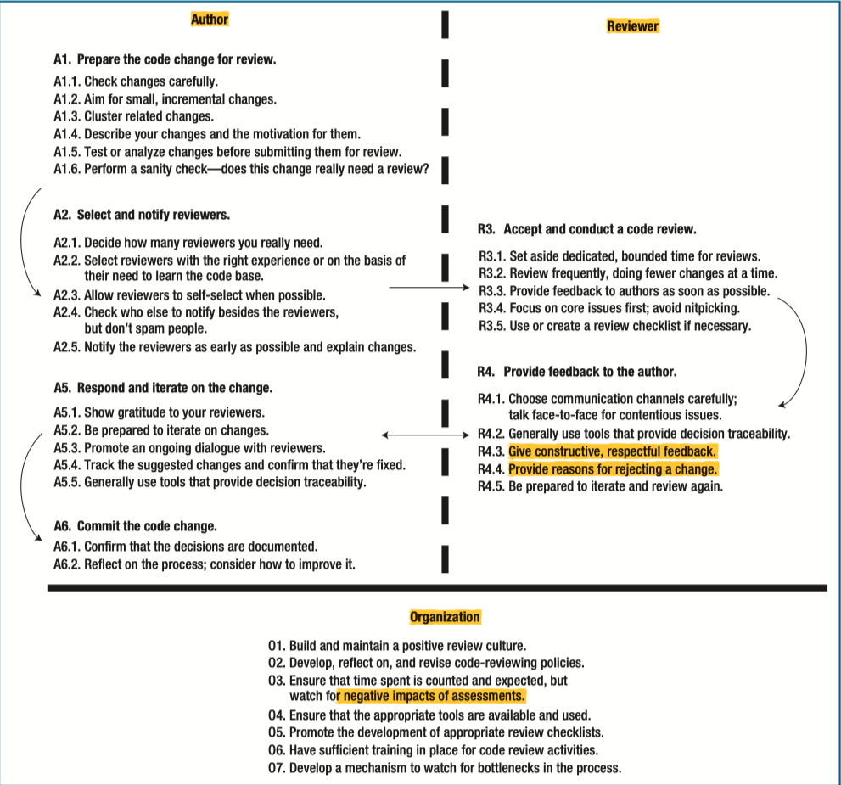
Code reviewing in the trenches.
Laura MacLeod et al.
IEEE Software 2018.

Slide 20
Code reviewing in the trenches.
Laura MacLeod et al.
IEEE Software 2018.

Slide 21
Select at least one practice that
you couldn’t understand
you think is relevant
you think is irrelevant
you have never practiced

Slide 22
Consider trade-offs when selecting practices

Slide 23
No code reviews for small changes that don’t affect code’s logic

Slide 24
Process Aspects and Social Dynamics of Contemporary Code Review: Insights from Open Source Development and Industrial Practice at Microsoft
Amiangshu Bosu et al. IEEE TSE 2017.
Surveys of Microsoft and OSS developers
Developers spend ~10-15% of their time with code reviews
more experienced developers spend more time
Quality of the submitted code helps to form impression about authors
Large similarity between OSS and Microsoft developers
main motivation in OSS is impression formation, contrasting with knowledge transfer at Microsoft
Notes:
muito mais ainda para pegar do paper
Process Aspects and Social Dynamics of Contemporary Code Review: Insights from Open Source Development and Industrial Practice at Microsoft. Amiangshu Bosu et al. IEEE TSE 2017.

Slide 25
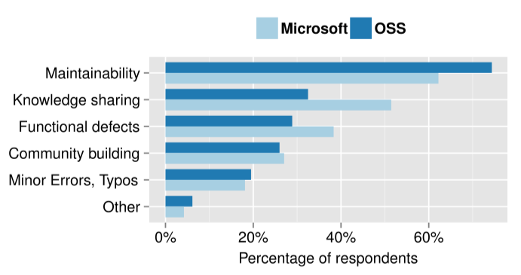
Code review motivation
Process Aspects and Social Dynamics of Contemporary Code Review: Insights from Open Source
Development and Industrial Practice at Microsoft. Amiangshu Bosu et al. IEEE TSE 2017.

Slide 26
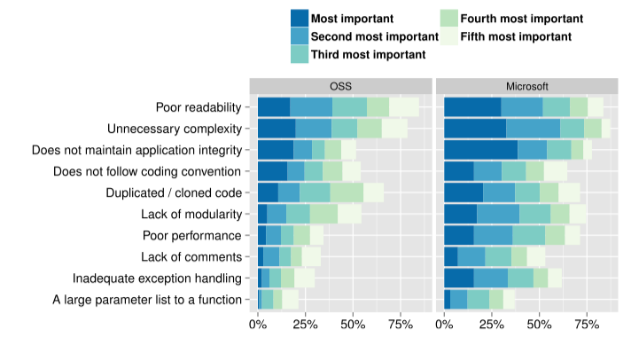
Common detected characteristics of poor code
Process Aspects and Social Dynamics of Contemporary Code Review: Insights from Open Source
Development and Industrial Practice at Microsoft. Amiangshu Bosu et al. IEEE TSE 2017.

Slide 27
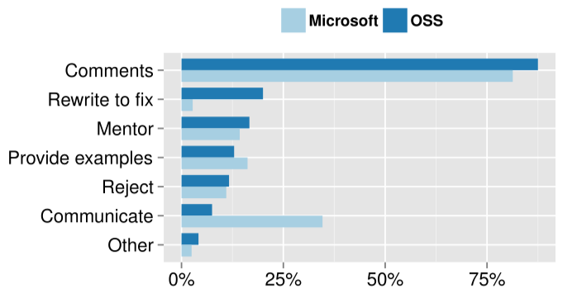
How reviewers assist to fix poor code
Process Aspects and Social Dynamics of Contemporary Code Review: Insights from Open Source
Development and Industrial Practice at Microsoft. Amiangshu Bosu et al. IEEE TSE 2017.

Slide 28
Code reviews
(lightweight, informal, tool-based)
versus
Inspections
(heavyweight, formal, meeting-based)

Slide 29
Code Review book and posts
Michaela Greiler
https://www.michaelagreiler.com/code-review-book/

Slide 30
Software Engineering
Paulo Borba
Informatics Center
Federal University of Pernambuco
pauloborba.cin.ufpe.br

