Slide 1
Software Engineering
Paulo Borba
Informatics Center
Federal University of Pernambuco
pauloborba.cin.ufpe.br

Slide 2
To do before class
Watch videos
Read chapter 7 and basic concepts of chapter 6 in the textbook
Send questions and opinions through slack

Slide 3
SaaS 1
Notes:
Arquitetura e linguagens de aplicações de SaaS

Slide 4
Software Engineering
Paulo Borba
Informatics Center
Federal University of Pernambuco
pauloborba.cin.ufpe.br

Slide 5
Software as a Service (SaaS)
Delivers software and data as a service over the Internet
No need to install applications and backup data in the user computing device
Easier to improve the service
Notes:
MIND MAP dos conceitos no final da aula!

Slide 6


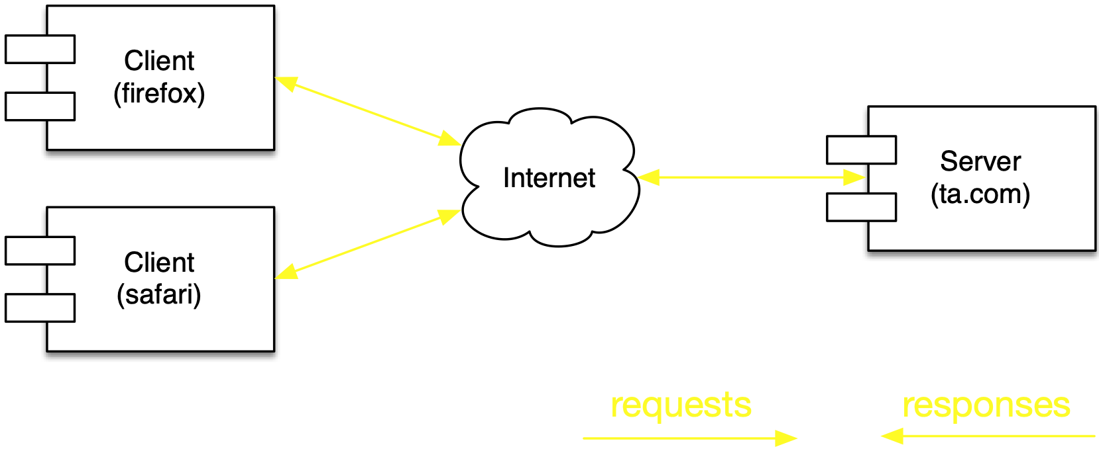
Client-server structure and behavior
services and data in the company computers
browser in user device

Slide 7
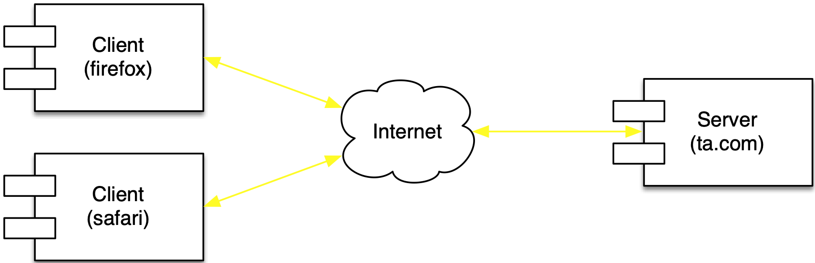
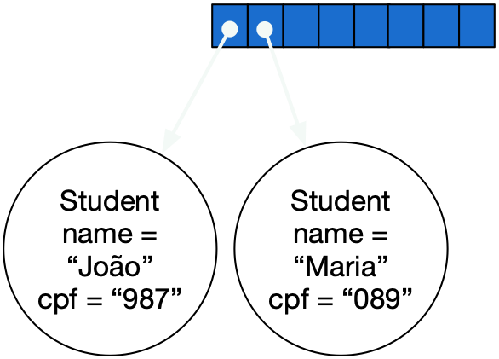
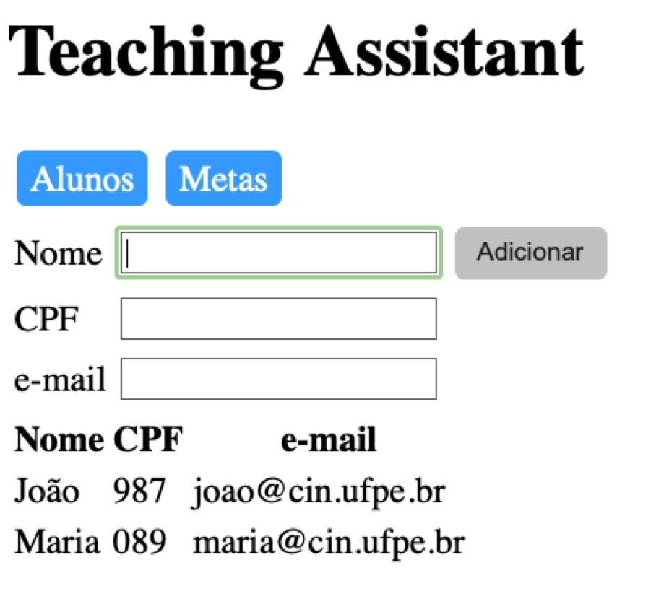

Notes:
servidor tem toda a logica para receber a requisicao, valida-la, realizar operacoes, armazenar ou atualizar dados, e retornar dados

Slide 8
Pattern principles
Separation of concerns between clients and servers
Separates functionality and processing place
Different interface for each server

Slide 9
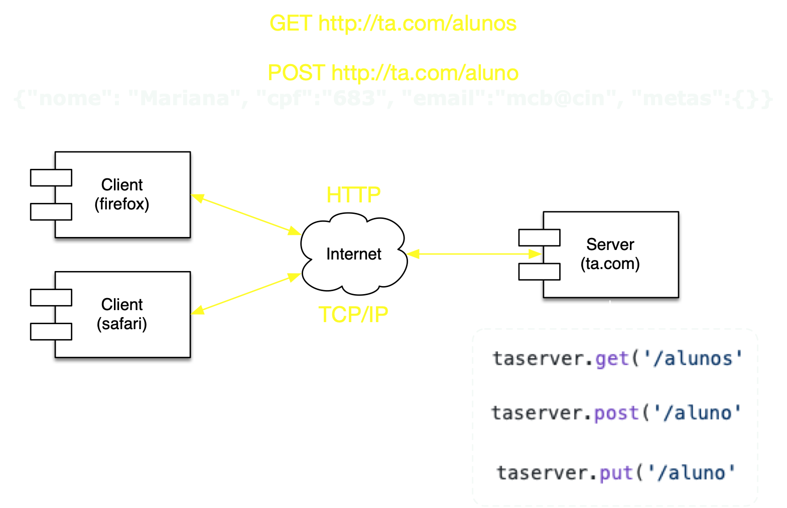
Client-server communication protocols
requests
available services
Notes:
When the method is GET, all form data is encoded into the URL, appended to the action URL as query string parameters. With POST, form data appears within the message body of the HTTP request.
http://www.diffen.com/difference/GET_%28HTTP%29_vs_POST_%28HTTP%29
http://www.w3.org/2001/tag/doc/whenToUseGet.html
1.3 Quick Checklist for Choosing HTTP GET or POST
• Use GET if:
◦ The interaction is more like a question (i.e., it is a safe operation such as a query, read operation, or lookup).
• Use POST if:
◦ The interaction is more like an order, or
◦ The interaction changes the state of the resource in a way that the user would perceive (e.g., a subscription to a service), or
◦ The user be held accountable for the results of the interaction.

Slide 10
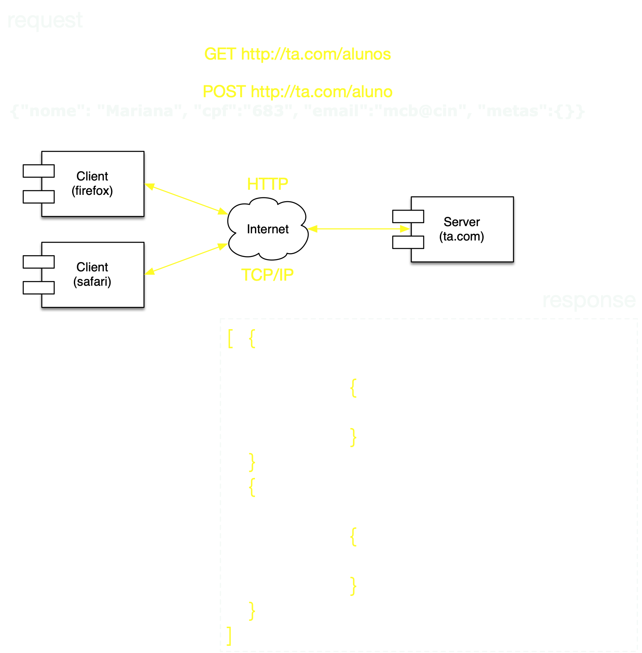
JSON object
Notes:
When the method is GET, all form data is encoded into the URL, appended to the action URL as query string parameters. With POST, form data appears within the message body of the HTTP request.
http://www.diffen.com/difference/GET_%28HTTP%29_vs_POST_%28HTTP%29
http://www.w3.org/2001/tag/doc/whenToUseGet.html
1.3 Quick Checklist for Choosing HTTP GET or POST
• Use GET if:
◦ The interaction is more like a question (i.e., it is a safe operation such as a query, read operation, or lookup).
• Use POST if:
◦ The interaction is more like an order, or
◦ The interaction changes the state of the resource in a way that the user would perceive (e.g., a subscription to a service), or
◦ The user be held accountable for the results of the interaction.

Slide 11
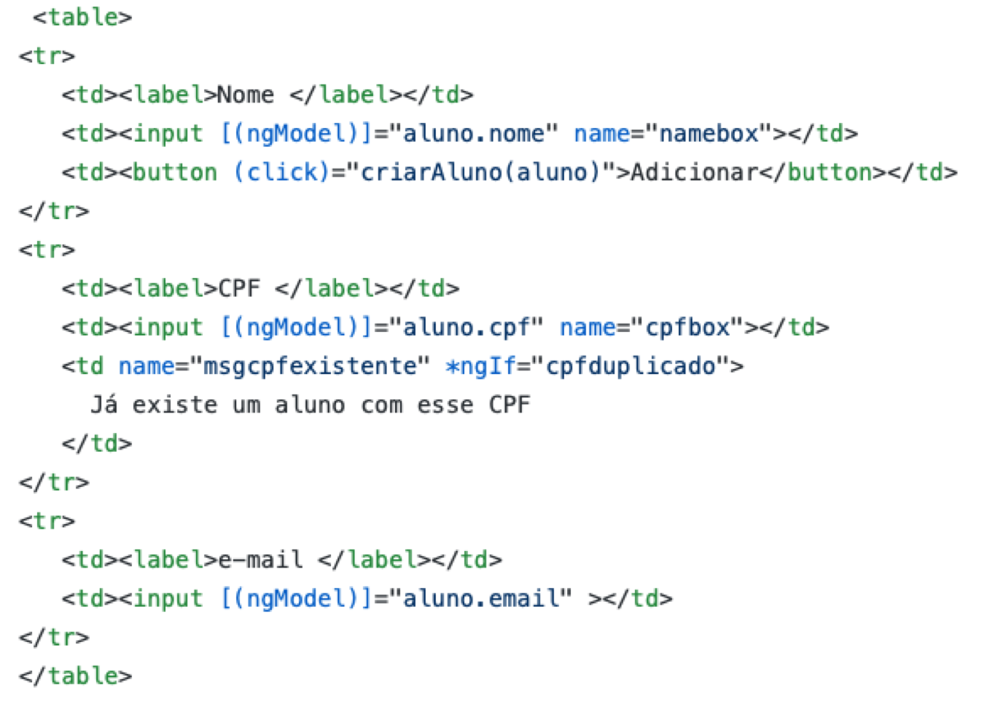
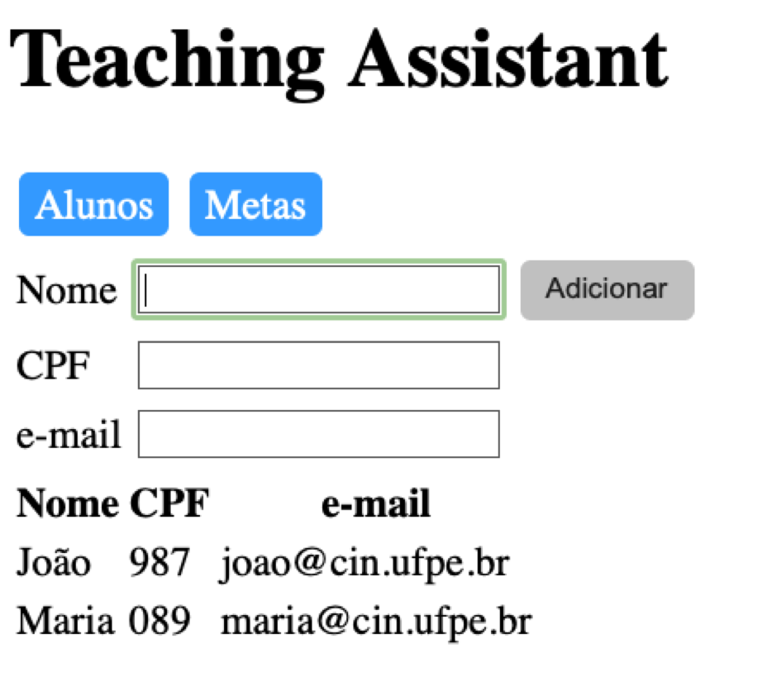
HTML + CSS + JS
(rendered by the browsers)
allows users to request services
shows information to users
allows users to provide information

Slide 12
HTML
(specifies content to be rendered)
page, element hierarchy
element tree
value
element, beginning
attribute, for reference, or rendering and event semantics
content
element, end
tag, specifies what to render
Notes:
html descreve o conteúdo da página a ser renderizada pelo browser. css… html é uma arvore de elementos html. cada elemento especifica os detalhes do conteúdo a ser renderizado. cada elemento é especificado por uma tag html associada. um elemento pode conter atributos que podem ser usados para referenciar o elemento (no css ou em outras partes do html, código da gui) ou indicar variações na renderização do elemento. na arvore, cada elemento é representado por um no/objeto DOM.

Slide 13
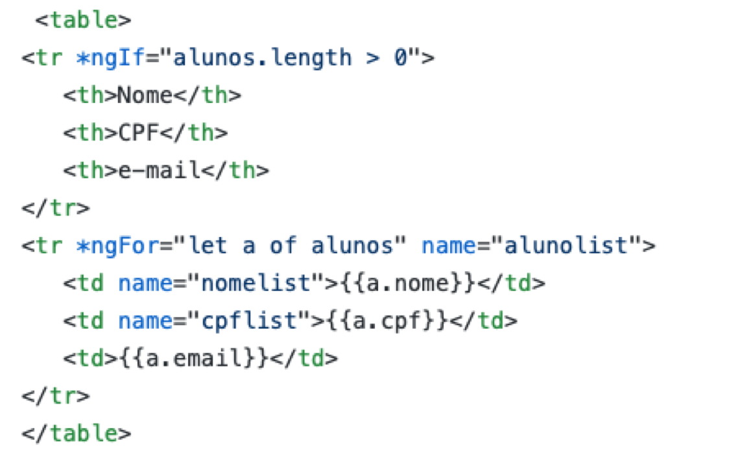
HTML templates
(specifies how to create content from data)
conditional content
content generation loop

Slide 14
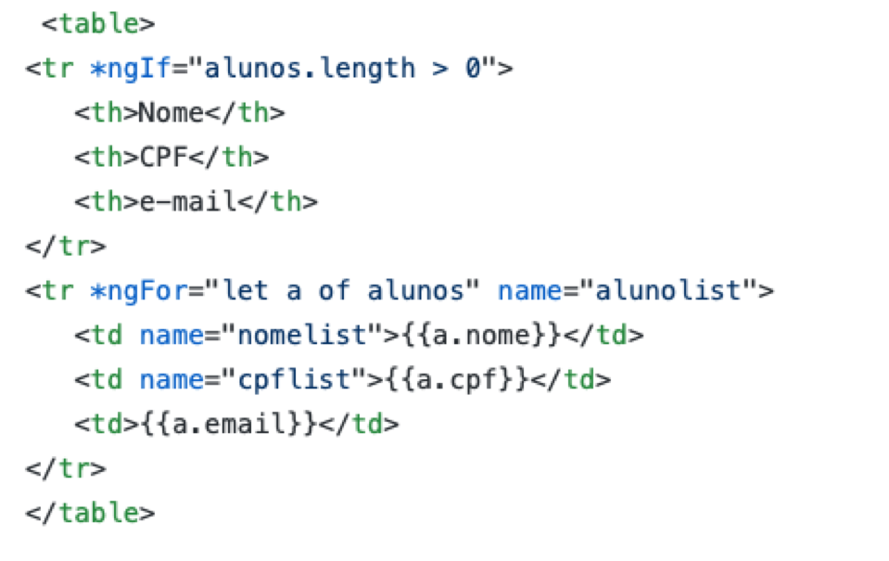
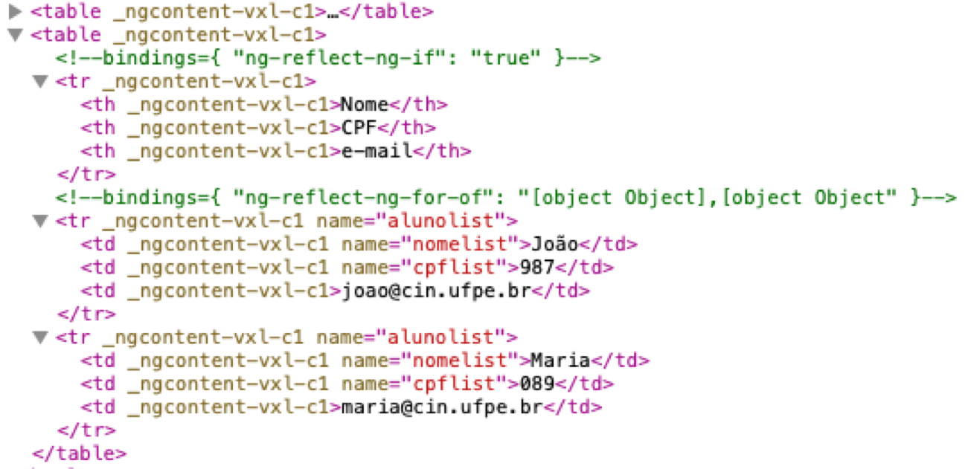
HTML template,
written by a developer,
interpreted by a web framework
DOM object in the browser,
representing HTML obtained by
instantiating the template
rendering of the DOM object
in the browser

Slide 15
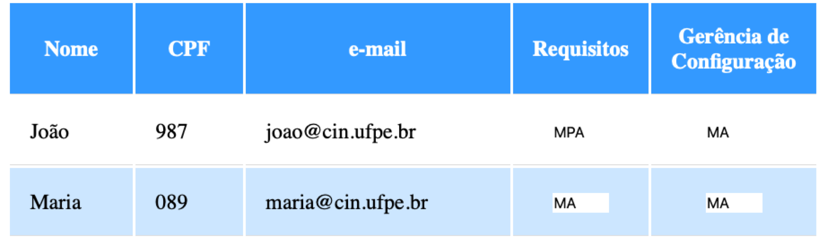
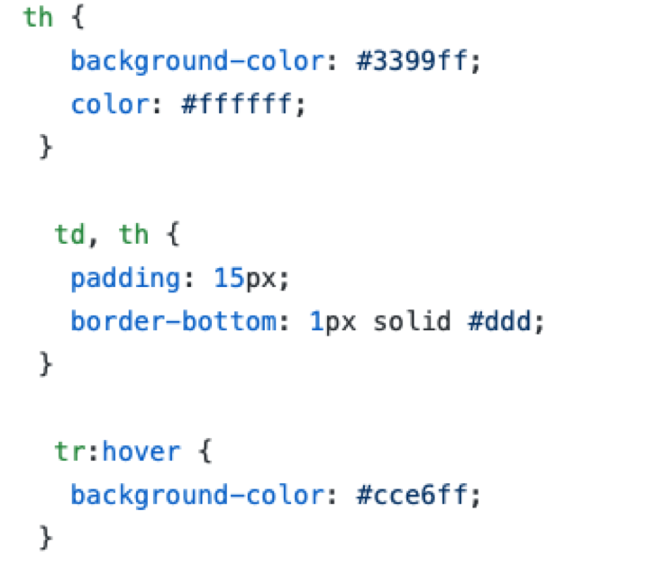
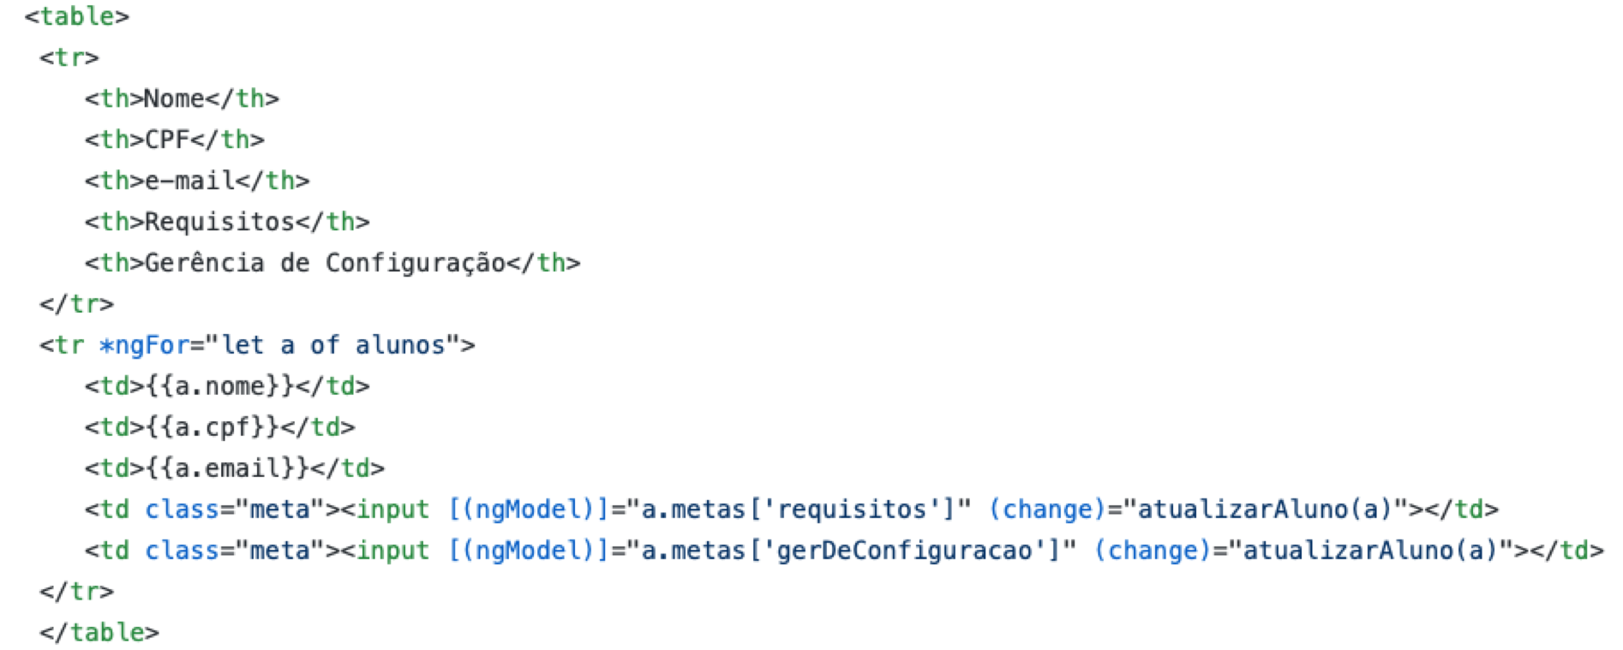
CSS (specifies presentation details of the content to be rendered)
CSS
HTML template

Slide 16
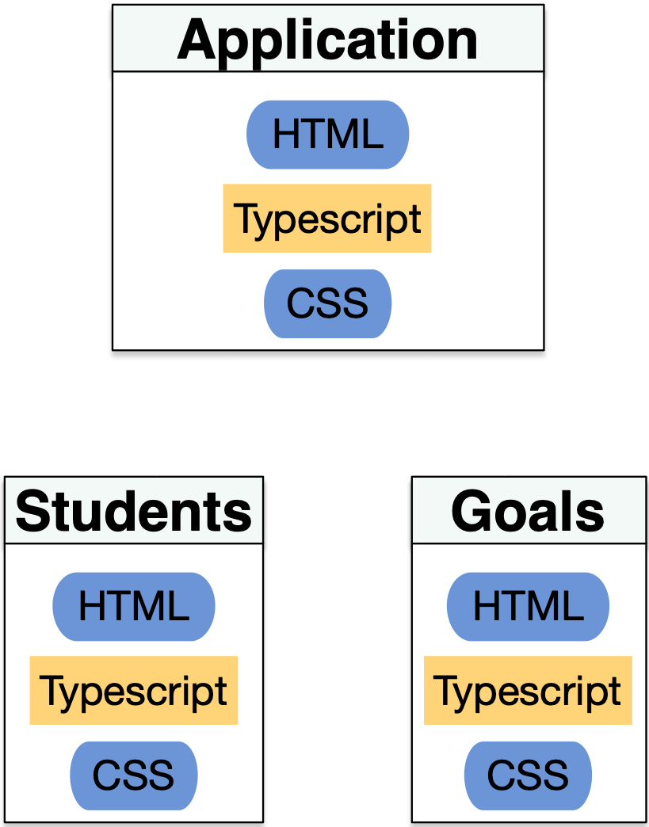
Web components (modularizing client code)

Slide 17
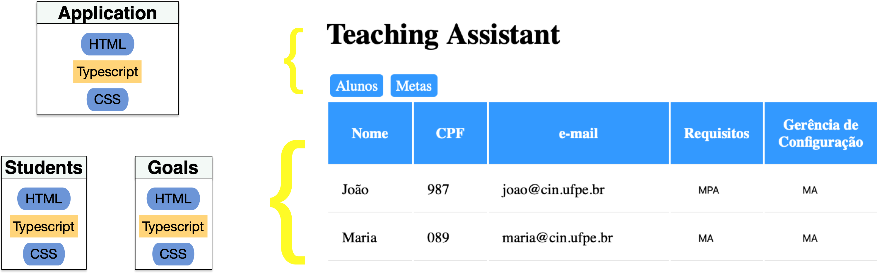

Slide 18
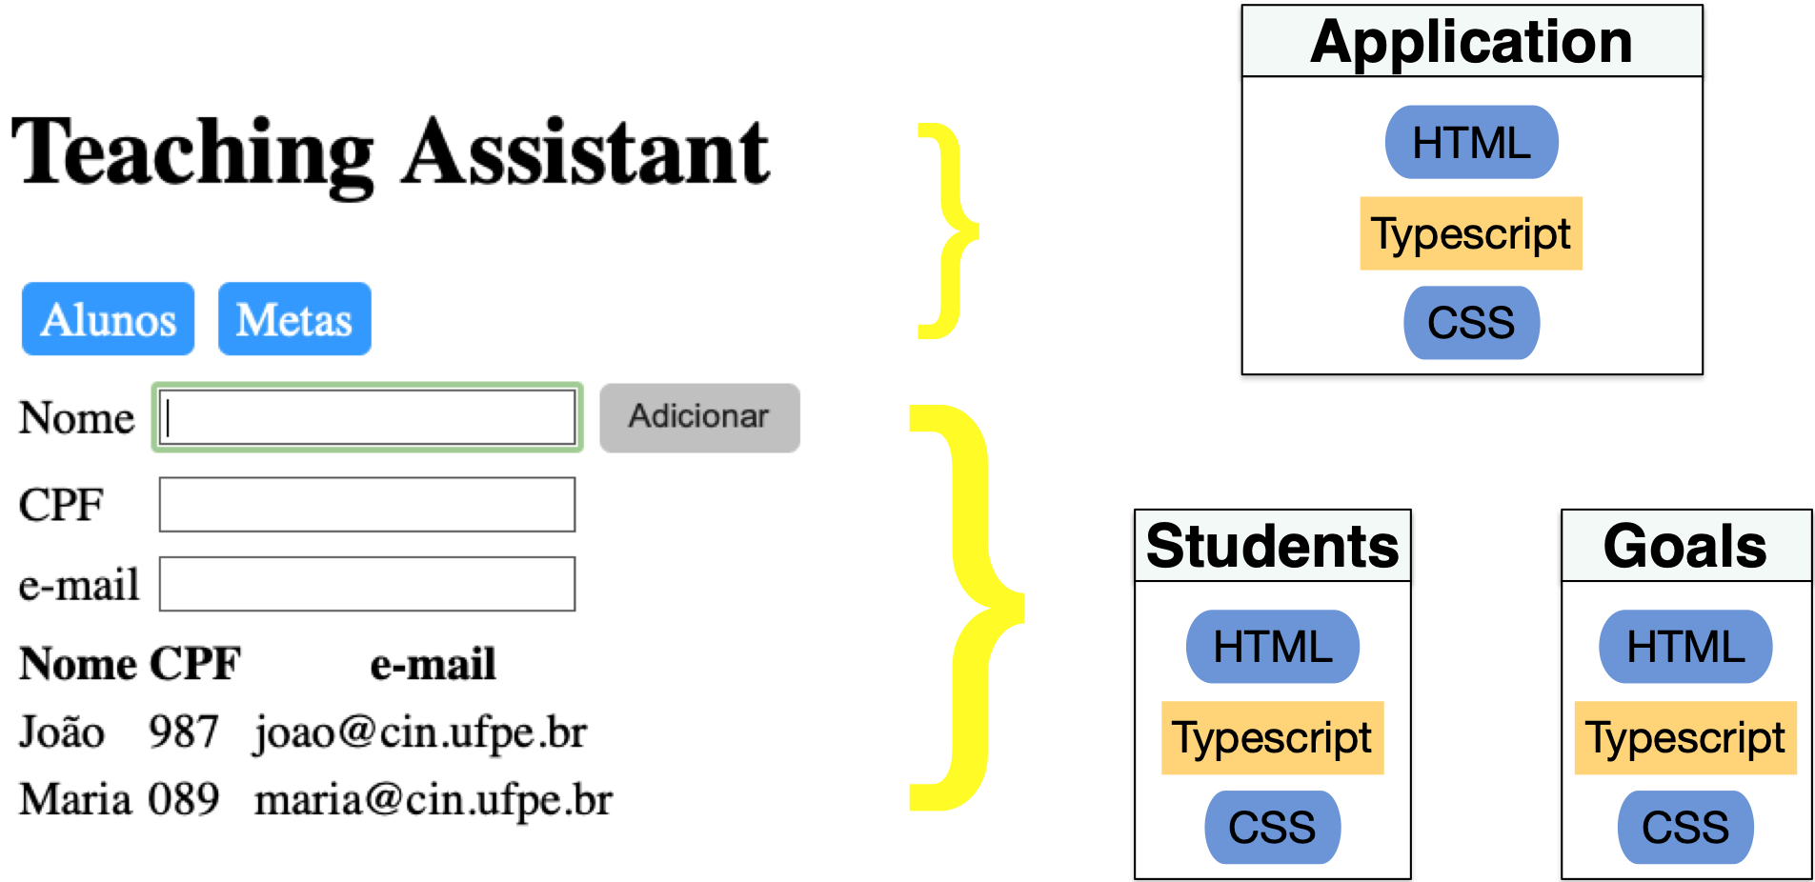

Slide 19
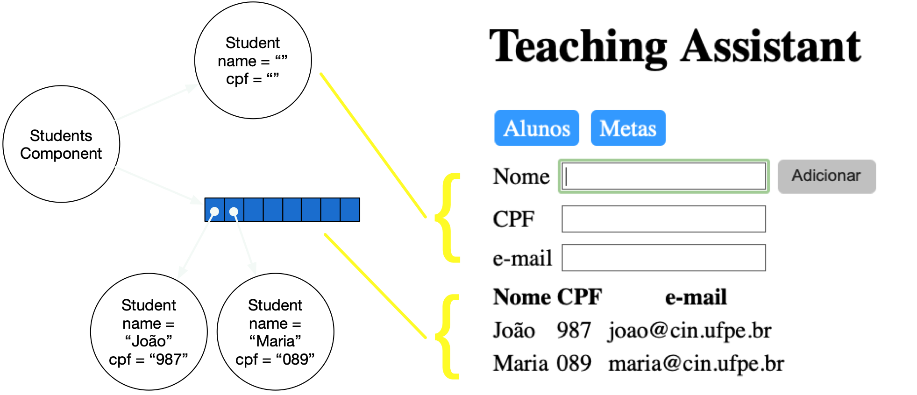
JS (TS) objects as component state

Slide 20
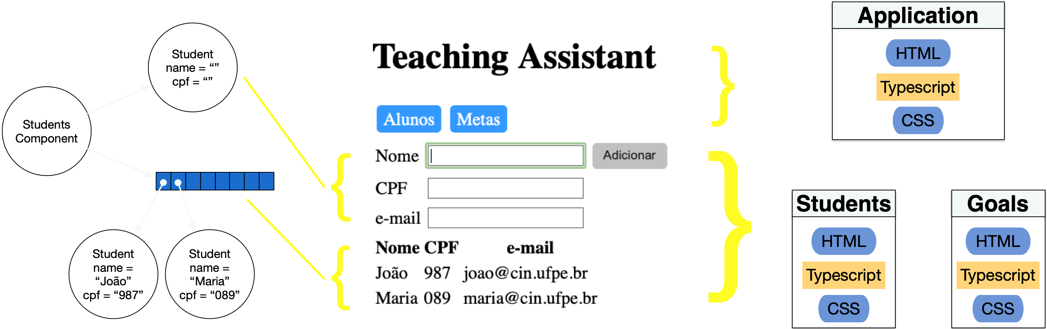
state read and written by the interpretation of the templates
specifies the structure of the state, and how it’s initialised and changed
result of the rendering process by interpreting the CSS and HTML
specifies operations triggered by browser events

Slide 21
Angular architecture
Module contain
Components
contain HTML, CSS, Typescript class
use services (Typescript class)
refer to models (Typescript class)

Slide 22
Take notes, now!

Slide 23
Hands on exercises
Notes:
Indo de aluno por aluno, verificando o progresso, e registrando como comentário no assignment do classroom.

Slide 24
SaaS 1

Slide 25
SaaS 2

Slide 26
For each commit…
Check system running
Check commit changes
Starting at second commit and going up to “melhor visualizacao do botao e da lista de alunos”
Notes:
1h mostrando o sistema funcionando, navegando pelos commits e explicando o código até o commit "melhor visualizacao do botao e da lista de alunos".
método gravar deveria retornar algum valor, ou mudar o tipo de retorno para void

Slide 27
Hands on exercises
Notes:
Indo de aluno por aluno, verificando o progresso, e registrando como comentário no assignment do classroom.

Slide 28
SaaS 2

Slide 29
SaaS 3

Slide 30
For each commit…
Check system running
Check commit changes
Starting at commit "evitar cadastro de mais de um aluno com o mesmo cpf" and going up to “melhorias na visualizacao de metas”
Notes:
metodos gravar devem verificar se o aluno é diferente de null
modularizando o componente principal não contém todos os arquivos (vários só aparecem em melhorias na visualizacao de metas). reorganizar a lista de commits e o que deve ter em cada um. novo projeto no GitHub.
também não tem primeira versão do componente de metas, que recebia informações do componente pai
ajeitar .gitignore nos varios directorios (servidor, gui, testes), e comandos para colocar tudo no ar, testar, etc, automatizar todo o processo
array unico para os dois componentes… não faz sentido duplicar…

Slide 31
Hands on exercises
Notes:
Indo de aluno por aluno, verificando o progresso, e registrando como comentário no assignment do classroom.

Slide 32
SaaS 3

Slide 33
SaaS 4

Slide 34
For each commit…
Check system running
Check commit changes
Starting at commit "versao inicial do servidor" and going up to first part of "servidor integrado ao cliente"
Notes:
vi as mudanças no servidor, cadastro de alunos, e aluno service, explicando um pouco de promise (precisa de slides e explicações bem melhores)
faltou ver as mudanças nos componentes que chamam o aluno service

Slide 35
Hands on exercises
Notes:
Indo de aluno por aluno, verificando o progresso, e registrando como comentário no assignment do classroom.
You can find assertions on the web that say
POST should be used to create a resource, and PUT should be used to modify one
PUT should be used to create a resource, and POST should be used to modify one
Neither is quite right.
Better is to choose between PUT and POST based on idempotence of the action.
PUT implies putting a resource - completely replacing whatever is available at the given URL with a different thing. By definition, a PUT is idempotent. Do it as many times as you like, and the result is the same. x=5 is idempotent. You can PUT a resource whether it previously exists, or not (eg, to Create, or to Update)!
POST updates a resource, adds a subsidiary resource, or causes a change. A POST is not idempotent, in the way that x++ is not idempotent.
By this argument, PUT is for creating when you know the URL of the thing you will create. POST can be used to create when you know the URL of the "factory" or manager for the category of things you want to create.
so:
POST /expense-report
or:
PUT /expense-report/10929

Slide 36
SaaS 4

Slide 37
SaaS 5

Slide 38
For each commit…
Check system running
Check commit changes
Starting at the second part of commit “servidor integrado ao cliente”, going up to "tratamento de erro do atualizar”
Notes:
vi praticamente tudo na aula anterior, e tratamento de erro do atualizar tem muito pouca coisa
tratarErro, no service, nao deveria ser Promise<any>; tipos não casam… catch retorna promessa de promessa de any? confuso
melhorar design da aplicação: se atualizar não precisa do retorno do aluno, eliminar isso (precisa antes pq não tinha promessa, então funcionava como retorno do código de erro. agora não precisa mais disso pois o esquema de promessa é responsável pelo tratamento de erro

Slide 39
Hands on exercises
Notes:
Indo de aluno por aluno, verificando o progresso, e registrando como comentário no assignment do classroom.
You can find assertions on the web that say
POST should be used to create a resource, and PUT should be used to modify one
PUT should be used to create a resource, and POST should be used to modify one
Neither is quite right.
Better is to choose between PUT and POST based on idempotence of the action.
PUT implies putting a resource - completely replacing whatever is available at the given URL with a different thing. By definition, a PUT is idempotent. Do it as many times as you like, and the result is the same. x=5 is idempotent. You can PUT a resource whether it previously exists, or not (eg, to Create, or to Update)!
POST updates a resource, adds a subsidiary resource, or causes a change. A POST is not idempotent, in the way that x++ is not idempotent.
By this argument, PUT is for creating when you know the URL of the thing you will create. POST can be used to create when you know the URL of the "factory" or manager for the category of things you want to create.
so:
POST /expense-report
or:
PUT /expense-report/10929

Slide 40
SaaS 5

Slide 41
SaaS 6

Slide 42
Hands on exercises
Notes:
Indo de aluno por aluno, verificando o progresso, e registrando como comentário no assignment do classroom.
You can find assertions on the web that say
POST should be used to create a resource, and PUT should be used to modify one
PUT should be used to create a resource, and POST should be used to modify one
Neither is quite right.
Better is to choose between PUT and POST based on idempotence of the action.
PUT implies putting a resource - completely replacing whatever is available at the given URL with a different thing. By definition, a PUT is idempotent. Do it as many times as you like, and the result is the same. x=5 is idempotent. You can PUT a resource whether it previously exists, or not (eg, to Create, or to Update)!
POST updates a resource, adds a subsidiary resource, or causes a change. A POST is not idempotent, in the way that x++ is not idempotent.
By this argument, PUT is for creating when you know the URL of the thing you will create. POST can be used to create when you know the URL of the "factory" or manager for the category of things you want to create.
so:
POST /expense-report
or:
PUT /expense-report/10929

Slide 43
SaaS 6

Slide 44
SaaS research at CIn
Cloud and distributed architectures: Kiev, Vinicius, Castor
Specification of distributed architectures: Alexandre Mota, Augusto

Slide 45
To do after class
Answer questionnaire (check classroom assignment), study correct answers
Finish exercise (check classroom assignment), study correct answers
Read, again, parts of chapters 7 and 10 in the textbook
Evaluate classes
Study questions from previous exams

Slide 46
To do after class
HTML: https://www.w3schools.com/tags/
CSS: https://www.w3schools.com/css/default.asp (reference), https://www.w3schools.com/colors/colors_picker.asp (colors)
Angular: https://angular.io/guide/ (reference), https://stackblitz.com (IDE), https://plnkr.co (IDE), https://angular.io/tutorial (tutorial)
Typescript: https://www.typescriptlang.org/docs/home.html
Javascript: https://www.w3schools.com/jsref/default.asp (básico), http://exploringjs.com/es6/index.html (avançado)
Node.js: https://nodejs.org/en/
Express: http://expressjs.com
body-parser: https://www.npmjs.com/package/body-parser
RxJS: http://reactivex.io/rxjs/ (API), https://www.learnrxjs.io

Slide 47
Questions from previous exams
Explique brevemente a diferença entre testes de unidade e testes de integração (a). Qual o impacto negativo de realizar apenas os testes de unidade? (b) Qual o impacto negativo de realizar apenas os testes de integração?
Explique brevemente a diferença entre testes de aceitação e testes de integração, e porque você acha que algumas empresas realizam os dois tipos de teste.

Slide 48
Software Engineering
Paulo Borba
Informatics Center
Federal University of Pernambuco
pauloborba.cin.ufpe.br

