Slide 1
Software and systems engineering
Paulo Borba
Informatics Center
Federal University of Pernambuco
pauloborba.cin.ufpe.br

Slide 2
Course overview

Slide 3
Topics and expected results

Slide 4

Starting a new job or startup… Tasks
application and interaction design
Defining, maintaining and managing requirements
Managing configurations and changes
Managing software projects
Implementing, maintaining and executing tests
Designing, implementing and maintaining features
Creating or adapting features
Finding and fixing bugs
Refactoring
Finding and fixing reuse and modularity issues
architecture and implementation design

Slide 5
Starting a new job or startup… Background
Process and collaboration technologies
git, GitHub, modular development
Software architecture concepts
web architecture, patterns
Programming and testing technologies for SaaS (software as a service)
HTML, Typescript, Angular, Node.js, Cucumber

Slide 6
Thoughtworks core values and practices

Slide 7
Expected results
Develop quality systems, in a productive way, using techniques and tools
Apply refactoring techniques to increase code reuse and modularity
Critically compare techniques and tools, identifying their advantages, disadvantages, and limitations

Slide 8
Focus on Software as a Service (SaaS), not systems in general

Slide 9
Focus on Agile development, not more rigorous techniques
Notes:
Foco em sistemas exigiria modelagem híbrida, pelo menos para simulação e testes

Slide 10
You will not become a software engineer with this course, but you will find out the way to become one!
Notes:
Traditional engineers are regulated, certified, and subject to apprenticeship and continuing education. Engineering claims an explicit responsibility to public safety and reliability, even if it doesn’t always deliver.https://www.theatlantic.com/amp/article/414271/
First, the pressure to get things right the first time around was relieved, because updates and changes could be applied centrally, as in the mainframe era. Over time, the ease of rapid repair became an excuse for rapid development, and Brooks-style prototyping mutated into the constant software updates we experience today. Facebook has wisely retired its one-time internal-development philosophy, “move fast and break things,” but no business reliant on civil or structural engineering would ever have adopted such a motto in the first place.

Slide 11
Tasks and recommendations

Slide 12
Engineering activities are performed both with…
a toy example, and
an actual system

Slide 13
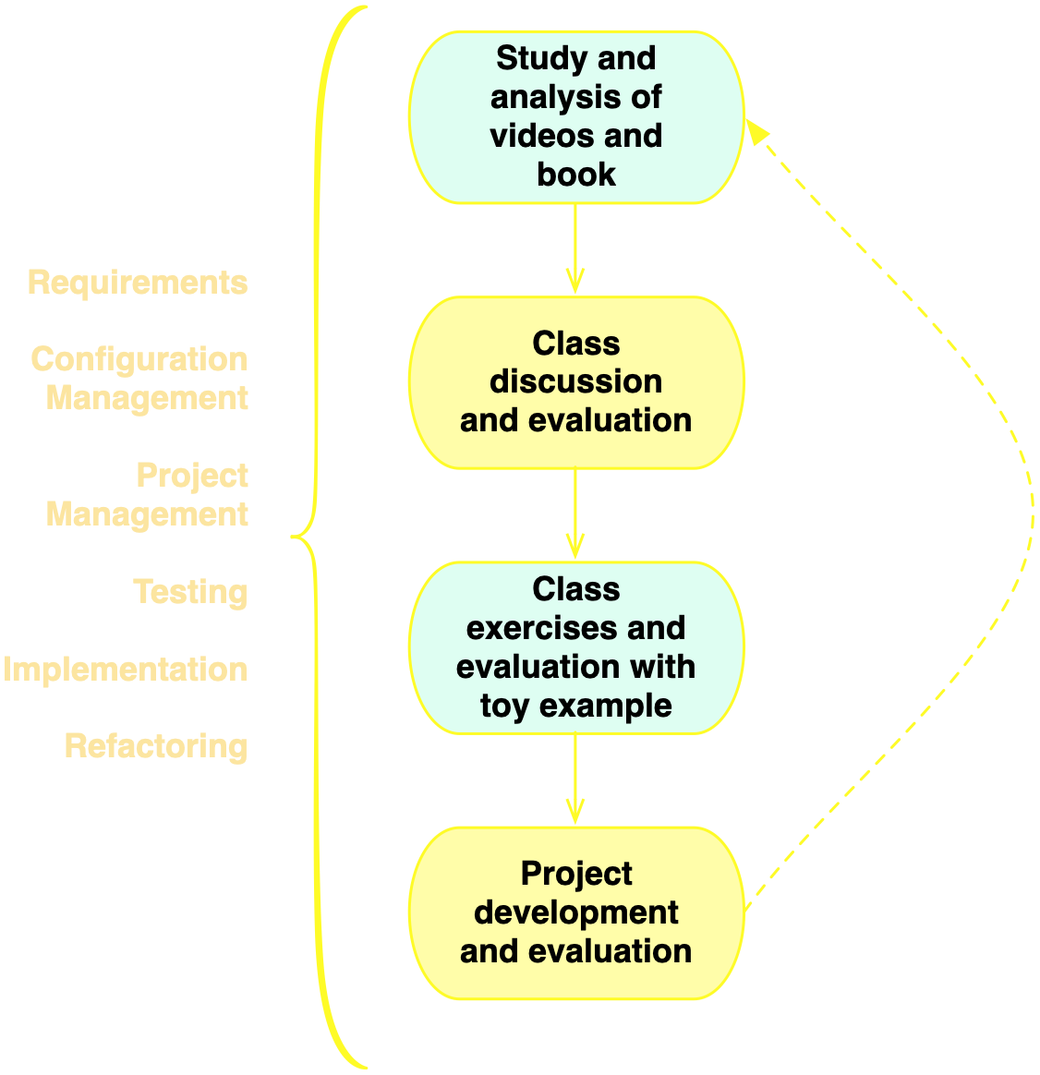
Course structure

Slide 14
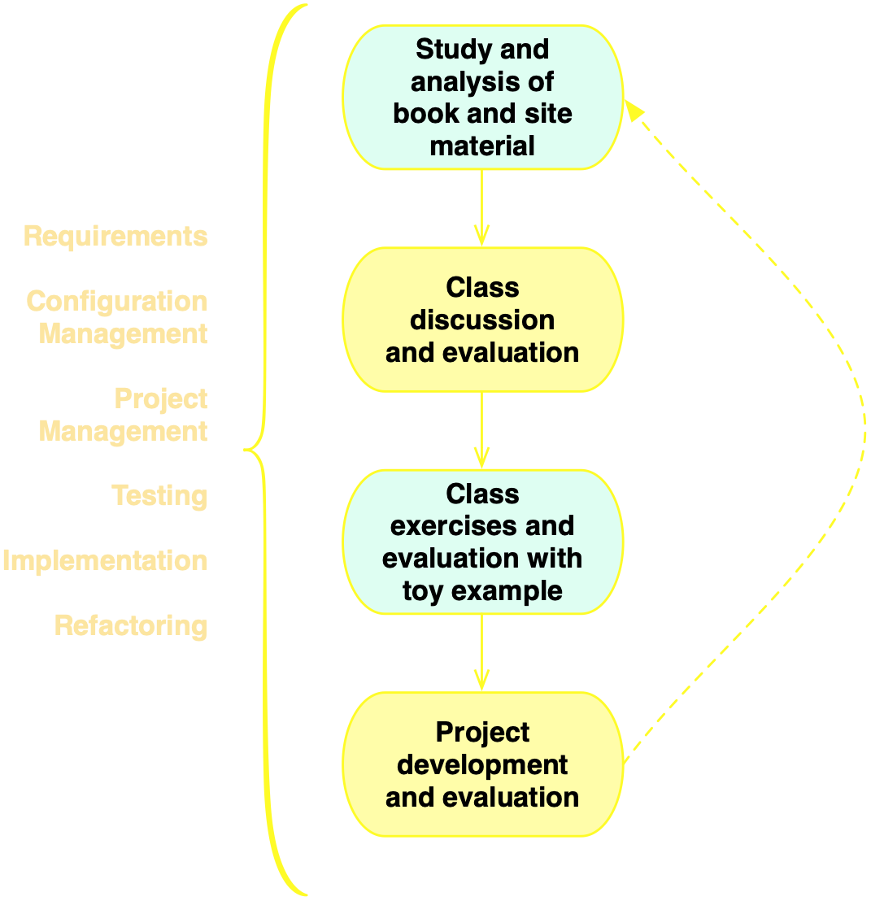
Course structure

Slide 15
Systems
(up to 10 students per system, with individual evaluation)
Non trivial system
Frequent access to the stakeholders is mandatory
Developed with the technology used in the example discussed in the course
Existing or new system (and small, in case of new)
Notes:
DEFINIR tecnologia única é importante por questões de instalações de sw no lab, monitores, e, principalmente, para seguir um único roteiro nas monitorias e exemplos em sala.

Slide 16
My expectations
Ethical behavior (fraud implies in failing the course)
Attendance to all classes and evaluation sessions (unless progress is shown before class)
Punctuality
Good time management and minimum dedication of 10-12 hours a week (including classes)
Behave as CS elite

Slide 17
My expectations
Ethical behavior (fraud implies in failing the course)
Attendance to all classes and evaluation sessions (unless progress is shown before class)
Punctuality
Good time management and minimum dedication of 10 hours a week (including classes)
Behave as CS elite
No use of mobile phones, tablets, computers, etc. during class, unless when explicitly requested by the professor

Slide 18
Textbook
Engineering Software as a Service: An Agile Approach Using Cloud Computing
by David Patterson and Armando Fox
http://www.saasbook.info
(Portuguese version is available, but English skills are very important for a software engineer)

Slide 19
You should primarily study by reading the textbook!
Studying by reading the slides and wikipedia is a very bad idea!
Notes:
deixar claro que Muitos assuntos presentes no cap 1 e 7 não foram abordados.

Slide 20
Classes are for discussing the material studied before the class
Do not expect to learn only through classes!
Watch, read and practice!

Slide 21
Manage your time!
Make sure you make the most of this opportunity!

Slide 22
https://classroom.google.com
Carefully follow the course site!
Notes:
mostrar class code!

Slide 23
Carefully follow the course guidelines!
https://is.gd/essguidelines
Notes:
mostrar class code!

Slide 24
Communication
ess-cc-ufpe.slack.com
#general, #naaula
google classroom
phmb@ (com [ESS] no subject)

Slide 25
Para quem precisa de uma melhor base de leitura e escrita em Inglês, recomendo muito investir agora. Reforço fortemente a importância do domínio do Inglês para a carreira em computação, e a disponibilidade de cursos de Inglês de baixo custo no CAC e no SENAC.

Slide 26
Course evaluation

Slide 27
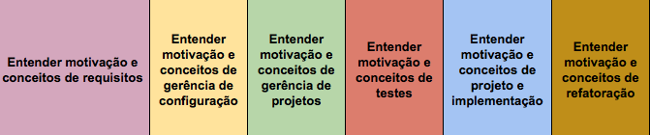
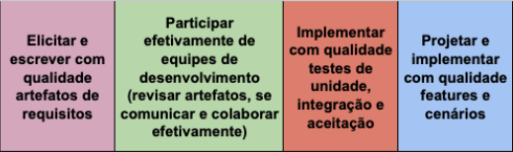
Learning goals

Slide 28
Evaluation items
Project (9)
Class and slack participation (0.5)
Quizzes (0.5)
Exercise sets (2 extra points)
includes questions related to the Project (so must be delivered on time)

Slide 29
Project evaluation
requirements (1)
configuration management (1)
project management (1)
tests (2)
design and implementation (3)
refactoring (1)
individual presentation (practical and conceptual questions, auto-evaluation)

Slide 30
Class and slack participation
Asking questions
Discussing topics
Answering questions from other students
Correcting answers from other students

Slide 31
Each learning goal is evaluated
MANA
MPA
MA
MPA
MANA
MA
Meta Ainda Não Atingida
Meta Atingida
Meta Parcialmente Atingida

Slide 32
Conceptual learning goals are evaluated through 2 exams

Slide 33
Practical learning goals are evaluated through project deliverables

Slide 34
Class grade is the
sum of learning goal points
No MANAs
MA = 10/number of goals
MPA = 6/number of goals
MANA = 0
At least one MANA
MA = 6.9/(number of goals - 1)
MPA = 4.5/(number of goals - 1)
MANA = 0

Slide 35
Extra points
grade >= 7
extra points are added to the grade
no need for a final exam
grade < 7
extra points are added to the grade of the final exam

Slide 36
Learning goal evaluation, exams
(2 questions for evaluating the same goal)
right + (right, or partially right) = MA
right + wrong = MPA
partially right + partially right = MPA
wrong + (partially right, or wrong) = MANA

Slide 37
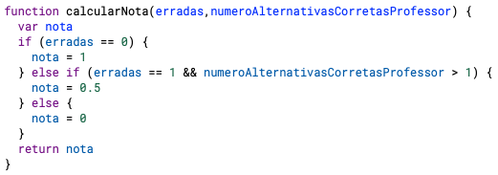
Quizzes
Points per quiz question
Summing up points of quiz questions
IF( points >= 2.5, "MA",
IF( points >= 1.5, "MPA",
"MANA")))

Slide 38
Points from quizzes
Per quizz
MA = 0.5/number of quizzes
MPA = 0.3/number of quizzes
MANA = 0
Rounding class grades is subject to quiz participation

Slide 39
Extra points from quizzes
Per quizz
MA = 0.12/number of quizzes
MPA = 0.072/number of quizzes
MANA = 0
Rounding class grades is subject to quiz participation

Slide 40
Exercise sets
MA = % of correct answers > 50 &&
% of wrong/undelivered answers < 20
MANA = % of wrong answers > 50
MPA = otherwise
MANA? = exercise set not delivered on deadline

Slide 41
Extra points from exercise sets
Per exercise set
MA = 2/number of exercise sets
MPA = 1.2/number of exercise sets
MANA = 0
Subject to class attendance, participation, and solving exercises in class

Slide 42
Extra points from exercise sets
Per exercise set
MA = 0.88/number of exercise sets
MPA = 0.53/number of exercise sets
MANA = 0
Subject to class attendance, participation, and solving exercises in class

Slide 43
quizzes are answered during classes (check calendar)
no second chance for quizzes
oral final exam

Slide 44
exercises are answered during classes
exercises are mandatory for those students in class

Slide 45
Introduce yourself...
Name
What do you expect from this course?
What questions do you have about the course?

Slide 46
Choose your system and join your team as soon as possible!

Slide 47
Take care of yourself
acolhimento@cin.ufpe.br

Slide 48
Problemas para alunos do CIn
Outro problema que alguns parecem ignorar é que o CIn exige total dedicação do aluno ao curso. Enquanto é verdade que o aluno precisa se esforçar ­e, afinal, o CIn é da UFPE, não de uma instituição qualquer, com o perdão da palavra, fica difícil de manter o estudo, a própria dedicação e a motivação em alta com a montanha de exercícios, listas e miniprovas dados ao aluno. Os professores, em geral, tendem a pensar que apenas a disciplina deles existe e os alunos se vêem frequentemente inundados de coisas para fazer…

Slide 49
Problemas para alunos do CIn
Acho que uma das grandes dificuldades dos cursos do CIn é a questão que quando você comete um deslize a grande tendência é esse deslize se agravar. Reprova uma cadeira, perde acesso a benefícios, fica triste por achar que não é bom o suficiente, reprova mais uma, acha que agora lascou tudo de vez e sente agonia só de ir pra faculdade. Acho que uma solução é mostrar que mesmo falhando, há solução e há espaço pros alunos e indicaria um acompanhamento para alunos que estejam com problemas…

Slide 50
Software and systems engineering
Paulo Borba
Informatics Center
Federal University of Pernambuco
pauloborba.cin.ufpe.br

