Slide 1
Software and systems engineering
Paulo Borba
Informatics Center
Federal University of Pernambuco
phmb@cin.ufpe.br ◈ twitter.com/pauloborba

Slide 2
To do before class
Watch videos
Read chapter 9 in the textbook
Send questions and opinions through slack

Slide 3
Refactoring 1

Slide 4
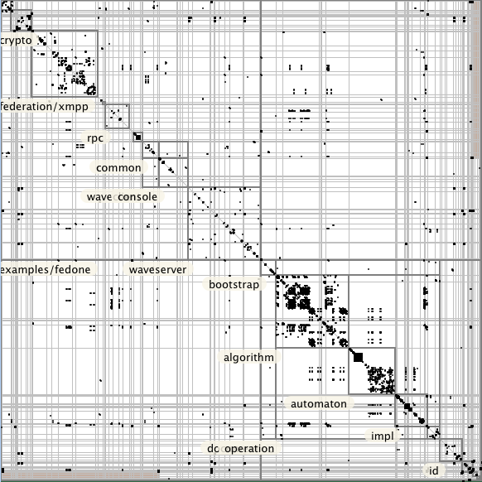
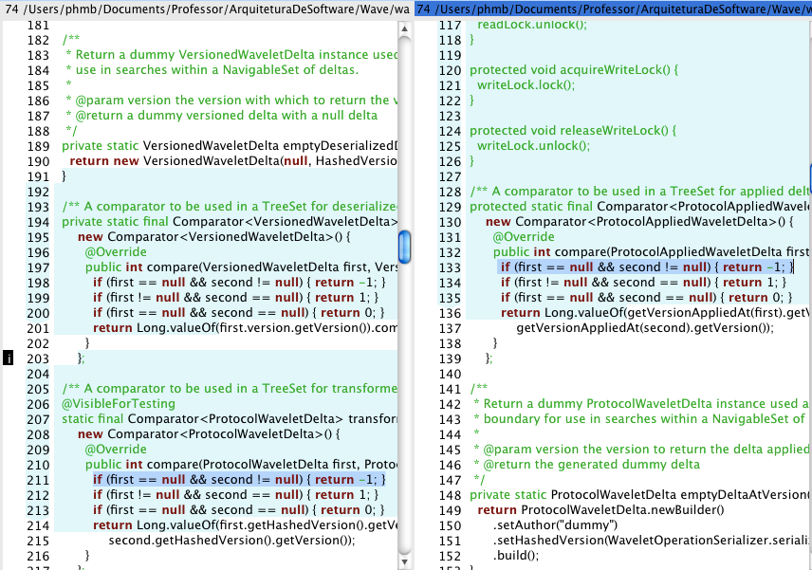
Reuse problems

Slide 5
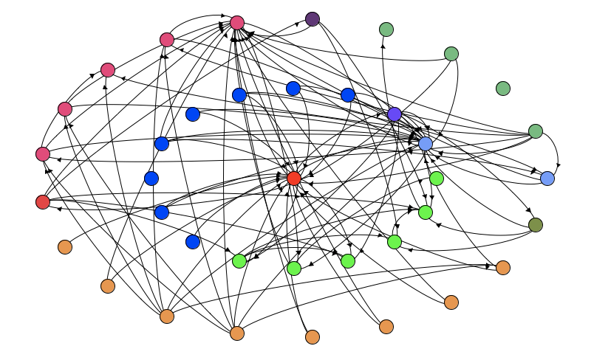
Modularity problems

Slide 6
How and when to solve them?

Slide 7
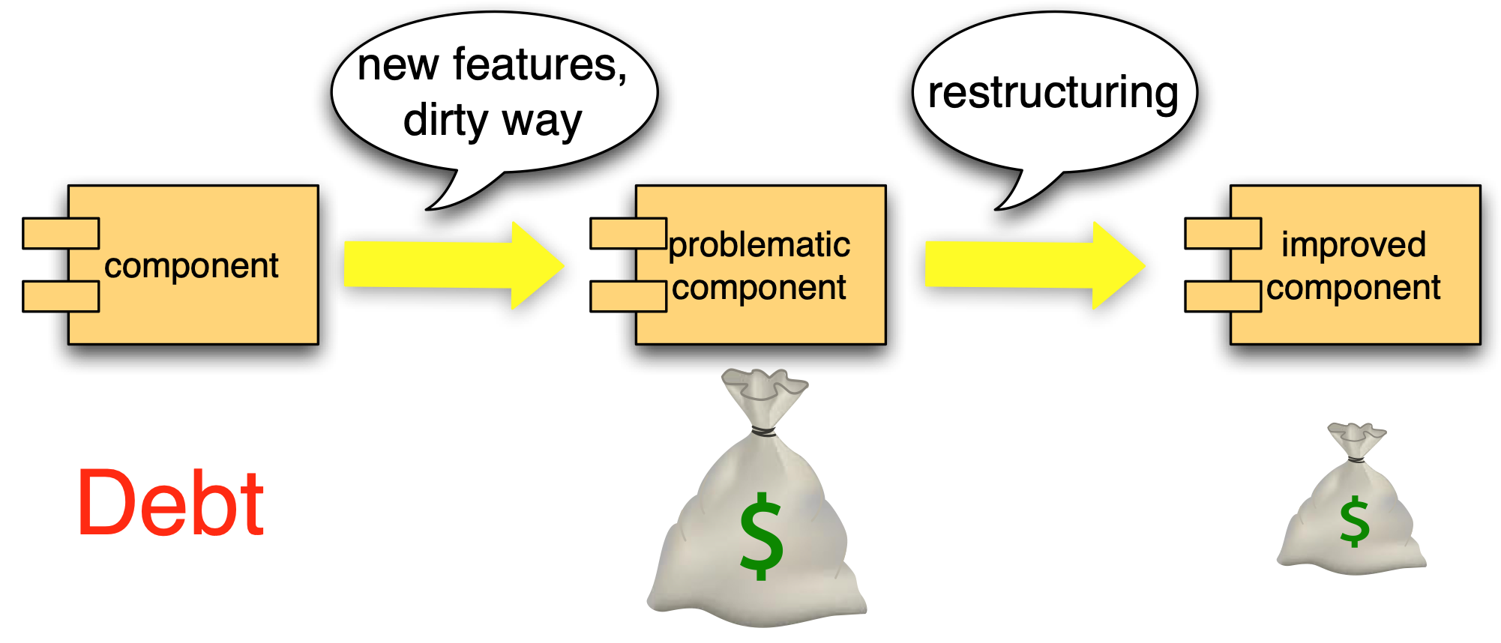
Technical debt

Slide 8
evidencia de que vale a pena reduzir o debito?
There has been some research relating to the benefits of clean code and a better architected system. The following is the results from research based upon Raymond Slot’s PhD thesis where he did a thorough analysis from a survey of 49 industrial software development projects ranging from smaller size projects to larger projects. The following is an outline of some of his results.
[if !supportLists]a) [endif]19% decrease in project budget overrun
[if !supportLists]b) [endif]Increased predictability of project budget planning, which decreases the percentage of projects with large budget overruns from 38% to 13%
[if !supportLists]c) [endif]40% decrease in project time overrun
[if !supportLists]d) [endif]Increased customer satisfaction, with 0.5 to 1 point – on a scale of 1 to 5
[if !supportLists]e) [endif]10% increase of results delivered
[if !supportLists]f) [endif]Increased technical fit of the project results
From reading a summary of this research, and by looking at the details of his analysis, you see that although these numbers are already pretty good, the underlying numbers can be even better. For example, the decrease in project budget overrun is presented as a percentage of the total budget. The expected overrun decreases from 22% to 3% - a factor 7 improvement!

Slide 9
https://martinfowler.com/bliki/DesignStaminaHypothesis.html

Slide 10
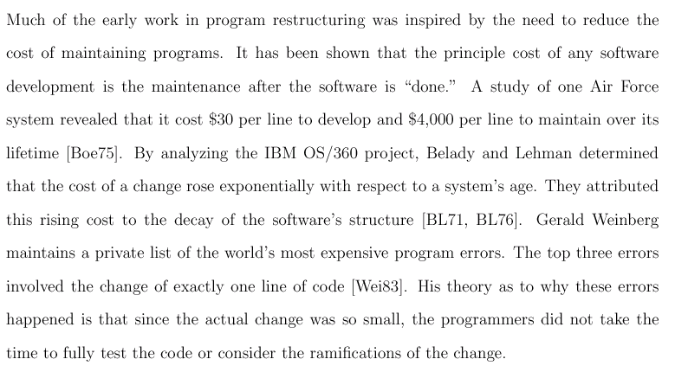
Maintenance costs more
Practical Analysis for Refactoring, Don Roberts, 1999.

Slide 11
Lehman’s first law
“A large program that is used undergoes continuing change or becomes progressively less useful”
“The change process continues until it is judged more cost effective to replace the system with a recreated version”

Slide 12
Lehman’s second law
“As a large program is continuously changed, its complexity, which reflects deteriorating structure, increases unless work is done to maintain or reduce it”

Slide 13
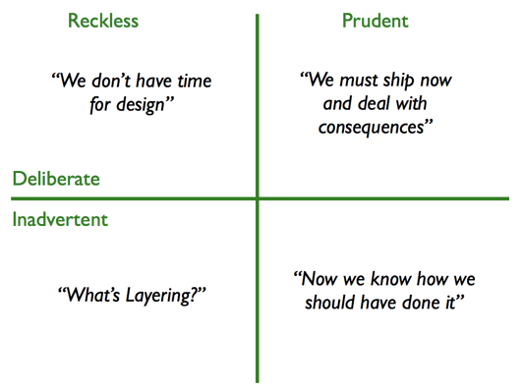
Technical debt quadrant
http://martinfowler.com/bliki/TechnicalDebtQuadrant.html
Notes:
reckless
Prud/Inadvertent = o cara domina as técnicas mas errou no projeto...

Slide 14
How to solve the problems and reduce the debt?

Slide 15
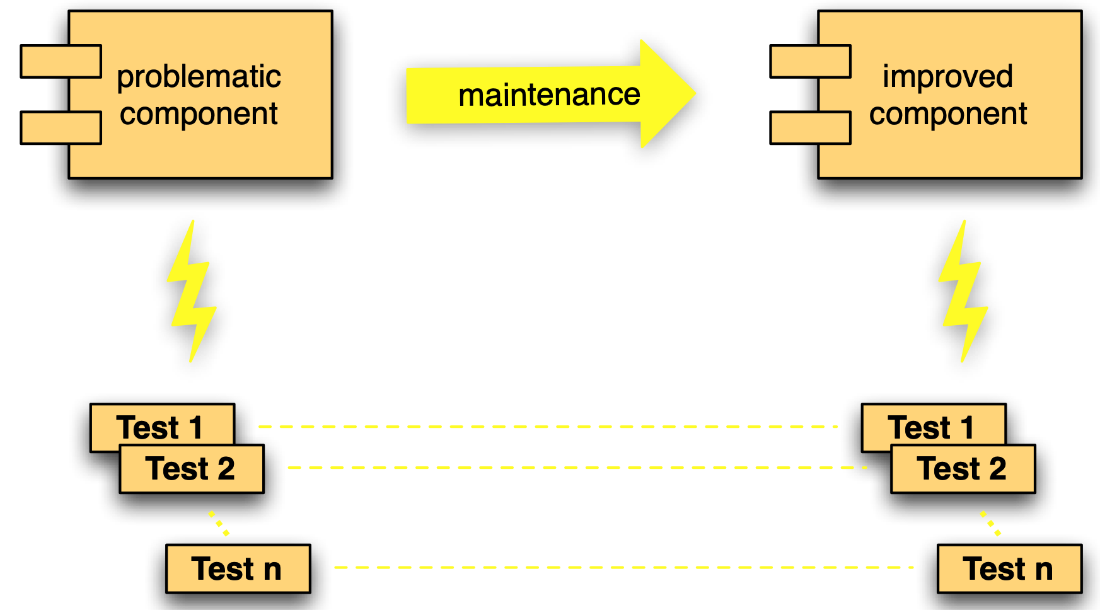
Preserving behavior

Slide 16
Refactorings are...
behavior-preserving
source-to-source
transformations that
improve internal quality factors
Notes:
Automatic refactorings reduce risks, and tedious tasks and associated costs.

Slide 17
Reuse and modularity problem
if(objeto.getNome() == null ||
objeto.getNome().equals("") ||
objeto.getSobrenome() == null ||
objeto.getSobrenome().equals("") ||
objeto.getTipo() == null ||
objeto.getTipo().equals("") ||
...

Slide 18
Extract method refactoring
automatic
boolean nullOrEmpty(Membro s) {
return s.getNome() == null ||
s.getNome().equals("");
}
boolean nullOrEmpty(String s) {
return s == null ||
s.equals("");
}
manual
Notes:
o primeiro é automático, o segundo não...
generalização... se linguagem fosse funcional, poderia generalizar de outra forma...

Slide 19
Debt reduced
if(nullOrEmpty(objeto.getNome()) ||
nullOrEmpty(objeto.getSobrenome()) ||
nullOrEmpty(objeto.getTipo()) ||
...
if(objeto.getNome() == null ||
objeto.getNome().equals("") ||
objeto.getSobrenome() == null ||
objeto.getSobrenome().equals("") ||
objeto.getTipo() == null ||
objeto.getTipo().equals("") ||
...

Slide 20
Debt eliminated
if(invalidStringFields(objeto)
...
if(nullOrEmpty(objeto.getNome()) ||
nullOrEmpty(objeto.getSobrenome()) ||
nullOrEmpty(objeto.getTipo()) ||
...

Slide 21
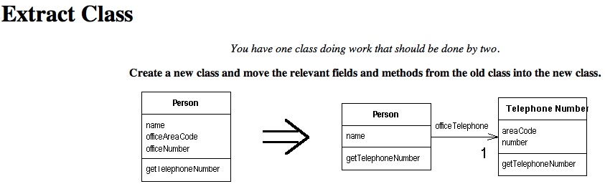
Refactoring catalogue
http://www.refactoring.com/catalog/index.html

Slide 22
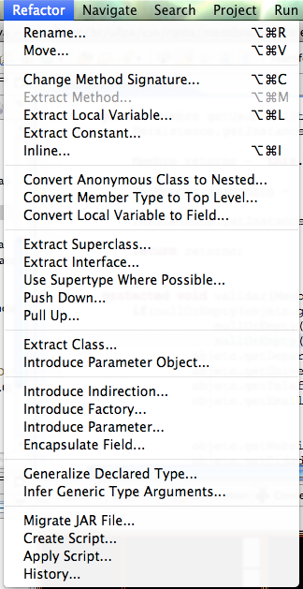
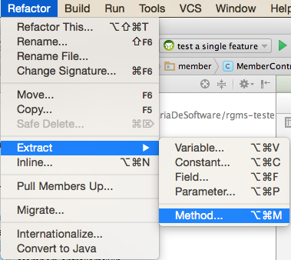
Automatic
refactorings
Notes:
Exercise: which refactorings you would use (or have you used) for solving a specific problem you remember?

Slide 23
Tools give no behavior preservation guarantee

Slide 24
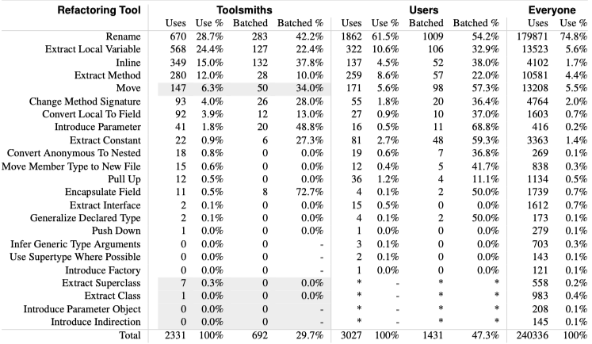
How We Refactor, and How We Know It. E. Murphy-Hill, C. Parnin, A. Black. ICSE 2009.

Slide 25
Be aware of refactoring preconditions

Slide 26
Take notes, now!

Slide 27
Hands on exercises
Notes:
Indo de aluno por aluno, verificando o progresso, e registrando como comentário no assignment do classroom.
You can find assertions on the web that say
POST should be used to create a resource, and PUT should be used to modify one
PUT should be used to create a resource, and POST should be used to modify one
Neither is quite right.
Better is to choose between PUT and POST based on idempotence of the action.
PUT implies putting a resource - completely replacing whatever is available at the given URL with a different thing. By definition, a PUT is idempotent. Do it as many times as you like, and the result is the same. x=5 is idempotent. You can PUT a resource whether it previously exists, or not (eg, to Create, or to Update)!
POST updates a resource, adds a subsidiary resource, or causes a change. A POST is not idempotent, in the way that x++ is not idempotent.
By this argument, PUT is for creating when you know the URL of the thing you will create. POST can be used to create when you know the URL of the "factory" or manager for the category of things you want to create.
so:
POST /expense-report
or:
PUT /expense-report/10929

Slide 28
Refactoring 1

Slide 29
Refactoring 2
Notes:
a aula passada passou uns 20 minutos do tempo, esta deve acabar mais cedo

Slide 30
Black belt parametrization!

Slide 31

Smells good?
functions as parameters
artigos.each{|a|
map = {}
a.elements.each("DADOS-BASICOS-DO-ARTIGO"){|d|
atts = d.attributes
map["TITULO-DO-ARTIGO"] = atts["TITULO-DO-ARTIGO"]
map["ANO-DO-ARTIGO"] = atts["ANO-DO-ARTIGO"]
}
a.elements.each("DETALHAMENTO-DO-ARTIGO"){|d|
atts = d.attributes
map["TITULO-DO-MEIO"] = atts["TITULO-DO-MEIO"]
map["VOLUME"] = atts["VOLUME"]
map["FASCICULO"] = atts["FASCICULO"]
map["PAGINA-INICIAL"] = atts["PAGINA-INICIAL"]
map["PAGINA-FINAL"] = atts["PAGINA-FINAL"]
}
...

Slide 32
Not only for articles...
...
a.elements.each("AUTORES"){|author|
map["AUTORES"] = (if map["AUTORES"] then
map["AUTORES"]
else [] end) +
[author.attributes["NOME-PARA-CITACAO"]]
}
}

Slide 33
XML structure as parameter
structure = {
"DADOS-BASICOS-DO-ARTIGO" =>
["TITULO-DO-ARTIGO", "ANO-DO-ARTIGO"],
"DETALHAMENTO-DO-ARTIGO" =>
["TITULO-DO-MEIO", "VOLUME", "FASCICULO",
"PAGINA-INICIAL", "PAGINA-FINAL"],
"AUTORES" =>
["*", "NOME-PARA-CITACAO"]}
}

Slide 34
Abstracting structure details
structure.keys.each {|e|
a.elements.each(e) {|d|
atts = d.attributes
if structure[e].include?("*") then
(structure[e] - ["*"]).each {|att|
map[e] = (if map[e] then map[e] else [] end) +
[atts[att]]
}
else
structure[e].each {|att|
map[att] = atts[att]
}
end
}
}

Slide 35
Improvement is more often needed than not, so abstract to see it!

Slide 36
How to choose refactoring targets?

Slide 37
Bad smells based on...
Values
Principles
Patterns

Slide 38
Strategy
Identify problem
Any pattern for problem in the given context?
New solution based on values and principles?
Apply appropriate refactorings
Test

Slide 39
Checklist
Design and implementation conforms to discussed principles and patterns
Most well known refactoring have been applied

Slide 40
Take notes, now!

Slide 41
Hands on exercises
Notes:
Indo de aluno por aluno, verificando o progresso, e registrando como comentário no assignment do classroom.
You can find assertions on the web that say
POST should be used to create a resource, and PUT should be used to modify one
PUT should be used to create a resource, and POST should be used to modify one
Neither is quite right.
Better is to choose between PUT and POST based on idempotence of the action.
PUT implies putting a resource - completely replacing whatever is available at the given URL with a different thing. By definition, a PUT is idempotent. Do it as many times as you like, and the result is the same. x=5 is idempotent. You can PUT a resource whether it previously exists, or not (eg, to Create, or to Update)!
POST updates a resource, adds a subsidiary resource, or causes a change. A POST is not idempotent, in the way that x++ is not idempotent.
By this argument, PUT is for creating when you know the URL of the thing you will create. POST can be used to create when you know the URL of the "factory" or manager for the category of things you want to create.
so:
POST /expense-report
or:
PUT /expense-report/10929

Slide 42
Refactoring 2

Slide 43
Refactoring research at CIn
Refactoring of software product lines: Paulo, Leopoldo
Formal refactoring: Márcio, Augusto

Slide 44
To do after class
Answer questionnaire (check classroom assignment), study correct answers
Finish exercise (check classroom assignment), study correct answers
Read, again, chapter 9 in the textbook
Evaluate classes (check classroom assignment)
Study questions from previous exams
Notes:
misturar mais teoria e prática!

Slide 45
To do after class, optional
estudar material (definição, quadrante) sobre débito técnico
estudar catálogo de refactorings, e assistir vídeo se você não é familiar com a noção de refactoring
ler resumos ou assistir vídeos do debate Is TDD dead?

Slide 46
Questions from previous exams
Explique (a) o que é teste de regressão e (b) porque eles são úteis para atividades de refatoração.
Cite (a) um ``mau cheiro'' associado à refatoração “extract class”, e (b) explique qual a mudança sugerida por essa refatoração.
Explique brevemente quais as vantagens de refatorar o código e porque algumas empresas não realizam esta atividade rotineiramente.
Cite um ``mau cheiro'' associado à refatoração extract method, e explique qual a mudança sugerida por essa refatoração.

Slide 47
Software and systems engineering
Paulo Borba
Informatics Center
Federal University of Pernambuco
phmb@cin.ufpe.br ◈ twitter.com/pauloborba

Slide 48
A FAZER depois da aula
enviar a correção dos questionários de avaliação dos alunos; não limpar pois depois será utilizado pelos scripts
ler as avaliações da aula e transferir sugestões para os slides aqui; não limpar pois depois será utilizado pelos scripts
carregar avaliações parciais sobre as metas na planilha principal e enviar para os alunos
elaborar prova, com foco em testes, design e refatoração, 2 questões de cada assunto
distribuir a mini-prova para correção pelos monitores, com base em planilha de correção de questões da mini (que monitor corrige que questão de que mini?)
@channel, bruno vai montar uma planilha para organizarmos a distribuição de questões de mini-provas para correção. a ideia é que cada questão seja corrigida pela mesma pessoa, para evitar discrepâncias. me consultem no privado sobre dúvidas na correção, e principalmente sobre o que é esperado como resposta para cada questão

