Slide 1
In class and after class interaction
open questions (about key concepts, about superficially covered concepts, from previous exams, etc.) to consolidate or extend knowledge: 1. Explique a diferença entre fator de qualidade interno e externo, e dê exemplos de ambos. 2. Como você exemplificaria a diferença entre "how to do it?" e "how to do it right?"?
discussion topics (value systems, method and technology choices, blog posts, tweet threads, short videos, additional references, etc.) to motivate, extend knowledge, and exercise reflection and communication skills: 1. Como você acha que poderia medir a produtividade de um programador? 2. See To do after class 3. https://www.youtube.com/watch?v=rwvmru5JmXk video que mostra prédio sendo construído em 15 dias! O que tornou isso possível?
quizzes (about key concepts) to consolidate knowledge and self assessment: 1. "Indique a seguir a única causa essencial (ou seja, não acidental) para os problemas em projetos de desenvolvimento de software:" "Dificuldade de formalização" "Equipe inexperiente" "Uso de linguagem inadequada" "Gerenciamento inadequado"
surveys (about student difficulties, required effort, wishes, and activity progress; about course methodology, etc.): 1. "Você prevê algum problema (de ordem emocional, de dificuldade de estudo, da metodologia adotada para a disciplina, sobrecarga de atividades, etc.) que pode atrapalhar o seu desempenho na disciplina?" "Sim" “Não"

Slide 2
Software and systems engineering
Paulo Borba
Informatics Center
Federal University of Pernambuco
pauloborba.cin.ufpe.br

Slide 3
What is software and systems engineering?
Notes:
a primeira coisa é entender o nome. a primeira parte é>>>

Slide 4
Engineering is…
the application of science
to the design, building and use
of machines, construction, etc.
The Concise Oxford Dictionary
Notes:
falta agora a segunda parte do nome>>>

Slide 5
System =
Software +
People + Data +
Hardware
(computers, sensors,
phones, watches,
drones, etc.)
Notes:
nome criado por volta de 1966, por Margaret Hamilton, da NASA, software que levou o homem para a lua, “discipline of making software products” (foco em programa para uso próprio, produto não)
E por que é importante uma abordagem de engenharia para desenvolvimento de sistemas?>>>

Slide 6

Our society depends on software systems
They are the basis of essential services, communication, entertainment, etc. and drive innovation
Every year, billions of lines of code (LOC) are created or modified
Volvo car > 50 MLOC
A380 > 100 MLOC
Notes:
>>>Primeiro…
por conta disso, para ela funcionar, precisamos de>>>

Slide 7
Software and systems engineering is concerned with…
Quality
and
Productivity
Notes:
não é só questão de criar, mas como criar com qualidade e produtividade,
e só atingimos isso com… >>>>

Slide 8
Professional software and systems development
http://www.home-dzine.co.za/diy/diy-doghouse.htm
http://silviarangel.wix.com/fotografa
Notes:
parte arte, parte engenharia, levantar discussão
para casa de cachorro, basta o pedreiro… para a outra, o engenheiro…
mas o profissionalismo não é uma questão de conseguir desenvolver algo grande vs pequeno>>>

Slide 9
It’s not about small versus large
http://transmissionsmedia.com/the-inexplicable-precision-in-the-construction-of-the-great-pyramid-at-giza/
Notes:
>>> pode-se construir algo grande com gambiarras e sem engenharia…
de fato>>>

Slide 10
Most software today is very much like an Egyptian pyramid with millions of bricks piled on top of each other, with no structural integrity, but just done by brute force and thousands of slaves.
Alan Kay
http://en.wikipedia.org/wiki/Alan_Kay
Notes:
mas isso reflete>>>

Slide 11
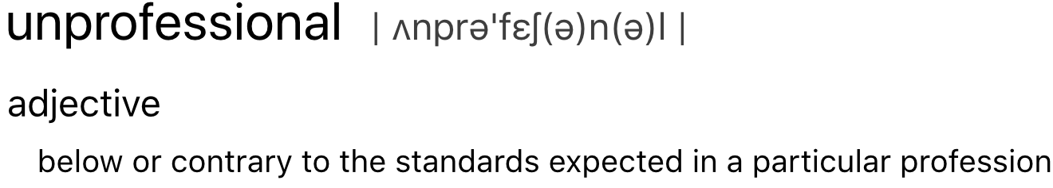
Notes:
>>>preocupante
reflete foco em>>>

Slide 12
focus
on how to do it?
vs
on how to do it right?
Notes:
temos de focar no segundo, porque a gente não quer ser visto como>>>

Slide 13
Should we be concerned that we might be viewed as an over- paid, over-privileged elite that does not care enough about the damage that our work can cause?
Be Gracious. Leon J. Osterweil.
https://dl.acm.org/citation.cfm?id=3203100
Notes:
de fato, temos que>>>

Slide 14
Ultimately, we need to assure ourselves and our society that our software has been made as sound and robust as feasible so that failures are not attributable to our own carelessness, recklessness, or laziness.
Your Software Dwells in the House of Tomorrow, Too.
Leon J. Osterweil.
http://doi.acm.org/10.1145/3041765.3041769,
Notes:
muita gente trabalha assim, mas muita gente trabalha de forma não profissional também!
qual o segredo de quem trabalha assim? qual a vantagem competitiva associada? nosso objetivo aqui é entender e praticar isso…

Slide 15
So our main goal is…
Software and systems quality
Software and systems development and operation productivity
costs and deadlines

Slide 16
Software and systems engineering
Paulo Borba
Informatics Center
Federal University of Pernambuco
pauloborba.cin.ufpe.br

Slide 17
What is the software crisis?

Slide 18
Practical impact of quality and productivity
Companies competitiveness
Better and safer products, smaller costs (long term)
Attraction of new companies to local ecosystems
investments, more taxes
Notes:
mas, nem sempre se chega lá

Slide 19
Not always achieved, almost never easy!

Slide 20
Software development issues, (crisis? since 1968!)
Project cancellations
Development time and cost go well beyond the estimative
Systems do not work as planned
Difficult reuse and maintenance
Notes:
cuidado com as estatísticas

Slide 21
No silver bullet!
Notes:
colocar a referencia

Slide 22
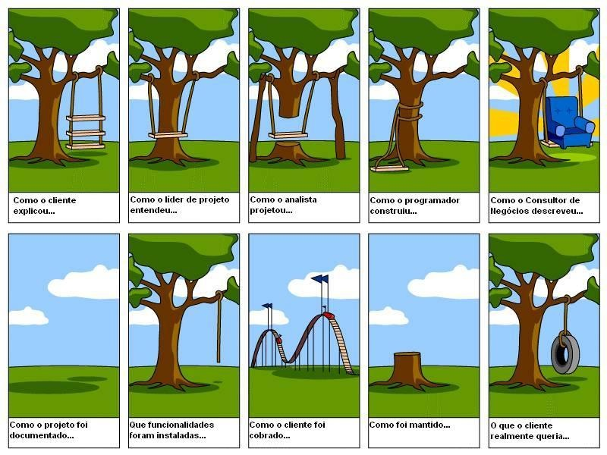
Essential causes of software issues
Increasing systems complexity
Formalization difficulties and costs

Slide 23
Accidental causes of software issues
People lack skills and experience
Poor process and practices
Lack of proper languages and tools
little synthesis
Weak organisational structure
poor management
conflicts
conflict ethics and business values
Too many project constraints

Slide 24
Teams that don’t achieve share these deficiencies

Slide 25
Handling the crisis
50: compilers, OS
60: SE (management, formal, testing), OO, databases
80: no silver bullet, configuration management
90: maturity model, processes, patterns
70:
information hiding/modules
top-down, stepwise refinement
incremental builds (today’s MVP)
inspections
requirements verification and validation

Slide 26
Software and systems engineering
Paulo Borba
Informatics Center
Federal University of Pernambuco
pauloborba.cin.ufpe.br

Slide 27
What is software quality?

Slide 28
Software quality factors, focus on ethics and business values
Reliability
Correctness
Robustness
Extensibility
Reusability
Compatibility (backward)
Portability
Notes:
the importance of backward compatibility, and relate it to the other definition of compatibility. the Windows 2000 sources had a copy of Windows 3.1 (in x86 assembly!) and routines for detecting legacy applications and implementing various buggy behaviors that they depended on.

Slide 29
More factors, internal and external
Performance
Scalability
Integrity, privacy and security
Usability
Flexibility
Fault tolerance
Safety
Notes:
safety is different from reliability, is not being able to cause losses
lack of reliability can lead to losses too, but losses can occur even if system is reliable
can result from emergent behavior by composing reliable components, or even from contextual issues
unsafety often results from requirements issues! lack of validation issue, or even not being able to anticipate an specific situation

Slide 30
For example, why would those factors be important for a store automation system?

Slide 31
Qualidade de software (para o varejo)
Correto
A loja não pode deixar de cobrar por produtos
Robusto e altamente disponível
A loja não pode parar de vender
Eficiente
O consumidor não pode esperar
A empresa quer investir pouco em recursos computacionais (CPU, memória, rede)

Slide 32
Qualidade de software (para o varejo)
Altamente extensível e adaptável
A empresa tem sempre novos requisitos (para ontem!)
A empresa quer o software customizado do seu jeito (interface, teclado, idioma, moeda, etc.)
Reusável
Várias empresas precisam usar partes de um mesmo sistema

Slide 33
Qualidade de software (para o varejo)
Amigável e fácil de usar
A empresa quer investir pouco em treinamento
Aberto, compatível, de fácil integração com outros sistemas
Empresa já tem outros sistemas; controle de estoque, fidelização, etc.

Slide 34
Qualidade de software (para o varejo)
Portável e independente de plataforma (hw e sw)
Cada empresa opta por uma determinada plataforma
Baixo custo de instalação e atualização
A empresa tem um grande número de PDVs

Slide 35
Software and systems engineering
Paulo Borba
Informatics Center
Federal University of Pernambuco
pauloborba.cin.ufpe.br

Slide 36
What is software productivity?

Slide 37
Productivity aspects, assuming constant functionality and quality
Reduced development cost
Consuming company wishes to invest little in software
Producing company should offer “inexpensive software"
Reduced development time
Quick support and attention to market needs

Slide 38
“Inexpensive software”
Not only a result of lower development costs, but also of the cost distribution among a number of clients
Reuse, extensibility and flexibility are important
factors for achieving such distribution

Slide 39
Trade-offs between quality and productivity
Investing too much in quality can reduce productivity in the short term
Neglecting quality can impact productivity even in the short term
Professional ethics should not be part of the trade-off
careful with software that is ethically non-neutral
Notes:
caso da toyota, barragens, etc.

Slide 40
To obtain software quality and productivity, teams have to deal with those issues in a professional way!

Slide 41
Take notes, now!

Slide 42
To do after class
Read Uma longa noite aprendendo, and Chapter 1 from the textbook
Read Software Engineering Code of Ethics and Professional Practice
Watch “Na rota do dinheiro sujo”, episode “Emissões mortais”, and Software powers the world
Choose your team
Subscribe to the course calendar
Study questions from previous exams

Slide 43
Questions from previous exams
Indique dois fatores de qualidade de software e explique porque eles são importantes.
Indique quais dos seguintes termos correspondem a fatores de qualidade de software: corretude, robustez, produtividade e extensibilidade. Defina e explique brevemente porque cada um dos fatores que você indicou é importante.

Slide 44
Software and systems engineering
Paulo Borba
Informatics Center
Federal University of Pernambuco
pauloborba.cin.ufpe.br

