Slide 1
AI agents can perform accurate bioinformatics analyses through a computational workbench
Agents working in Galaxy compared with agents writing custom code: 160 tasks, three benchmarks, four models
Paulo Cilas Morais Lyra
Goecks Lab · Moffitt Cancer Center
October 2026
Galaxy
custom code
Notes:
Title adapted from Jeremy Goecks's title comment. The claim: AI agents can perform bioinformatics analyses through Galaxy as accurately as with custom code, and the analyses they produce are recorded, inspectable and rerunnable. Not the claim: a new benchmark, or that Galaxy beats custom code.
Colours throughout: blue = Galaxy, vermillion = custom code.

Slide 2
INTRODUCTION · AGENTS
Agent benchmarks evaluate agents as programmers: each agent writes and runs its own code
• Agents are being used for biomedical data analysis.
• Benchmarks now test whether they can complete whole bioinformatics analyses, for example BixBench-Verified-50 and CompBioBench.
• These benchmarks evaluate agents as programmers: each agent writes and runs its own code.
Task and data
a biomedical question
Agent writes code
installs software, writes scripts
Agent runs it
in its own workspace
Answer
scored against the benchmark
The gap: whether agents can work through a scientific workbench, instead of writing their own code, has not been tested.
Outline P1 and abstract.
2
Notes:
P1. Agents are being used for biomedical data analysis, and benchmarks now test whether they can complete whole bioinformatics analyses. These benchmarks evaluate agents as programmers: each agent writes and runs its own code. Whether agents can work through a workbench to complete bioinformatics tasks as accurately as they can write code has not been tested.

Slide 3
INTRODUCTION · GALAXY
Galaxy is a widely used scientific workbench, and a Model Context Protocol server opens it to agents
For people
For agents: the Galaxy MCP server
Versioned tools
▸ Tool search
▸ Parameter descriptions
▸ History inspection
▸ Job submission and monitoring
▸ User-defined tools (UDTs) for operations no installed tool covers
every tool and version is defined
Managed compute
jobs run on the server, not on a laptop
Histories
record parameters, inputs and outputs
Shared, turned into workflows, rerun
a history is a reusable analysis
Outline P1 and P2. MCP, Model Context Protocol; analyses run on usegalaxy.org.
3
Notes:
P1: scientific workbenches such as Galaxy are a widely used alternative for people: versioned tools, managed compute, and histories that record parameters, inputs and outputs and can be shared, turned into workflows and rerun.
P2: Galaxy provides a Model Context Protocol server that gives agents tool search, parameter descriptions, history inspection, job submission and monitoring, and user-defined tools (UDTs) for operations no installed tool covers.

Slide 4
HYPOTHESIS
Can agents work through a workbench as accurately as they write code?
Hypothesis. AI agents can perform bioinformatics analyses through Galaxy as accurately as with custom code, and the analyses they produce are recorded, inspectable and rerunnable.
Why both together, and why this matters
Recorded and inspectable
Rigor becomes cheap
Agents as virtual users
Every Galaxy run leaves a structured record of every tool, parameter and dataset. People can review the analysis in Galaxy and rerun or continue it without using model tokens.
Galaxy makes rigor-improving approaches cheap: running several methods for the same step and comparing them, or validating results before reporting.
Agent traces show where scientific software is hard to use, and give a quantitative cost for each problem.
Not the claim: a new benchmark, or that Galaxy beats custom code.
Outline framing, abstract and P6. The rigor approaches are hypotheses this study did not test.
4
Notes:
Main claim (outline framing). Why it matters: the payoff in the abstract (structured record of every tool, parameter and dataset), P5 (agents as virtual users) and P6 (Galaxy makes rigor-improving approaches cheap; present as hypotheses this study did not test). Not the claim: a new benchmark ("Galaxy-Bench"), or that Galaxy beats custom code (Jeremy Goecks's review comments, 2026-09-07).

Slide 5
EXPERIMENTAL DESIGN AND SETUP
Same model, two conditions: 160 tasks × 4 models × 3 replicates = 3,840 runs
Four model configurations
Galaxy
Three benchmarks, 160 tasks
All analysis runs as Galaxy jobs, including UDTs, through the Galaxy MCP server
BixBench-Verified-50
in the Codex harness
50 tasks · accepted answer
• GPT-5.5
• GPT-5.6 Sol
• GPT-5.6 Luna
• DeepSeek V4 Pro
CompBioBench
Custom code (baseline)
100 tasks · agreement with the key
The agent installs software and writes its own code
IWC-derived tasks
10 tasks · output agreement, correct at ≥ 0.99
3 replicates per task and condition → 3,840 runs. Why IWC: its tasks come from Galaxy workflows, so they test whether workbench-native tasks behave differently from platform-neutral ones.
Outline P2. IWC, Intergalactic Workflow Commission.
5
Notes:
P2. Two conditions defined once: Galaxy (all analysis runs as Galaxy jobs, including UDTs) and custom code (the agent installs software and writes its own code), with custom code as the baseline. Four model configurations in the Codex harness, 160 tasks (BixBench-Verified-50, CompBioBench, IWC-derived tasks), three replicates per task and condition, 3,840 runs. A run is correct when accepted (BixBench-Verified-50, CompBioBench) or at IWC output agreement >= 0.99.

Slide 6
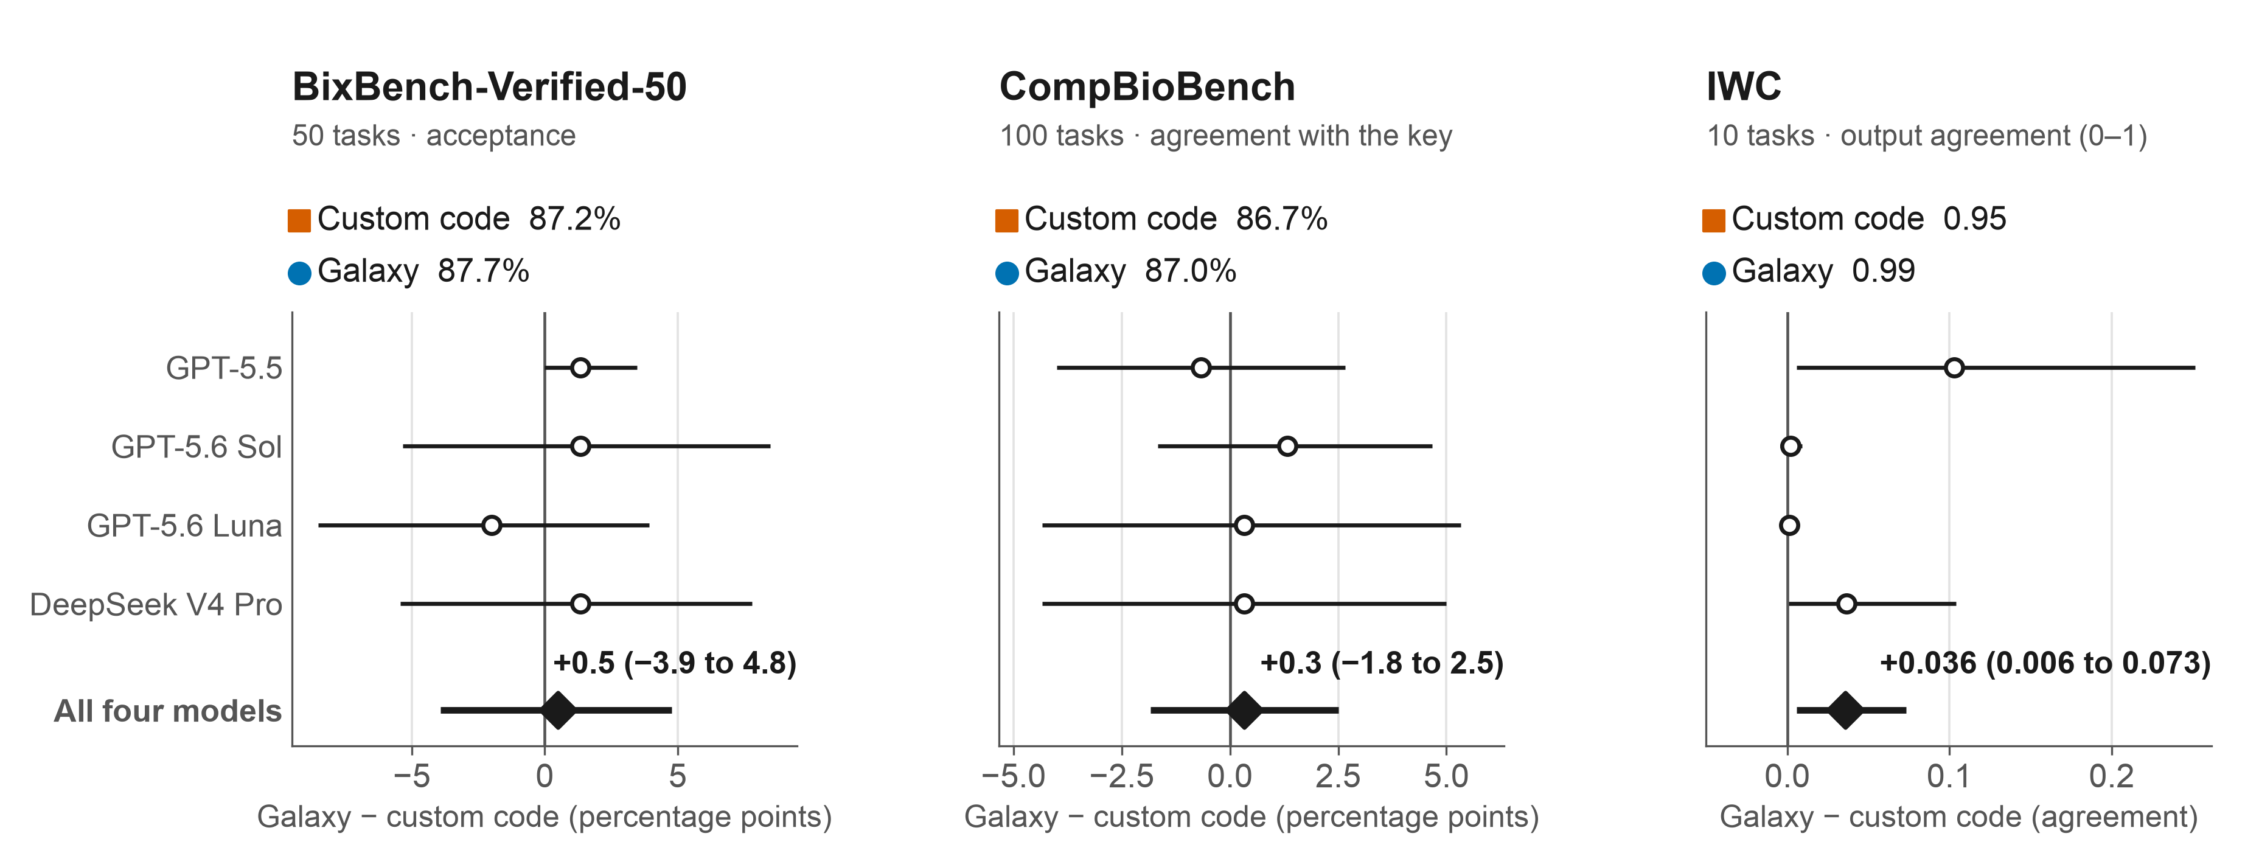
RESULT 1 · ACCURACY
Agents can use Galaxy to accurately complete bioinformatics tasks at the same level of accuracy as custom code
Robust: differences stay within about one point of zero after removing tasks with audited benchmark-side problems.
Galaxy − custom code with 95% cluster-bootstrap intervals, by model and for all four models pooled. IWC wf_007 runs as the results site published them on 12 Oct 2026.
6
Notes:
P3 (numbers from PR #12, site-matched scores).
BixBench-Verified-50: 87.2% custom code, 87.7% Galaxy, +0.5 (-3.9 to 4.8) points.
CompBioBench: 86.7% and 87.0%, +0.3 (-1.8 to 2.5) points.
IWC: output agreement 0.95 and 0.99, +0.036 (0.006 to 0.073); three tasks containing a zero-scored run account for most of the difference.
Robustness: removing 15 BixBench tasks with audited benchmark-side problems or 66 CompBioBench task-configuration cells keeps both differences within about one point of zero.
No per-model difference is significant after Holm adjustment. This does not establish equivalence.

Slide 7
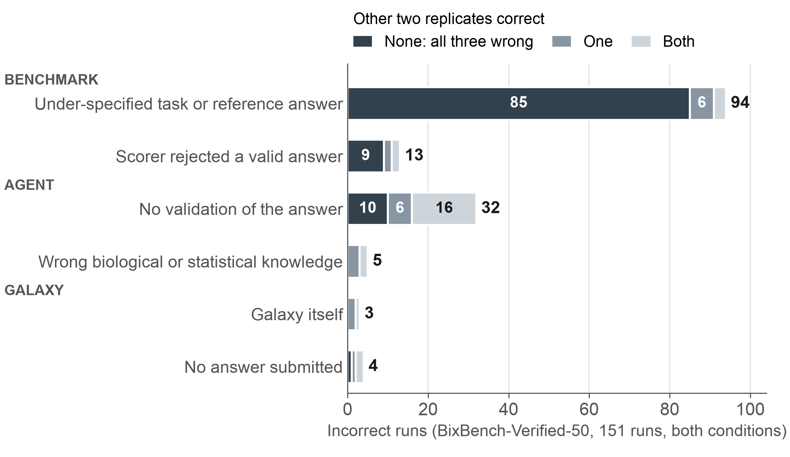
RESULT 2 · ERRORS
Errors come in two kinds: systematic errors come mostly from the benchmark, random errors mostly from missing validation
Systematic
Repeat in every replicate. 85 of the 94 benchmark-specification errors sit in replicate groups where all three runs were wrong, which usually give the same wrong answer: the task or the answer key, not chance.
Random
Differ between replicates. Missing validation is spread out: 16 of its 32 errors are in groups where the other two were correct. bix-30-q3: failed custom-code runs added exclusions, normalization and a test the task did not ask for.
Most wrong answers are not runs that broke: 69–94% of correct runs also hit an execution error and recovered; wrong runs finished and reported the wrong thing.
BixBench-Verified-50: 151 incorrect runs, causes from execution traces; 71% from the benchmark, 25% agent errors, 3 from Galaxy, 4 without an answer.
7
Notes:
P4. BixBench (151 incorrect runs, causes from execution traces): 71% came from the benchmark, an under-specified task or reference answer (94) or a scorer rejecting a valid answer (13); 25% were agent errors, no validation of the answer (32) or wrong biological or statistical knowledge (5); Galaxy itself caused 3, and 4 runs submitted no answer.
Missing validation is a primary or secondary cause in 116 of the 151 incorrect runs; it often turns an ambiguous task into a confidently wrong answer. Example: bix-30-q3, failed custom-code runs added exclusions, normalization and a statistical test the task did not ask for (Galaxy 12/12 correct, custom code 4/12). Counter-example: CompBioBench variant-status-q1, Galaxy runs that added a read-position check were right.
Incorrect runs in all-wrong replicate groups: 105 of 151 (BixBench), 144 of 316 (CompBioBench), 36 of 55 (IWC). When all three are wrong they usually give the same wrong answer (77-83% of such groups in BixBench, 61-64% in CompBioBench): the task or the answer key, not chance.
CompBioBench and IWC have no failure-cause audit yet.

Slide 8
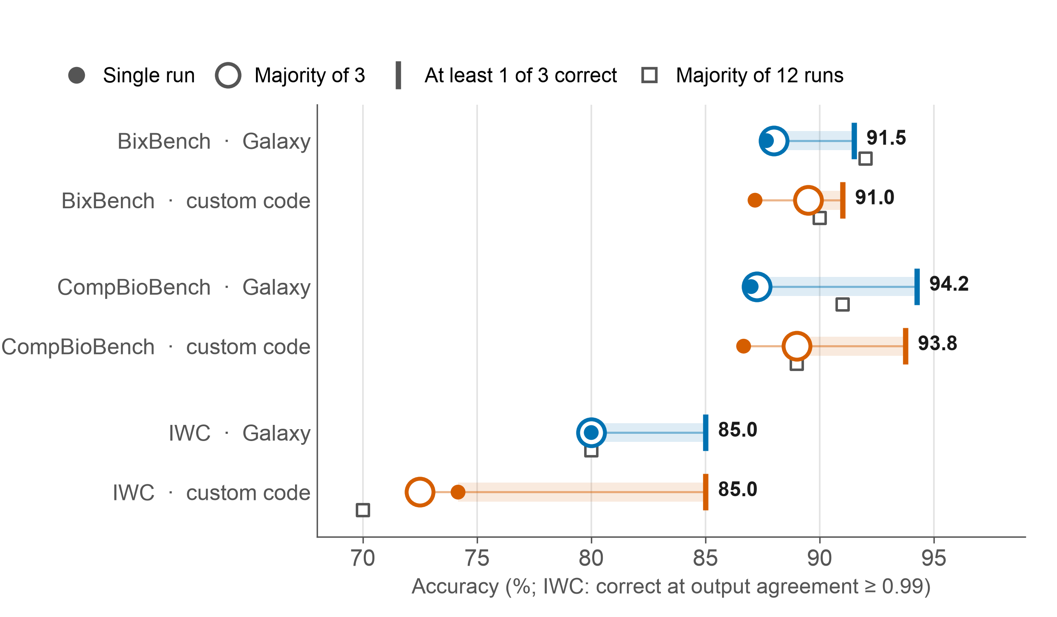
RESULT 3 · CONSENSUS
Consensus helps a little; a validation step that picks the correct replicate would help more
• A majority vote over three replicates adds 0.3 to 2.3 points (BixBench-Verified-50, CompBioBench).
• At least one replicate was correct in 85–94% of replicate groups: most of the room left is a correct answer produced but not chosen.
• Disagreement flags answers to check without the true answer: replicates split on 8–10% (BixBench), 15–17% (CompBioBench) and 10–20% (IWC) of groups.
• Galaxy runs are more consistent, which cuts both ways: voting gains 0.3 points in Galaxy against 2.3 with custom code.
Consistent wrong answers need fixes in the tools, not votes: bix-45-q1 failed in all 12 Galaxy runs because of the PhyKIT version (custom code 8/12).
Estimates from the existing runs; no consensus strategy was run. Votes from correctness; IWC correct at agreement ≥ 0.99.
8
Notes:
P4, consensus table (data/replicate_consensus.csv, rerun on PR #12 data).
Single run / majority of 3 / at least 1 of 3 / majority of 12:
BixBench Galaxy 87.7 / 88.0 / 91.5 / 92.0; custom code 87.2 / 89.5 / 91.0 / 90.0.
CompBioBench Galaxy 87.0 / 87.3 / 94.3 / 91.0; custom code 86.7 / 89.0 / 93.8 / 89.0.
IWC Galaxy 80.0 / 80.0 / 85.0 / 80.0; custom code 74.2 / 72.5 / 85.0 / 70.0 (updated for the wf_007 runs the site replaced on 12 Oct; the outline table predates that update).
A majority over all 12 runs of a task reaches 89-92% on BixBench and CompBioBench. A text vote on BixBench scores below a single run, because 10% of groups with three correct runs gave differently worded correct answers. On IWC's continuous score the median of three raises mean agreement from 0.990 to 0.991 (Galaxy) and from 0.954 to 0.964 (custom code); the best of three reaches 0.995 and 0.994.
Caveats: votes from correctness assume correct answers agree; ties count as incorrect; none of these strategies were run.

Slide 9
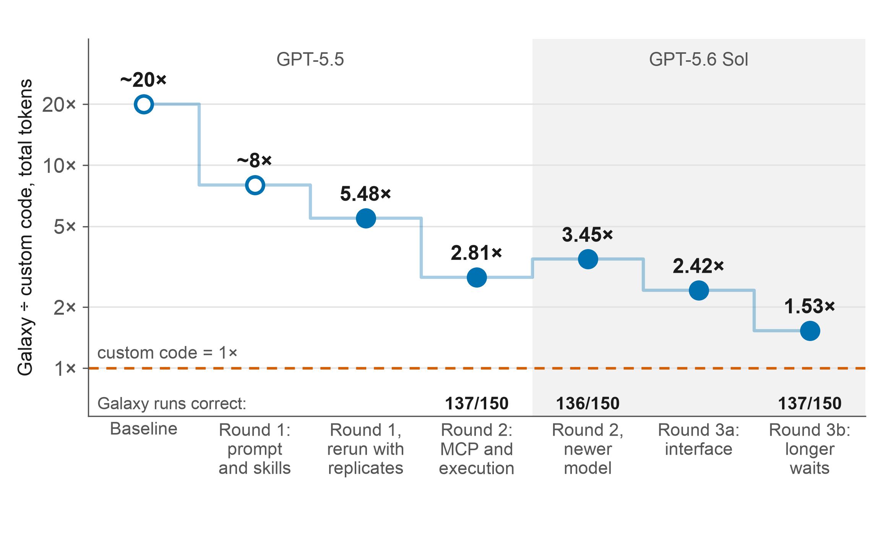
RESULT 4 · WHAT GALAXY ADDS AND WHAT IT COSTS
Agent traces showed where Galaxy's tokens went; interface fixes cut its cost from about 20× to 1.53× custom code
What Galaxy adds: a structured record
One Galaxy run (bix-45-q1, GPT-5.6 Sol, replicate 1)
PhyKIT metrics 0.2.0+galaxy0
ok
relative composition variability · animals → 3 datasets
PhyKIT metrics 0.2.0+galaxy0
ok
relative composition variability · fungi → 3 datasets
Nonparametric rank tests 0.1.0+galaxy2
ok
Mann–Whitney U, animal vs fungal → 1 dataset
Tool versions, parameters, datasets and job states: reviewable in Galaxy and rerunnable without model tokens.
Where the tokens went: 95% of Galaxy tokens were cached input; 2.66× as many agent steps, each with 2.2× as much context. Cost = round trips × context size.
BixBench-Verified-50. Not a controlled ablation; ~20× and ~8× are one run per task, not yet on the results site. Main runs: 4.2× BixBench, 2.7× CompBioBench, 0.92× IWC.
9
Notes:
P5. What Galaxy adds: every Galaxy run leaves a structured record of tool identities and versions, requested and resolved parameters, datasets and job states; people can review it in Galaxy and rerun or continue it without model tokens. The example record also shows the PhyKIT version behind the bix-45-q1 systematic error.
Where the tokens went (6 July experiment, GPT-5.5, 150 runs per condition): cached input was 95% of Galaxy tokens and output under 1%; Galaxy runs took 2.66x as many agent steps, each carrying 2.2x as much context.
Stages: baseline about 20x; round 1 (prompt and skills) about 8x; round 1 rerun with replicates 5.48x; round 2 (MCP and execution) 2.81x, Galaxy tokens down 55.2%; round 2 with GPT-5.6 Sol 3.45x; round 3a (interface) 2.42x; round 3b (longer waits) 1.53x, 137/150 correct.
Agents as virtual users: each overhead was found in agent traces, fixed in the interface, and the benchmark rerun to measure the effect.
Caveats: not a controlled ablation (the model alone moves the ratio, 2.81x vs 3.45x); baseline and round 1 used one run per task and need run records before they can be cited; round 3 is one benchmark and one model; the main Galaxy results use the round-2 interface.

Slide 10
CONCLUSIONS
AI agents can perform bioinformatics analyses through Galaxy as accurately as with custom code, and the analyses are recorded, inspectable and rerunnable
Accuracy
Errors
Similar in the two conditions on every benchmark: +0.5 and +0.3 points; IWC +0.036 agreement.
Systematic errors come mostly from the benchmark; random errors mostly from missing validation.
Consensus
Cost
A vote helps a little; a validation step that picks the correct replicate would help more.
Agents as virtual users found the interface overheads; fixes cut Galaxy from about 20× to 1.53× custom code.
Implications to test next
• Galaxy makes rigor-improving approaches cheap: running several methods for the same step and comparing them, or validating results before reporting.
• Agent traces could become a routine source of usability evidence for scientific software.
Limitations: a fixed set of models and benchmarks, prompts that differ between conditions, and models that change quickly.
10
Notes:
Main claim and the four results. P6: Galaxy makes rigor-improving approaches cheap, such as running several methods for the same step and comparing them, or validating results before reporting; these are hypotheses this study did not test. Agents as virtual users: run agents on representative tasks, attribute cost and failure to specific interface features, fix them, and re-measure. Limitations: a fixed set of models and benchmarks, prompts that differ between conditions, and models that change quickly.

