Slide 1

ICB response
prediction
Nemotron clinical copilot
Execution pipeline and model harnesses
Research demonstration
Notes:
This deck explains Paulo’s local interpretation component and the interfaces that will connect the clinical, mIF and fusion models to Junhao’s demo. The copilot uses NVIDIA Nemotron-Mini-4B-Instruct through local vLLM. NVIDIA describes it as a general instruction model, rather than a clinically tuned model. Upstream model integration, UI implementation and actual A30 generation remain pending. The cover is a conceptual AI illustration, not a pathology image. Visual provenance: built-in ImageGen, presentations/assets/cover.png. Prompts are recorded in presentations/assets/image_prompts.md.
Sources:
User-provided hackathon scope
https://github.com/paulocilasjr/MyStudies_AppliedScripts/blob/103f5af/NVIDIA_Nemotron/README.md
https://huggingface.co/nvidia/Nemotron-Mini-4B-Instruct
This expanded edition details runtime prerequisites, model harnesses, contracts, failure behavior and acceptance gates. Implemented checks and proposed hardening are identified separately.

Slide 2
Research scope
Available patients
Research question
Does combining clinical and mIF information improve prediction of ICB responders?
Planned comparison
Clinical-only, mIF-only and late-fusion predictions on the same evaluation patients.
The 29 paired patients are a subset of 48. H&E and extra mIF batches remain possible extensions.
Notes:
The user reports 48 patients with clinical data and 29 of those with mIF. The 29 paired patients form the target comparison cohort, but the actual evaluable count depends on complete predictions, labels, an agreed endpoint and declared test/out-of-fold status. The extra mIF cases have substantial batch effects. H&E remains pending. Counts describe available data, not completed model experiments.
Sources:
User-provided hackathon scope
https://github.com/paulocilasjr/MyStudies_AppliedScripts/blob/103f5af/NVIDIA_Nemotron/docs/research_review.md

Slide 3
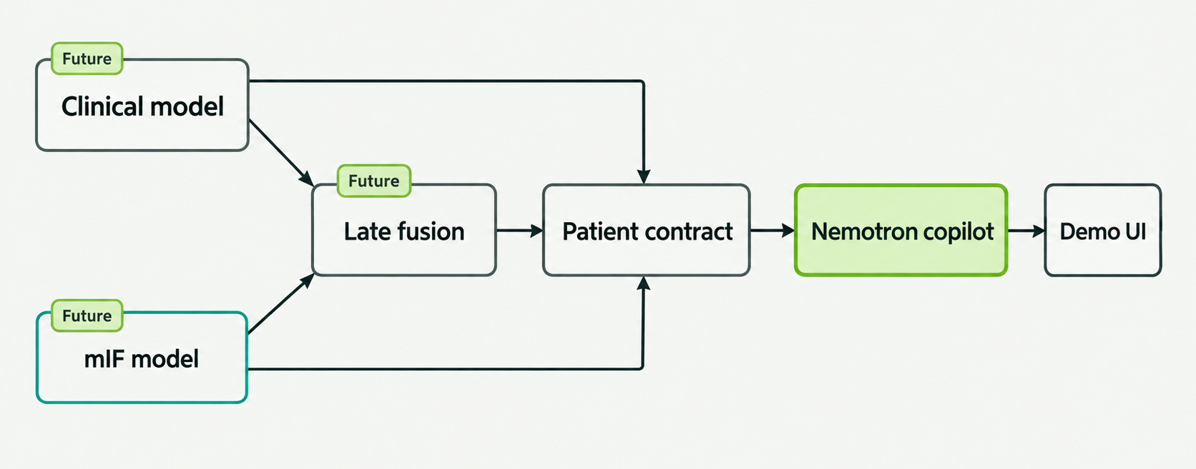
System architecture
Models export scores, features and context. This repository implements the copilot and its interfaces.
Notes:
Upstream clinical and mIF models provide scores to a future late-fusion model. Clinical, mIF and fused outputs each independently enter the shared patient contract, which preserves missing modalities and permits clinical-only records. Raw clinical data and image data remain in upstream model workflows. The copilot consumes exported predictions, feature measurements, optional signed model attributions and supplied context. All upstream models and the demo UI are separate workstreams. This repository implements the copilot and its Python, CLI and local HTTP integration interfaces. The image is a conceptual architecture diagram generated with built-in ImageGen; exact prompt is in presentations/assets/image_prompts.md. Diagram labels and seven edges were inspected against the implementation.
Sources:
https://github.com/paulocilasjr/MyStudies_AppliedScripts/blob/103f5af/NVIDIA_Nemotron/docs/integration.md
https://github.com/paulocilasjr/MyStudies_AppliedScripts/blob/103f5af/NVIDIA_Nemotron/src/icb_copilot/io.py
https://github.com/paulocilasjr/MyStudies_AppliedScripts/blob/103f5af/NVIDIA_Nemotron/src/icb_copilot/copilot.py

Slide 4
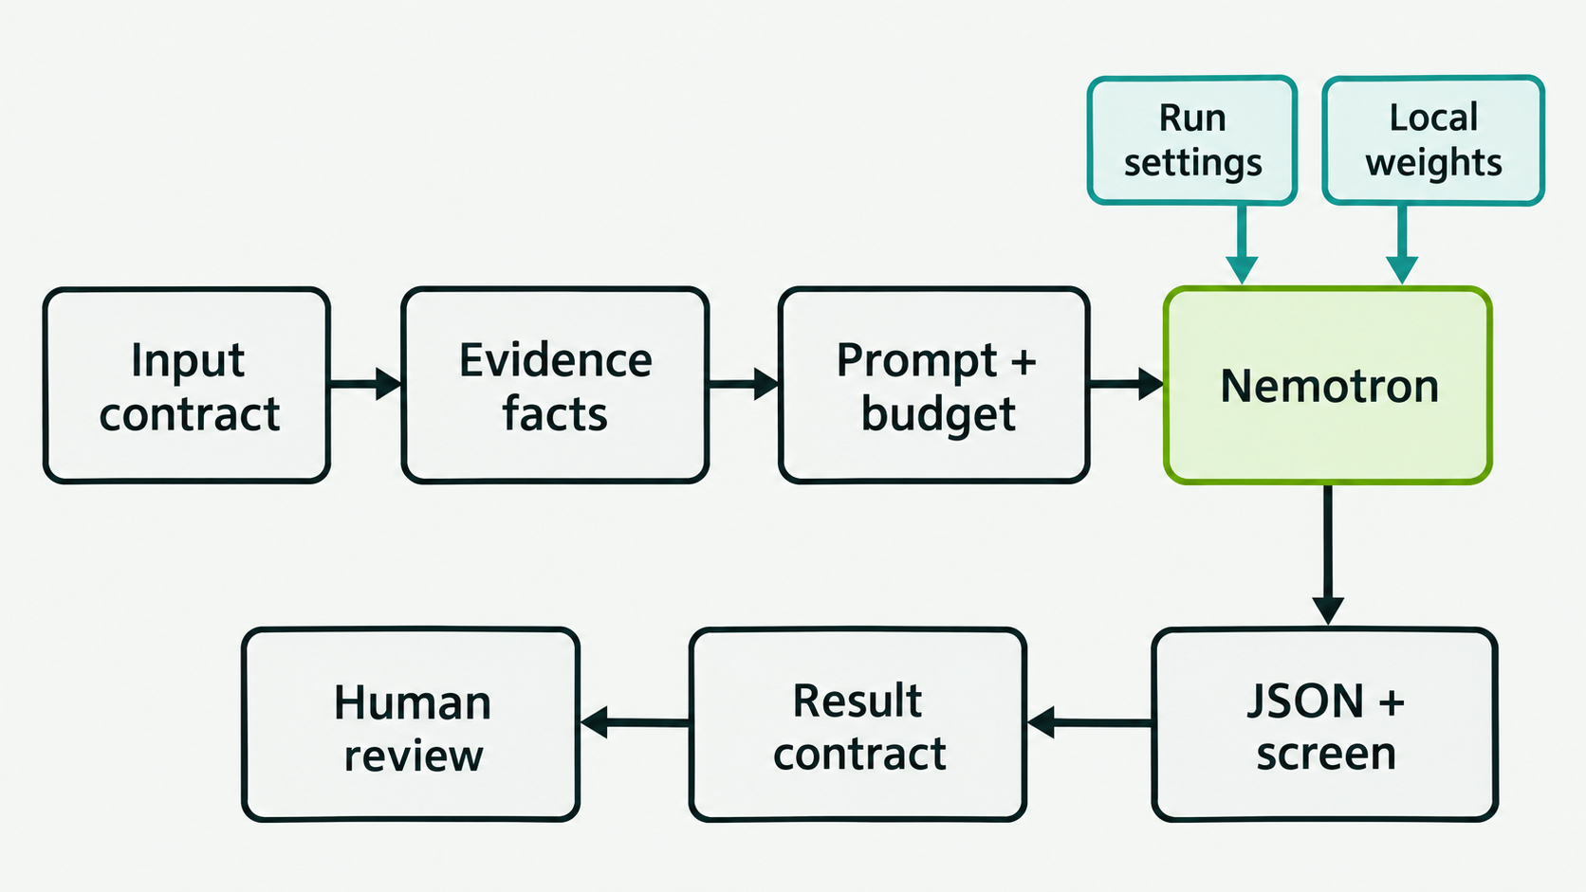
Application harness around Nemotron
The harness controls evidence and execution. Every summary requires independent human review.
Notes:
Harness means the application code around the language model: validate the producer contract, preserve authoritative facts, construct bounded prompts, run a local backend with fixed settings, screen generated text and assemble the structured result. The code implements each shown stage. Result fields exist, but a separate machine-readable response-schema validator is a proposed hardening task. The model consumes exported scores/features/context and generates interpretation prose. It does not train the prediction models, create fusion scores or establish clinical validity. Ground-truth labels stay out of the LLM prompt.
Sources:
https://github.com/paulocilasjr/MyStudies_AppliedScripts/blob/103f5af/NVIDIA_Nemotron/src/icb_copilot/copilot.py
https://github.com/paulocilasjr/MyStudies_AppliedScripts/blob/103f5af/NVIDIA_Nemotron/src/icb_copilot/backends.py
https://github.com/paulocilasjr/MyStudies_AppliedScripts/blob/103f5af/NVIDIA_Nemotron/src/icb_copilot/schema.py
Diagram provenance: built-in ImageGen. Exact prompt and asset provenance are in presentations/assets/execution/image_prompts.md. Labels and edge topology were inspected against the implementation.

Slide 5
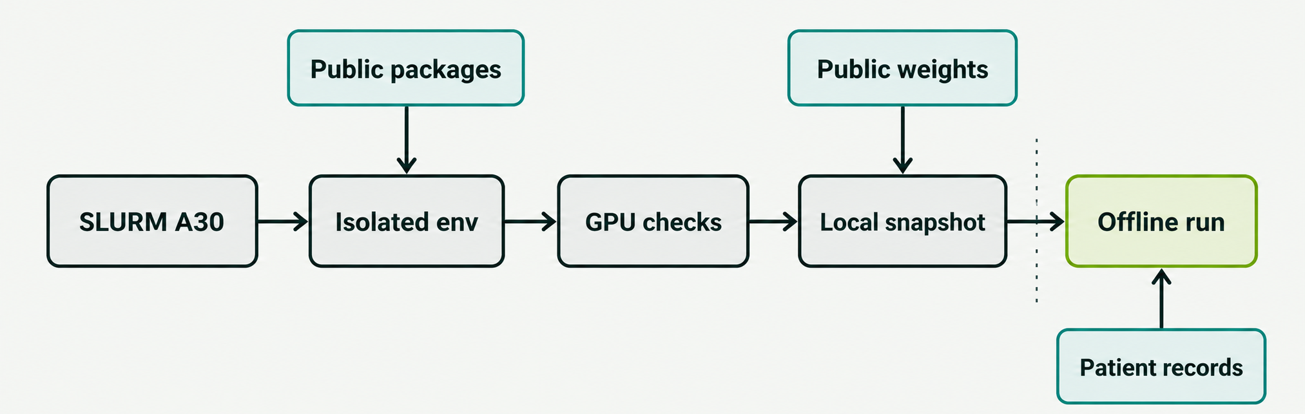
HPC execution pipeline
bash run_hpc.sh
Preparation downloads public artifacts. Patient inference then uses local weights with offline settings.
The GPU engine loads lazily on the first interpretation request.
Notes:
The root launcher submits asynchronously to SLURM, prints the job ID and log paths, and exits before the scheduled job completes. The GPU job creates/reuses the isolated environment, runs doctor before fetching model weights, prepares the public snapshot, enables offline library settings and executes experiment or serve. Patient input is processed by the Python command after preparation. The GPU engine loads lazily in VLLMBackend.generate after inputs are validated. The diagram shows the scheduled conceptual phases; it does not imply network firewall isolation. On network-limited compute nodes, prepare public artifacts on an approved connected node with --prepare-only and then submit --offline. Real inputs/results remain in approved Moffitt storage.
Sources:
https://github.com/paulocilasjr/MyStudies_AppliedScripts/blob/103f5af/NVIDIA_Nemotron/scripts/run_hpc.sh
https://github.com/paulocilasjr/MyStudies_AppliedScripts/blob/103f5af/NVIDIA_Nemotron/scripts/hpc_job.sh
https://github.com/paulocilasjr/MyStudies_AppliedScripts/blob/103f5af/NVIDIA_Nemotron/src/icb_copilot/backends.py
https://github.com/paulocilasjr/MyStudies_AppliedScripts/blob/103f5af/NVIDIA_Nemotron/docs/hpc.md
Diagram provenance: built-in ImageGen. Exact prompt and asset provenance are in presentations/assets/execution/image_prompts.md. Labels and edge topology were inspected against the implementation.

Slide 6
Runtime prerequisites
Layer | Selected deployment requirement
GPU | One A30 with 24 GB VRAM and BF16 support.
Host platform | Linux x86_64 with glibc 2.28 or newer.
NVIDIA driver | 570.26 or newer for the selected native CUDA 12.8 path.
Python | Fresh Python 3.11 environment from the Anaconda module.
GPU libraries | vLLM 0.10.2 and PyTorch 2.8.0+cu128.
Tokenizer libraries | Transformers 4.55.2 and Hugging Face Hub 0.34.4.
Model snapshot | Local configuration, tokenizer, weight files and revision metadata.
Job defaults | 32 GB host RAM, four CPUs and a four-hour allocation.
Doctor checks CUDA allocation. A generation experiment must verify model loading.
Notes:
These are requirements of this repository’s chosen pinned deployment, not a general statement about every Nemotron/vLLM deployment. The bootstrap targets Linux x86_64 with glibc >=2.28. Doctor conservatively requires driver >=570.26 and native CUDA12.8, exact pinned packages, visible GPU, BF16 capability, at least20GiB VRAM and a small allocation/synchronization. The user supplies A30 24GB, red partition and Anaconda3/2024.02-1. The selected pinned vLLM runtime uses its own PyTorch/CUDA wheel dependencies. Existing CUDA13/PyTorch2.1.2 modules are purged by default. Model preparation verifies config/tokenizer_config and expected nonempty weight files but does not calculate full weight hashes. A standalone weight file or a HuggingFace snapshot without backing blobs is insufficient.
Sources:
https://github.com/paulocilasjr/MyStudies_AppliedScripts/blob/103f5af/NVIDIA_Nemotron/requirements-vllm.txt
https://github.com/paulocilasjr/MyStudies_AppliedScripts/blob/103f5af/NVIDIA_Nemotron/src/icb_copilot/models.py
https://github.com/paulocilasjr/MyStudies_AppliedScripts/blob/103f5af/NVIDIA_Nemotron/config/hpc.env.example
https://github.com/paulocilasjr/MyStudies_AppliedScripts/blob/103f5af/NVIDIA_Nemotron/docs/hpc.md
https://docs.vllm.ai/en/v0.10.2/getting_started/installation/gpu.html

Slide 7
Token budget and execution settings
Default context allocation
Current execution defaults
dtype = bfloat16
GPU memory fraction = 0.80
GPU concurrent sequences = 4
Experiment batch size = 8
temperature = 0.0
seed = 42
Character limits do not guarantee a prompt fits the token budget.
4,096 − 300 = 3,796 input tokens maximum
Notes:
The backend tokenizes the complete applied chat template with add_special_tokens=False, so the token budget includes system/user instructions, serialized evidence and role/template markers. The check occurs after lazy engine loading and tokenization, before generation. It rejects any prompt whose token length plus max_tokens exceeds max_model_len. At defaults, prompt <=3796, output reservation=300 and total<=4096. This is capacity accounting, not a measured patient token count. The wrapper does not silently truncate or summarize inputs. Reduce approved evidence/context or explicitly revise settings if budget checks fail. Generation defaults are BF16, tensor parallel 1, eager execution, GPU memory utilization 0.80, max_num_seqs 4, temperature 0 and seed 42. CLI batch_size 8 is application chunking, not GPU concurrency. Seed and temperature do not guarantee byte-identical behavior across hardware/runtime changes.
Sources:
https://github.com/paulocilasjr/MyStudies_AppliedScripts/blob/103f5af/NVIDIA_Nemotron/src/icb_copilot/backends.py
https://github.com/paulocilasjr/MyStudies_AppliedScripts/blob/103f5af/NVIDIA_Nemotron/src/icb_copilot/cli.py
https://github.com/paulocilasjr/MyStudies_AppliedScripts/blob/103f5af/NVIDIA_Nemotron/src/icb_copilot/experiment.py
https://huggingface.co/nvidia/Nemotron-Mini-4B-Instruct

Slide 8
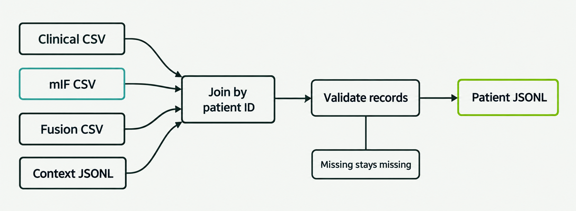
Patient joins and missing modalities
Identity gate
Availability gate
Resolve slide IDs upstream. Export one score per patient per modality.
Missing predictions remain absent. The structured result names unavailable modalities.
Notes:
assemble_predictions joins by canonical patient_id, preserves the union of patients and stable input order, and never joins by row number. CSV patient_id and probability headers are required; documented optional headers are model_id,calibration,decision_threshold. Duplicate headers, invalid column counts, duplicate patient IDs, invalid scores and context IDs with no prediction match fail. Context JSONL cannot override predictions. Slide-to-patient mapping and repeated slide aggregation belong upstream. The canonical schema supports any nonempty subset of clinical/mif/fused, so a clinical-only patient remains clinical-only. A missing modality is omitted, not filled with zero, a mean or an invented fused score. The target29paired cohort is not imposed by the adapter.
Sources:
https://github.com/paulocilasjr/MyStudies_AppliedScripts/blob/103f5af/NVIDIA_Nemotron/src/icb_copilot/io.py
https://github.com/paulocilasjr/MyStudies_AppliedScripts/blob/103f5af/NVIDIA_Nemotron/src/icb_copilot/schema.py
https://github.com/paulocilasjr/MyStudies_AppliedScripts/blob/103f5af/NVIDIA_Nemotron/docs/integration.md
Diagram provenance: built-in ImageGen. Exact prompt and asset provenance are in presentations/assets/execution/image_prompts.md. Labels and edge topology were inspected against the implementation.

Slide 9
Shared patient contract
{
"schema_version": "1.0",
"patient_id": "P12",
"predictions": {
"clinical": {"probability": 0.21},
"mif": {"probability": 0.78},
"fused": {"probability": 0.57}
},
"response_definition": "Not specified"
}
Patient identity
One canonical patient ID and one prediction per patient per modality.
Score metadata
Model version, calibration status and optional threshold travel with each score.
Feature evidence
Measurement direction and signed attribution are separate.
Positive class: ICB responder. The team has not yet agreed the responder definition.
Notes:
This compact example intentionally leaves the responder endpoint unspecified. The canonical schema supports clinical, mif and fused keys, each with probability and optional model_id, calibration and decision_threshold. Probability must be numeric, finite and in [0,1]. Missing scores remain absent. Top features carry value, unit, measurement direction and an optional signed attribution with method and scale. All scores and attribution signs must refer to the responder class. Unsupported keys, including a future H&E modality, require an explicit versioned extension. This example omits feature/context metadata only for readability.
Sources:
https://github.com/paulocilasjr/MyStudies_AppliedScripts/blob/103f5af/NVIDIA_Nemotron/docs/integration.md
https://github.com/paulocilasjr/MyStudies_AppliedScripts/blob/103f5af/NVIDIA_Nemotron/src/icb_copilot/schema.py

Slide 10
Feature evidence contract
{
"feature": "LDH level",
"value": 510,
"unit": "U/L",
"direction": "elevated",
"attribution": {
"method": "shap",
"value": -0.18,
"scale": "log_odds"
}
}
Measurement meaning
Value, units and reference direction describe the supplied observation.
Model effect
A signed attribution describes that model’s responder score on a declared scale.
Upstream semantic checks
Confirm class mapping, units and prediction timepoint. Avoid causal claims.
Synthetic example. A high measurement alone does not determine the feature’s effect on a model score.
Notes:
The synthetic P12 fixture supplies LDH510U/L with direction elevated and a SHAP attribution -0.18 log_odds for the responder class. This is demonstration data, not an actual patient. The measurement and attribution use separate fields. The schema checks field types/finite attribution values and records method/scale, but cannot establish correct biomarker units, reference interval, attribution target class or causal interpretation. These semantic conditions belong to upstream owners and reviewers. Feature names max160characters, value strings max256, direction max160, units max80, max10features per modality, clinical_context max2000characters. Full features remain in the structured output, while the factual narrative sentence uses at most two features per modality. Restrict data to the agreed prediction timepoint as a proposed upstream study contract.
Sources:
https://github.com/paulocilasjr/MyStudies_AppliedScripts/blob/103f5af/NVIDIA_Nemotron/examples/mock_predictions.jsonl
https://github.com/paulocilasjr/MyStudies_AppliedScripts/blob/103f5af/NVIDIA_Nemotron/src/icb_copilot/schema.py
https://github.com/paulocilasjr/MyStudies_AppliedScripts/blob/103f5af/NVIDIA_Nemotron/src/icb_copilot/copilot.py

Slide 11
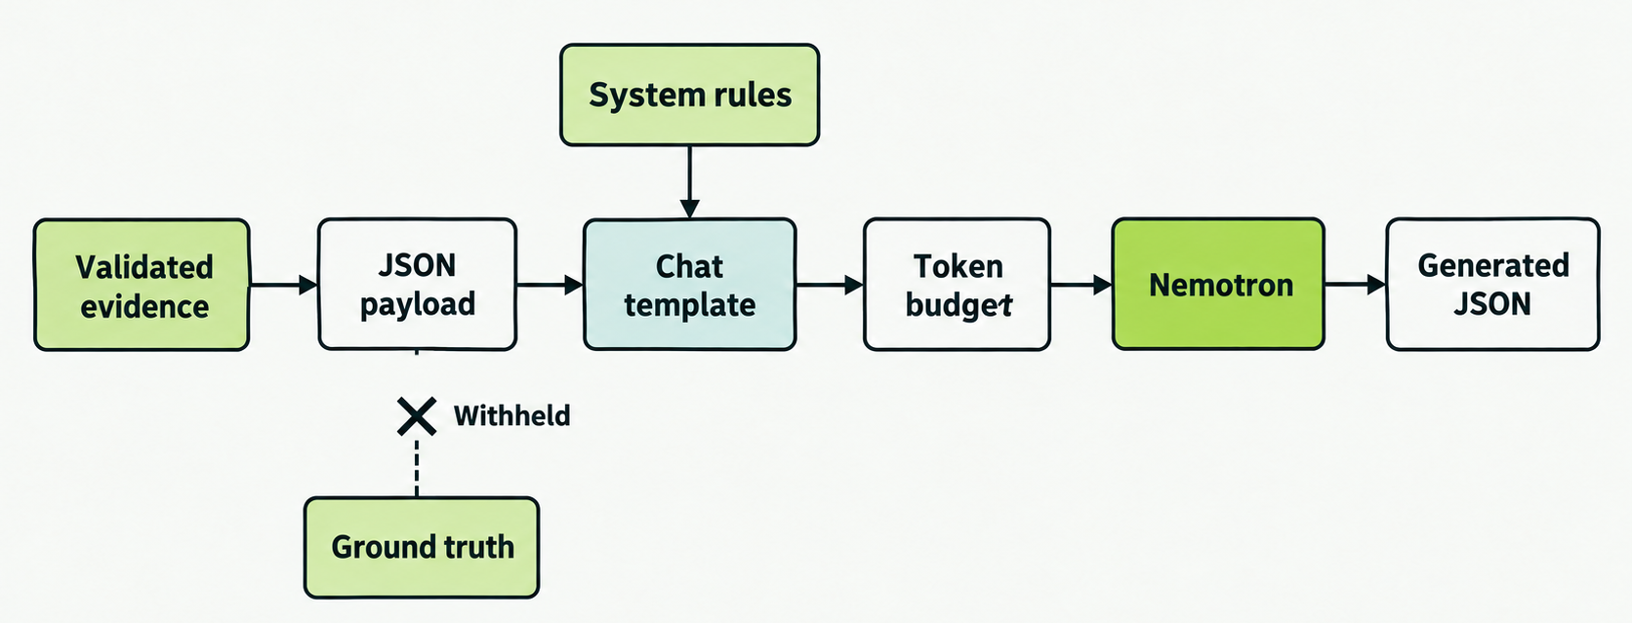
Prompt and context harness
Expected model JSON: {"interpretation": "Two concise research sentences."}
Ground truth stays outside generation. Human review still checks factual correctness and context leakage.
Notes:
build_messages includes predictions,top_features,clinical_context,response_definition, and intentionally excludes patient_id,ground_truth,evaluation_partition. It JSON-serializes with allow_nan=False and escapes angle brackets so role delimiter text does not become chat boundaries. System rules instruct the model to treat evidence as untrusted data, return one interpretation field with two concise sentences, avoid numbers/patient facts/feature names with digits, avoid treatment/prognosis/causality/performance claims and acknowledge research review. The local tokenizer provided by vLLM applies the chat template before token counting. These controls mitigate failures but do not prove prompt injection resistance or factual accuracy. Ground-truth omission does not prove clinical_context itself is free of label leakage. A semantic context review is proposed.
Sources:
https://github.com/paulocilasjr/MyStudies_AppliedScripts/blob/103f5af/NVIDIA_Nemotron/src/icb_copilot/backends.py
https://huggingface.co/nvidia/Nemotron-Mini-4B-Instruct
Diagram provenance: built-in ImageGen. Exact prompt and asset provenance are in presentations/assets/contracts/image_prompts.md. Labels and edge topology were inspected against the implementation.

Slide 12
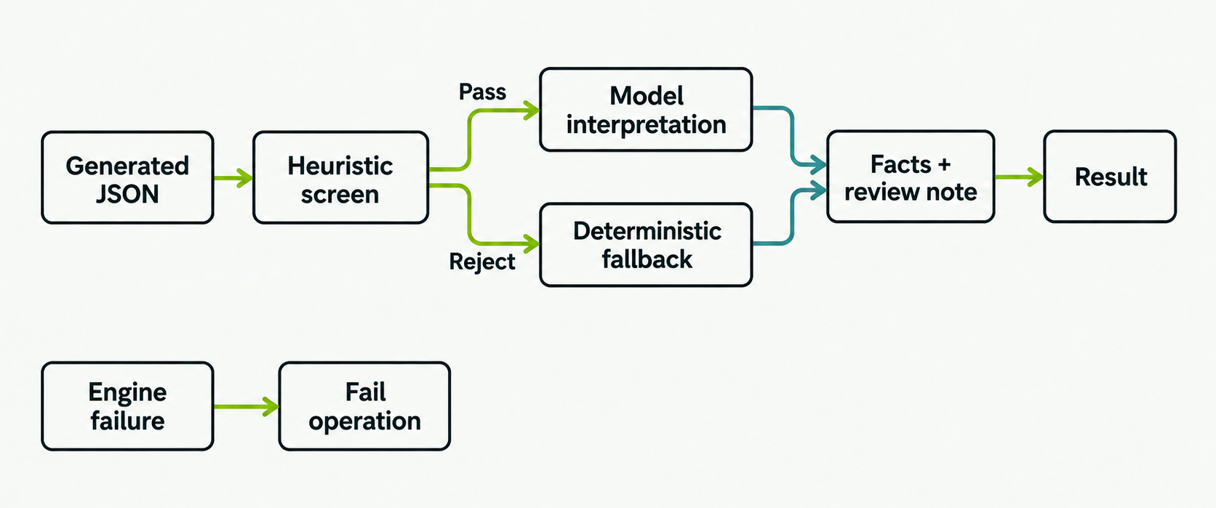
Output quality gates and fallback
Rejected prose falls back. Engine errors stop a batch run or return an API error.
Notes:
GuidedDecodingParams constrains the model output to an object with required interpretation:string and no extra properties. The wrapper reparses with duplicate-key/nonfinite rejection and screens interpretation length40..1200characters, generated digits/percentages, role/markup/URL patterns, selected treatment/performance/causality language, measurement-as-effect patterns and invented patient/biology assertions. This is heuristic: a pass is not verified clinical truth, and negated harmless terms can also fall back. The application independently creates numeric facts from the canonical record and appends the review sentence. A rejected textual result uses deterministic fallback with source=fallback and issues listed. An input, token-budget, backend cardinality or GPU/runtime failure propagates and does not become mock or a narrative fallback.
Sources:
https://github.com/paulocilasjr/MyStudies_AppliedScripts/blob/103f5af/NVIDIA_Nemotron/src/icb_copilot/backends.py
https://github.com/paulocilasjr/MyStudies_AppliedScripts/blob/103f5af/NVIDIA_Nemotron/src/icb_copilot/copilot.py
https://docs.vllm.ai/en/v0.10.2/features/structured_outputs.html
Diagram provenance: built-in ImageGen. Exact prompt and asset provenance are in presentations/assets/contracts/image_prompts.md. Labels and edge topology were inspected against the implementation.

Slide 13
Expected result contract
Field group | Expected behavior
Identity and predictions | Same patient ID and validated scores. No fabricated missing score.
Narrative | Facts from input, a screened interpretation or fallback, and a review note.
Source and quality | Source: mock / vllm / fallback. Quality: mock / passed / fallback.
Comparison and limitations | Show availability, score gaps and supplied-threshold classifications.
Review status | review_required is always true. The summary remains research output.
Provenance | Record prompt version, backend, local model metadata and settings.
Result fields are implemented. A formal response-schema validator is a proposed hardening step.
Notes:
Copilot.interpret returns one structured result; interpret_many preserves input order and rejects duplicate IDs. Predictions are validated/canonicalized and retained at original numeric precision. The narrative combines authoritative score/feature facts, generated-or-fallback prose and a fixed research review sentence; score prose rounds to three decimals. Output contains schema_version,patient_id,predictions,top_features,clinical_context,response_definition,narrative,narrative_source,review_required,limitations,comparison,quality,provenance. narrative_source values are mock,vllm,fallback. quality.status values are mock,passed,fallback. comparison includes missing_modalities,clinical_mif_gap,disagreement_threshold,score_disagreement,threshold_disagreement,predicted_classes. Provenance includes prompt_version and backend metadata. A dedicated versioned response-schema validator and cross-field invariants are proposed additions, not implemented capabilities.
Sources:
https://github.com/paulocilasjr/MyStudies_AppliedScripts/blob/103f5af/NVIDIA_Nemotron/src/icb_copilot/copilot.py
https://github.com/paulocilasjr/MyStudies_AppliedScripts/blob/103f5af/NVIDIA_Nemotron/docs/integration.md

Slide 14
Synthetic case: discordant predictions
P12 / synthetic model scores
“Clinical and spatial mIF predictions are discordant and warrant review of the supplied evidence.”
Clinical–mIF gap: 0.57
Calibration: unknown
Human review: required
This is deterministic mock output. The supplied fused score does not establish better performance.
Notes:
Case P12 is entirely synthetic. The scores are clinical 0.21, mIF 0.78 and fused 0.57, with unknown calibration. The absolute clinical/mIF score gap is 0.57, exceeding the configurable presentation cutoff of 0.20. This cutoff is heuristic and is not a clinical uncertainty threshold. The supplied 0.5 classification thresholds also yield disagreement. The quoted text is an exact sentence from the deterministic mock interpretation. The fused score comes from the fixture and does not demonstrate an improvement in accuracy, clinical decisions or outcomes.
Sources:
https://github.com/paulocilasjr/MyStudies_AppliedScripts/blob/103f5af/NVIDIA_Nemotron/examples/mock_predictions.jsonl
https://github.com/paulocilasjr/MyStudies_AppliedScripts/blob/103f5af/NVIDIA_Nemotron/src/icb_copilot/copilot.py

Slide 15
Failure handling and recovery
Failure | Current behavior | Operator response
Contract error | Reject input before generation. | Correct IDs, types or metadata.
Prompt too long | Reject before token generation. | Reduce approved context or features.
GPU / cache failure | Stop runtime or scheduled job. | Inspect doctor, cache and SLURM logs.
Rejected model prose | Publish deterministic fallback. | Inspect screen issues and review the case.
Engine failure | Stop run. API returns an error. | Fix the runtime and retry in a new run dir.
Existing result directory | Protect the completed run. | Choose a new output directory.
A fallback is a labeled summary. A runtime failure is an execution error, with no partial batch publication.
Notes:
Current paths: invalid JSON/types/duplicates reject before generation; over-budget prompts raise ValueError after local engine load and tokenization but before generate; doctor/cache/env failures stop the runner; malformed/rejected model text uses a deterministic fallback; engine failures propagate and batch experiment publishes no new completed result directory. HTTP ValueError maps422, other failures503; wrong content-type415 and oversizedbody413. A model runtime error does not get converted into mock output. The operator should preserve logs/configuration, correct root causes and retry using a new output directory. Automatic retries, resumable patient checkpoints and failed-run audit manifests are proposed, not implemented. Avoid repeating invalid data or blindly retrying OOM without reviewing budget/allocation.
Sources:
https://github.com/paulocilasjr/MyStudies_AppliedScripts/blob/103f5af/NVIDIA_Nemotron/src/icb_copilot/server.py
https://github.com/paulocilasjr/MyStudies_AppliedScripts/blob/103f5af/NVIDIA_Nemotron/src/icb_copilot/experiment.py
https://github.com/paulocilasjr/MyStudies_AppliedScripts/blob/103f5af/NVIDIA_Nemotron/src/icb_copilot/backends.py
https://github.com/paulocilasjr/MyStudies_AppliedScripts/blob/103f5af/NVIDIA_Nemotron/scripts/run_hpc.sh

Slide 16
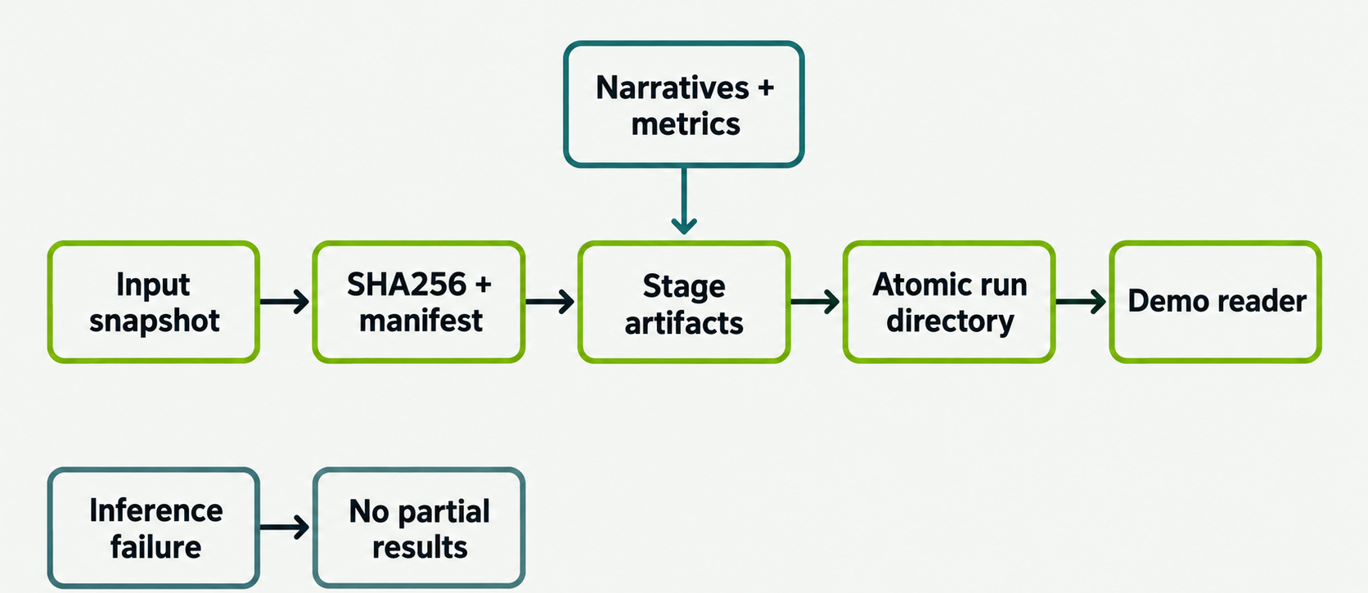
Experiment publication and provenance
narratives.jsonl narratives.csv report.md manifest.json metrics.json
Notes:
run_experiment reads the input bytes once, parses that immutable snapshot and computes its SHA256. A producer rewriting the handoff during generation does not change the consumed input identity. The manifest records input path/hash,count,timestamp,elapsed time,backend/settings,batch_size,disagreement threshold,runtime package versions,response definitions and source/quality counts. The model manifest records exact requested revision,weight filenames and byte sizes, but not full weight hashes. The manifest records four core package versions. The resolved pip freeze is stored separately in shared .state/requirements-resolved.txt; it is not embedded in each run manifest. The pins and freeze do not form a fully hashed environment lock. On success, the component writes narratives.jsonl,narratives.csv,report.md,manifest.json,metrics.json in a sibling staging directory and renames it atomically. Files receive0600 and run directory0700. Nonempty existing result directories are protected. Request IDs, per-stage latency and failed-run manifests are proposed additions.
Sources:
https://github.com/paulocilasjr/MyStudies_AppliedScripts/blob/103f5af/NVIDIA_Nemotron/src/icb_copilot/experiment.py
https://github.com/paulocilasjr/MyStudies_AppliedScripts/blob/103f5af/NVIDIA_Nemotron/src/icb_copilot/models.py
https://github.com/paulocilasjr/MyStudies_AppliedScripts/blob/103f5af/NVIDIA_Nemotron/scripts/run_hpc.sh
Diagram provenance: built-in ImageGen. Exact prompt and asset provenance are in presentations/assets/contracts/image_prompts.md. Labels and edge topology were inspected against the implementation.

Slide 17
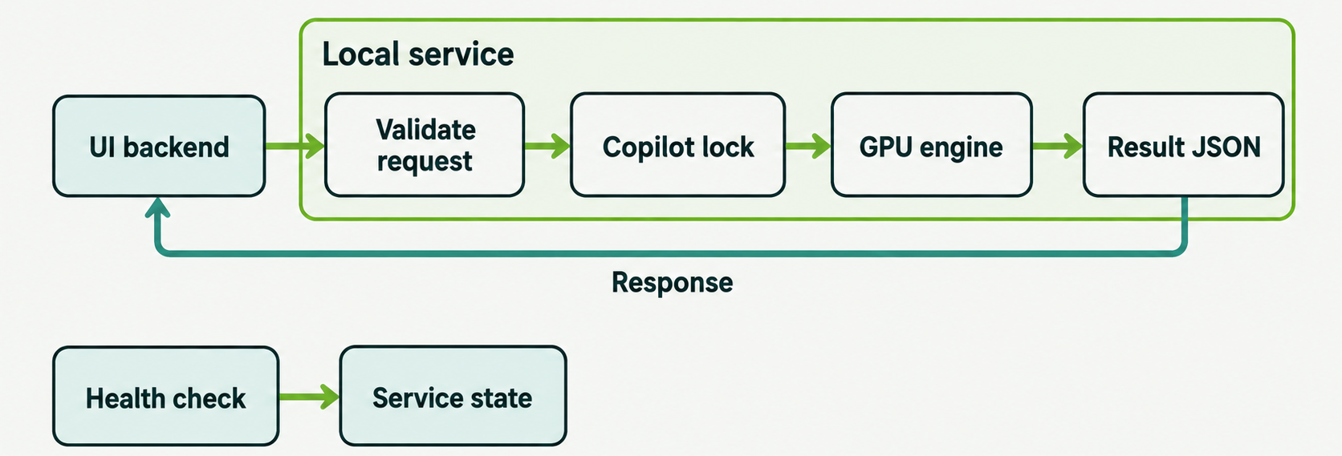
Local API execution envelope
Current request limits
Readiness distinction
2 MB requests. Batches contain 1–128 patients. Model calls serialize.
Health checks service state. Generation verifies model execution.
Authentication, bounded queues and inference deadlines are proposed additions, not current API features.
Notes:
The service has GET/health,POST/v1/interpret and POST/v1/interpret-batch. It binds to IPv4 loopback/localhost, requires application/json and a single Content-Length, rejects chunked bodies, limits body size2,000,000bytes and batch size1..128 uniquepatients. ThreadingHTTPServer receives requests while Copilot._lock serializes each vLLM generate call, including first lazy loading. max_num_seqs4 refers to internal engine sequencing, not parallel API requests. /health reports service status/backend/schema/model_loaded and does not perform a generation probe. The30s connection socket timeout is not an end-to-end model deadline. The code does not implement authentication,CORS,bounded worker queue,rate limits,request IDs or inference deadlines. Keep actual patient data in approved Moffitt hosts/storage. Broader service exposure would require explicit access/operational hardening.
Sources:
https://github.com/paulocilasjr/MyStudies_AppliedScripts/blob/103f5af/NVIDIA_Nemotron/src/icb_copilot/server.py
https://github.com/paulocilasjr/MyStudies_AppliedScripts/blob/103f5af/NVIDIA_Nemotron/src/icb_copilot/copilot.py
https://docs.vllm.ai/en/v0.10.2/usage/security.html
Diagram provenance: built-in ImageGen. Exact prompt and asset provenance are in presentations/assets/contracts/image_prompts.md. Labels and edge topology were inspected against the implementation.

Slide 18
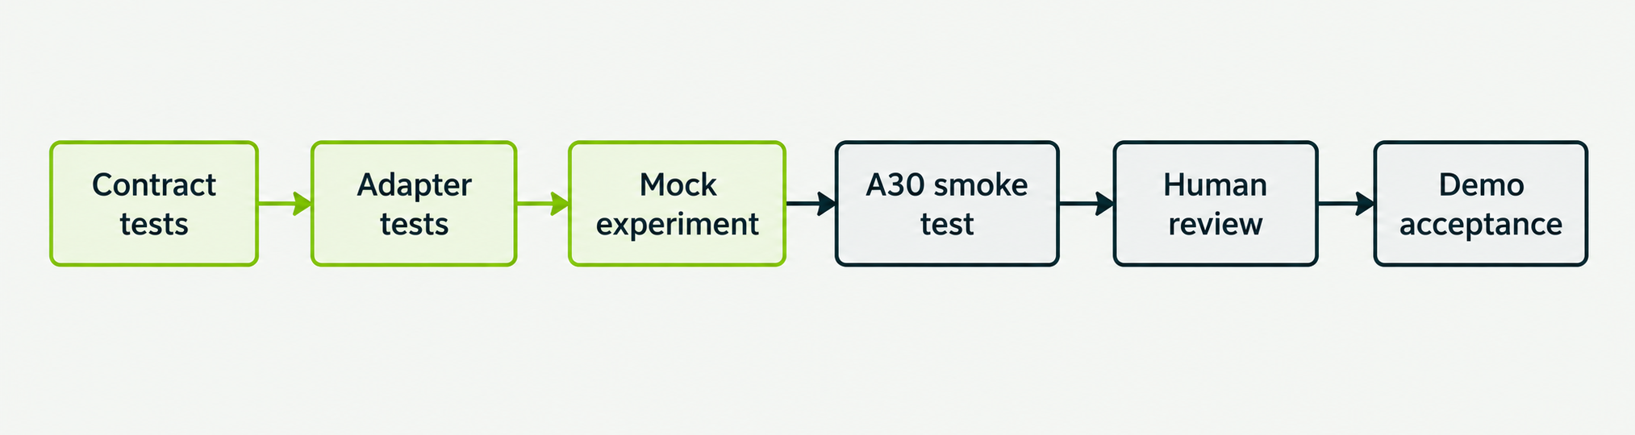
Testing harness and readiness gates
Implemented tests
Remaining site checks
Schema, adapters, mocks, artifacts, HTTP and mocked SLURM tests pass.
Run four synthetic cases on A30. Review each resulting narrative.
Software tests verify the harness. Prediction and narrative quality need separate evidence.
Notes:
The completed CPU/mock suite has 67 tests covering strict inputs, upstream joins, label withholding, role delimiter escaping, guided schema/chat-template/budget behavior with fake backends, local HTTP constraints, immutable input hashes, protected/atomic artifacts, held-out evaluation and mocked SLURM prep/offline paths. These do not prove actual GPU model loading, runtime performance or clinical narrative validity. The four synthetic fixtures represent concordant, discordant, clinical-only and near-threshold cases. The next A30 smoke test must run real vLLM locally and check output count/identity, unchanged structured scores, source counts, screen/fallback behavior and human review. Acceptance tolerances require team agreement.
Sources:
https://github.com/paulocilasjr/MyStudies_AppliedScripts/blob/103f5af/NVIDIA_Nemotron/tests/
https://github.com/paulocilasjr/MyStudies_AppliedScripts/blob/103f5af/NVIDIA_Nemotron/examples/mock_predictions.jsonl
https://github.com/paulocilasjr/MyStudies_AppliedScripts/blob/103f5af/NVIDIA_Nemotron/docs/research_review.md
Diagram provenance: built-in ImageGen. Exact prompt and asset provenance are in presentations/assets/execution/image_prompts.md. Labels and edge topology were inspected against the implementation.

Slide 19
Acceptance contracts for the real-data run
Gate | Evidence required before demo use
Identity and completeness | Expected IDs and row counts match. Missing modalities stay explicit.
Prediction meaning | Responder class, endpoint, units and attribution scales are confirmed.
Runtime execution | Real A30 generation succeeds and source/fallback counts are visible.
Narrative review | Review numeric facts, supplied evidence and unsupported claims.
Model evaluation | Compare eligible paired patients using agreed folds and endpoint.
Demo display | Show scores, source, limitations and the human-review flag.
Proposed acceptance rubric. The team must agree fallback tolerance, latency targets and the reviewer.
Notes:
These are proposed team acceptance conditions, not new implemented validators. Verify each expected patient ID appears once, input/output counts align, modality availability matches source exports and probabilities remain unchanged. Confirm the responder class, endpoint and assessment window with producers. Check feature units, attribution target/scale and the context prediction timepoint; keep labels out of generation. The A30 smoke test must produce actual source=vllm outputs and disclose any fallbacks. A coherent fallback alone does not prove GPU inference. Compare eligible paired test/OOF predictions using the same folds and endpoint; the evaluator currently groups metadata strings and trusts producers. Review every narrative, including screen-passed and fallback outputs. Agree fallback and latency tolerances using observed smoke-test and review evidence. This component does not establish clinical benefit.
Sources:
https://github.com/paulocilasjr/MyStudies_AppliedScripts/blob/103f5af/NVIDIA_Nemotron/docs/research_review.md
https://github.com/paulocilasjr/MyStudies_AppliedScripts/blob/103f5af/NVIDIA_Nemotron/src/icb_copilot/copilot.py
https://github.com/paulocilasjr/MyStudies_AppliedScripts/blob/103f5af/NVIDIA_Nemotron/src/icb_copilot/evaluate.py

Slide 20
Connections to future models
Owner / workstream | Handoff to the copilot
Isis / clinical model | Clinical prediction CSV plus clinical features and context.
Alyssa / mIF model | mIF prediction CSV plus feature metadata and canonical patient IDs.
Fusion owner / TBD | Fused prediction CSV with model provenance for paired patients.
Paulo / copilot | Assemble, validate and interpret the combined patient records.
Junhao / demo UI | Read structured narrative results or call the local interpretation API.
Future H&E predictions require a versioned contract and adapter change. Raw images stay upstream.
Notes:
These are the planned team workstreams and the interfaces they will provide once their models are ready. Isis owns clinical preprocessing/modeling, Alyssa owns mIF preprocessing/modeling, Paulo owns this copilot and Junhao owns the UI. A fusion owner has not been assigned in the supplied plan. Clinical, mIF and fused CSVs each include patient_id and probability, with optional metadata. A context JSONL sidecar carries features, clinical context, response definition, labels and evaluation partition. Slide mapping and aggregation belong upstream. assemble joins the patient union and preserves missing modalities. H&E requires a new model plus explicit schema, adapter and evaluation changes because the current schema accepts only clinical/mif/fused.
Sources:
User-provided team responsibilities
https://github.com/paulocilasjr/MyStudies_AppliedScripts/blob/103f5af/NVIDIA_Nemotron/docs/integration.md
https://github.com/paulocilasjr/MyStudies_AppliedScripts/blob/103f5af/NVIDIA_Nemotron/src/icb_copilot/io.py
https://github.com/paulocilasjr/MyStudies_AppliedScripts/blob/103f5af/NVIDIA_Nemotron/src/icb_copilot/schema.py

Slide 21
Evaluation and review
Prediction quality
Narrative quality
Use the same eligible patients across modalities.
Agree the endpoint and preserve patient-level folds.
Inspect AUROC and Brier score on paired outputs.
Check reproduced scores and supplied features.
Review disagreement and missing modalities.
Inspect unsupported claims, source and limitations.
A successful mock run establishes interface behavior. Clinical validity and multimodal benefit require further evidence.
Notes:
The current evaluator computes exploratory AUROC and Brier score for explicitly labeled test/out_of_fold records with a specified response definition. It separates partition/endpoint strings but does not prove true held-out status or fold construction. available_cohorts can have different patient sets. paired_all_modalities includes only records with all three outputs and is the relevant paired comparison. Accuracy uses only supplied thresholds and may have a different denominator. Multiple model IDs are listed and require producer review. Synthetic/unlabeled records do not establish performance. The current four synthetic cases yield no eligible performance cohort. The implementation does not compute confidence intervals or significance. Independent narrative review must examine exact facts, evidence, source and limitations. Guided JSON controls format, not medical correctness.
Sources:
https://github.com/paulocilasjr/MyStudies_AppliedScripts/blob/103f5af/NVIDIA_Nemotron/src/icb_copilot/evaluate.py
https://github.com/paulocilasjr/MyStudies_AppliedScripts/blob/103f5af/NVIDIA_Nemotron/docs/research_review.md
https://github.com/paulocilasjr/MyStudies_AppliedScripts/blob/103f5af/NVIDIA_Nemotron/src/icb_copilot/copilot.py

Slide 22
Harness hardening still to add
Proposed additions beyond the current implementation
Harness area | Addition to design and implement
Machine contracts | Versioned JSON Schemas and output cross-field invariants.
Evidence semantics | Check endpoint, timepoint, units, class mapping and fold provenance.
Live service controls | Model warmup, bounded queue, inference deadline and access policy.
Local observability | Request IDs, stage latency, live fallback counters and failed-run records.
Reproducibility | Hash-locked environment and weight digests when needed.
Acceptance automation | GPU regression cases plus independent narrative review.
These tasks strengthen execution and auditability. They do not establish clinical validity by themselves.
Notes:
These are engineering recommendations based on current code, not completed features. Publish machine-readable input/output JSON Schemas and validate cross-field, count and probability invariants. Enhance semantic checks for units, timepoint, class mapping and fold provenance; obtain independent clinical review. For live API use, add model warmup/generation readiness probes and bounded queue/deadline policies. Add safe request/run IDs, per-stage latency, live/per-request fallback counters and failed-run records without logging raw clinical content by default. Existing successful experiment manifests already aggregate source and quality counts. Preserve hash-locked environments and weight digests when required. Add GPU regression and narrative review after deployment. Screen-passed text can still be incorrect.
Sources:
https://github.com/paulocilasjr/MyStudies_AppliedScripts/blob/103f5af/NVIDIA_Nemotron/src/icb_copilot/server.py
https://github.com/paulocilasjr/MyStudies_AppliedScripts/blob/103f5af/NVIDIA_Nemotron/src/icb_copilot/backends.py
https://github.com/paulocilasjr/MyStudies_AppliedScripts/blob/103f5af/NVIDIA_Nemotron/src/icb_copilot/experiment.py
https://huggingface.co/nvidia/Nemotron-Mini-4B-Instruct
https://docs.vllm.ai/en/v0.10.2/usage/security.html

Slide 23
Decisions needed for the real-data demo
Proposed starting choices and owners for team confirmation
Decision | Suggested owner | Starting choice to confirm
Responder endpoint | Clinical owner TBD + Isis | Agree the responder definition and assessment window.
Patient identity | Isis + Alyssa | Use canonical IDs. Resolve slide aggregation upstream.
Evaluation design | Modeling team | Share patient-level folds. Start with the paired cohort.
Late-fusion method | Owner TBD | Assign an owner. Prespecify a simple fusion baseline.
Export metadata | All model owners | Fix class mapping, attribution scales and score metadata.
Demo and acceptance | Paulo + Junhao Reviewer TBD | Choose demo mode. Verify A30 output and review cases.
H&E and extra mIF batches also need a scope decision before inclusion.
Notes:
All owner assignments and defaults below are proposals to confirm with the team. The responder definition is explicitly undecided in the user’s reply. There is no supplied fusion owner or clinical reviewer, so those remain TBD. A prespecified simple late-fusion baseline is a proposed starting point rather than implemented fusion. Avoid training or tuning fusion on evaluation predictions; use appropriately constructed training/OOF data and a shared independent evaluation design. Unknown calibration and null thresholds should remain until the modeling team provides supported metadata. The artifact-first recommendation reflects demo reliability, not an adopted team choice. Extra batches and H&E remain pending extensions.
Sources:
User reply: responder definition still undecided
User-provided team responsibilities
https://github.com/paulocilasjr/MyStudies_AppliedScripts/blob/103f5af/NVIDIA_Nemotron/docs/integration.md
https://github.com/paulocilasjr/MyStudies_AppliedScripts/blob/103f5af/NVIDIA_Nemotron/docs/research_review.md

Slide 24
Completion checkpoints
Checkpoint | Evidence of completion
Contract agreement | The team records the endpoint, IDs, splits and model exports.
A30 smoke experiment | Paulo generates local Nemotron output from the synthetic cases.
Real prediction handoff | Model owners supply held-out clinical, mIF and fused scores.
Review and comparison | The team inspects paired metrics and representative narratives.
Demo integration | Junhao displays each patient’s scores, evidence and review status.
Ready now: mock experiment, HPC runner and integration interfaces. Pending: real GPU and model handoffs.
Notes:
These are proposed checkpoints with no invented dates. Current implementation and synthetic interface tests are complete, but no real A30 model generation has occurred in this local task. The team must agree endpoint and exports, verify model generation on HPC, provide correctly held-out model predictions and fusion, run the copilot on the resulting records, review representative narratives and integrate the UI. Acceptance must distinguish real vLLM output from deterministic fallback and show limitations/source/review flags. H&E and batch expansion can remain later work until schema and evaluation plans are agreed. The one-command path provides the runnable setup/experiment mechanism once transferred to the approved site filesystem.
Sources:
https://github.com/paulocilasjr/MyStudies_AppliedScripts/blob/103f5af/NVIDIA_Nemotron/README.md
https://github.com/paulocilasjr/MyStudies_AppliedScripts/blob/103f5af/NVIDIA_Nemotron/docs/hpc.md
https://github.com/paulocilasjr/MyStudies_AppliedScripts/blob/103f5af/NVIDIA_Nemotron/docs/research_review.md

