Slide 1
LORIS
V1
Paulo

Slide 2
ALL
 | Paper - (training/validation - file 05_2) | #1 Pycaret (create_model) | #2 Pycaret (create_model) | #1 Pycaret (tune_model) | #2 Pycaret (tune_model) | Paper (prediction - file 06_1) | #1 Pycaret (prediction) | #2 Pycaret (prediction)
AUC | 0.74/0.71 | 0.73 | 0.74 | 0.73 | 0.74 | 0.75 | 0.69 | 0.67
Accuracy | 0.69/0.68 | 0.68 | 0.73 | 0.68 | 0.73 | 0.73 | 0.71 | 0.76
F1 | 0.54/0.52 | 0.53 | 0.4 | 0.53 | 0.34 | 0.52 | 0.48 | 0.0.32
MCC | 0.33/0.3 | 0.31 | 0.28 | 0.31 | 0.26 |  | 0.29 | 0.23
PRAUC | 0.55/0.53 |  |  |  |  | 0.55
Precision | 0.48/0.46 | 0.4729 | 0.59 | 0.4748 | 0.63 |  |  | 0.54
Recall | 0.64/0.61 | 0.6297 | 0.3 | 0.6116 | 0.24 |  |  | 0.22
BA | 0.67/0.66
Dataset | Chowell train | Chowell train | Chowell train | Chowell train | Chowell train | Chowell test | Chowell test | Chowell test

Slide 3
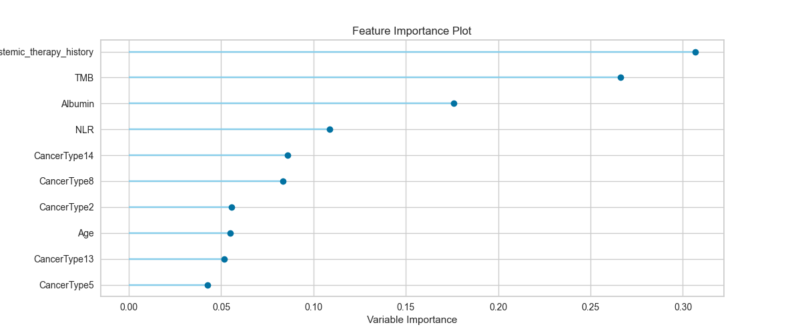
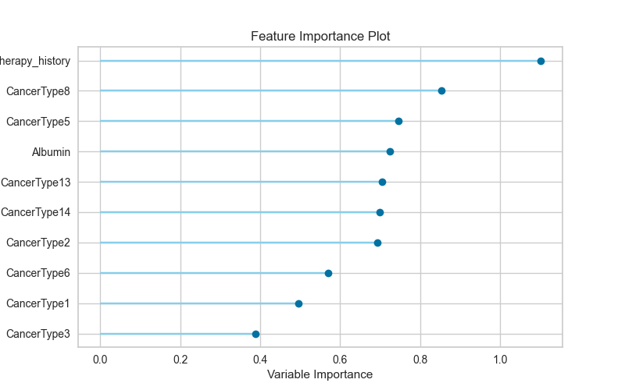
Pycaret
#1
Paper
#2

Slide 4
PAPER DETAILS

Slide 5
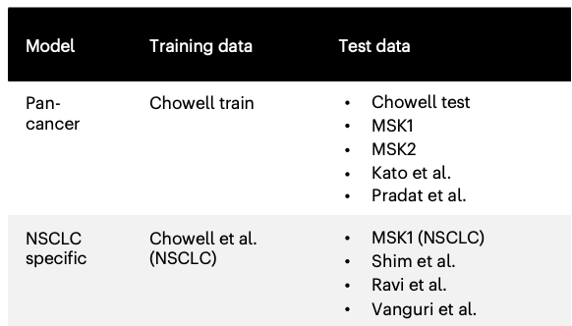
LLR6: the six-feature logistic LASSO regression classifer
- tuned the optimal hyperparameters using fivefold cross-validation on the training set;
- random search approach with the RandomizedSearchCV function
- maximize the AUC scores in a fivefold cross-validation of the training data.
- evaluated using 2,000 repeats of fivefold cross-validation to ensure unbiased results
(equating to 10,000 random training–validation splits in total).
- Combinations of hyperparameters:
solver = ‘saga’,
penalty = ‘elasticnet’,
class_weight = ‘balanced’,
l1_ratio from 0 to 1 (step size 0.1),
max_iter from 100 to 1,000 (step size 100)
C from 10−3 to 103 (logarithmic step size 1).
Optimal combination:
solver = ‘saga’,
penalty = ‘elasticnet’,
max_ iter = 100,
l1_ratio = 1,
class_weight = ‘balanced’
C = 0.1.
Finally, the selected models were further tested on multiple unseen test cohorts.
File 05_5: extracts coefficients and intercept to calculate LORIS

Slide 6
PyCaret Run #1 and #2 details

Slide 7
$ cv = RepeatedKFold(n_splits=5, n_repeats=2000, random_state=42)
$ setup(data=dataChowell_Train, target=phenoNA, session_id=randomSeed, normalize=True, normalize_method='zscore', fold_strategy=cv, use_gpu=True)
$ create_model('lr', penalty='elasticnet', solver='saga', l1_ratio=1, class_weight='balanced', C=0.1)
$ param_grid = {
'solver': ['saga'],
'penalty': ['elasticnet'],
'class_weight': ['balanced'],
'l1_ratio': [i/10.0 for i in range(0, 11)], # l1_ratio from 0 to 1 in steps of 0.1
'max_iter': [i for i in range(100, 1100, 100)], # max_iter from 100 to 1000 in steps of 100
'C': [10**i for i in range(-3, 4)] # C from 10^-3 to 10^3 in logarithmic steps
}
$ tune_model(LLR6_model, optimize='AUC', custom_grid=param_grid)
$ predictions_df = predict_model(tuned_LLR6_model, data=dataChowell_Test)

Slide 8
Create_model()
Fold | Accuracy | AUC | Recall | Prec. | F1 | Kappa | MCC
0 | 0.637 | 0.7184 | 0.6 | 0.4211 | 0.4948 | 0.225 | 0.2336
1 | 0.6815 | 0.7775 | 0.75 | 0.4426 | 0.5567 | 0.333 | 0.3613
2 | 0.6519 | 0.7118 | 0.5682 | 0.4717 | 0.5155 | 0.2474 | 0.25
3 | 0.6741 | 0.6998 | 0.5366 | 0.4681 | 0.5 | 0.2599 | 0.2612
4 | 0.7313 | 0.744 | 0.5833 | 0.5 | 0.5385 | 0.3506 | 0.3526
... | ... | ... | ... | ... | ... | ... | ...
9997 | 0.6889 | 0.7094 | 0.5854 | 0.4898 | 0.5333 | 0.3028 | 0.3055
9998 | 0.7037 | 0.7892 | 0.7368 | 0.4828 | 0.5833 | 0.3686 | 0.3884
9999 | 0.694 | 0.7357 | 0.6304 | 0.5472 | 0.5859 | 0.3452 | 0.3474
Mean | 0.6865 | 0.734 | 0.6297 | 0.4729 | 0.5376 | 0.3079 | 0.3168
Std | 0.0366 | 0.0417 | 0.0766 | 0.0626 | 0.0582 | 0.0764 | 0.078
[10002 rows x 7 columns]
model created: LogisticRegression(C=0.1, class_weight='balanced', dual=False,
fit_intercept=True, intercept_scaling=1, l1_ratio=1,
max_iter=1000, multi_class='auto', n_jobs=None,
penalty='elasticnet', random_state=1, solver='saga',
tol=0.0001, verbose=0, warm_start=False)

Slide 9
Tune_model()
Fold | Accuracy | AUC | Recall | Prec. | F1 | Kappa | MCC
0 | 0.6593 | 0.7171 | 0.575 | 0.4423 | 0.5 | 0.2482 | 0.2531
1 | 0.6889 | 0.7778 | 0.75 | 0.45 | 0.5625 | 0.3438 | 0.3708
2 | 0.637 | 0.7223 | 0.5455 | 0.4528 | 0.4948 | 0.2154 | 0.2177
3 | 0.6815 | 0.7102 | 0.5366 | 0.4783 | 0.5057 | 0.2719 | 0.2729
4 | 0.7388 | 0.7395 | 0.5556 | 0.5128 | 0.5333 | 0.3524 | 0.3529
... | ... | ... | ... | ... | ... | ... | ...
9997 | 0.6741 | 0.7039 | 0.5122 | 0.4667 | 0.4884 | 0.25 | 0.2506
9998 | 0.7037 | 0.7862 | 0.7368 | 0.4828 | 0.5833 | 0.3686 | 0.3884
9999 | 0.709 | 0.7465 | 0.6304 | 0.5686 | 0.5979 | 0.3708 | 0.372
Mean | 0.6887 | 0.7355 | 0.6116 | 0.4748 | 0.532 | 0.3046 | 0.3118
Std | 0.0366 | 0.0415 | 0.0785 | 0.0639 | 0.06 | 0.0784 | 0.0799
[10002 rows x 7 columns]
Done tune: LogisticRegression(C=0.01, class_weight='balanced', dual=False,
fit_intercept=True, intercept_scaling=1, l1_ratio=0.1,
max_iter=1000, multi_class='auto', n_jobs=None,
penalty='elasticnet', random_state=1, solver='saga',

Slide 10
Prediction()
Model | Accuracy | AUC | Recall | Prec. | F1 | Kappa | MCC
Logistic Regression | 0.7165 | 0.6921 | 0.5433 | 0.4395 | 0.4859 | 0.2932 | 0.2963

Slide 11
Run #2
$ setup(data=dataChowell_Train, target=phenoNA, session_id=randomSeed, use_gpu=True)
$ create_model('lr’)
$ tune_model(LLR6_model)
$ predictions_df = predict_model(tuned_LLR6_model, data=dataChowell_Test)

Slide 12
 | Description | Value
0 | Session | id | 1
1 | Target | Response
2 | Target | type | Binary
3 | Original | data | shape | (964, | 22)
4 | Transformed | data | shape | (964, | 22)
5 | Transformed | train | set | shape | (674, | 22)
6 | Transformed | test | set | shape | (290, | 22)
7 | Numeric | features | 21
8 | Preprocess | TRUE
9 | Imputation | type | simple
10 | Numeric | imputation | mean
11 | Categorical | imputation | mode
12 | Fold | Generator | StratifiedKFold
13 | Fold | Number | 10
14 | CPU | Jobs | -1
15 | Use | GPU | TRUE
16 | Log | Experiment | FALSE
17 | Experiment | Name | clf-default-name
18 | USI | 7ed2

Slide 13
Create_Model
Fold | Accuracy | AUC | Recall | Prec. | F1 | Kappa | MCC
0 | 0.7353 | 0.7938 | 0.25 | 0.625 | 0.3571 | 0.2273 | 0.2652
1 | 0.8088 | 0.726 | 0.45 | 0.8182 | 0.5806 | 0.47 | 0.5053
2 | 0.7647 | 0.7083 | 0.35 | 0.7 | 0.4667 | 0.3366 | 0.3699
3 | 0.6912 | 0.725 | 0.3 | 0.4615 | 0.3636 | 0.1717 | 0.1786
4 | 0.7015 | 0.7096 | 0.2 | 0.5 | 0.2857 | 0.1388 | 0.1621
5 | 0.7761 | 0.8734 | 0.4 | 0.7273 | 0.5161 | 0.3861 | 0.4153
6 | 0.6866 | 0.6968 | 0.15 | 0.4286 | 0.2222 | 0.0798 | 0.0971
7 | 0.7761 | 0.7029 | 0.3684 | 0.7 | 0.4828 | 0.357 | 0.387
8 | 0.7015 | 0.7675 | 0.3158 | 0.4615 | 0.375 | 0.1879 | 0.1937
9 | 0.7313 | 0.7193 | 0.2632 | 0.5556 | 0.3571 | 0.2138 | 0.2377
Mean | 0.7373 | 0.7423 | 0.3047 | 0.5978 | 0.4007 | 0.2569 | 0.2812
Std | 0.0402 | 0.0524 | 0.0872 | 0.1281 | 0.1038 | 0.1177 | 0.1248
LogisticRegression(C=1.0, class_weight=None, dual=False, fit_intercept=True,
intercept_scaling=1, l1_ratio=None, max_iter=1000,
multi_class='auto', n_jobs=None, penalty='l2',
random_state=1, solver='lbfgs', tol=0.0001, verbose=0,
warm_start=False)

Slide 14
Tune_model
Fold | Accuracy | AUC | Recall | Prec. | F1 | Kappa | MCC
0 | 0.7353 | 0.801 | 0.25 | 0.625 | 0.3571 | 0.2273 | 0.2652
1 | 0.7941 | 0.7281 | 0.35 | 0.875 | 0.5 | 0.399 | 0.4655
2 | 0.75 | 0.7156 | 0.3 | 0.6667 | 0.4138 | 0.2829 | 0.3193
3 | 0.7059 | 0.6948 | 0.3 | 0.5 | 0.375 | 0.1981 | 0.2092
4 | 0.7164 | 0.7181 | 0.15 | 0.6 | 0.24 | 0.1369 | 0.1871
5 | 0.7761 | 0.8798 | 0.4 | 0.7273 | 0.5161 | 0.3861 | 0.4153
6 | 0.7015 | 0.7138 | 0.1 | 0.5 | 0.1667 | 0.0746 | 0.111
7 | 0.7463 | 0.6842 | 0.2105 | 0.6667 | 0.32 | 0.2129 | 0.2666
8 | 0.7015 | 0.7741 | 0.2632 | 0.4545 | 0.3333 | 0.1583 | 0.1681
9 | 0.7463 | 0.7303 | 0.1579 | 0.75 | 0.2609 | 0.18 | 0.2607
Mean | 0.7373 | 0.744 | 0.2482 | 0.6365 | 0.3483 | 0.2256 | 0.2668
Std | 0.0301 | 0.0561 | 0.0895 | 0.1232 | 0.1047 | 0.0986 | 0.1039
LogisticRegression(C=1.0, class_weight=None, dual=False, fit_intercept=True,
intercept_scaling=1, l1_ratio=None, max_iter=1000,
multi_class='auto', n_jobs=None, penalty='l2',
random_state=1, solver='lbfgs', tol=0.0001, verbose=0,
warm_start=False)

Slide 15
Predict_model
 | Model | Accuracy | AUC | Recall | Prec. | F1 | Kappa | MCC
0 | Logistic | Regression | 0.7631 | 0.6759 | 0.2283 | 0.5472 | 0.3222 | 0.2071 | 0.2362

