Slide 1
EEE320 Lecture 00
DRAFT 0.1
Introduction to Version Control and Configuration Management

Slide 2
What is Version Control?
Why should you care about this?
Version Control is a system that records changes to a file or set of files over time so that you can recall specific versions later.
In this course you will be controlling the versions of source code, however you can do this with any file type.
Notes:
Even the simplest of collaborative projects can become very complex very quickly.
Think of the Software Development Lifecycle. Most of the time in a project is on support and maintenance.
A goal of EEE320 is to teach proper software design (and design patterns) so your code requires the least amount of code refactoring,
however software redesign is a fact of life on larger projects.
Changes have to tracked and managed over time.

Slide 3
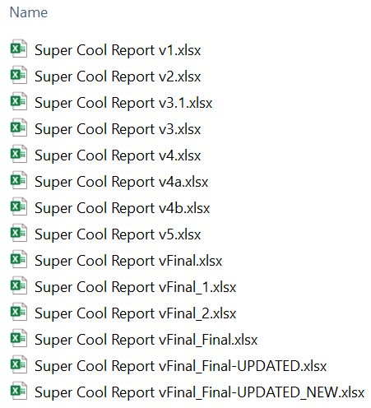
Why is Version Control?
A single source of truth
Costs of management complexity and communication overhead grow as projects grow in code and developers.
A safety net to protect the source code from irreparable harm.
Notes:
Who has ever created a file (an essay, or a design document (image, flyer, etc) that has gone through multiple revisions and multiple people.
Config Management / Version Control solves the problem of controlling the evolution of a software system.
This is something that is in the solution space, not the problem space.
- problem space “give me a program that plays tetris”
- solution space “git allows me to code this problem effectively”

Slide 4
What is Configuration Management?
The process of controlling the evolution of a software system.
Establish Mechanisms to:
Simplify code sharing
Be able to revert to an older version
Coherently integrate contributions from team members
Notify interested parties about new modifications
Track software issues
Create an auditing trail

Slide 5
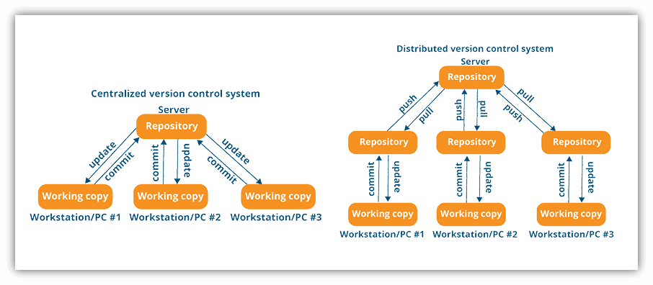
Distributed vs Centralized
Centralized VCS are what older VCS used
Check-outs and check-ins are done with reference to the central repo
Distributed VCS
Each user gets own repo and working copy
After you commit you must push your changes to the central repository
Notes:
Centralized:
What if two or more people want to edit the same file at the same
time?
• Option 1: make them take turns
– But then only one person can be working at any time
–And how do you enforce the rule?
• Option 2: patch up differences afterwards
– Requires a lot of re-working –Stuff always gets lost
Reference:
https://k21academy.com/devops-job-bootcamp/git-overview-workflow-advantages/

Slide 6
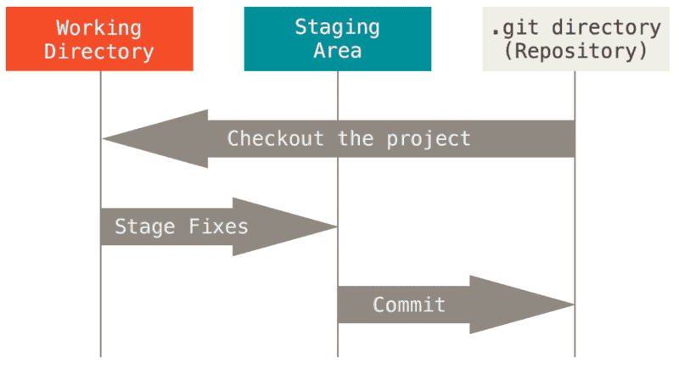
Terminology
Some initial git commands and their meaning
git init: setup a directory as a git repo
git clone <url>: retrieve a repo from a remote URL
git add <file>: add the file to the staging area (your next commit)
git branch <name>: creates a new branch at the current commit
git checkout: switch to another branch and check it out to your working directory
git commit –m “<good message>”: commit your staged content as a new commit
git merge <branch>: merge the specific branch’s history into the current one
Notes:
One of the best cheat sheets on the internet is provided from github.com and will be included with the course notes for this lecture.
https://education.github.com/git-cheat-sheet-education.pdf
It is important to have an understanding of git on the command line. However, the integration in most modern IDEs are really good now. VSCode is awesome.
You need to initialize your directory
You clone to create your repo
You add files to the staging area

Slide 7
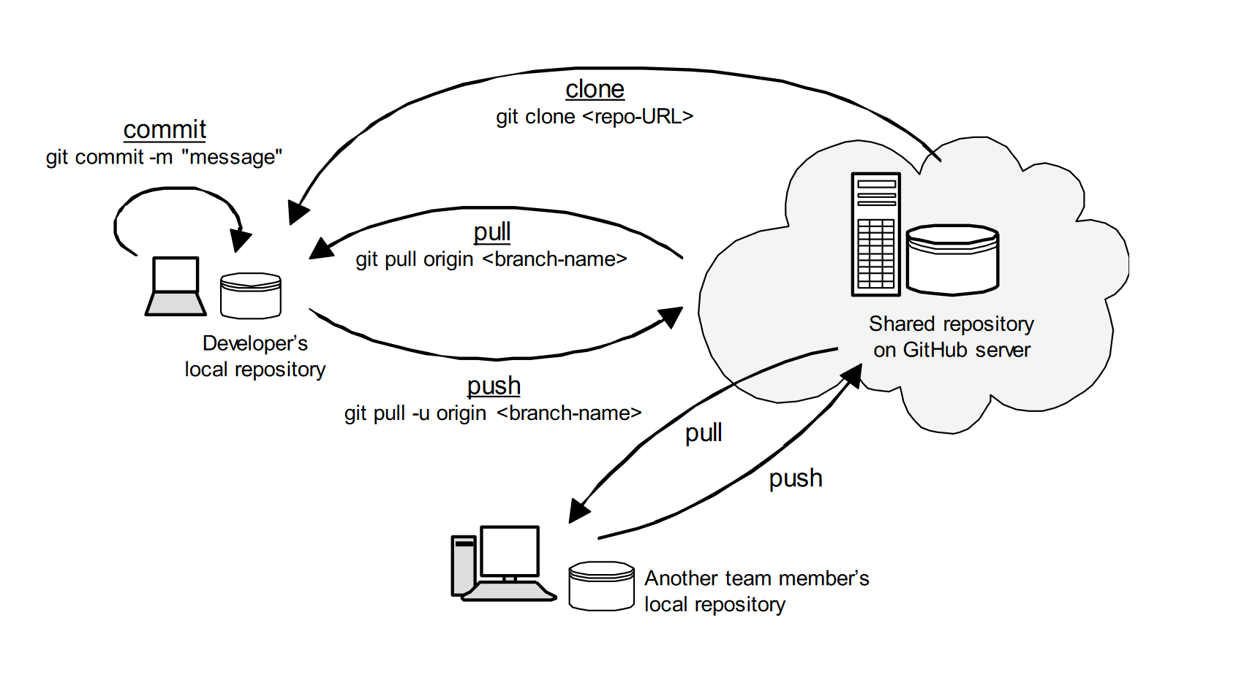

Slide 8
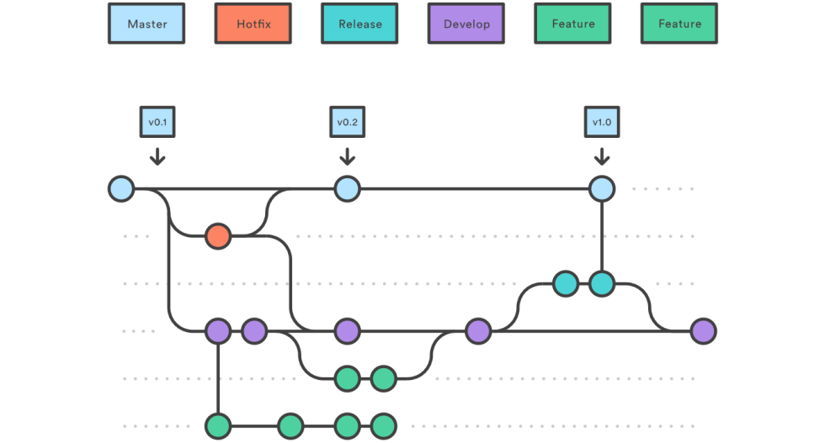
An approach to branching
Best Practice
The master branch is what is in production presently.
Don’t mess with production!
The dev branch contains the essential integrations for the next release.
Dev is merged to master
A feature branch is to create one feature.
A feature is merged with dev when completed.
Hotfixes start on prod.
They are merged with dev and master.
Notes:
You will have a main production branch
Usually called MASTER, sometimes called PROD or PRODUCTION
You’ll have a DEV or DEVELOPMENT BRANCH that contains integrations from the next release
You will create branches off DEV to create a feature. Don’t call it “feature” name the branch “add logging” or “adding1234”

Slide 9
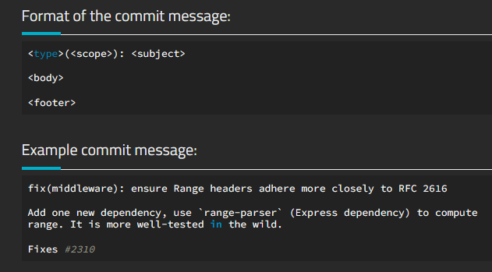
Commit Messages
Best Practice: Conventional Commit
feat: new feature to the user
fix: bug fix for the user
docs: changes to documentation
style: formatting, no prod code change
refactor: e.g. renaming a variable
test: adding, refactoring tests, etc
chore: grunt tasks
Notes:
Good
feat: improve performance with lazy load implementation for images
chore: update npm dependency to latest version
Fix bug preventing users from submitting the subscribe form
Update incorrect client phone number within footer body per client request
Bad
fixed bug on landing page
Changed style
oops
I think I fixed it this time?
empty commit messages
Subject Line is in imperative language: “fix: (webserver): Add fix to improve dark mode text legibility”
Not “added fix or Fixed the dark mode”
The specifics will be dictated by your development shop
The scope can be empty
but you can use (config, web-server, proxy, whatever)
Grunt tasks – (updating libs / dependencies / no major prod change)

Slide 10
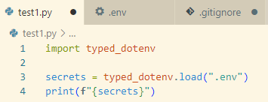
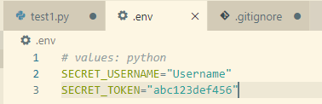
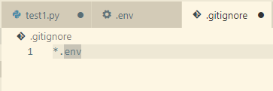
Security
What about information you don’t want to share?
A .gitignore file specifies intentionally untracked files that git should ignore.
#ignore all .log files
*.log
#ignore all files in /temp/ dir
temp/
This is one example to ensure data is not uploaded to your public repo inadvertently.
Notes:
There are literally thousands of pages on securing your git and repos, using encryption, etc.
The example on the slide uses a import of the typed_dotenv library…. What are the security implications of that? (do you trust the import, every import you do is other people’s code )
This course is a design course. Your general rules will be:
Don’t hardcode any usernames / passwords
Use a .gitignore file to make sure the external data isn’t uploaded to your “potentially public” git
2023 No Fly List Hack – initial access was through a git – creds were kept in a git and that was the ballgame

Slide 11
References
Pro Git; Chacon & Stroud https://git-scm.com/book/en/v2
Configuration Management; CSE 362 El Mezouar
How to write better Git commit messages; Pina https://www.freecodecamp.org/news/how-to-write-better-git-commit-messages/
GitHub Git Cheat Sheet; https://education.github.com/git-cheat-sheet-education.pdf

