Slide 1

+++ RAG PROOF-OF-CONCEPT · TECHNICAL OVERVIEW +++
RAG Lab: Six Pipelines, One Benchmark
Six RAG architectures over one shared PDF corpus — hybrid retrieval, DeepEval scoring, and an interactive Vue dashboard.
6 RAG approaches
DeepEval · 100 goldens
Claude + Ollama
FastAPI + Vue 3
AI & SAP Consulting Paul Oesterwitz · June 2026

Slide 2
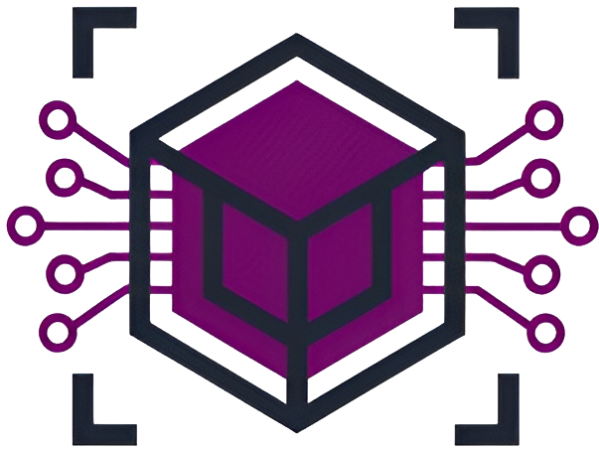
+++ OVERVIEW +++
What I Built
A self-contained lab that compares six RAG architectures on identical data — same corpus, same retriever, only the layer on top changes.
Six pipelines, one corpus
Hybrid retrieval core
Dual LLM backend
Same PDFs, same retriever — only the technique on top changes, so comparisons stay fair.
Dense vectors + BM25, fused — the shared foundation under all six approaches.
Anthropic Claude (cloud) or Ollama (fully local), switched by one env var.
Controlled
Foundation
No lock-in
DeepEval scoring
Interactive Vue app
No external vector DB
100 synthesized goldens, six quality metrics plus five retrieval metrics.
Re-embed, chat with any approach, compare scores live — chunks always quoted.
In-process NumPy cosine + rank-bm25 — runs on a laptop or one A100.
Measured
Transparent
Self-contained
© AI & SAP Consulting Paul Oesterwitz 2026
02

Slide 3
+++ ARCHITECTURE +++
Shared Foundation: Hybrid Retrieval
Index time
Query time
PDFs parsed with PyMuPDF; dynamic chunking on paragraph / heading boundaries (min 120 chars).
Each chunk embedded once — e5-small (384-d) or embeddinggemma (768-d).
Parallel BM25 sparse index built over the same chunks (rank-bm25).
Stored in-process with NumPy + pickle — no Pinecone, Weaviate, or vector server.
Re-embed rebuilds the dense + BM25 indexes together, with a live per-document progress bar.
Embed the query; score every chunk by cosine similarity (dense) and BM25 (sparse).
Fuse the two score lists with a weighted sum (bm25_weight = 0.35).
Take top-k = 5 from a wider candidate pool of 20.
Pass the chunks verbatim to the LLM as numbered, citable sources.
This one retriever powers all six approaches — they differ only in what wraps it.
© AI & SAP Consulting Paul Oesterwitz 2026
03

Slide 4
+++ APPROACHES +++
The Six RAG Approaches
All six share the hybrid retriever above; each adds one distinct technique on top.
Plain Hybrid
+ Reranker
HyDE
Dense + BM25 fusion, nothing else. The clean baseline; strong on single-hop.
Jina v2 cross-encoder re-orders a 20-chunk pool before generation.
LLM drafts a hypothetical answer, then retrieves on its embedding.
Baseline
Best ROI
Query rewrite
Corrective (CRAG)
Agentic
GraphRAG
Grades retrieved docs; if weak, rewrites the query and re-retrieves.
Plans sub-queries, reflects on evidence, loops up to 3 rounds.
Entity knowledge graph + Louvain communities; retrieves by entity links.
Self-checking
Multi-hop
Structural
© AI & SAP Consulting Paul Oesterwitz 2026
04

Slide 5
+++ IMPLEMENTATION +++
How the Advanced Pipelines Work
Query-side augmentation
Multi-step & structural
Reranker — wide recall (20), then a cross-encoder re-scores query + passage jointly. Cascade: Jina v2 → BGE v2 → LLM pointwise.
HyDE — LLM drafts a 4–6 sentence pseudo-answer, embedded as a document vector to close the query-to-answer gap.
Corrective — grades the top-8 (0–1); if fewer than 3 pass 0.5, decomposes into 3 sub-queries, re-retrieves, keeps relevant-only.
All three reuse the same hybrid index — only the query vector or candidate pool changes, never the corpus.
Agentic — plans 2–3 sub-queries, merges and dedupes hits, reflects 'sufficient?', then up to 2 follow-up rounds.
GraphRAG offline — LLM extracts entities + relations per chunk → networkx graph → Louvain communities → LLM summaries.
GraphRAG query — anchors query entities, expands 1-hop, scores 0.6·dense + 0.4·entity-overlap, hybrid backfill if sparse.
Every step is logged to a transparency trace — sub-queries, reflections, graph anchors and community summaries.
© AI & SAP Consulting Paul Oesterwitz 2026
05

Slide 6
+++ EVALUATION +++
Evaluation Harness
Every approach is scored on the same synthesized question set with the same LLM judge.
Goldens auto-synthesized by DeepEval's Synthesizer: 50 single-hop (adjacent same-document chunk pairs) + 50 multi-hop (cross-document pairs via cosine).
Six DeepEval quality metrics: Answer Relevancy, Faithfulness, Contextual Relevancy / Precision / Recall, Correctness (G-Eval) — plus a Composite mean.
Five custom retrieval metrics: gold-chunk hit rate, gold-doc hit rate, avg latency, avg context chars, avg # contexts.
LLM-as-judge via a custom DeepEval wrapper (ClaudeJudge / OllamaJudge) — the same judge across all six approaches.
Results split by golden type and written incrementally to results.json; the dashboard updates live as each approach finishes.
© AI & SAP Consulting Paul Oesterwitz 2026
06

Slide 7
+++ RESULTS +++
Benchmark Results
Approach
Composite
Gold-chunk hit
Single-hop
Multi-hop
RAG + Reranker
0.811
94%
0.826
0.796
Plain Hybrid
0.808
93%
0.816
0.800
HyDE
0.806
93%
0.815
0.798
Agentic RAG
0.802
93%
0.812
0.792
GraphRAG
0.802
92%
0.801
0.803
Corrective RAG
0.801
86%
0.818
0.785
Strong
Partial / Medium
Limited / None
Green leads its column · amber trails the field · red = notable drop. 100 goldens · qwen3.6:35b judge · 768-d embeddings · run locally on one A100.
© AI & SAP Consulting Paul Oesterwitz 2026
07

Slide 8
+++ FINDINGS +++
What the Numbers Say
Reranker wins overall (0.811): the Jina cross-encoder lifts Contextual Precision (+0.02) and G-Eval correctness (+0.024) with no recall loss — best ROI in the lab.
Simple beats complex on single-hop: plain hybrid (0.816) edges agentic; CRAG's grader sometimes discards the gold chunk, dropping its hit rate to 86%.
GraphRAG wins multi-hop (0.803): entity links surface cross-document connections that pure chunk similarity misses.
All six land within 0.010 composite — the hybrid BM25 + dense baseline is strong; question type matters more than pipeline complexity.
Takeaway: add a reranker first; reach for agentic / graph only when questions are genuinely multi-hop.
© AI & SAP Consulting Paul Oesterwitz 2026
08

Slide 9
+++ THE APP +++
Interactive Dashboard & Ops
The whole lab runs from one Vue dashboard and a matching CLI — no notebooks, no manual wiring.
Index & Eval
Chat / Explore
DeepEval Dashboard
Re-embed the corpus, build the graph, synth goldens and run DeepEval — each step with a live progress bar.
Query any approach; see the answer plus every retrieved chunk quoted with score, page range and citation index.
Radar across all metrics, per-metric bars, a summary table, and per-question score drill-down by approach.
Orchestrate
Inspect
Compare
Goldens browser
One-process serving
CLI + guardrails
Browse the synthesized eval set — question, expected answer, source document and the exact gold chunks.
A single FastAPI process serves the built Vue app at / and the API at /api — nothing else to deploy.
Mirror CLI (embed · graph · synth · eval · all · status) and a per-model token-bucket rate limiter.
Verify
Deploy
Operate
© AI & SAP Consulting Paul Oesterwitz 2026
09

Slide 10
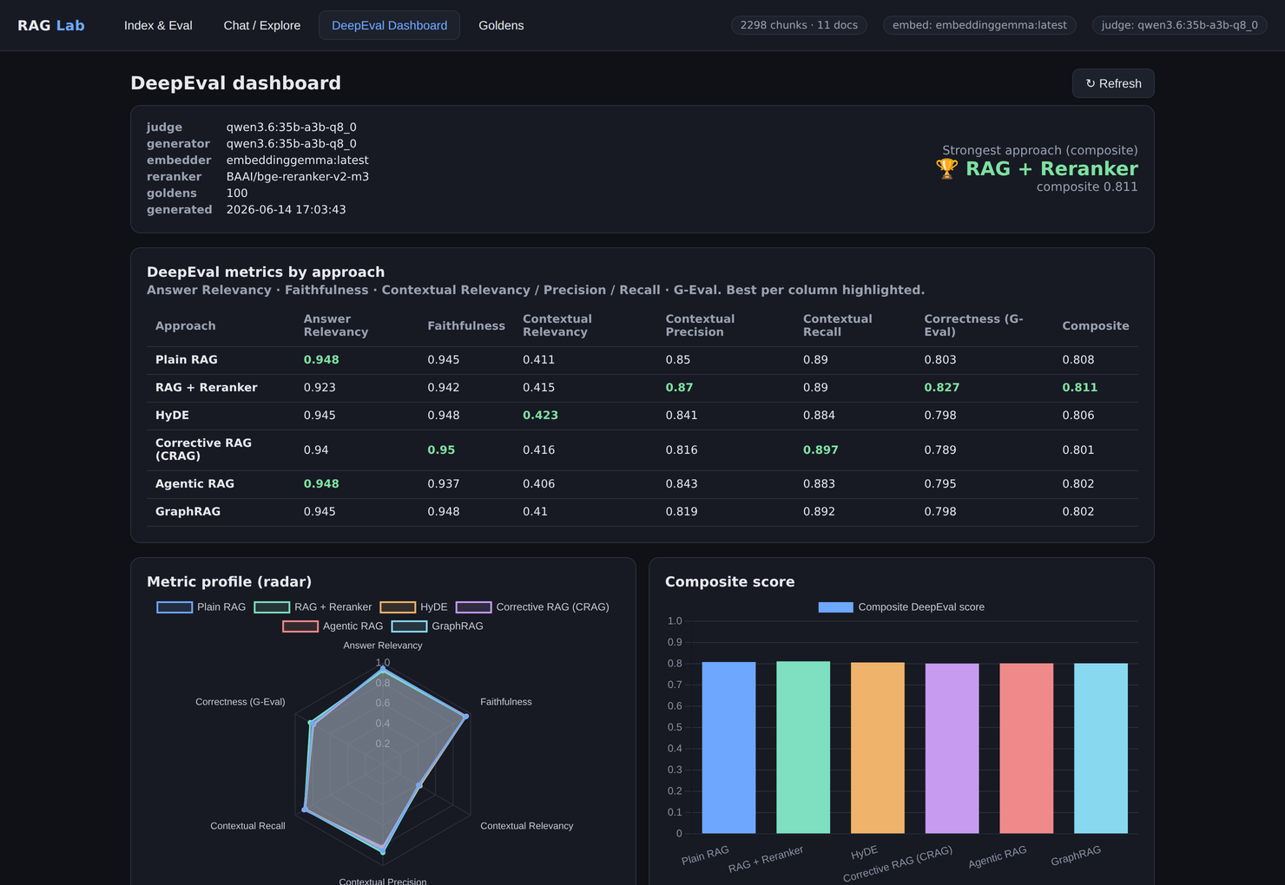
+++ USER INTERFACE +++
Inside the Vue App
■ Tab bar — Index & Eval · Chat / Explore · DeepEval Dashboard · Goldens.
■ Winner badge — highest composite score (RAG + Reranker).
■ Metric table — 6 approaches × 6 DeepEval metrics, best-in-column highlighted.
■ Metric-profile radar — every approach overlaid on one spider plot.
■ Composite bars — side-by-side score comparison across approaches.
© AI & SAP Consulting Paul Oesterwitz 2026
10
The DeepEval Dashboard — one of the app's four tabs.

Slide 11
From PoC to Production RAG
Six architectures, one honest benchmark — so the pipeline you ship is the one your data actually rewards.
Let's bring evaluated, production-grade RAG to your SAP landscape.
oesterwitz-consulting.de · linkedin.com/in/paul-oesterwitz-078a1a68
© AI & SAP Consulting Paul Oesterwitz 2026
11

