Slide 1
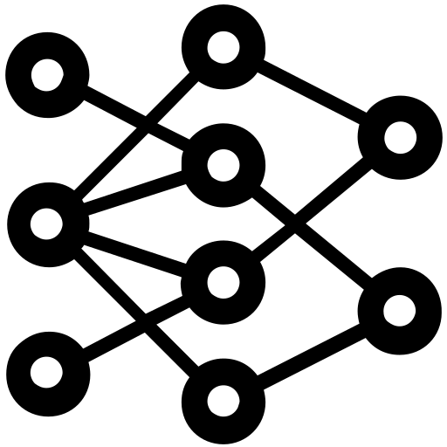



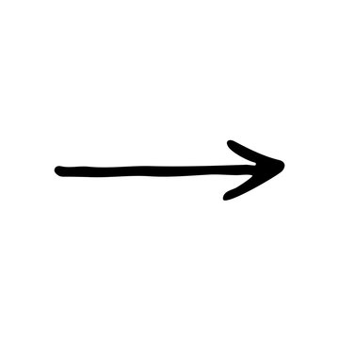


User with
webcam
Pre-Trained model
Prediction
Captures
photo
Results
Screenshot
Image from webcam
Frontend
Predictions
results
API

Slide 2
Betweenness centrality

