Slide 1
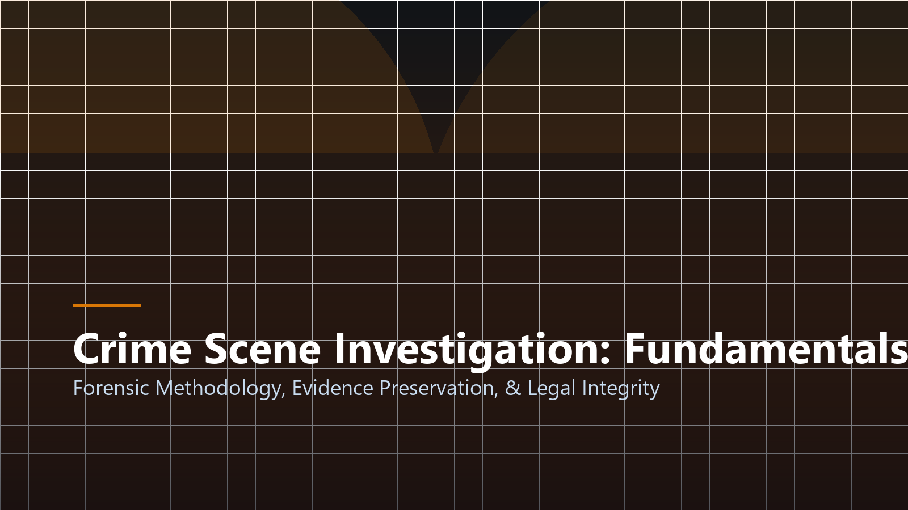
CRIMINOLOGY & FORENSIC SCIENCE
Crime Scene Investigation
Forensic Methodology, Evidence Preservation, and Legal Chain of Custody
Presenter: Jhon Paulo Gascon • STI West Negros University
Notes:
Good morning class. Today we examine the core scientific and procedural foundations of Crime Scene Investigation. Our focus centers on evidence preservation, meticulous documentation, and courtroom admissibility.

Slide 2

FOUNDATIONAL LAW
Locard's Exchange Principle
Every Contact Leaves a Trace
Pioneered by Dr. Edmond Locard: physical contact between two surfaces results in cross-transfer of physical evidence.
Mutual Material Transfer
The perpetrator leaves traces (fibers, DNA, toolmarks) while carrying away elements of the scene.
Scientific Infallibility
Physical evidence cannot commit perjury; it can only be misunderstood, contaminated, or improperly handled.
Notes:
As Dr. Locard established: 'Wherever he steps, whatever he touches, whatever he leaves, will serve as a silent witness against him.' Our sacred duty is to preserve those microscopic traces without contamination.

Slide 3
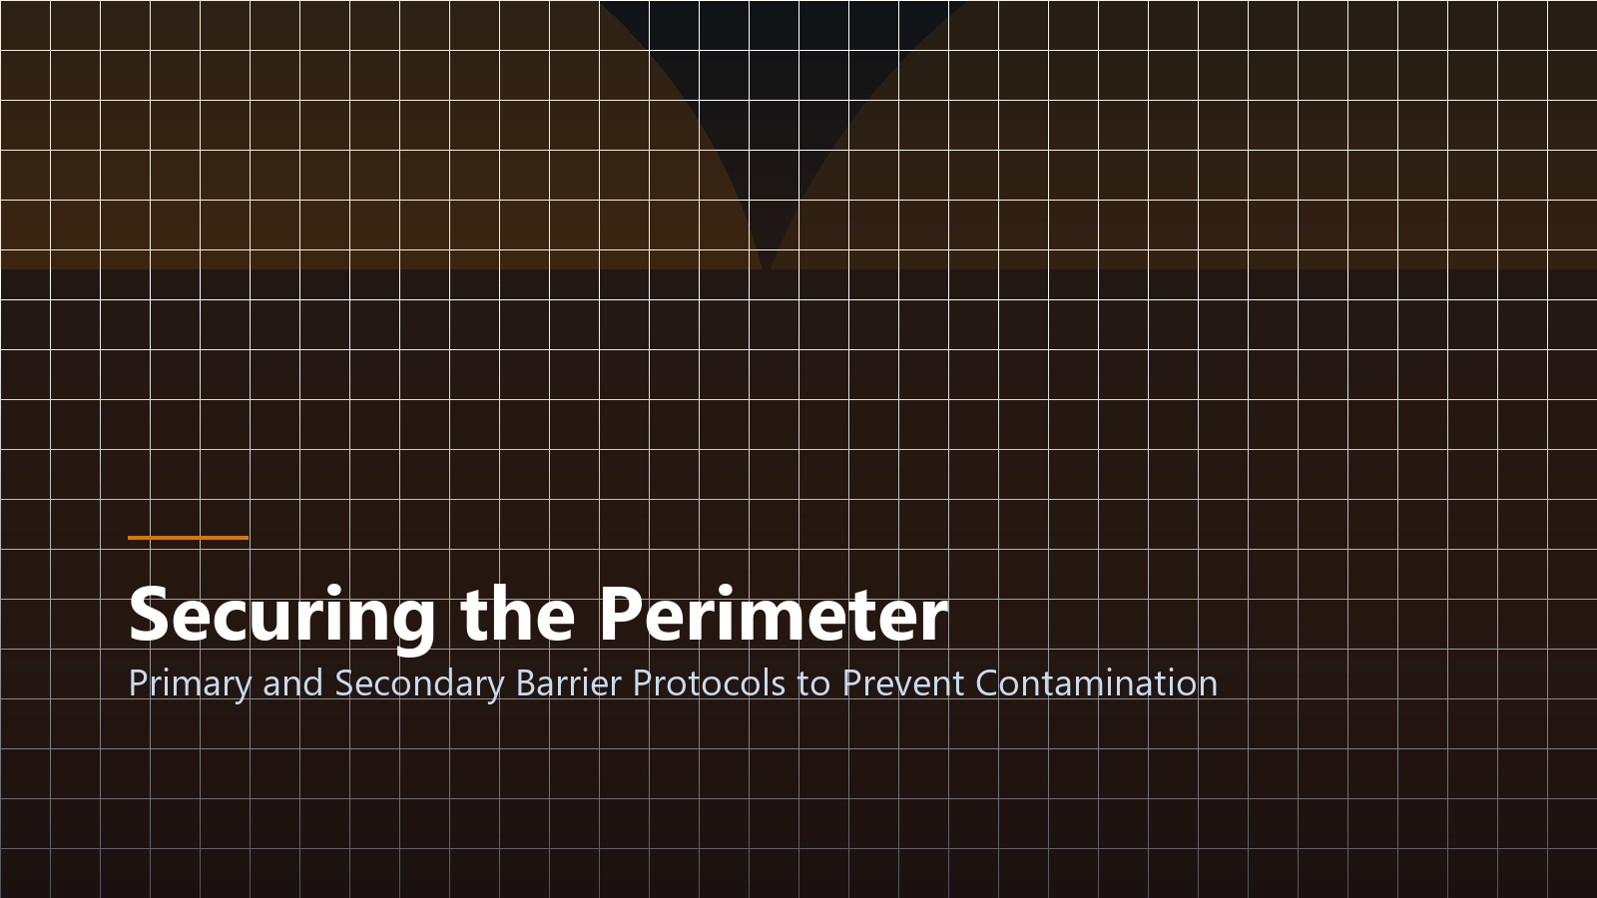
Securing the Scene & Perimeter
Primary & Secondary Barrier Protocols to Prevent Contamination
Notes:
The initial response dictates the ultimate success of prosecution. Securing the physical perimeter prevents contamination by curious bystanders, media, and unauthorized personnel.

Slide 4

PROCEDURAL STANDARDS
Forensic Scene Documentation
Panoramic to Macro Photography
Capture overall establishing shots, mid-range contextual photos, and close-up views with metric scale rulers.
Rough & Final Sketches
Triangulation and baseline coordinate measurements linking key evidence to permanent architectural fixtures.
Audio & Written Logs
Detailed contemporaneous notes documenting time of entry, atmospheric conditions, and initial witness observations.
Notes:
Documentation must occur prior to disturbing a single artifact. If an item is moved before it is photographed with a scale, its legal probative weight in court is severely jeopardized.

Slide 5
SEARCH METHODOLOGY
Four Standard Search Patterns
1. Strip / Line Search
Investigators walk parallel paths in a straight line; ideal for large open outdoor fields and expansive terrains.
2. Grid Search
Two perpendicular strip searches offering thorough dual-coverage across complex indoor or vegetative areas.
3. Spiral Search (Inward/Outward)
Path spirals toward or away from the central focus; effective in localized rooms with clear focal epicenters.
Notes:
Choosing the correct search pattern depends on the physical geography of the scene. A grid search provides the highest redundancy and minimizes the likelihood of overlooking minute trace fibers.

Slide 6
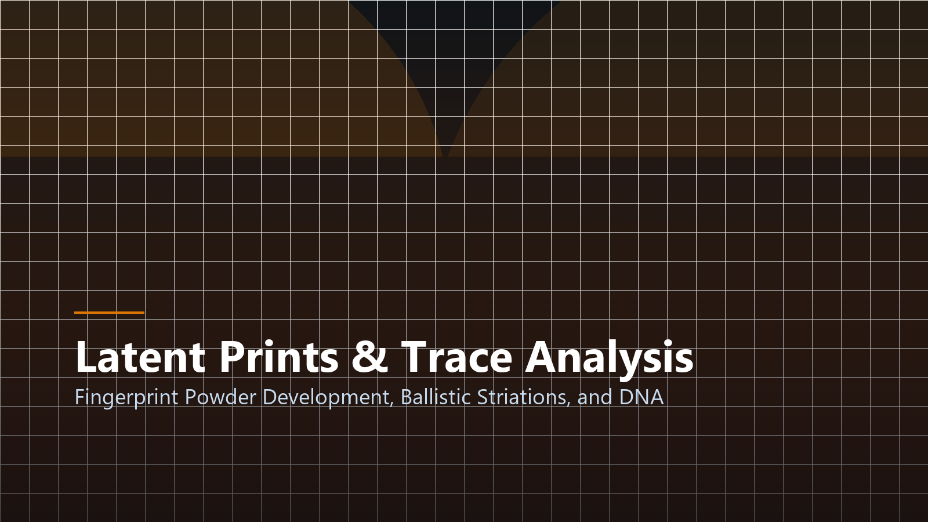
COLLECTION PROTOCOLS
Physical & Biological Evidence
Biological Fluids (Blood/DNA)
Air-dried before packaging in breathable paper bags to prevent anaerobic fungal degradation.
Trace Evidence (Fibers/Paint)
Sealed in druggist folds and rigid containers to prevent cross-contamination.
Ballistics & Firearms
Firearms unloaded with chamber cleared; bullets wrapped in cotton to protect rifling striations.
Notes:
Biological evidence requires strict handling. Never seal wet bloodstains in plastic bags; moisture fosters mold growth that degrades DNA. All biological items must be air-dried and stored in paper containers.

Slide 7

Strict Chain of Custody
Preserving Unbroken Accountability from Scene to Courtroom
Notes:
An unbroken chain of custody is the absolute lifeblood of criminal prosecution. Any gap in the custody record can result in vital evidence being declared legally inadmissible.

Slide 8

CHAIN OF CUSTODY
Evidence Tagging & Custody Records
Tamper-Evident Evidence Seals
Custody labels signed across tape seams; any peel attempt creates visible voids.
Comprehensive Transfer Receipts
Exact log recording date, time, releasing officer, receiving technician, and specific analysis requested.
Secure Evidence Locker Vaults
Climate-controlled, biometric-logged storage preventing unauthorized access or spoliation.
Notes:
Every individual who touches an item of evidence must sign the custody receipt. From the discovering patrolman to the forensic chemist, every transfer must be documented with absolute precision.

Slide 9
JUDICIAL SCRUTINY
Three Grounds for Evidence Inadmissibility
1. Unlawful Search (Warrantless)
Evidence obtained in violation of Sec. 2, Art. III of the 1987 Constitution falls under the Exclusionary Rule.
2. Contamination / Spoliation
Failure to wear protective PPE resulting in investigator DNA being introduced into biological samples.
3. Broken Chain of Custody
Inability to account for custody during transfer intervals creates reasonable doubt regarding tampering.
Notes:
Defense attorneys vigorously attack gaps in the chain of custody. If the prosecution cannot prove where a knife was stored for 48 hours, the court may exclude it entirely.

Slide 10
PROFESSIONAL PRINCIPLES
Essential Takeaways for Forensic Students
Scientific Objectivity
Investigators gather objective facts without bias, regardless of public pressure or premature suspect theories.
Meticulous Precision
Treat every millimeter of a crime scene as vital historical testimony waiting to be interpreted.
Ethical Integrity
The pursuit of justice requires uncompromising adherence to statutory law, human rights, and forensic rigor.
Notes:
In conclusion, a forensic investigator is a seeker of truth. By combining scientific precision with ethical integrity, you ensure that the innocent are vindicated and the guilty held accountable.

Slide 11
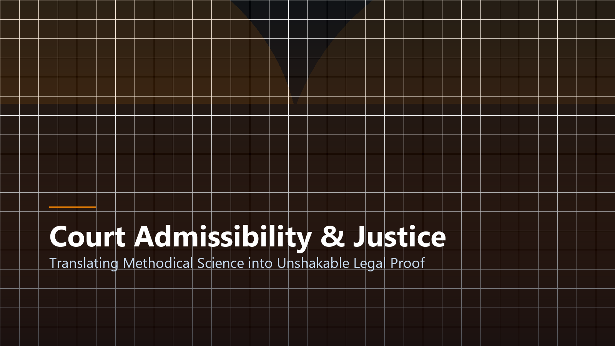
Forensic Excellence in the Pursuit of Justice
Where Science Meets the Law to Protect Human Rights
Image & Academic Credits:
• Visual Assets: Custom 3D renders & high-res vector graphics.
• Research Citations: APA 7th academic standards.
• STI West Negros University • BSIT Program 2026–2027
Notes:
Thank you class. Methodical science protects the integrity of our judicial system. Review your procedural manuals for our upcoming laboratory practical on evidence collection.

