Slide 1
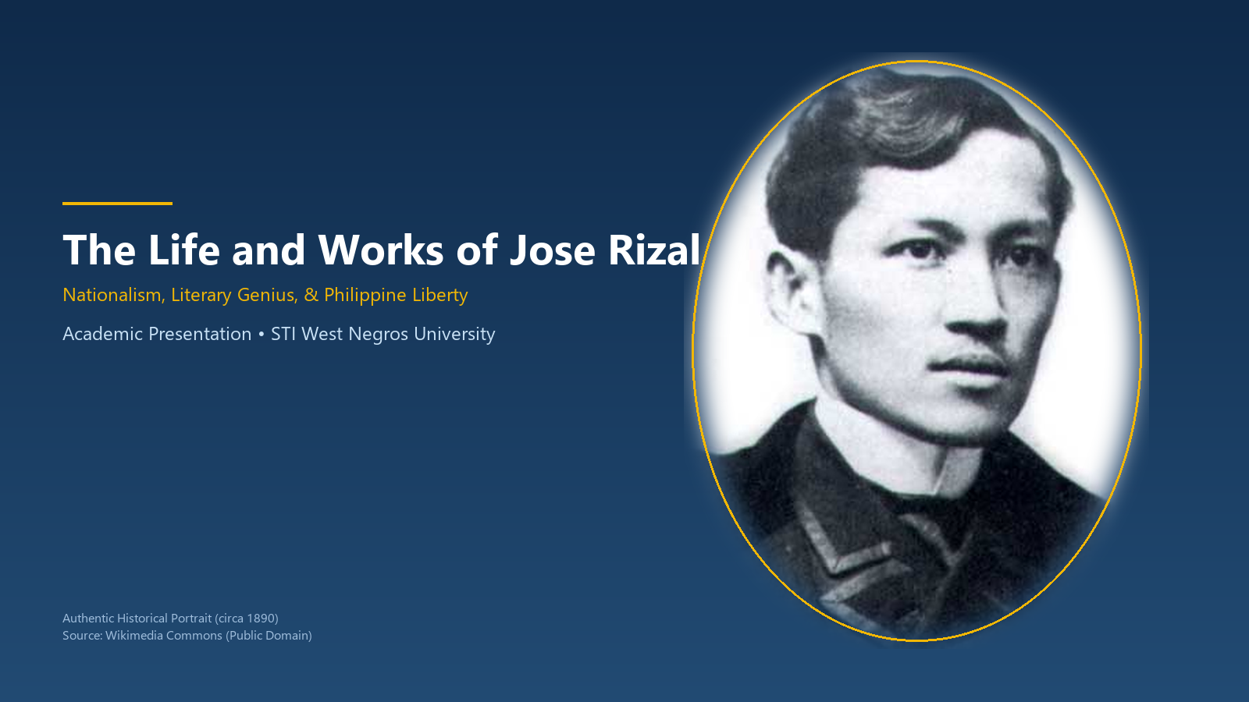
PHILIPPINE HISTORY & GOVERNANCE
The Life and Works of Jose Rizal
Nationalism, Literary Genius, and the Awakening of the Filipino Consciousness
Presenter: Jhon Paulo Gascon • STI West Negros University
Notes:
Magandang araw. Today we explore the extraordinary life, literary masterpieces, and enduring patriotic legacy of Dr. Jose Protacio Rizal Mercado y Alonso Realonda.

Slide 2
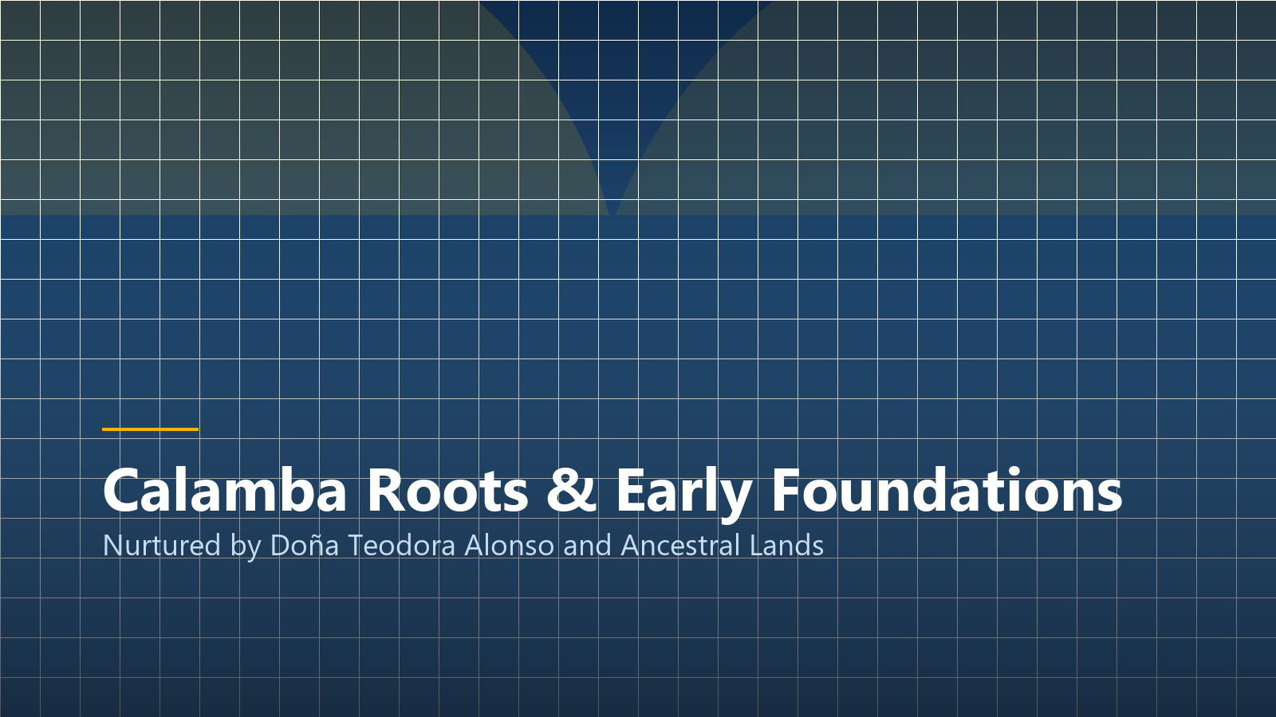
FORMATIVE YEARS
Calamba Roots & Early Foundations
Nurtured by Doña Teodora
Rizal's mother served as his first teacher, instilling love for literature and moral courage through the Parable of the Moth.
Ancestral Agrarian Heritage
Growing up in prosperous Calamba exposed Rizal to agrarian disputes between tenant farmers and the Dominican hacienda.
The Martyrdom of GOMBURZA
The tragic 1872 execution of Fathers Gomez, Burgos, and Zamora profoundly awakened young Rizal's national consciousness.
Notes:
Rizal's intellect was fostered in Calamba. The unjust execution of Gomburza in 1872, when Rizal was just eleven years old, dedicated his life to avenging the victims of colonial injustice.

Slide 3
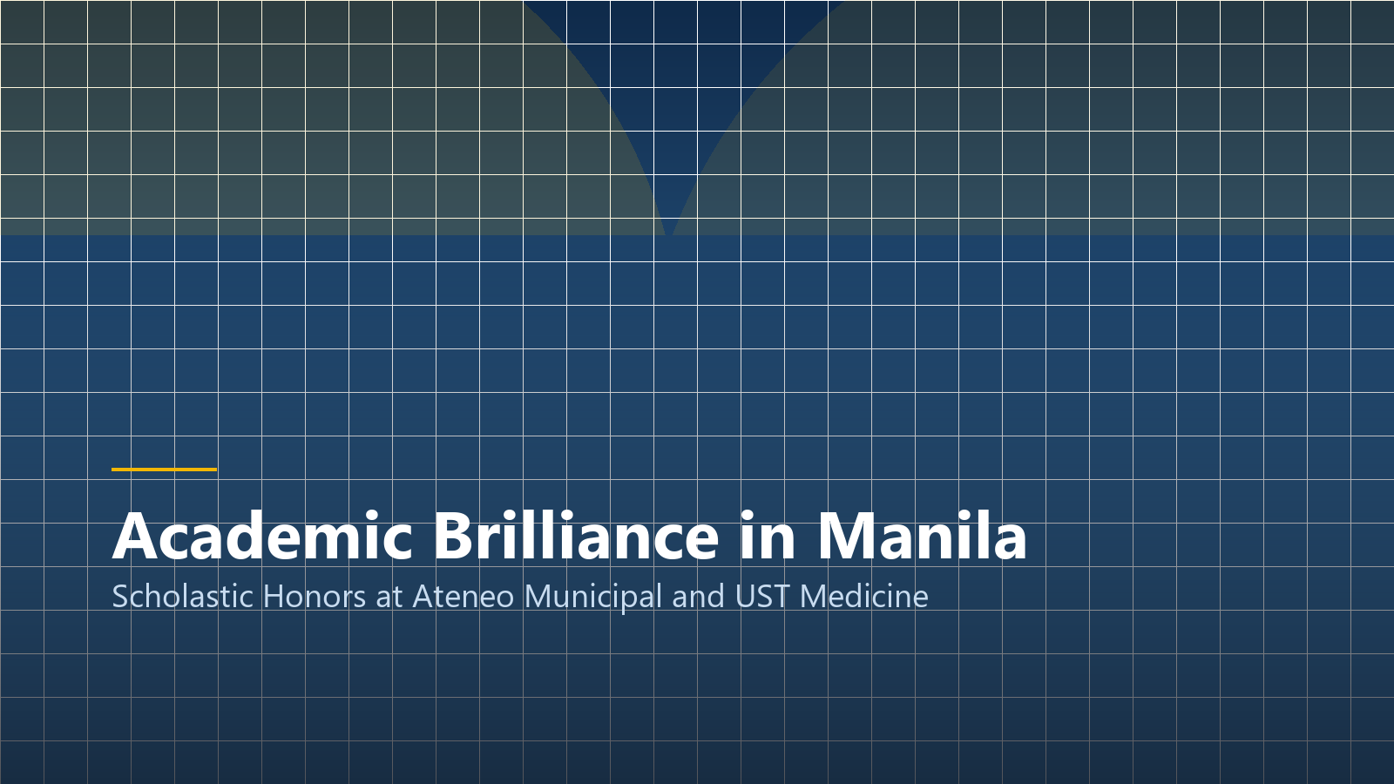
Scholastic Brilliance in Manila
Distinction at Ateneo Municipal & Medical Studies at UST
Notes:
Rizal's academic journey took him to Ateneo Municipal where he graduated with highest honors, followed by medical studies at the University of Santo Tomas.

Slide 4
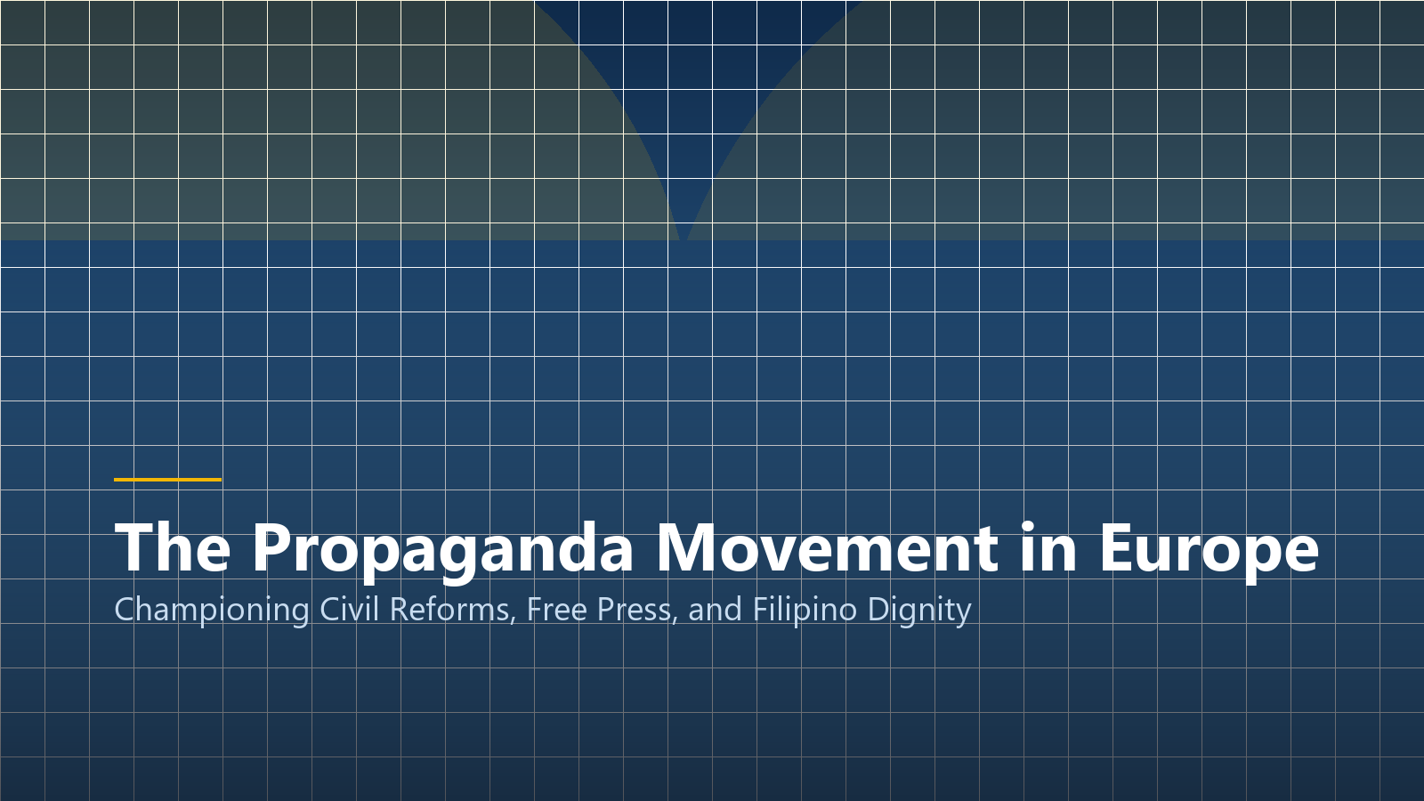
EXILE & ADVOCACY
The Propaganda Movement in Europe
Writing for La Solidaridad
Together with Marcelo H. del Pilar and Graciano Lopez Jaena, Rizal campaigned for peaceful reforms and representation in the Spanish Cortes.
Annotations of Morga's Sucesos
Rizal painstakingly transcribed Antonio de Morga's 1609 work in London to prove that pre-colonial Filipinos possessed rich civilization.
Polymathic Pursuits
Mastered over 22 languages while specializing in ophthalmology under Dr. Louis de Wecker in Paris.
Notes:
In Europe, Rizal proved Filipino equality through intellectual rigor. His annotations of Morga's history destroyed the colonial myth that the Philippines was uncivilized prior to Spanish arrival.

Slide 5
REFORM OBJECTIVES
Three Foundations of the Propaganda Movement
1. Equality Before the Law
Demanding that native Filipinos enjoy identical civil liberties, legal protections, and due process as peninsulares.
2. Representation in Cortes
Securing parliamentary representation in Madrid to articulate Philippine economic and social grievances.
3. Secularization of Parishes
Ending monastic abuse and transferring parish administration to qualified Filipino secular priests.
Notes:
These three demands formed the bedrock of the peaceful reform movement, demonstrating Rizal's belief in legal enlightenment before armed struggle.

Slide 6
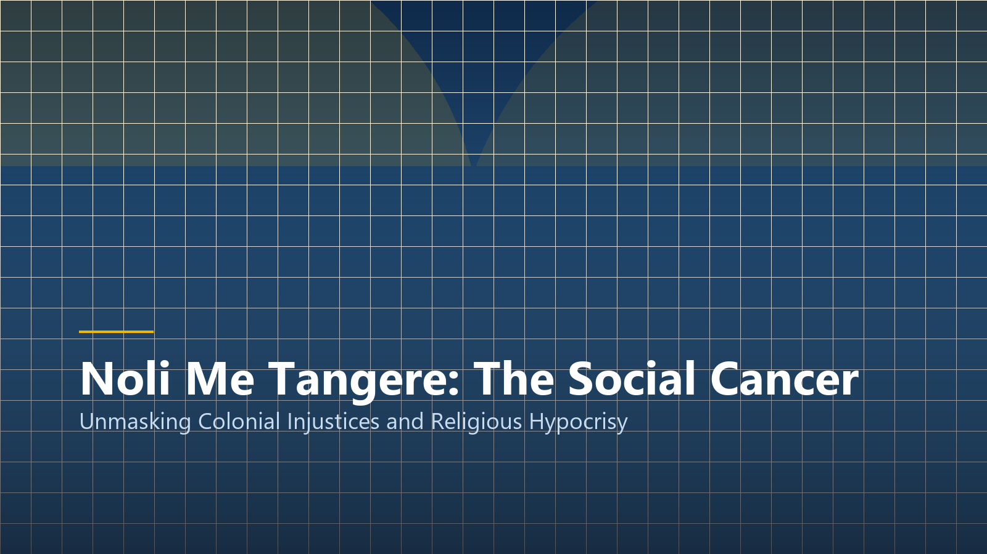
LITERARY MASTERPIECE
Noli Me Tangere: The Social Cancer
Published in Berlin (1887)
Funded through the crucial financial assistance of his dear friend Dr. Maximo Viola.
Diagnosing Colonial Affliction
Through characters like Crisostomo Ibarra, Maria Clara, and Padre Damaso, Rizal unmasked clerical abuse and colonial hypocrisy.
The Awakening of Elias
Introduced the voice of the oppressed masses who demanded radical liberation from systemic tyranny.
Notes:
Noli Me Tangere was a literary bombshell. By diagnosing the social cancer of the colony, Rizal forced Spaniards and Filipinos alike to confront the realities of oppression.

Slide 7
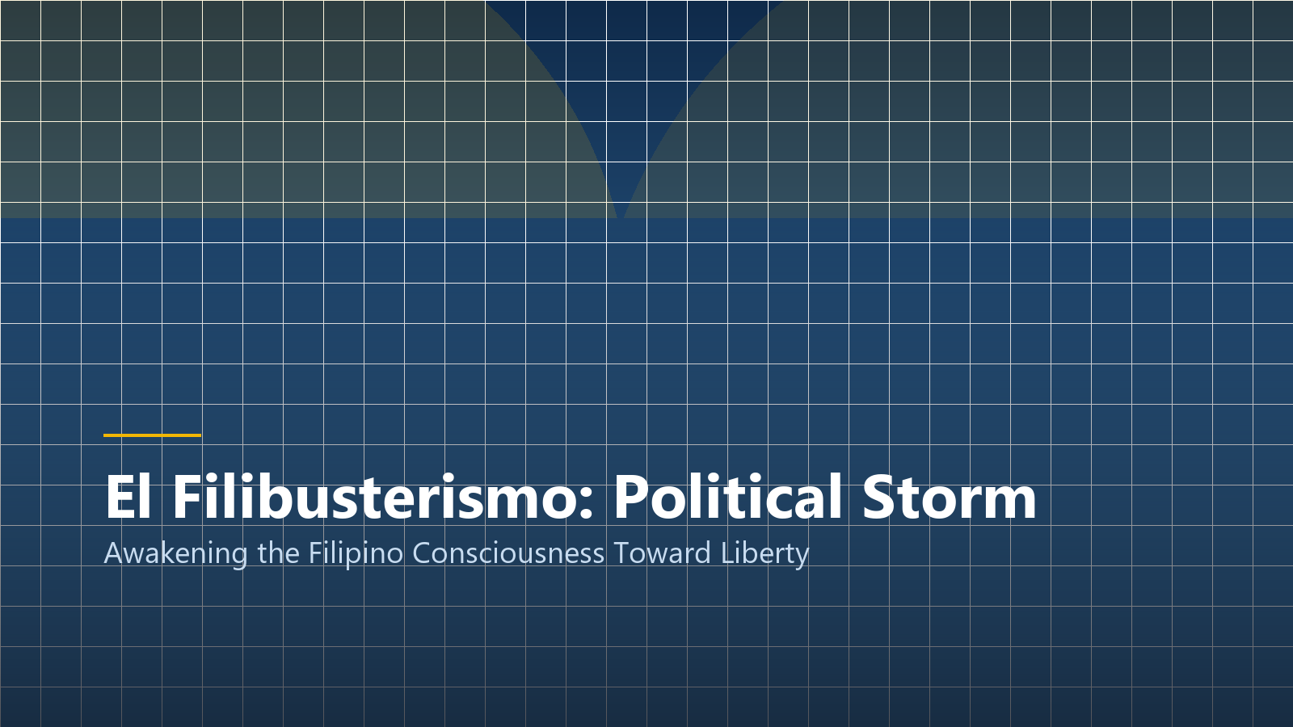
El Filibusterismo: The Subversive
Ghent (1891): Simoun and the Approaching Revolutionary Tempest
Notes:
Four years later, Rizal published El Filibusterismo in Ghent, Belgium, aided by Valentin Ventura. The tone shifts from romantic idealism to dark revolutionary reckoning.

Slide 8
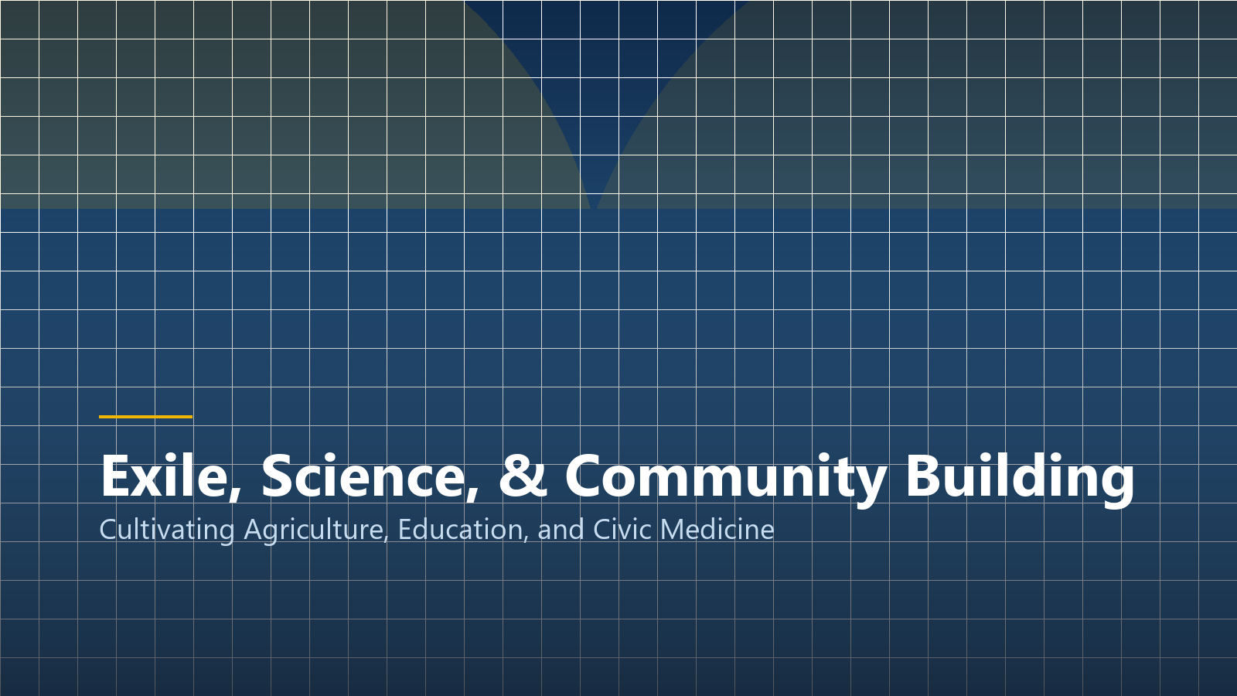
CIVIC LEADERSHIP
Exile, Science, & Community in Dapitan
Civic Engineer & Educator
Constructed a town waterworks system, established a school for local youth, and introduced modern agriculture.
Biological Discoveries
Collected rare specimens, discovering Draco rizali (flying lizard) and Apogonia rizali (beetle).
Model Community Development
Demonstrated that true nation-building starts with grassroots public health, education, and economic cooperatives.
Notes:
During his four-year exile in Dapitan, Rizal exemplified practical patriotism. He did not languish in despair; he built schools, water systems, and treated impoverished patients for free.

Slide 9
MODERN RELEVANCE
Core Lessons from Rizal for BSIT Students
1. Excellence in Craft
Rizal dedicated himself to world-class mastery in medicine, writing, and linguistics. We must bring equal dedication to technology.
2. Civic Tech Innovation
Using digital tools to solve tangible community problems, echoing Rizal's hydraulic engineering in Dapitan.
3. Ethical Responsibility
Recognizing that technological expertise carries a patriotic duty to defend truth, privacy, and social equity.
Notes:
Rizal's life reminds modern IT students that technical skill without moral courage and civic devotion is empty. We are called to be digital builders for the nation.

Slide 10
TIMELINE
Historical Chronology & Milestones
1861 – Birth in Calamba
Born on June 19, 1861, the seventh child of Francisco Mercado and Teodora Alonso.
1887 – Publication of Noli
Berlin printing initiates the irreversible intellectual awakening of the Philippine archipelago.
1896 – Martyrdom at Bagumbayan
Executed on December 30, 1896; his death ignited the ultimate triumph of the Philippine Revolution.
Notes:
This chronology traces Rizal's 35 years of purposeful life. His martyrdom sealed the fate of the Spanish empire in Asia and catalyzed the birth of the first democratic republic in the region.

Slide 11
The Immortal Legacy of Jose Rizal
The Youth is the Hope of the Fatherland
Image & Academic Credits:
• Visual Assets: Custom 3D renders & high-res vector graphics.
• Research Citations: APA 7th academic standards.
• STI West Negros University • BSIT Program 2026–2027
Notes:
Rizal left us with the immortal charge: 'Where is the youth who will consecrate their golden hours to the welfare of their native land?' As STI students, let us honor that call.

