Slide 1
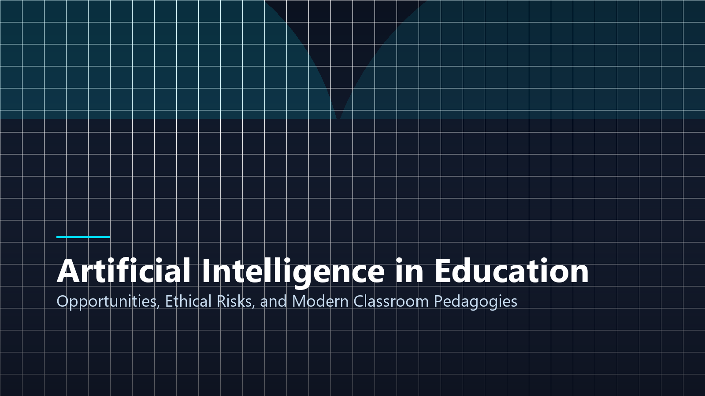
EDUCATIONAL TECHNOLOGY
Artificial Intelligence in Education
Opportunities, Ethical Risks, and Modern Pedagogies
Presenter: Jhon Paulo Gascon • STI West Negros University
Notes:
Welcome everyone. Today we analyze the profound impact of Artificial Intelligence in collegiate classrooms. Our objective is to evaluate how adaptive AI tutors accelerate mastery, while addressing critical ethical concerns regarding academic integrity and algorithmic bias.

Slide 2
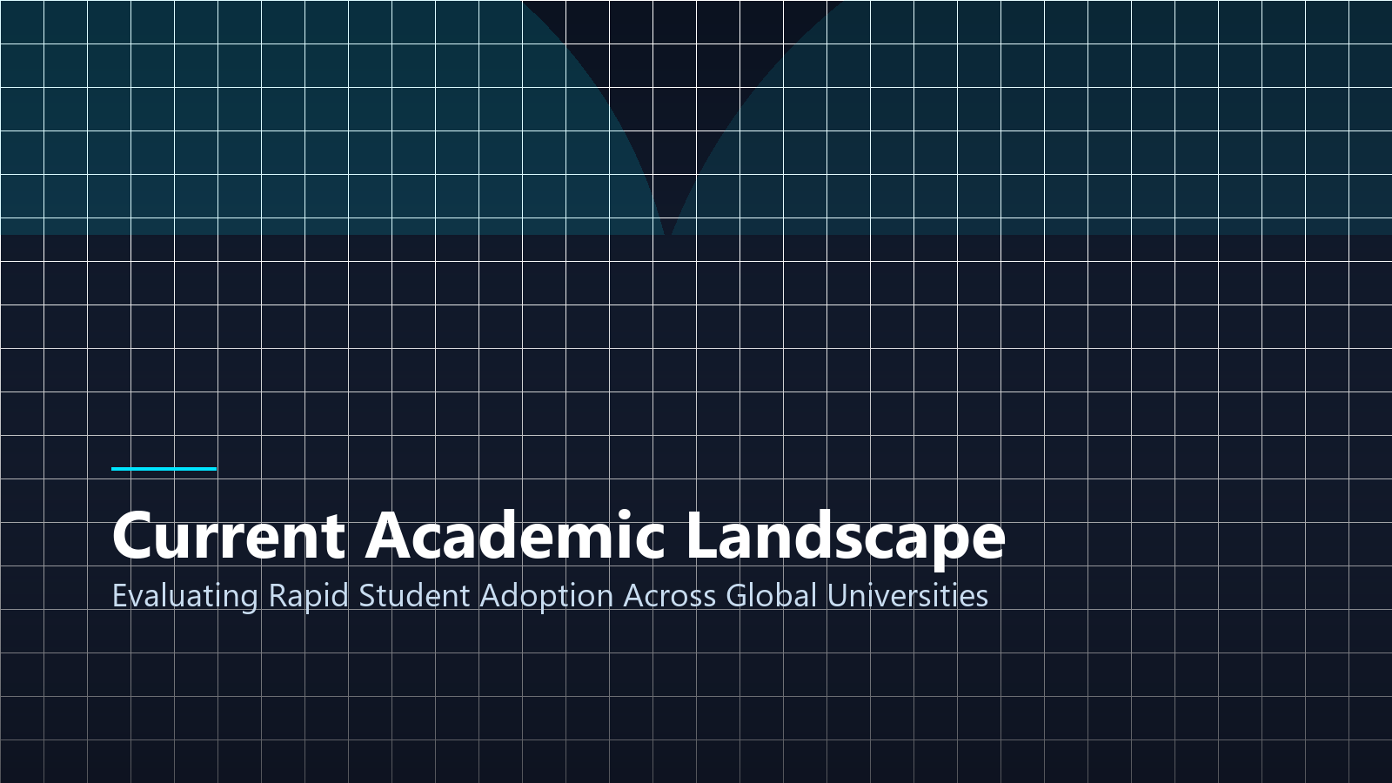
ACADEMIC CONTEXT
The Modern Classroom Landscape
Rapid Collegiate Adoption
Over 78% of undergraduate students leverage large language models for conceptual synthesis.
Shift from Rote to Evaluation
Educational paradigms are transitioning from memorizing facts to critically evaluating AI outputs.
Faculty Integration Challenges
Institutions face the urgent imperative to establish coherent, transparent AI classroom syllabi.
Notes:
As shown on the screen, AI adoption among students is unprecedented. Over three-quarters of college students actively use AI assistance. Faculty must therefore redesign assessments to evaluate critical synthesis rather than simple regurgitation.

Slide 3
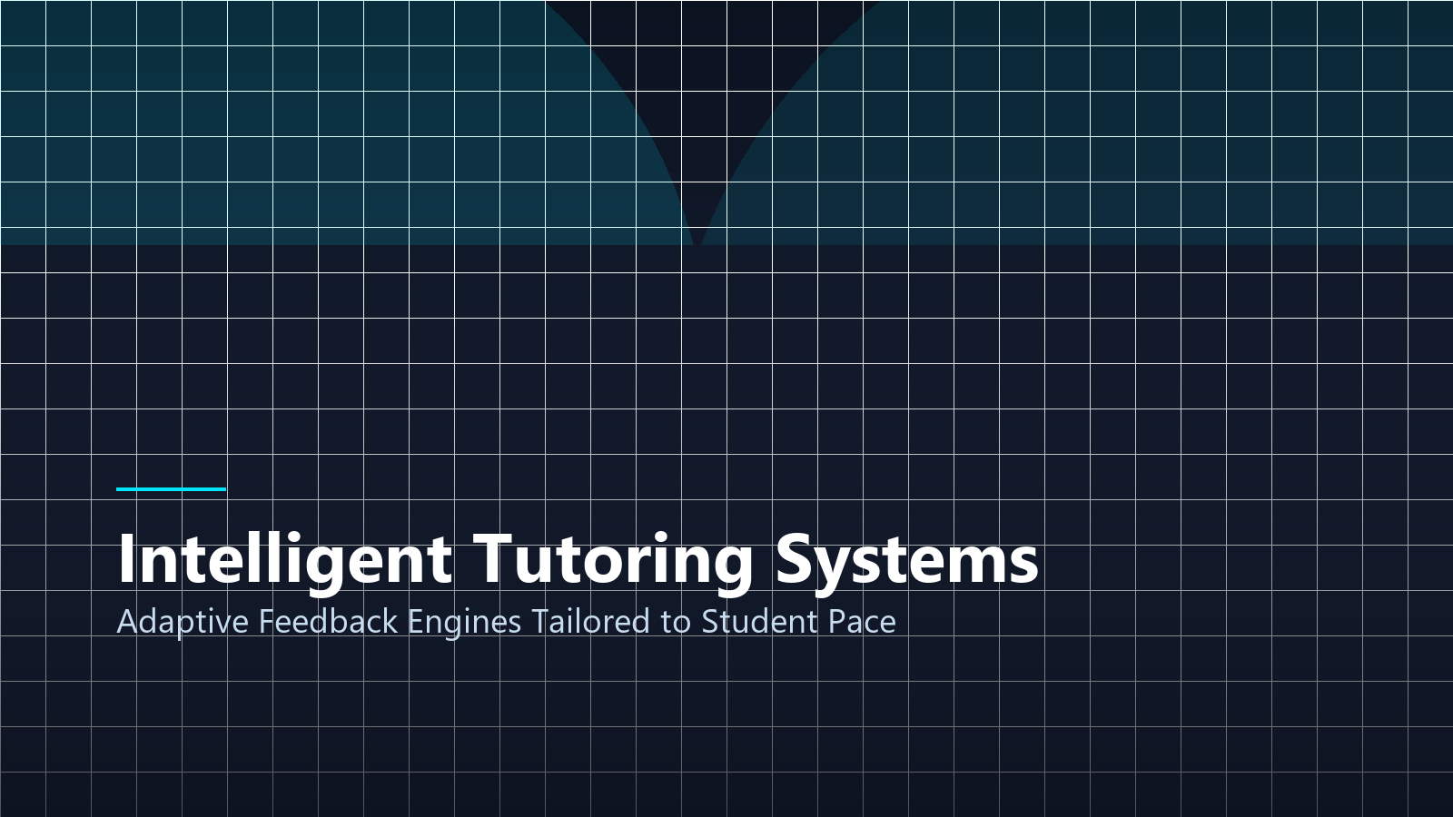
Intelligent Tutoring Systems
Transforming One-Way Lectures into 24/7 Adaptive Mentorship
Notes:
Moving to our first major pillar: Intelligent Tutoring Systems. Rather than passive textbook reading, students can now interact with conversational AI agents that adapt dynamically to their specific learning pace.

Slide 4
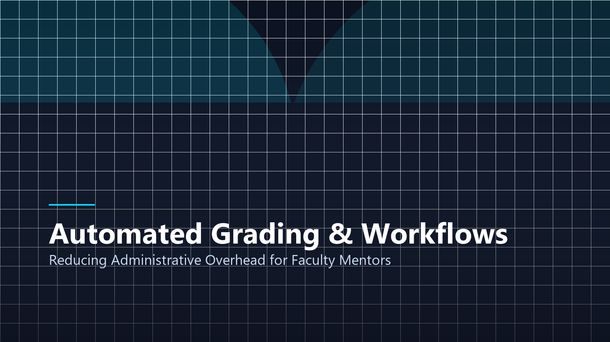
PEDAGOGICAL BENEFITS
Adaptive Feedback Mechanisms
Personalized Learning Cadence
AI models detect cognitive misconceptions and tailor practice problems in real time.
Instantaneous Code Debugging
For BSIT students, automated syntax checkers explain logic bugs line-by-line.
Continuous Formative Feedback
Low-stakes continuous self-assessments replace high-anxiety cram sessions.
Notes:
Adaptive feedback provides immediate diagnostic explanations. When a student struggles with a programming concept like recursion, the tutor generates tailored analogies until cognitive comprehension is achieved.

Slide 5
PEDAGOGICAL LEVERS
Three Core Academic Opportunities
1. Personalized Tutoring
Customized pacing and adaptive scaffolds designed around individual student neurodiversity and aptitude.
2. Faculty Workflow Automation
Automated routine grading of quizzes and diagnostic reports, liberating teachers for direct 1-on-1 mentorship.
3. Multilingual Accessibility
Real-time speech-to-text, dialect translation, and assistive reading engines for equitable classroom access.
Notes:
These three core levers demonstrate that AI serves to augment, not displace, human educators. By handling administrative grading, professors can dedicate more office hours to deep student mentorship.

Slide 6
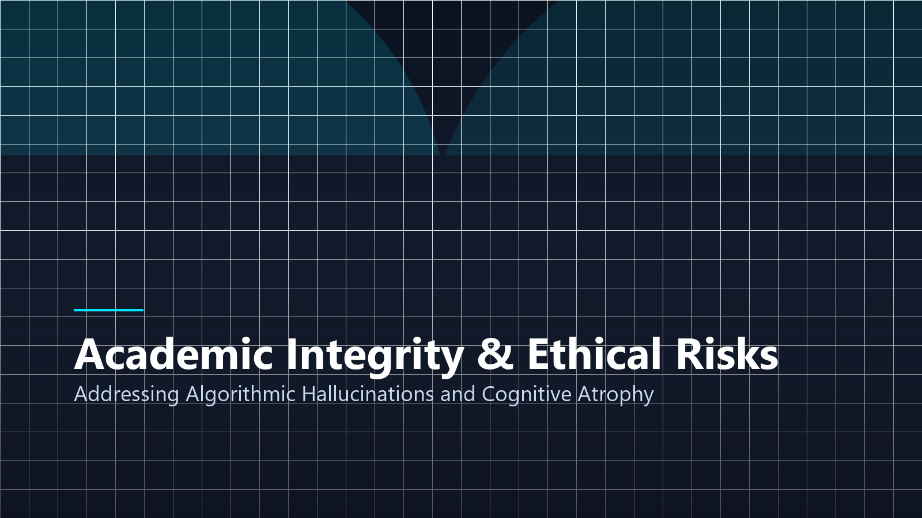
VULNERABILITY ANALYSIS
Academic Integrity & Ethical Risks
Cognitive Atrophy Hazard
Over-reliance on automated code completion impairs baseline algorithmic problem-solving.
Algorithmic Hallucinations
Generative models produce convincingly worded false citations and inaccurate historical facts.
Data Privacy & IP Exposure
Uploading proprietary university research into commercial model clouds creates serious data leaks.
Notes:
We must address the dark side: cognitive atrophy. If students allow AI to solve every homework problem, critical thinking muscles wither. Furthermore, AI models frequently invent completely fictitious citations with total confidence.

Slide 7
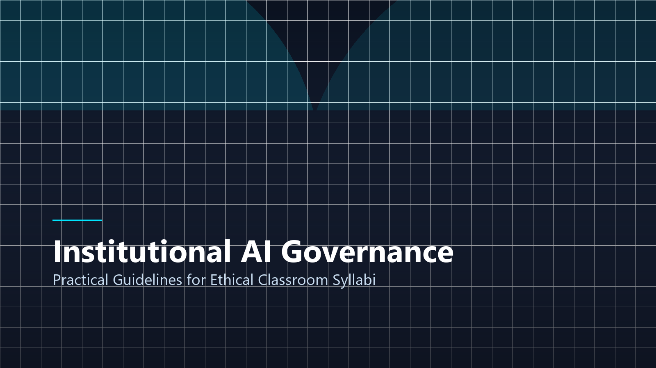
Institutional AI Policy
Constructing Ethical Governance Frameworks for Higher Education
Notes:
To address these vulnerabilities, academic institutions cannot simply ban AI tools. Blanket bans fail. Instead, colleges must deploy transparent usage frameworks.

Slide 8
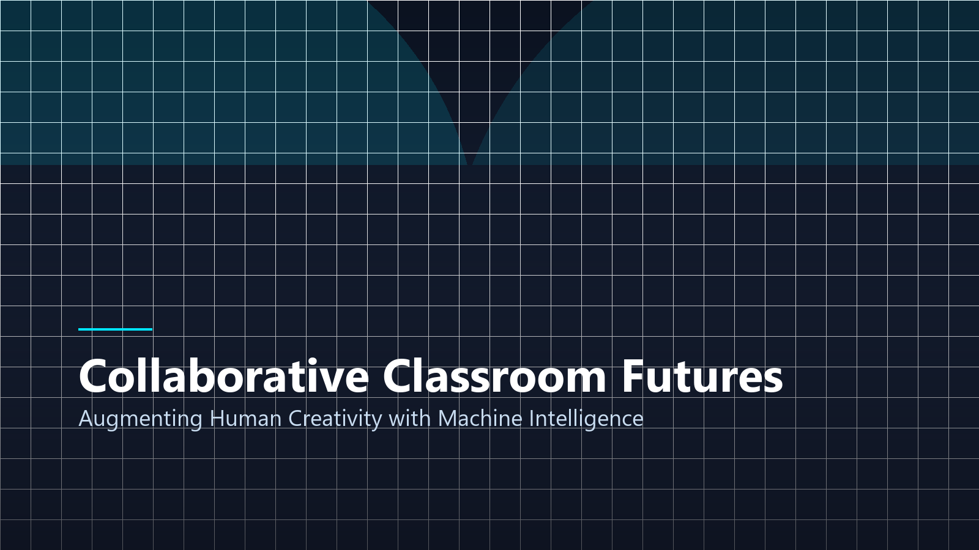
INSTITUTIONAL ACTION
Classroom Syllabi Best Practices
Mandatory Disclosure Logs
Students submit an AI appendix detailing prompts used, AI outputs, and personal revisions.
Oral Defense & Whiteboarding
Evaluating student code mastery through live whiteboard walkthroughs and conceptual defense.
Institutional Model Subscriptions
Universities provision privacy-shielded enterprise AI tiers that safeguard student data.
Notes:
The most effective policy is mandatory disclosure. When students must document their AI prompts and submit a reflective synthesis of what they changed, academic honesty is maintained while technical literacy grows.

Slide 9
POLICY BLUEPRINT
The Three Tiers of AI Governance
Tier 1: Permitted Use
Brainstorming project topics, finding syntax errors, and practicing mock interview questions.
Tier 2: Disclosed Use
Synthesizing research abstracts and drafting code templates with mandatory prompt citation.
Tier 3: Strictly Prohibited
Submitting unedited AI essays, take-home exam completions, and unauthorized auto-prompting.
Notes:
Here is our 3-tier governance rubric. Clearly articulating what constitutes permitted brainstorming versus prohibited plagiarism removes ambiguity for both instructors and learners.

Slide 10
STRATEGIC ROADMAP
Action Plan for Students & Faculty
For Students
Treat AI as a junior research assistant. Always fact-check citations, verify logic, and defend every line of code.
For Educators
Shift exam design to authentic case studies, practical problem solving, and contextual oral evaluations.
For STI Administration
Sponsor faculty training workshops and campus AI sandbox labs to bridge technological divides.
Notes:
In summary, students must treat AI as an intern whose work requires verification, while educators must evolve exam formats to prioritize real-time critical thinking.

Slide 11
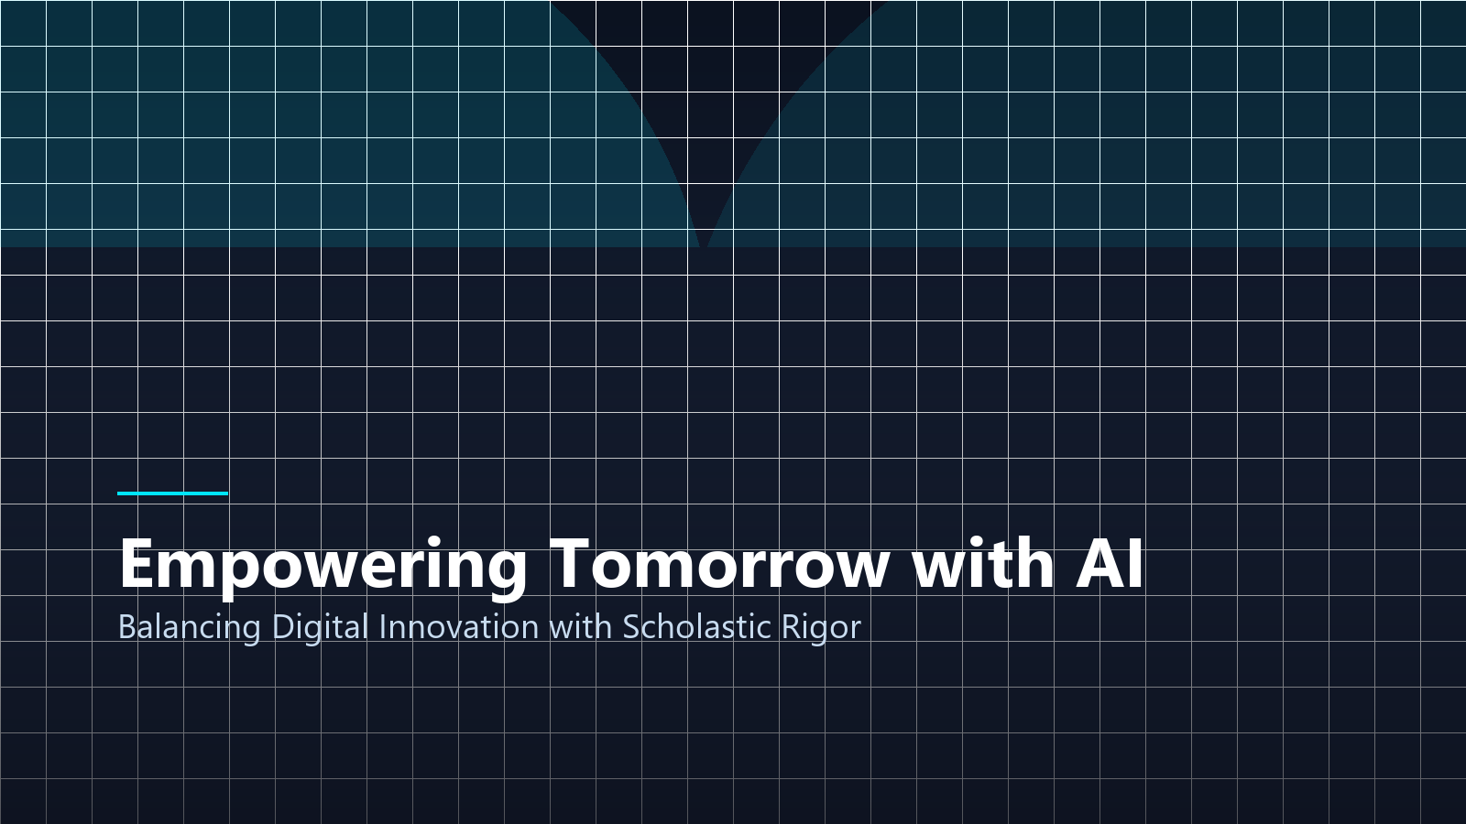
Empowering Tomorrow with AI
Balancing Technological Innovation with Scholastic Rigor
Image & Academic Credits:
• Visual Assets: Custom 3D renders & high-res vector graphics.
• Research Citations: APA 7th academic standards.
• STI West Negros University • BSIT Program 2026–2027
Notes:
Thank you for your attention. The future of education belongs to those who master collaborative intelligence — pairing human curiosity and ethics with artificial computing speed. I now welcome any questions.

