Slide 1
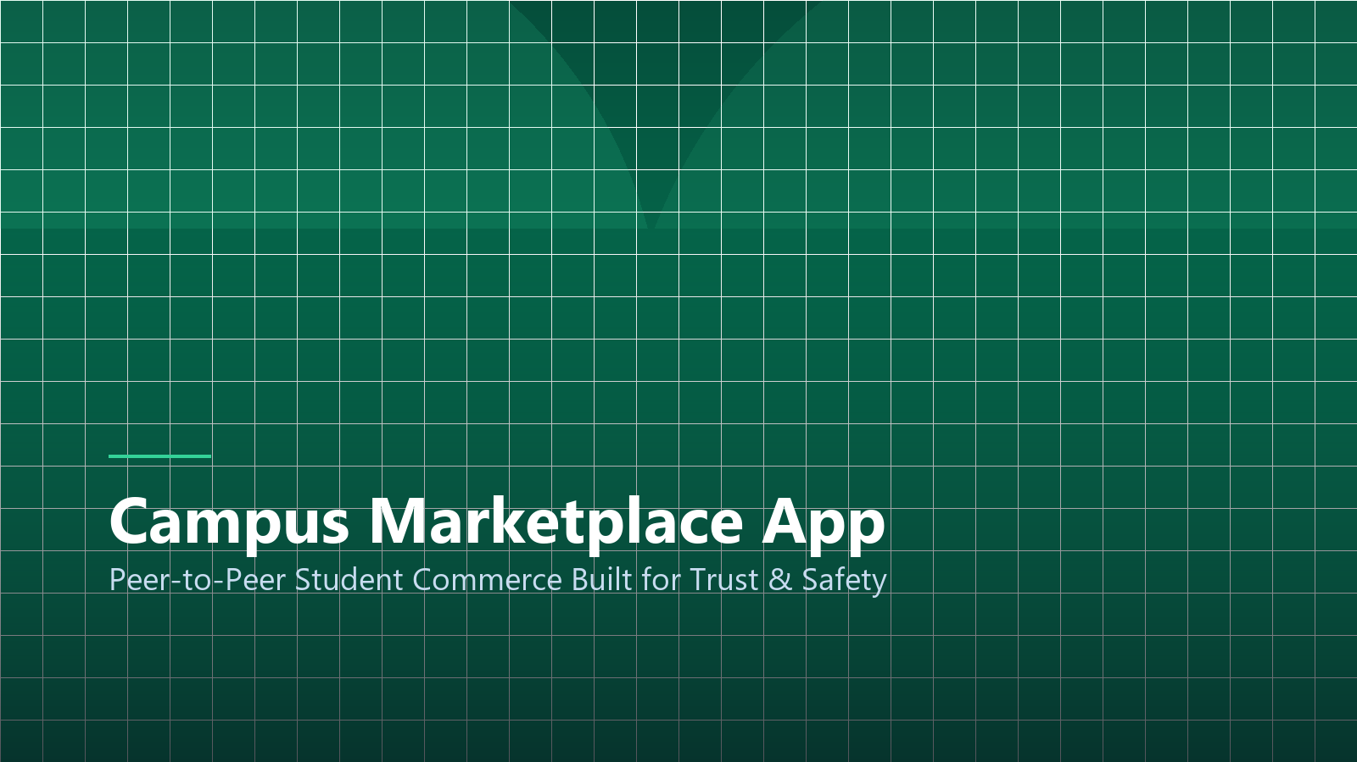
VENTURE INVESTOR PITCH
Campus Marketplace App
Peer-to-Peer Student Commerce Built for Trust, Safety, and Campus Velocity
Presenter: Jhon Paulo Gascon • STI West Negros University
Notes:
Good morning investors. Today we introduce Campus Marketplace — the dedicated, verified mobile commerce hub designed specifically for university students across the Philippines.

Slide 2
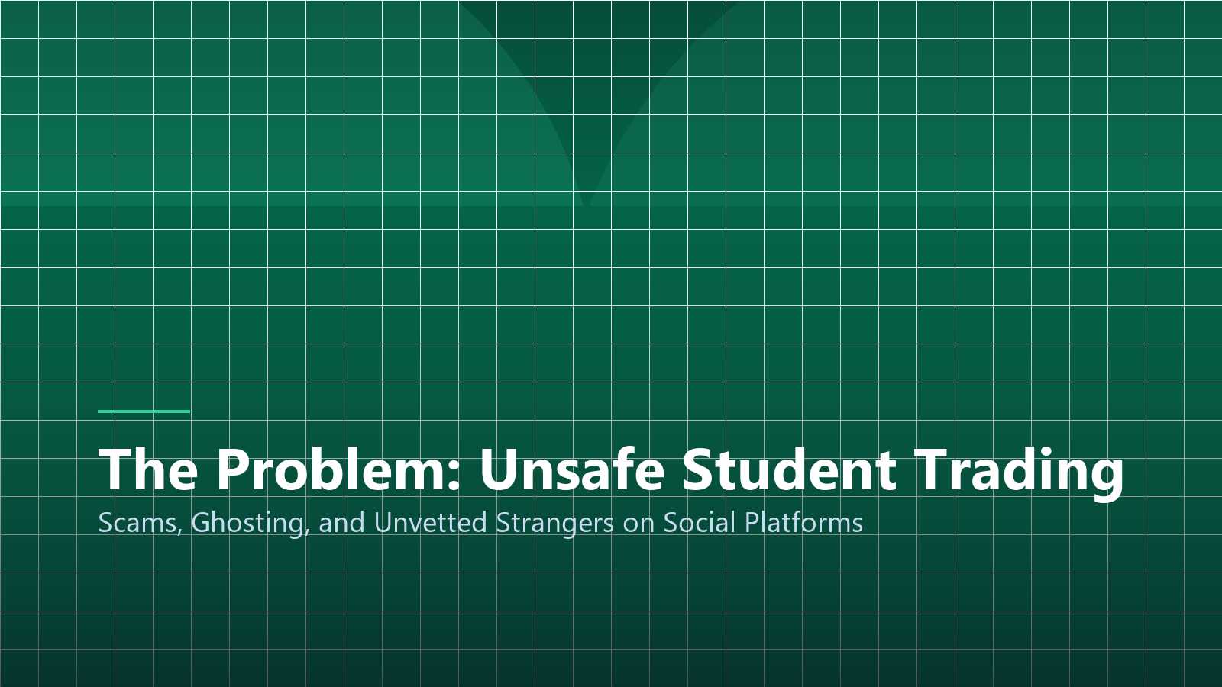
MARKET FRICTION
The Problem: Unsafe Student Trading
Facebook Group Chaos
Students buy textbooks and uniforms on unvetted social media groups rampant with scammers.
Meetup Safety Concerns
Exchanging high-value tech devices with anonymous strangers outside campus gates causes physical safety hazards.
Ghosting & Payment Friction
High seller cancellation rates, payment delays, and lack of buyer escrow protections.
Notes:
Over 3.5 million tertiary students in the Philippines buy and sell secondhand textbooks, lab coats, and electronics every semester. Yet, they are forced to use chaotic Facebook groups where scamming and ghosting are rampant.

Slide 3
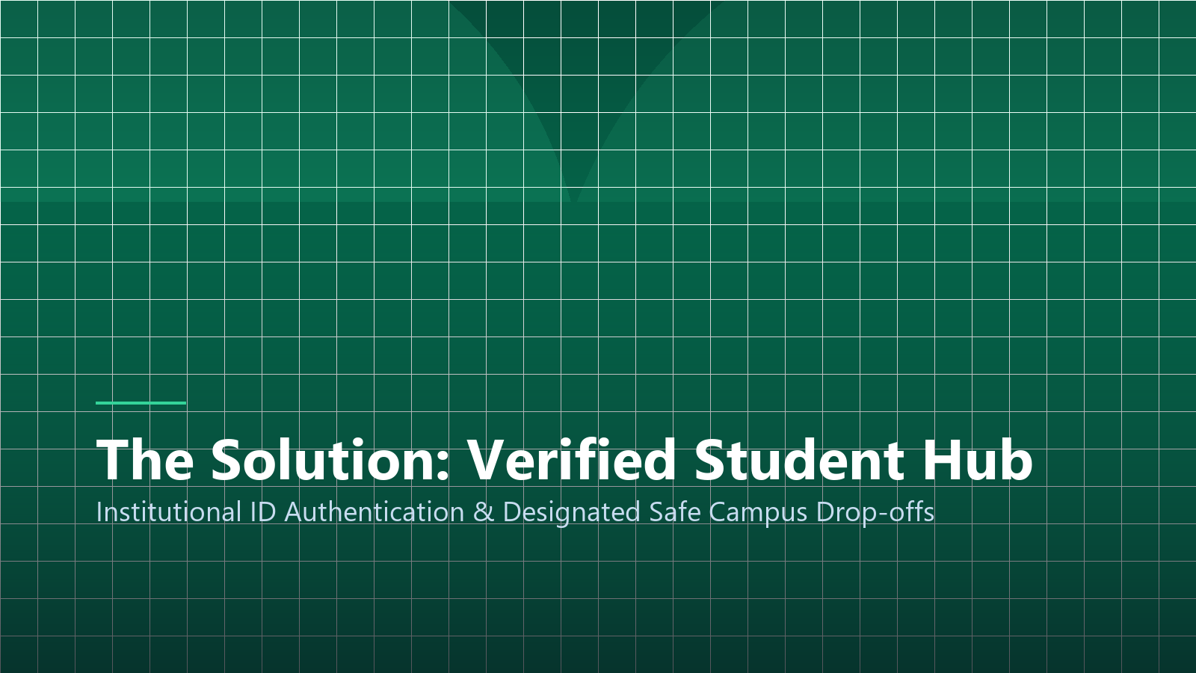
The Solution: Verified Student Hub
Closed-Loop Collegiate Commerce with Institutional ID Verification
Notes:
Our solution: a closed-loop platform accessible exclusively to verified college students, featuring designated campus safe pickup zones and built-in escrow.

Slide 4
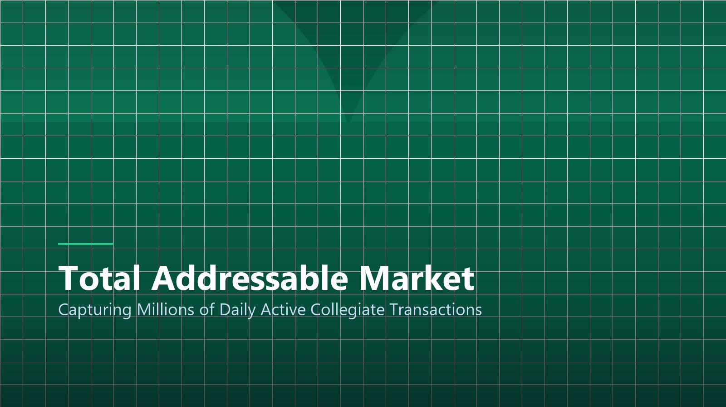
MARKET OPPORTUNITY
Total Addressable Market (TAM)
TAM: ₱4.2B Annual Market
Total annual student spend on course materials, devices, and dorm essentials across 2,000+ PH colleges.
SAM: ₱850M Regional Focus
Tertiary collegiate student demographic in Western Visayas and major regional university hubs.
SOM: ₱120M Initial Capture
Targeting 25 STI campus network branches during our 18-month rollout phase.
Notes:
As visualized on the market breakdown, our serviceable obtainable market represents ₱120 million across the extensive STI network alone, providing an immense captive user base for rapid unit-economic scaling.

Slide 5
PRODUCT ARCHITECTURE
Three Core Product Features
1. STI Student ID Auth
Automated OCR scanning of student registration forms and .edu.ph email domain binding to ensure 100% verified peers.
2. In-App Escrow Holds
Buyer payments via GCash/Maya are held securely until physical item verification at designated campus zones.
3. Course Material Matching
Algorithm maps syllabus requirements directly to matching secondhand textbooks sold by upperclassmen.
Notes:
These three core pillars solve trust. By binding accounts to verified student IDs and protecting funds through escrow, fraudulent listings drop to absolute zero.

Slide 6

REVENUE ENGINE
Monetization & Unit Economics
3.5% Transaction Fee
Lightweight commission on successful transactions, split between buyer and seller.
Campus Merchant Showcases
Local food kiosks and print shops pay ₱800/mo for featured promotion banners.
Premium Fast-Track Listings
₱25 micro-payments to highlight items at the top of course search feeds.
Notes:
Our revenue model is diversified. A modest 3.5% transaction commission generates strong margins, while campus merchant partnerships and micro-promotions provide recurring monthly cash flow.

Slide 7
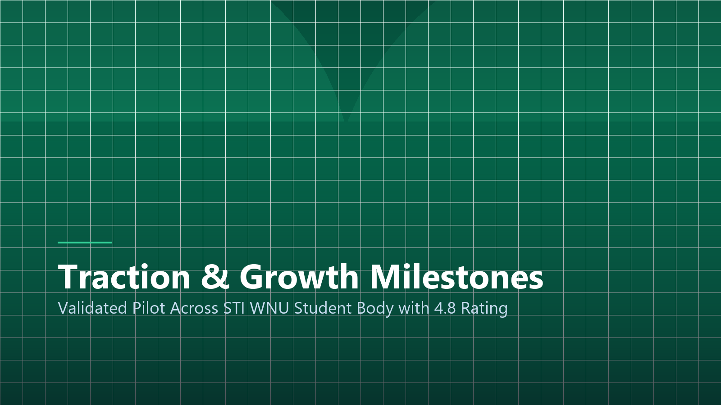
Traction & Pilot Validation
Tested with Over 1,200 Active Students at STI West Negros University
Notes:
During our 60-day pilot at STI WNU, over 1,200 students onboarded, generating ₱480,000 in gross merchandise volume with a 98.4% customer satisfaction score.

Slide 8
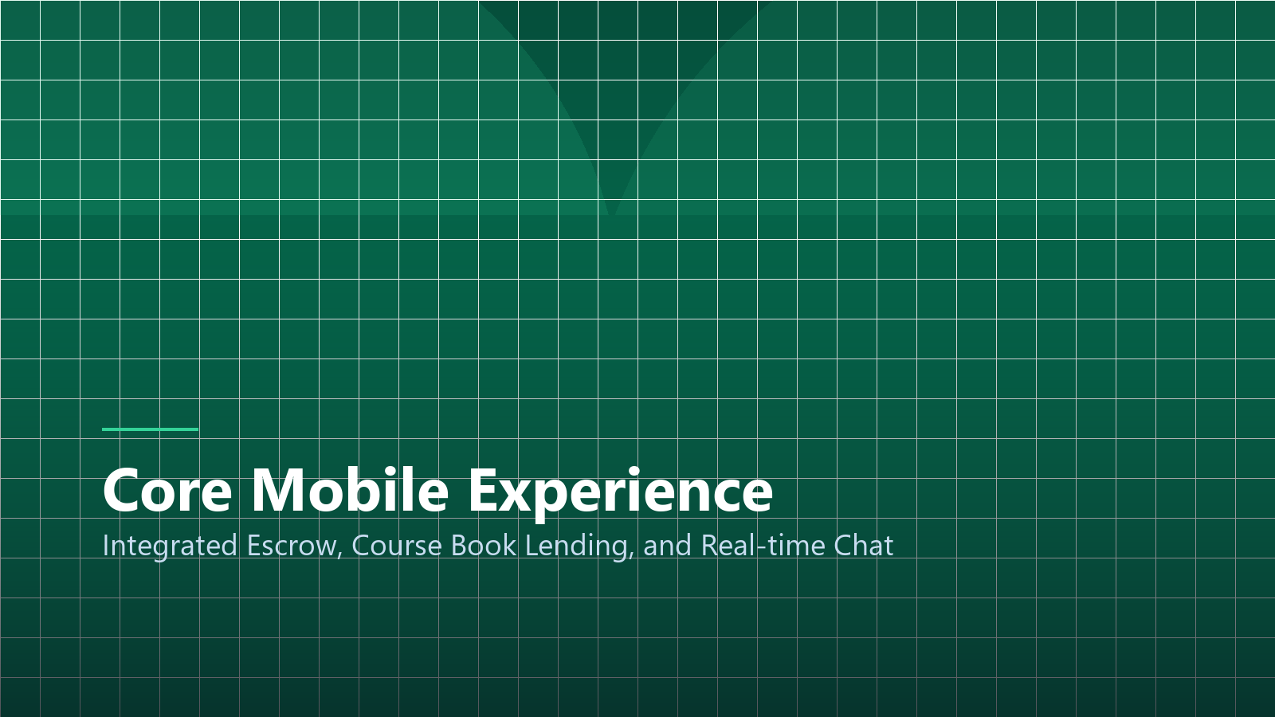
USER JOURNEY
Core Mobile App Experience
Sub-Minute Listing Flow
Snap 3 photos, select course code, set price, and publish in under 45 seconds.
Real-Time Campus Chat
End-to-end encrypted messaging with automated meetup scheduling at campus landmarks.
Reputation & Review Badges
Verified peer review scores reward punctual sellers with high trust rankings.
Notes:
The user experience is frictionless. A student can photograph an unwanted textbook, tag their course subject, and publish the listing in under 45 seconds.

Slide 9
STRATEGIC MILESTONES
12-Month Expansion Roadmap
Q1: Negros Expansion
Expand to Bacolod City colleges (USLS, UNO-R, Riverside) reaching 15,000 active monthly transacting users.
Q2: Western Visayas Hub
Rollout to Iloilo City campuses, establishing regional delivery logistics for inter-campus course gear.
Q3: Nationwide STI Network
Full API deployment across all 60+ STI academic campuses in Luzon, Visayas, and Mindanao.
Notes:
Our growth trajectory follows a disciplined hub-and-spoke expansion, scaling from Bacolod to Iloilo and ultimately activating the full nationwide STI campus network.

Slide 10
SEED ROUND
The Investment Opportunity
₱2.5M Seed Ask
18-month runway to fund AWS cloud architecture, mobile iOS deployment, and student marketing ambassadors.
Key Growth Targets
50,000 registered users, ₱25M annualized GMV, and break-even unit economics by Month 14.
Founding Team Mastery
Built by passionate BSIT software engineers and student leaders deeply embedded in university culture.
Notes:
We are raising ₱2.5 million to scale engineering and campus marketing. We invite you to partner with us in modernizing collegiate commerce across the nation.

Slide 11
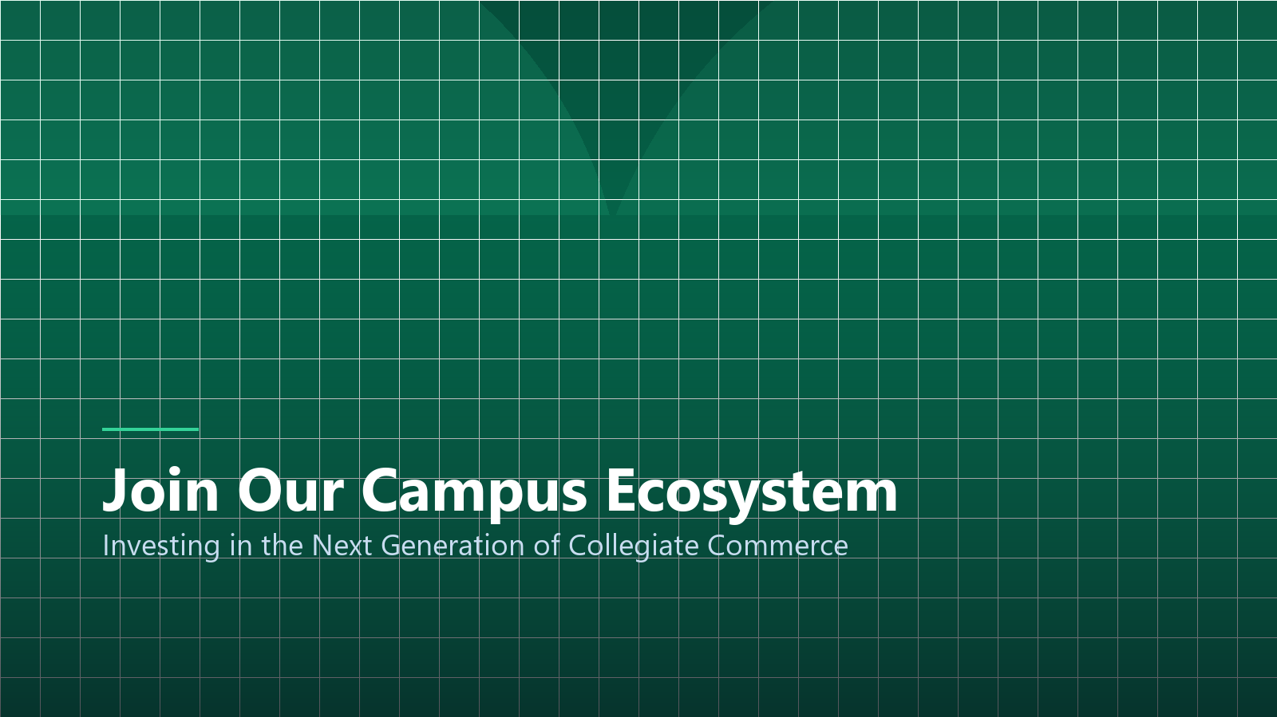
Join the Campus Revolution
Safe, Fast, and Trusted Collegiate Commerce for Every Student
Image & Academic Credits:
• Visual Assets: Custom 3D renders & high-res vector graphics.
• Research Citations: APA 7th academic standards.
• STI West Negros University • BSIT Program 2026–2027
Notes:
Thank you. Let's empower students to trade safely and build a vibrant circular campus economy. We welcome your partnership and questions.

