Slide 1

STUDENT GUIDANCE & WELLNESS
Stress Management and Student Wellness
Evidence-Based Resilience Frameworks and Cognitive Self-Care for Academic Success
Presenter: Jhon Paulo Gascon • STI West Negros University
Notes:
Welcome everyone. College life is demanding. Today we explore practical, evidence-based frameworks to manage academic stress, cultivate emotional resilience, and safeguard your mental wellbeing.

Slide 2

PHYSIOLOGICAL SCIENCE
The Neurobiology of Academic Stress
The Cortisol Response Loop
Academic deadlines activate the amygdala, triggering sustained cortisol secretion that impairs hippocampal memory.
Acute vs. Chronic Strain
Short stress spikes sharpen exam alertness, but chronic unmanaged tension triggers neurochemical exhaustion.
The Recovery Buffer Requirement
Brain synaptic consolidation requires intentional restorative down-time between study blocks.
Notes:
Stress is not merely emotional; it is intensely physiological. Chronic elevated cortisol directly shrinks dendrites in the hippocampus, impairing your ability to retain exam material.

Slide 3
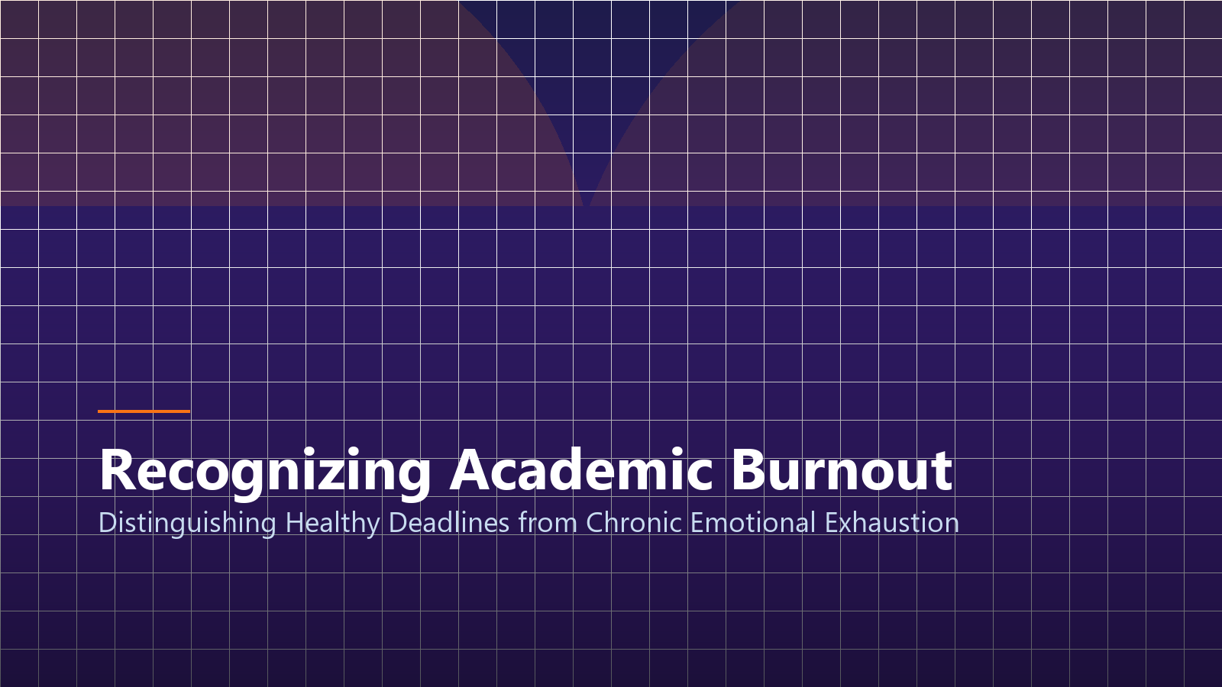
Recognizing Academic Burnout
Distinguishing Healthy Academic Deadlines from Emotional Collapse
Notes:
Many students dismiss chronic burnout as simple fatigue. It is vital to recognize the early warning symptoms before they escalate into clinical exhaustion.

Slide 4

PSYCHOLOGICAL SCAFFOLDING
Cognitive Reframing Techniques
Challenging Catastrophic Thoughts
Replace 'If I fail this midterm my entire career is destroyed' with 'This is one assessment that indicates areas for targeted revision.'
Separating Worth from Grades
Your human value and creative potential are not defined by a numerical GPA scorecard.
The Growth Mindset Protocol
Reframe mistakes in coding or mathematics as diagnostic feedback rather than personal inadequacy.
Notes:
Cognitive reframing is a proven psychological technique. When a panic thought arises, examine the evidence objectively and rewrite the narrative into constructive action.

Slide 5
DAILY PRACTICES
Three Resilient Wellness Habits
1. Box Breathing (4-4-4-4)
Inhale for 4s, hold for 4s, exhale for 4s, hold for 4s. Instantly lowers heart rate and stimulates the vagus nerve.
2. Strategic Time-Boxing
Block mandatory 45-minute daily offline windows dedicated exclusively to exercise, music, or nature walks.
3. Digital Sunsets
Disconnect from screens 45 minutes prior to sleep to prevent blue light from suppressing melatonin production.
Notes:
These three habits cost nothing but yield immense returns. Box breathing physically signals your nervous system that you are safe, terminating acute panic within two minutes.

Slide 6

COGNITIVE REGENERATION
Sleep Hygiene & Recovery
REM Memory Consolidation
During deep sleep, the brain transfers daytime facts into durable long-term storage.
The Myth of the Productive All-Nighter
Staying awake past 24 hours induces cognitive deficits equivalent to a 0.10% blood alcohol level.
Consistent Circadian Rhythm
Waking and sleeping at consistent hours stabilizes energy metabolism and daytime alertness.
Notes:
Sacrificing sleep to cram is a mathematical loss. All-nighters severely degrade executive functioning. Seven hours of sleep ensures your brain can actually access the material you studied.

Slide 7

Study-Life Balance Architecture
Structuring Sustainable Study Schedules for Long-Term Collegiate Stamina
Notes:
Sustainable academic achievement requires intentional schedule architecture. Balance is not something you find; it is something you actively schedule.

Slide 8

SUPPORT SYSTEMS
Campus Support & Crisis Networks
STI WNU Guidance Services
Confidential professional guidance counselors available on the 2nd Floor, Student Affairs Building.
Peer Study & Mentorship Circles
Collaborating with fellow BSIT classmates distributes academic pressure and prevents isolation.
National Crisis Hotlines (24/7)
Philippine National Center for Mental Health: Dial 1553 or 0917-899-8727 toll-free anytime.
Notes:
Never struggle in silence. Seeking support is an act of courage, not weakness. STI WNU offers confidential counseling, and national crisis helplines are available 24 hours a day.

Slide 9
HOLISTIC HEALTH
The Four Pillars of Student Wellbeing
Physical Pillar
Adequate sleep, balanced nutrition, daily hydration, and at least 20 minutes of physical movement.
Emotional Pillar
Self-compassion, mindful breathing, emotional regulation, and acknowledging boundaries.
Social Pillar
Nurturing genuine friendships, participating in campus organizations, and unplugging from toxic feeds.
Notes:
When all three pillars are nurtured, academic performance rises naturally without the collateral damage of chronic exhaustion.

Slide 10
COMMITMENT
Weekly Action Challenge
Day 1–2: Sleep Reset
Establish a fixed 11:00 PM sleep time and remove mobile devices from arm's reach of your bed.
Day 3–4: Time-Box Study
Apply 25-minute Pomodoro intervals during programming sprints with zero browser multitasking.
Day 5–7: Reconnect
Have an in-person meal with friends without checking academic group chats or notifications.
Notes:
I challenge each of you to implement this simple 7-day reset. Small consistent boundaries create transformative changes in academic vitality.

Slide 11

Prioritize Your Mental Health
Academic Excellence Begins with a Nurtured, Rested Mind
Image & Academic Credits:
• Visual Assets: Custom 3D renders & high-res vector graphics.
• Research Citations: APA 7th academic standards.
• STI West Negros University • BSIT Program 2026–2027
Notes:
Thank you. Remember: you are a human being before you are a student. Take care of your mind, honor your limits, and achieve greatness with joy. I welcome any questions.

