Slide 1

L2AP: Fast Cosine Similarity Search With Prefix L-2 Norm Bounds
David C. Anastasiu and George Karypis
Department of Computer Science and Engineering University of Minnesota
IEEE/2014
Paulo Henrique da Silva
Prof. Dr. Wellington Santos Martins
{paulohsilva, wellington}@inf.ufg.br
Similarity Search
26 September, 2018
Seminários

Slide 2
Sumary
Introduction
Relatade Works
Data and Methods
Conclusions
Future Works
1/15

Slide 3
Introduction
Context
  The importance of the text mining has increased significantly in recent years due to the enormous growth of information generated in digital media. Today there is an immense volume of data generated in the most varied formats, that is, in a destructured form and that needs to be structured, analyzed and indexed to extract relevant information
2/15

Slide 4
Introduction
Problem
  Given a dataset R, a query S, a function sim(x,y) and a threshold t, similarity search finds all objects in the dataset with a similarity value of at least t when compared to query S
  High dimensional sparse datasets
  Calculated by a distance function - Cosine similarity
  Inverted index
  All Pairs Similarity Search - O (n²)
3/15

Slide 5
Introduction
Motivation
  Relevance in many real-world applications in fields like information retrieval and text mining
    Near-duplicate document detection
    Clustering
    Collaborative fitering
    Recomender systems (e.g., books or movies)
4/15

Slide 6
Introduction
Objectives
  Propose new filtering techniques
  Prune candidates using value-based bounds (l²-norm)
  Reduce inverted index
  Framework candidate generation and verification
5/15

Slide 7
Related Works
Chaudhuri et al, formalizy prefix-filtering
Bayardo et al, developed additional pruning strategies
Xiao et al, introduce a tighter indexing bound and postional filtering
Ribeiro and Härder, minimize the size of the inverted index
Lee et al, introduce length filtering and suffix filtering
6/15

Slide 8
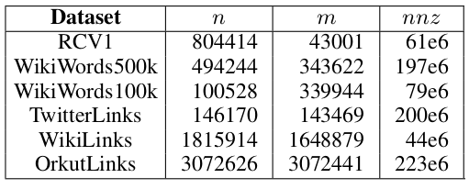
Data and Methods
Datasets
  Textual datasets (corpus)
  Represented as tf-idf weighted vectors
L2AP: Fast cosine similarity search with prefix L-2 norm bounds
7/15

Slide 9

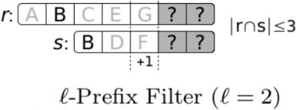
Data and Methods
L-2 Norm Bounds (Variable-Length Prefix Filter)
  Require at least 2 common tokens in the prefixes
  Prefix size for a set r: prefix₂(r) =
  Considering Ƭ = 0.65, prefix₂(r) = 5 and prefix₂(s) = 3
  The pairs is pruned
Sandes et al. 2017
8/15

Slide 10
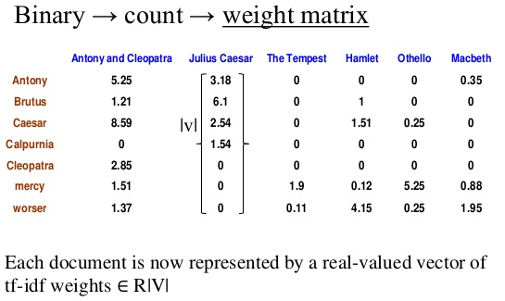
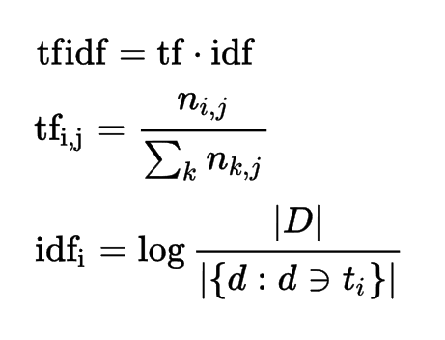
Data and Methods
TF-IDF
  TF – measure of how important the term is to the document
  IDF – measure the importance of the term in the corpus
www.google.com
9/15

Slide 11
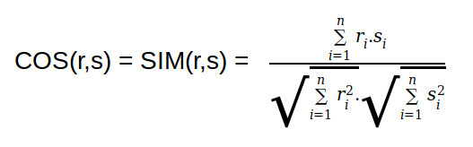
Data and Methods
Cosine Similarity
  Measure of similarity between two vectors
  Terms are axes in the vector space
  Documents are the vectors
  High dimensionality and sparsity
  Criar matriz documentos x termos
10/15

Slide 12
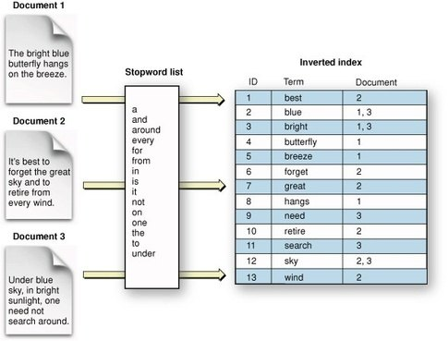
Data and Methods
Inverted index
  Links a word to a document
  Fetch the document
  Tokenize document
  Remove stop words
  Stem to root word
  Record document Ids
  Merge/store the words
https://www.quora.com
11/15

Slide 13
Conclusions
Introductions of new filtering strategies
Drastic reductions in the inverted index size
Significant speedups over all exact baselines methods – AllPairs, MMJoin
BayesLSH-Lite approximate candidate pruning cannot improve significantly over the exact pruning strategies
12/15

Slide 14
Future Works
Evaluate the efficiency of l²-norm with others similarity function (Dice and Tanimoto)
Apply this method with related problems such as Nearest Neighbor or k-Nearest Neighbor search
Scaling up the number of threads and processors
13/15

Slide 15
Questions?
14/15

Slide 16
L2AP: Fast Cosine Similarity Search With Prefix L-2 Norm Bounds
David C. Anastasiu and George Karypis
Department of Computer Science and Engineering University of Minnesota
IEEE/2014
Paulo Henrique da Silva
Prof. Dr. Wellington Santos Martins
{paulohsilva, wellington}@inf.ufg.br
Similarity Search
26 September, 2018
Seminários
15/15

