Slide 1

L2Knng: Fast Exact K-Nearest Neighbor Graph Construction with L2-Norm Pruning
David C. Anastasiu and George Karypis
Department of Computer Science and Engineering University of Minnesota
ACM/2015
Paulo Henrique da Silva
Prof. Dr. Wellington Santos Martins
{paulohsilva, wellington}@inf.ufg.br
Similarity Search
21 November, 2018
Seminários

Slide 2
Sumary
Introduction
Related Works
Data and Methods
Results
Conclusions
Future Works
1/15

Slide 3
Introduction
Context
  K-nearest neighbor search, also known as similarity search, involves finding the top k results (e.g., to 10 most similar) to a given query
  kNN is an optimization problem for finding the closest k points in metric space
2/15

Slide 4
Introduction
Problem
  Given a set D in a r-dimensional space and a query q, find the k points in D with the smallest distances dist(q, p)
  High dimensional sparse datasets
  Represented by weighted vectors
  Cosine function to measure vector similarity
3/15

Slide 5
Introduction
There are two major approaches to similarity search
  Exact methods, which return the exact set of k-nearest neighbors
  Approximate methods, which may not return the exact set of neighbors
5/15

Slide 6
Introduction
Motivation
  Relevance in many real-world applications
    Near-duplicate document detection
    Clustering
    Online advertising
    Recomender systems
4/15

Slide 7
Introduction
Objectives
  Introduce L2KnngApprox to obtain approximate initial solution for k-NNG
  Introduce L2Knng to solve the exact cosine similarity k-NNG
  New filtering methods to prune objects that will not be part of the final k-NNG
  Evaluate L2Knng e L2KnngApprox methods against baselines
  Improve baselines
5/15

Slide 8
Related Works
Bayardo et al. [2007] – Developed several strategies to prune the search space
Dong et al. [2011] – Iterative improvements of an initial random k-NNG by considering neighbors’ neighbors as potencial neighbors
Park et al. [2014] – Approximate approach that focus on object pairs that share high-weight features
Anastasiu and Karapis [2014] – Fast cosine similarity search with pruning strategies
6/15

Slide 9
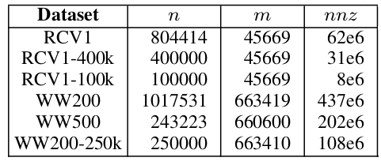
Data and Methods
Datasets
  Textual datasets
  Standard pre-processing tokenization and lemmatization
  Represented as tf-idf weighted vectors
L2Knng: Fast Exact K-Nearest Neighbor Graph Construction with L-2 norm Pruning
7/15

Slide 10
Data and Methods
L2KnngApprox
  Sorts the feature vectors and inverted index in decreasing weight order
  Builds a set of initial neighborhoods based on high-weight features of vectors with prefix filter
  Iteratively enhances the k-NNG by looking for new candidates in each neighbor’s neighborhood
  Uses an inverted index to identify candidate objects with common features with the query
8/15

Slide 11
Data and Methods
L2Knng
  Uses the initial approximate graph
  Scans over all remaining objects
  Filtering candidates by the suffix filter to pruning not true neighbors
  Reduce the full vector dot-products
  Updates the k most similar objects to builds final k-NNG
9/15

Slide 12
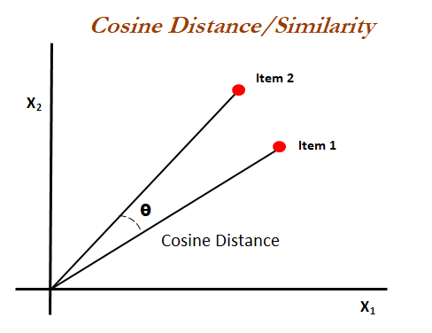
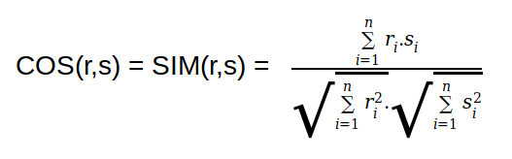
Data and Methods
Cosine Similarity
  Measure of similarity between two vectors
  Terms are axes in the vector space
  Documents are the vectors
  High dimensionality and sparsity
10/15

Slide 13
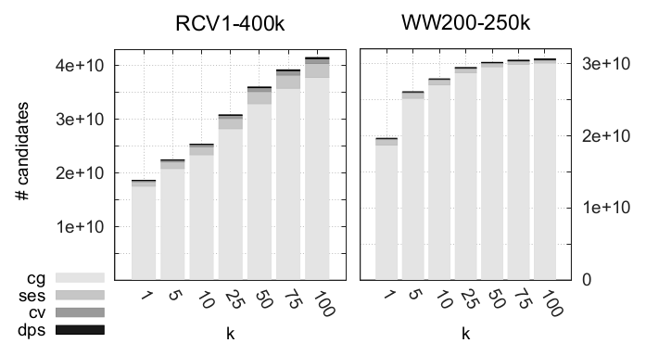
Results
Pruning effectiveness
cg (candidate generation), ses (suffix estimate score), cv (candidate verification), dps (full dot-product)
11/15

Slide 14
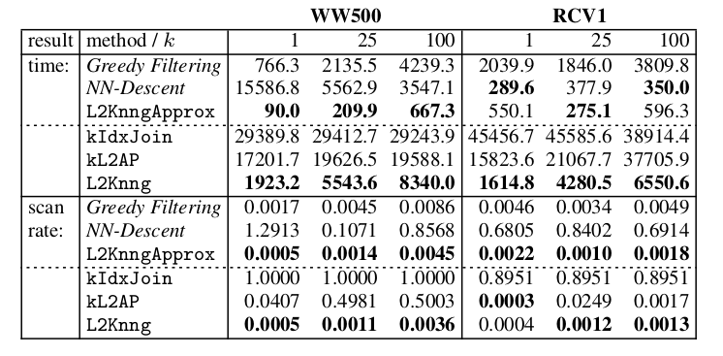
Results
Execution time and scan rate for competing algorithms
Best results are emphasized in bold
11/15

Slide 15
Conclusions
Introduction of new pruning bounds
Estrategies to avoid full similarity computation for most object pairs
Performance increased with the pruning of candidates
L2Knng achieves improvement against exact baselines
L2KnngApprox is faster than approximate baselines
12/15

Slide 16
Future Works
Evaluate the efficiency of l²-norm with others similarity function (Dice and Tanimoto)
Scaling up the number of threads and processors to solve the problem
13/15

Slide 17
L2Knng: Fast Exact K-Nearest Neighbor Graph Construction with L2-Norm Pruning
David C. Anastasiu and George Karypis
Department of Computer Science and Engineering University of Minnesota
ACM/2015
Paulo Henrique da Silva
Prof. Dr. Wellington Santos Martins
{paulohsilva, wellington}@inf.ufg.br
Similarity Search
21 November, 2018
Seminários

