Slide 1

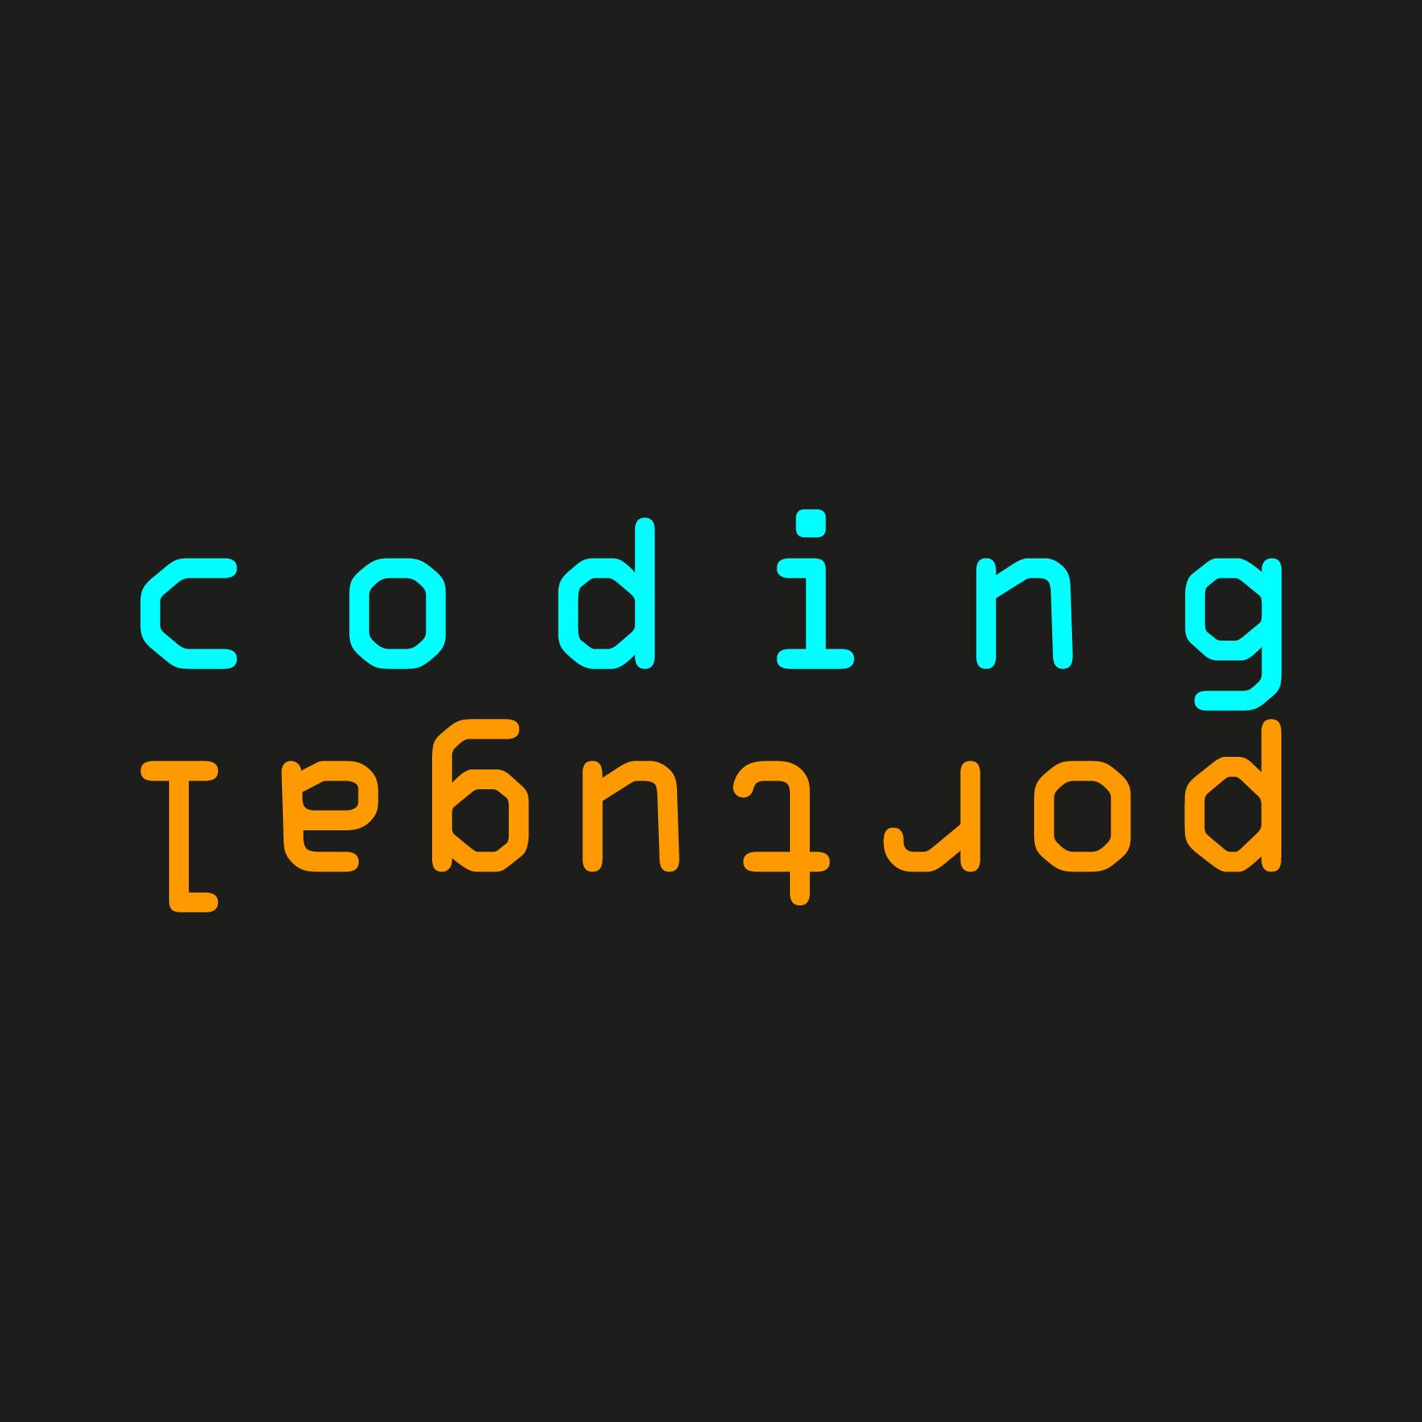
RPA4Developers
By Paulo Correia

Slide 2

About Me
42 years tech lover
Father of three
Partner of one
My first computer was a ZX Spectrum 48K at 6 years old
Coded my first game at 12 years old
Love the mountains and all sort of sports related
Like to travel to uncommon places without any planning beforehand
Travel motto “If all goes well, there’s nothing to tell”
Started operation “Bikini 2020” ☺

Slide 3
Today’s Agenda
Write here your great subtitle
1
What’s RPA?
4
Process evaluation
Robotic Process Automation
Indicators that a process can be a good candidate and the business case
2
Benefits
5
RPA Programming options
Benefits RPA can add to a process
5 ways to program RPA bots
3
Demo
6
RPA predictions
How easy can it be?
In the long term, market experts' predictions are…

Slide 4
ANY QUESTIONS?

Slide 5

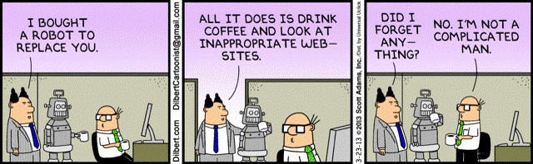
What’s RPA?
Robotic Process Automation
Robotic process automation is the use of software capable to handle high-volume, repeatable tasks that previously required humans to perform.

Slide 6

Benefits of RPA
TOP 5
Saving of cost
High Accuracy in Work
Improved Customer Experience
Increased Productivity
Works with Existing IT Infrastructure
and Applications
Notes:
https://www.accenture-insights.nl/en-us/articles/how-rpa-improves-our-performance

Slide 7
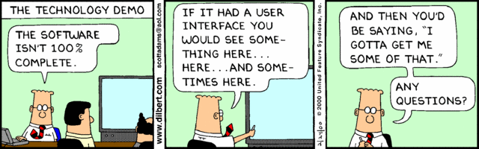
Demo time
Praise the Demo Gods

Slide 8

Process Evaluation
To RPA or Not to RPA?
Employee Involvement
Time-consuming process that require a lots of employee involvement and attention
Complexity
We can automate simple or complex tasks. Start small, gain trust, grow.
Volume
The higher volume of request, the higher the benefit. Robots work 24/7/365
Stability
Back-office repetitive and transactional tasks, that doesn’t change very often and might be subject to regulatory compliance are better candidates to RPA.

Slide 9





RPA Programming options
5 ways to program RPA bots
Coding
Explicitly code the tool to perform the necessary actions to replicate a process or functionality
Low code solutions: GUI
Vendors offer solutions to program simple RPA bots with drag & drop interfaces
Recording
Recording a complex set actions and having them automatically translated into a bot program facilitates programming
No code solutions
Powerful GUI and recorder function to enable programming even relatively complex bots without coding
Self-learning bots
These bots watch recorded employee activity to learn automatable tasks.

Slide 10






RPA predictions
Market experts' predictions
Wider adoption in the years to come
Artificial Intelligence
Emergence of SPA (Smart Process Automation)
Integration with other tools
RPA 2.0

Slide 11
ANY MORE QUESTIONS?

Slide 12


https://github.com/pauloiap
CONTACT ME
paulo.iap@gmail.com
https://www.linkedin.com/in/pauloiap/

