Slide 1
Groupby Midweek Presentation
Janice Tjeng, Paulo Kuong

Slide 2

Groupby is an e-commerce startup that aims to create highly converting and relevant site experience to maximize revenue through e-Commerce channels. It provides Software as a Service for data enrichment, search, navigation, personalization, merchandising, SEO and search autocomplete for its clients.

Slide 3
Problem & existing solutions
Problem
With many items to choose from, how can we identify items that customers are most likely to purchase?
How can we get users to convert?
Existing Solutions
Recommendation system techniques
Content based
Collaborative filtering
Hybrid approach
Predicting customer conversion
Classification techniques
Sequence modeling
Notes:
Focus on personalization in 2 parts: item recommendation and activities to get users to convert when they are browsing the site
GroupBy info: interested in users who conversion are between 0.2 and 0.8. Hypothesis is that less than 0.2, users will not buy, and if more than 0.8, don’t have to change a lot in their journey
Content based: recommend items based on similarity of item features
Collaborative filtering: recommend items to a user based on items similar sets of users likes

Slide 4
Our solution
Collaborative Filtering with Implicit Feedback + User conversion prediction
Questions to answer
How can we identify items to recommend to users?
Is it possible to predict customer conversion (from viewing to purchasing)?
What are the top features that define customer conversion?
Can we explain and visualize the predictive model for customer conversion on a journey and at a session level?
Can we predict customer churn on the e-commerce platform?
Can we apply transfer learning from other E-commerce data sets to our local data set?
Is there a pattern and trend across product types regarding the conversion event?

Slide 5
V1 findings - Recommendation system
Temporal split of users
Same users in train and test sets
383k users, 5.2k products
Match rate = (intersection between recommended items and actual interactions / total number of recommended items) * 100
Naive approach
15% match rate
Collaborative Filtering, ALS
35% match rate
Notes:
Match rate is defined by the percentage of the number of recommended items that the user actually interacts with out of the total number of items recommended

Slide 6
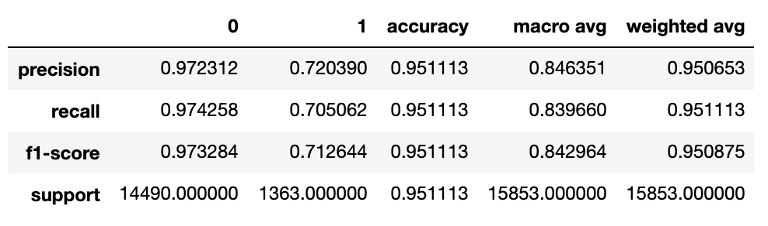
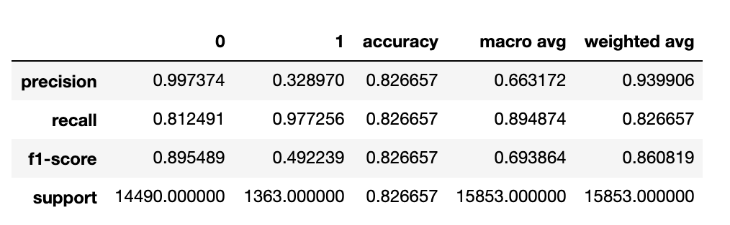
V1 findings - User conversion
Is it possible to predict customer conversion (from viewing to purchasing)?
When looking at the historical activities data, we are able to find important features and train 2 models. One is using XGBClassifier. For that, we are able to obtain the following metrics:
We are also able to train another model optimized for recall by stacking models of GaussianNB and MultinomialNB. The following are the metrics:

Slide 7
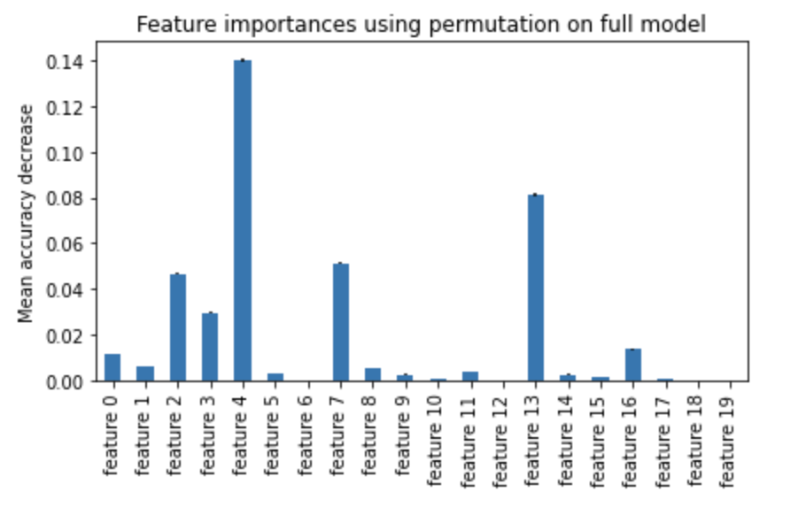
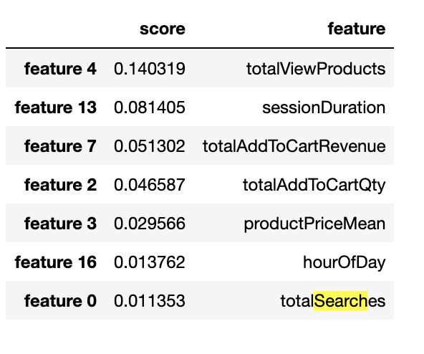
V1 findings - User conversion
What are the top features that define customer conversion?

Slide 8
V2 plans - Recommendation System
Random split of data
Apply on bigger dataset using PySpark/AWS
Apply on Groupby dataset

Slide 9
V2 plans - User Conversion
Can we explain and visualize the predictive model for customer conversion on a journey and at a session level?
Transform the data into sequential format and use LSTM to try to predict the chance of the next user activity will be a purchase
Can we predict customer churn on the e-commerce platform?
Since there is only one month of data from Groupby, we will define customer churn in term of days or hours. We will explore Kaggle e-commerce data for answering this question
Is there a pattern and trend across product types regarding the conversion event?
Product price is one of the important features
Using Logistic Regression, we have found that price is inversely proportional to the customer conversions
More product types to be defined
Can we apply transfer learning from other E-commerce data sets to our local data set?
Train model on Kaggle and try transfer model that we have learned from Kaggle data

Slide 10
Ethical considerations
Changing user preferences
Lack of information about new users and items
Balance between recommending too little or too many items
Tracking user information through session and user ids

Slide 11

Systems design
Recommendation/feedback
3
Customer Data
4
Data Acquisition (collection + annotation)
Process Data
Outcome and reporting to customer facing platform
1
2
5
Customer
Customer
Customer? Shoppers on e-commerce platform, internal sales and marketing team
Data? Session, product, traffic
Process? User-based item recommendation, customer conversion prediction, cluster analysis
Feedback? A/B Test
Outcome? Increase customer conversion and sales

Slide 12
Tentative Timeplan
Week | Deliverables
13 | Recommendation System model on Groupby Dataset Transform the data into sequential format and use LSTM to try to predict the chance of the next user activity will be a purchase Define customer churn, train model for predicting customer churn. Define more product types if possible.
14 | Deploy V1 models Explorer transfer learning
15 | Finalize project

