Slide 1
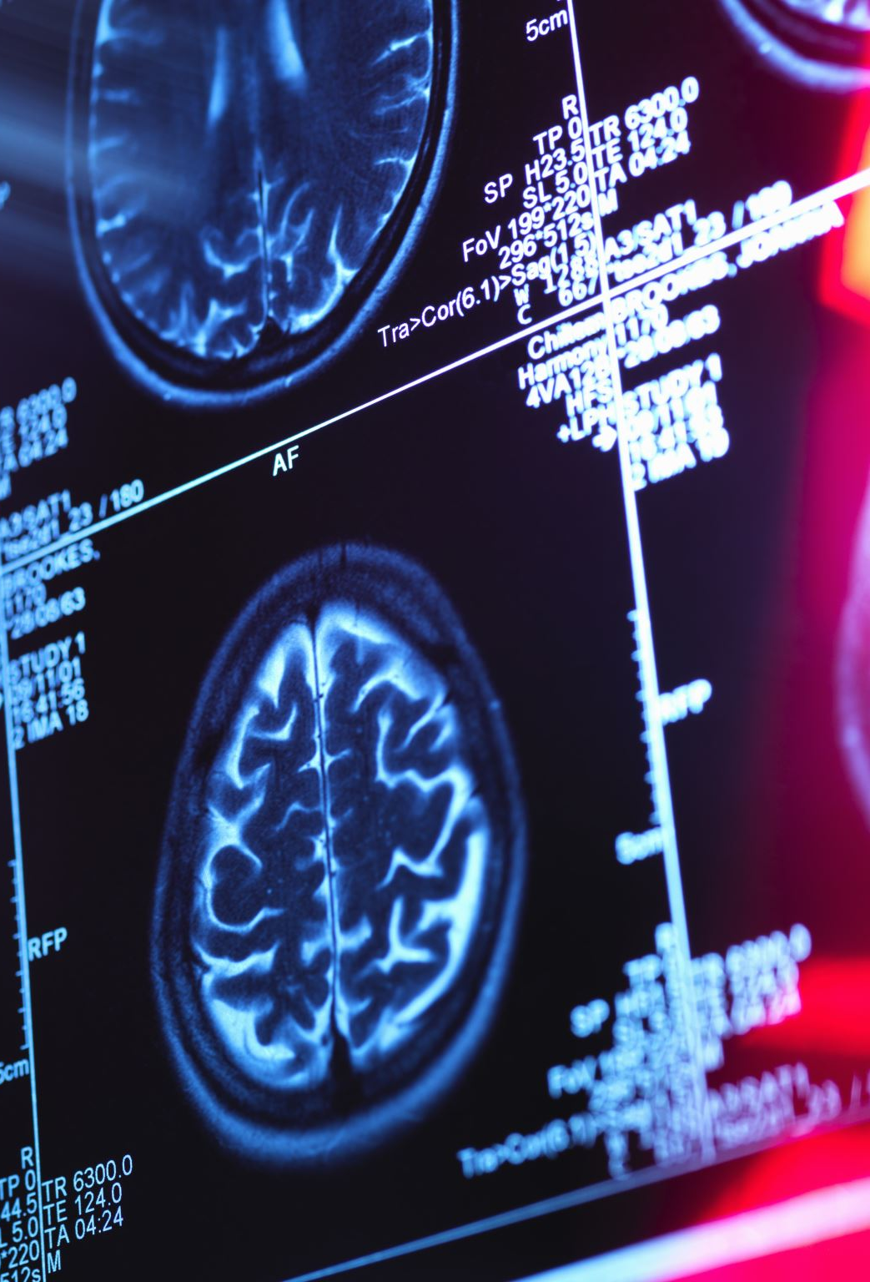
AI in Action A Hands-On Session on Training a Brain CT Hemorrhage Detector
Paulo Kuriki, MD
Neuroradiology Fellow
UTSW 10/5/2023

Slide 2

Objectives
ML Concepts: Inputs and Models
Datasets Creation
The Training Process
Improving Performance
Deep Learning Use Cases in Radiology
Kickstart Your AI Project

Slide 3
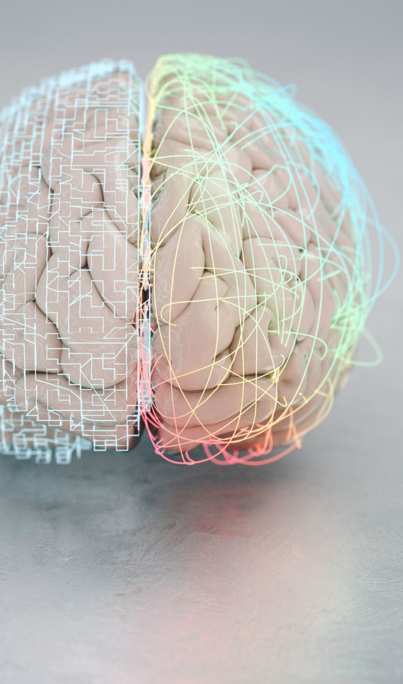
ML Concepts: Inputs and Models
Jupyter Colab

Slide 4
Dataset With 2 Classes and 100 Samples
shorturl.at/hpsDK
1. Download the file from the link above
2. Unzip the file. Remember where it is

Slide 5
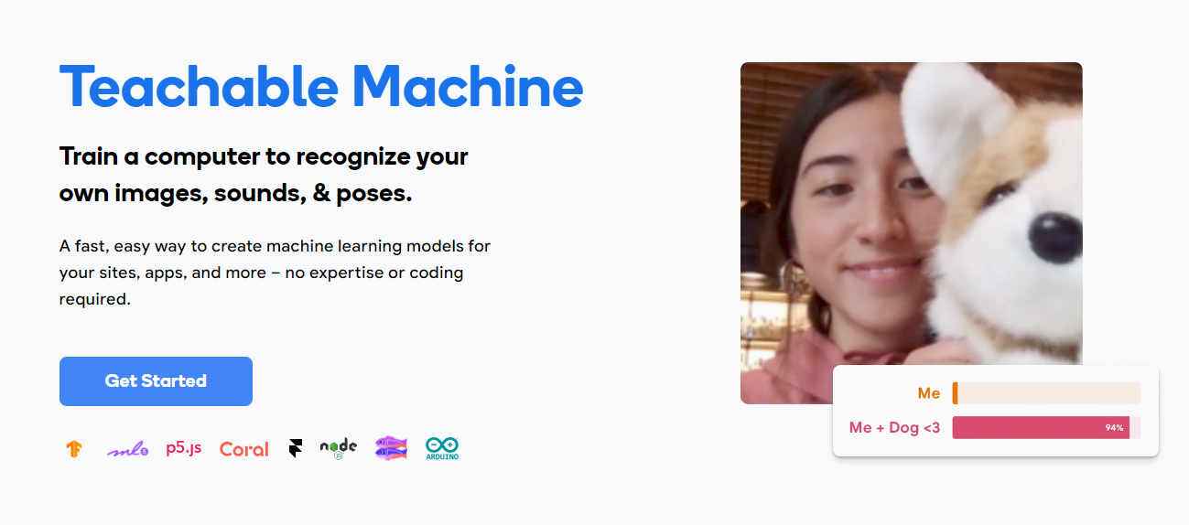
Teachable Machine
https://teachablemachine.withgoogle.com/

Slide 6
Improving Performance
Increase My Dataset: Add more cases
Augment My Dataset: Modify cases generating more samples [link]
Data Preprocessing: Adjust window levels for better visibility
Transfer Learning: Often beneficial in leveraging pre-trained models
Hyperparameter Tuning: Optimize model settings for best results
Train for a Longer Time: Take care to avoid overfitting
Increase Model Complexity: May increase computational cost [link]
Regularization: Prevents overfitting
Ensemble Models: Combine multiple models for improved accuracy
Cross Validation: Get a better estimate of model performance

Slide 7
Dataset 5 Classes and 500 Samples
Bonus. How the datasets for this lecture were prepared
github.com/paulokuriki/rsna-intracranial-hemorrhage-dataset
shorturl.at/egkrx

Slide 8
Use Cases in Radiology
Computer Vision:
Detect hemorrhage, fractures, nodules, microcalcifications, spine labeling, large vessel occlusion
Quantify: normal lung vs COPD/ COVID, prostate, hippocampi
NLP:
Classify reports, laterality mistakes, summarize medical records
Review reports, auto-complete reports
Voice Recognition: use voice to automatize process

Slide 9

Kickstart Your AI Project
Identify a pain point
Decompose the challenge into small pieces
Collect the dataset and curate it
Train your model
Evaluate it
Deploy in production
Monitor
Learn Python

Slide 10
Thanks
github.com/paulokuriki

