Slide 1

Marketing funnel & channel efficiency
FY24 – FY25
Paulo Muzyczuk
7 August 2026

Slide 2
Executive summary
FY25 growth was conversion-led, not traffic-led: attributed SQOs +35% on flat-to-declining trustworthy traffic
Efficiency fell as spend scaled: branded search cost/SQO doubled on ~3× budget
Roadmap: incrementality via geo-holdout on branded search, MMM for ongoing allocation

Slide 3
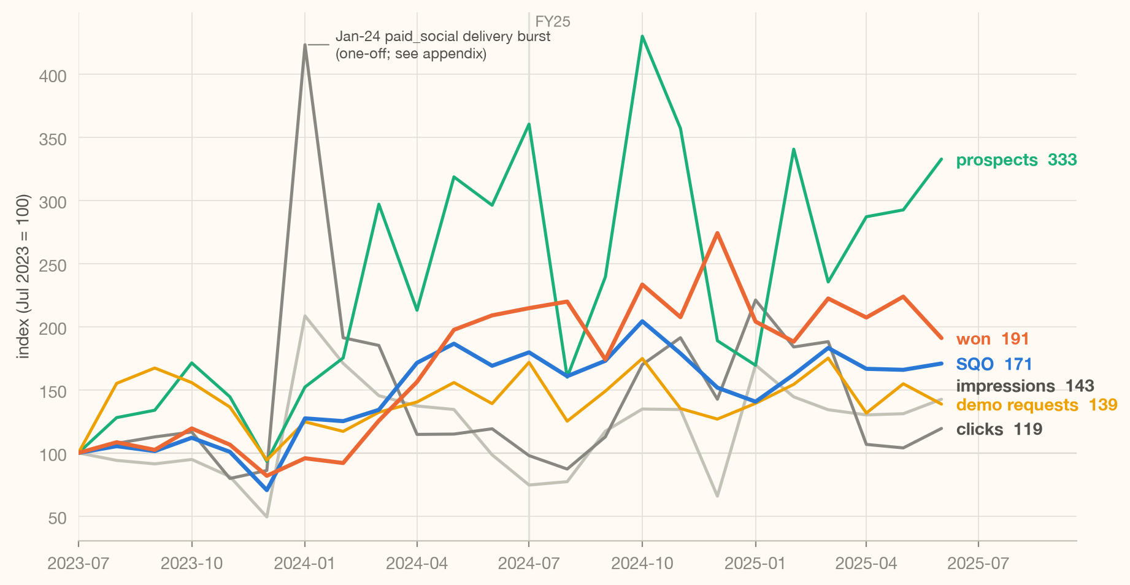
FY25 growth was conversion-led, not traffic-led
attributed SQOs +35% on flat-to-declining trustworthy traffic
the rate shift is broad-based (8 of 10 programs)
its cause is not determinable using the available data
sales-side or attribution change are plausible candidates

Slide 4
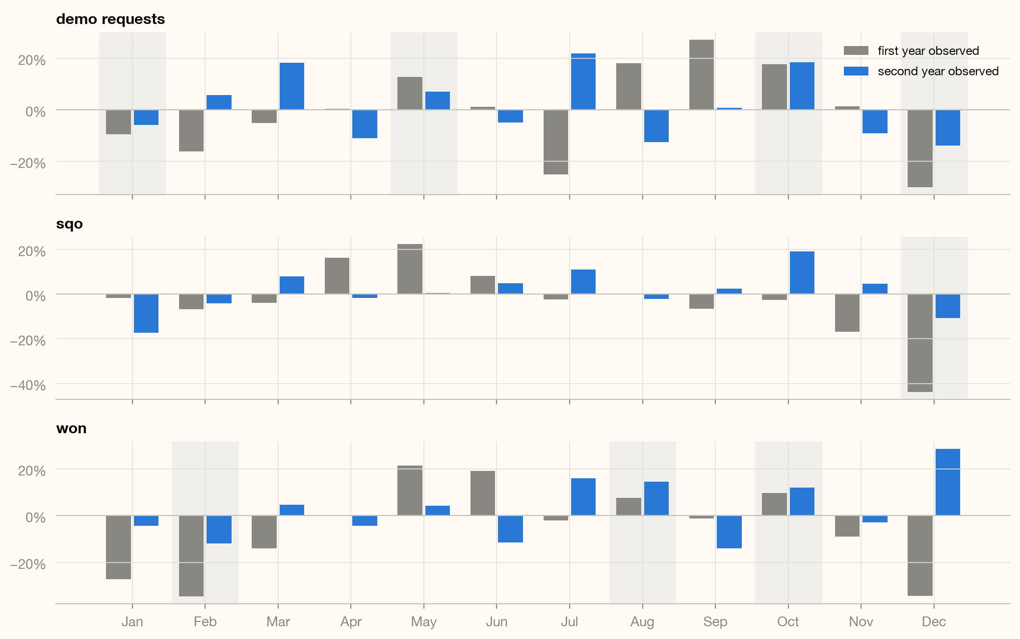
Seasonality looks straightforward and plannable
December dips, October lifts — direction repeats, amplitude doesn't
Patterns labeled seasonal only if recurring in both fiscal years; one-year swings listed in appendix.

Slide 5
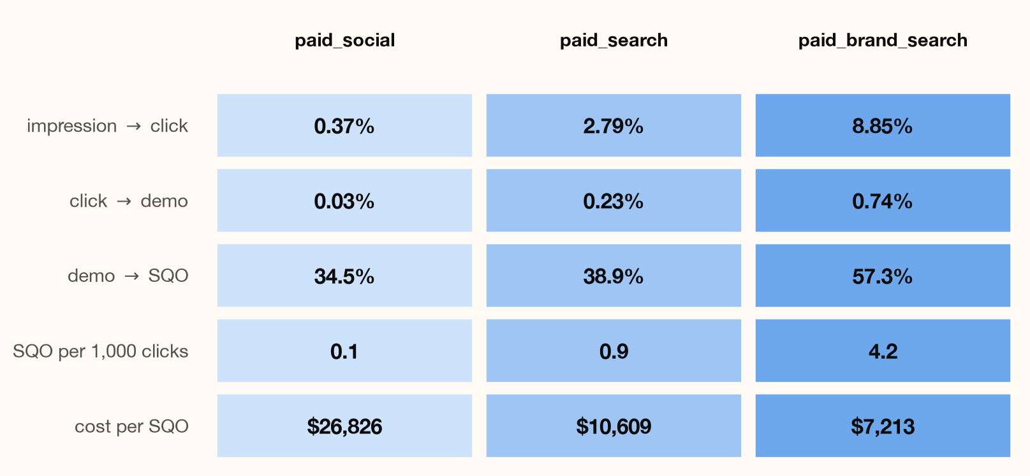
Channels do different jobs by design
social broadcasts, search captures, brand search converts — FY25 funnel shapes differ by an order of magnitude
FY25 (Jul-24–Jun-25); ratios of fiscal-year totals on attributed values, volume-weighted; funnel-lag caveat.

Slide 6
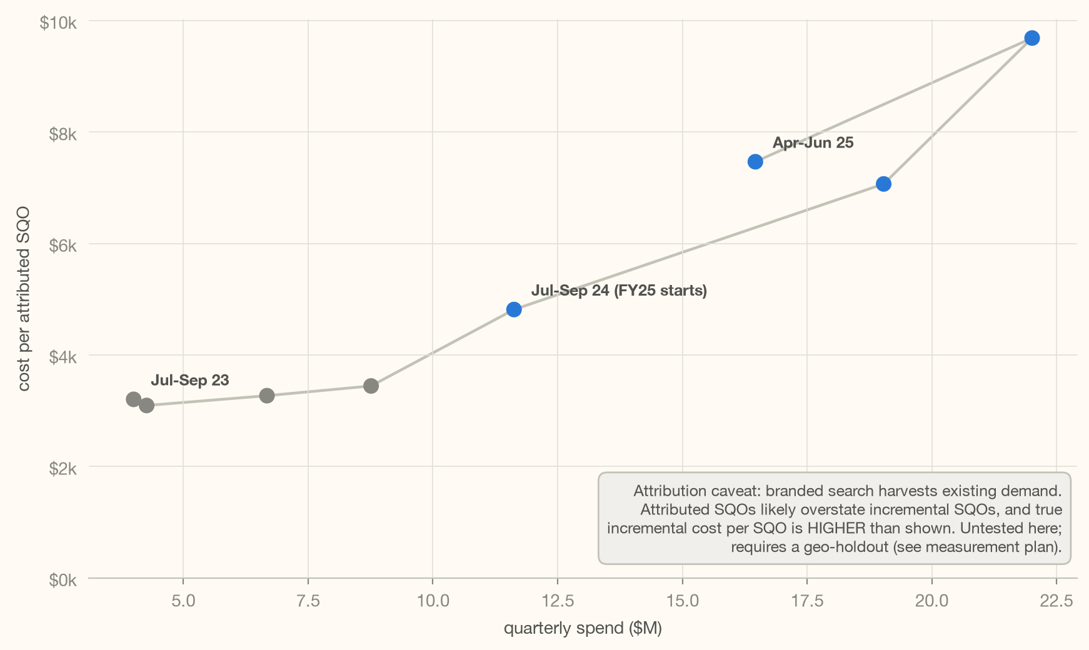
Efficiency fell as spend scaled — brand search cost/SQO doubled on ~3× budget
although expected, that’s undesirable and where optimization opportunities live
paid search's Oct-24 reach step-up: ~$32k of marginal spend per added SQO, ~4× its prior average
higher-spend months coincide with worse cost/SQO in both channels

Slide 7
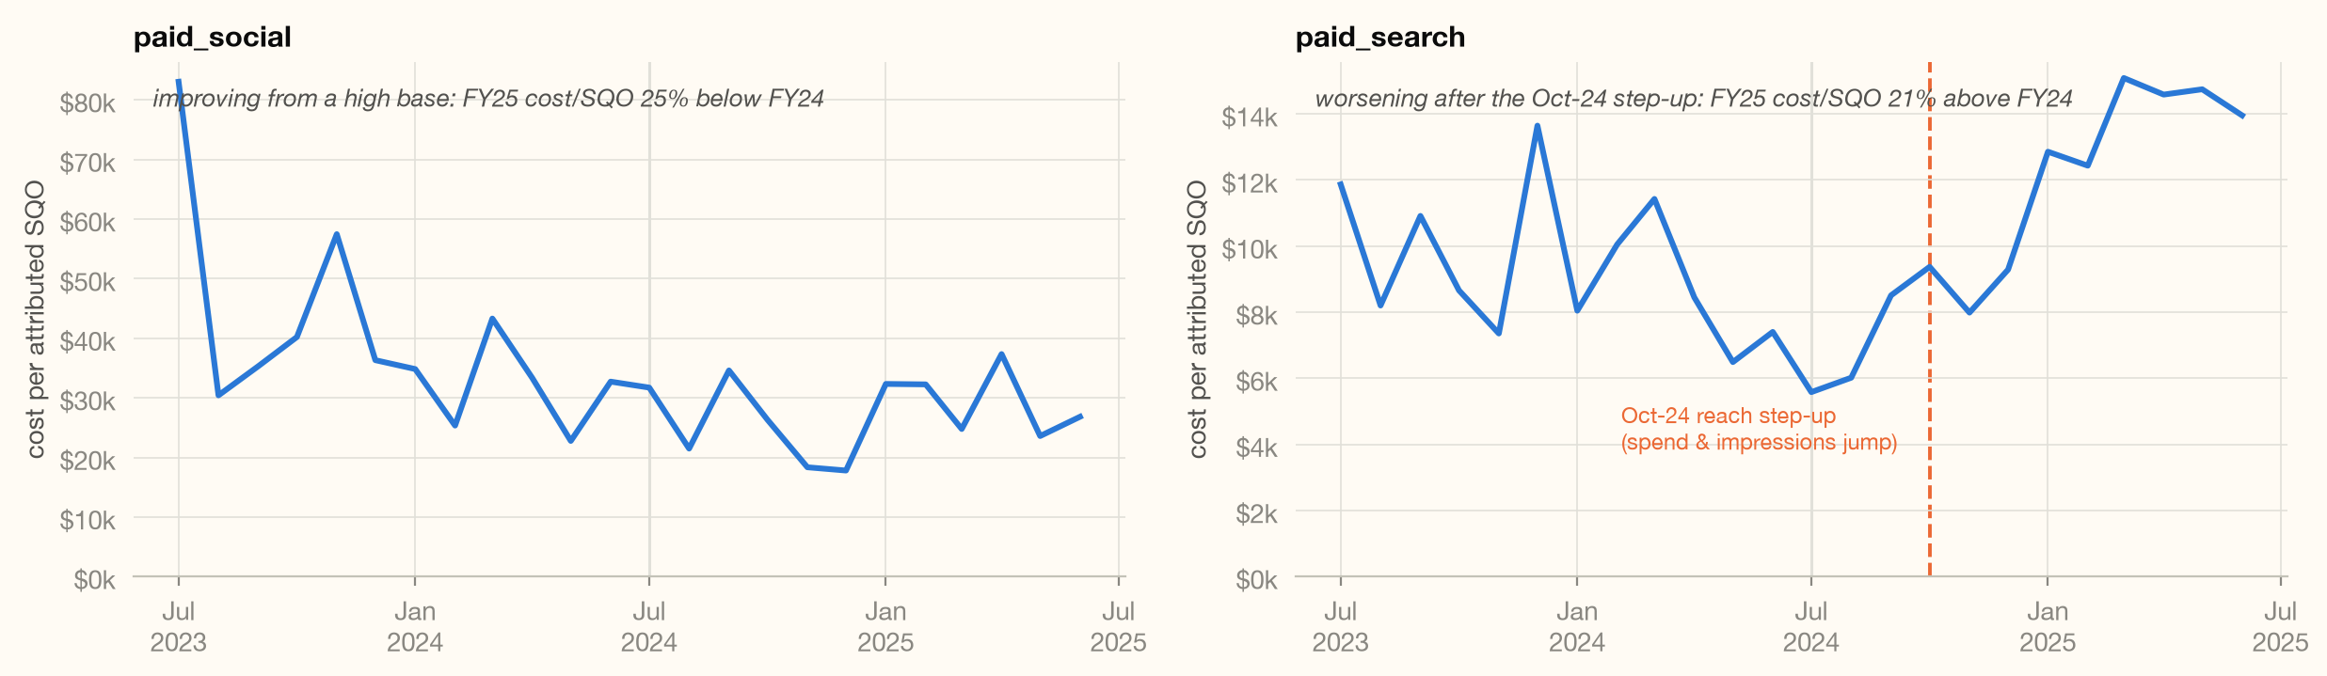
Paid Search’s Oct-24 ramp up
~$32k of marginal spend per added SQO, which is substantially (~4x) higher than its prior average
charts show monthly average cost per attributed SQO; the ~$32k headline is the marginal cost of the step-up (Δ spend ÷ Δ added SQOs) computed, not plotted on any line
Paid search’s average rose ~$7.9k → ~$12.1k across the step-up; the marginal dollar deteriorated fastest
disclaimer: arithmetic association, not incrementality

Slide 8
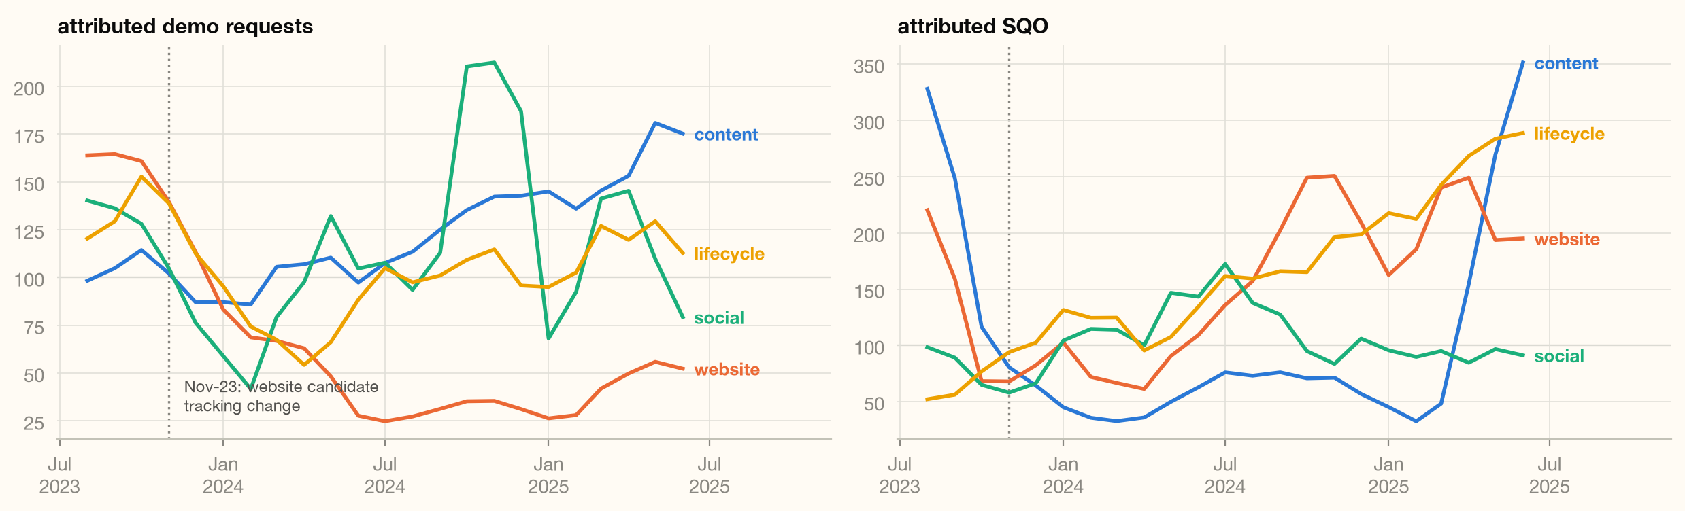
Zero-cost brand & organic channels grew while paid efficiency fell
lifecycle attributed SQOs +114% YoY
zero-media-cost channels hold 13.6% of FY25's attributed SQOs under a model that undercounts demand creation

Slide 9
Next Steps
Incrementality Measurement + Budgeting Process + Tracking Cleanup

Slide 10
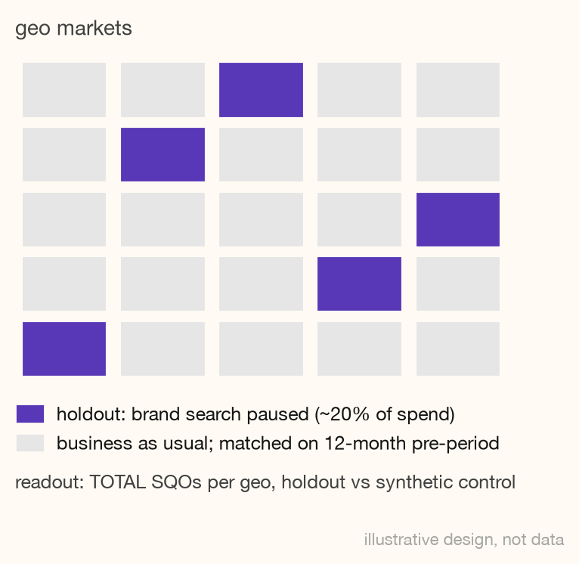
Measuring what's actually incremental through experimentation
brand search's efficiency is the least trustworthy number here (demand harvesting + the largest win-rate jump); MTA-based credit likely understates the zero-cost channels that create the demand it captures
Geo-holdout: pricing brand search incrementality
Pause paid_brand_search in matched geo markets covering ~20% of spend
12 weeks (2-week burn-in — assumed click→SQO lag, validated in-flight; 10-week read; 12-month pre-period for matching)
Primary metric: TOTAL SQOs per geo — never attributed SQOs; an attribution model cannot audit itself
Readout: matched-market / synthetic-control estimate (CausalImpact-style)
Decision rule:
  incremental cost/SQO > 2× the attributed $7.2k → cap and reallocate
  below → scale with confidence
Sized to separate “mostly incremental” from “mostly harvested”, not to estimate precise lift

Slide 11
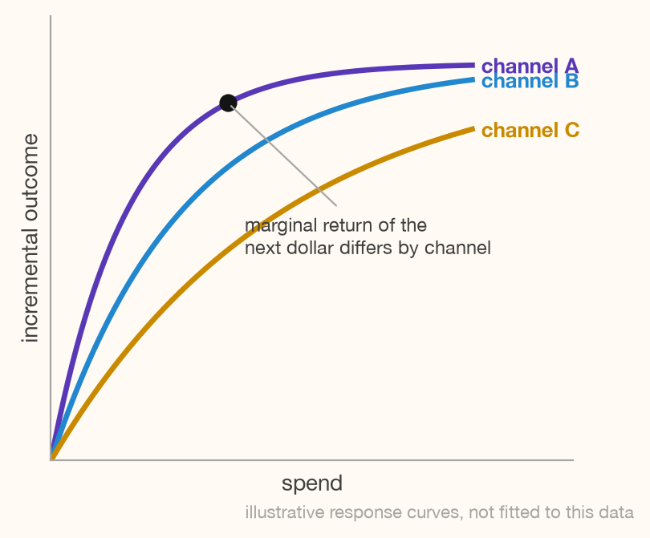
MMM prices the marginal dollar; experiments keep it honest
Attribution assigns credit to touchpoints but is not the right tool to find the marginal dollar per channel. Experiments answer single questions precisely while MMM generalizes them
MMM Prices the marginal dollar per channel
Start with a one-off MMM, then make it a permanent monthly budget-allocation tool:
Provides budget-allocation insights through the capture of media saturation and cross-channel effects while having robustness to tracking loss & attribution model changes
Inputs exist today with two full years of daily spend and outcomes
  plumbing the data is, nevertheless, usually challenging
Expect wide intervals at this program count — MMM for direction, experiments for the price
  holdout results calibrate the model rather than compete with it
Once properly set up it can be used on a monthly-basis for simulating the likely effects of changes in the budget, promotions or channel mix

Slide 12
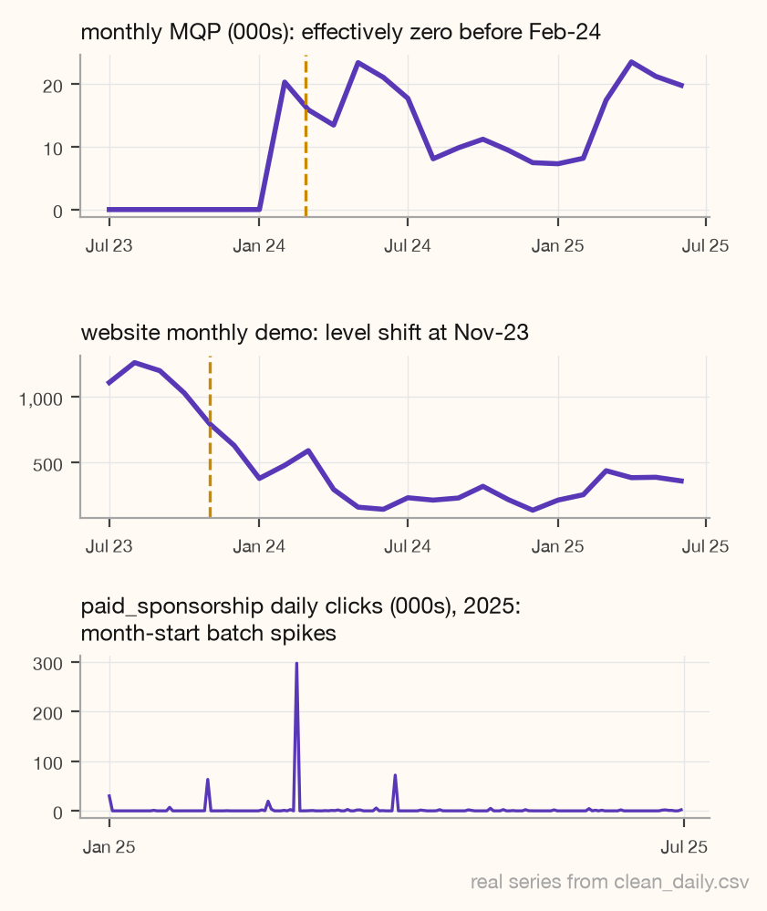
Historical trends aren't trustworthy until these tracking debts are cleared
because a good analysis starts with trustworthy data
Garbage in, garbage out
Having the historical data right (or having a documented explanation on why it isn’t) is a fundamental part of the roadmap.
MQP capture starts Feb-24 so it is necessary to have documented definitions and backfill or fence historical reporting.
Website demo definition shifted Nov-23 and reconciliation must happen before any trend crossing that date is trusted.
Enforcing daily-grain delivery contracts on vendor click batch-dumps (e.g. abm, sponsorship)
Define metrics in the semantic layer (dbt/Looker) and version tracking history, so future reporting inherits definitions instead of rediscovering these bugs

Slide 13
Stakeholder recommendations
Paid Marketing Director
Head of Marketing
Search and brand search hold 81% of FY25's growth in attributed “Wins”
The risk is rising marginal cost
  brand search cost/SQO doubled on ~3× spend
  Oct-24 reach expansion bought SQOs at ~4× the prior rate
  the holdout test (potentially funded by budget holds) shows within a quarter which spend is incremental.
Until the roadmap rollout:
  reduce paid search back to pre-Oct-24
  hold brand search
  hold paid social
In 2–3 months:
  test live, first readout, marginal-cost view in the pacing dashboards.
Zero-media-cost channels hold 13.6% of attributed SQOs and lifecycle +114%
  under a model that structurally undercounts demand creation.
If brand search harvests, your channels create what it captures.
The measurement plan shines a light on that:
  leading indicators (branded search volume, direct traffic, unattributed demos) within weeks
  geo-lift on any brand increase
  MMM for the full picture.
  In 2–3 months there will be a live baseline

Slide 14
Thank you
Paulo Muzyczuk · laracruz.paulo@gmail.com

Slide 15
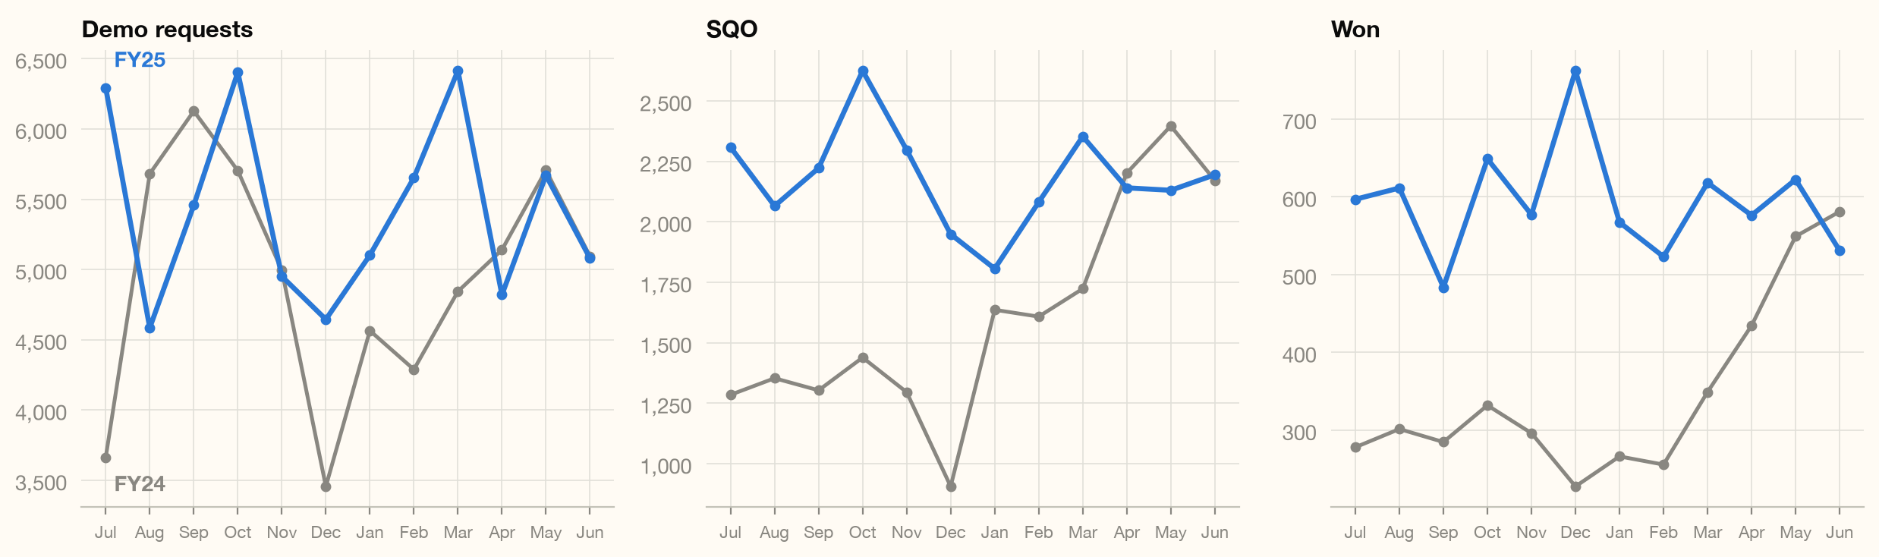
APPENDIX
FY24 vs FY25 by fiscal month: demo requests, SQO, won

Slide 16
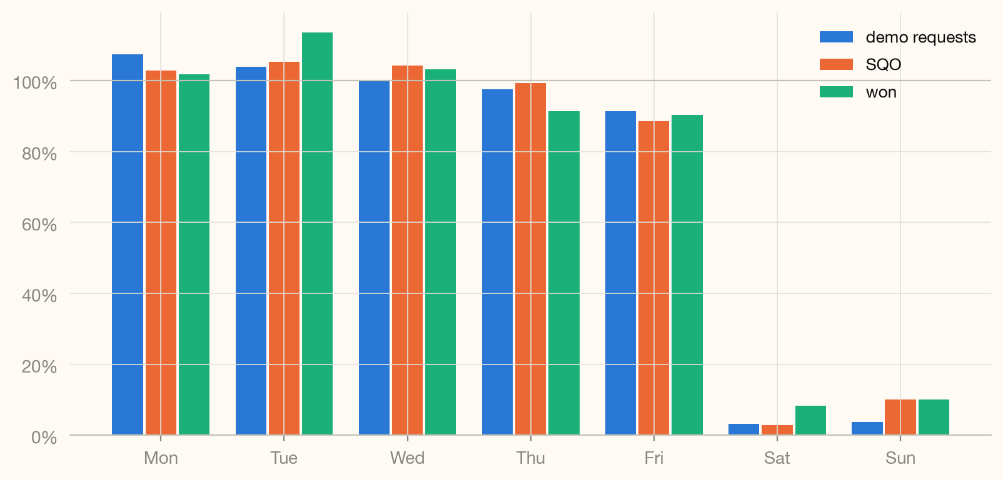
APPENDIX
Day-of-week profile: mean daily volume as % of the Mon–Fri average

Slide 17
APPENDIX
Seasonal patterns vs one-year swings: the both-years rule applied
December dip
recurring seasonal
demo −30%/−14%, SQO −44%/−11% vs centered rolling mean, both years
October lift
recurring seasonal
demo +18%/+18%, won +10%/+12%, both years
January restart dip
recurring seasonal
prospects −23%/−40%, demo −9%/−6%, both years
May–June prospects lift
recurring seasonal
May +28%/+6%, Jun +17%/+26%, both years
Jan-24 paid_social delivery burst
one-off event
impressions 5.3× and clicks 7.5× vs Dec-23 on cost +94%; CTR 2–3× norm
Jul-24 event burst
one-off event
prospects +40% vs rolling mean; single-day event MQP spike 957× median
Dec-24 Won spike
one-off event
+29% vs rolling mean; Dec-23 was −34%, failing the both-years rule
paid_awareness Mar-25 ramp
one-off event (flight)
monthly spend ~$133k → ~$1.1M from Mar-25; program is flighted by design
Seasonal = same-direction deviation from a centered 12-month rolling mean in BOTH fiscal years (|dev| > 5%). Full 16-row table with hypotheses and confirming evidence: task 1 notebook. Tracking artifacts (MQP start, website Nov-23, click dumps): slide 11.

Slide 18
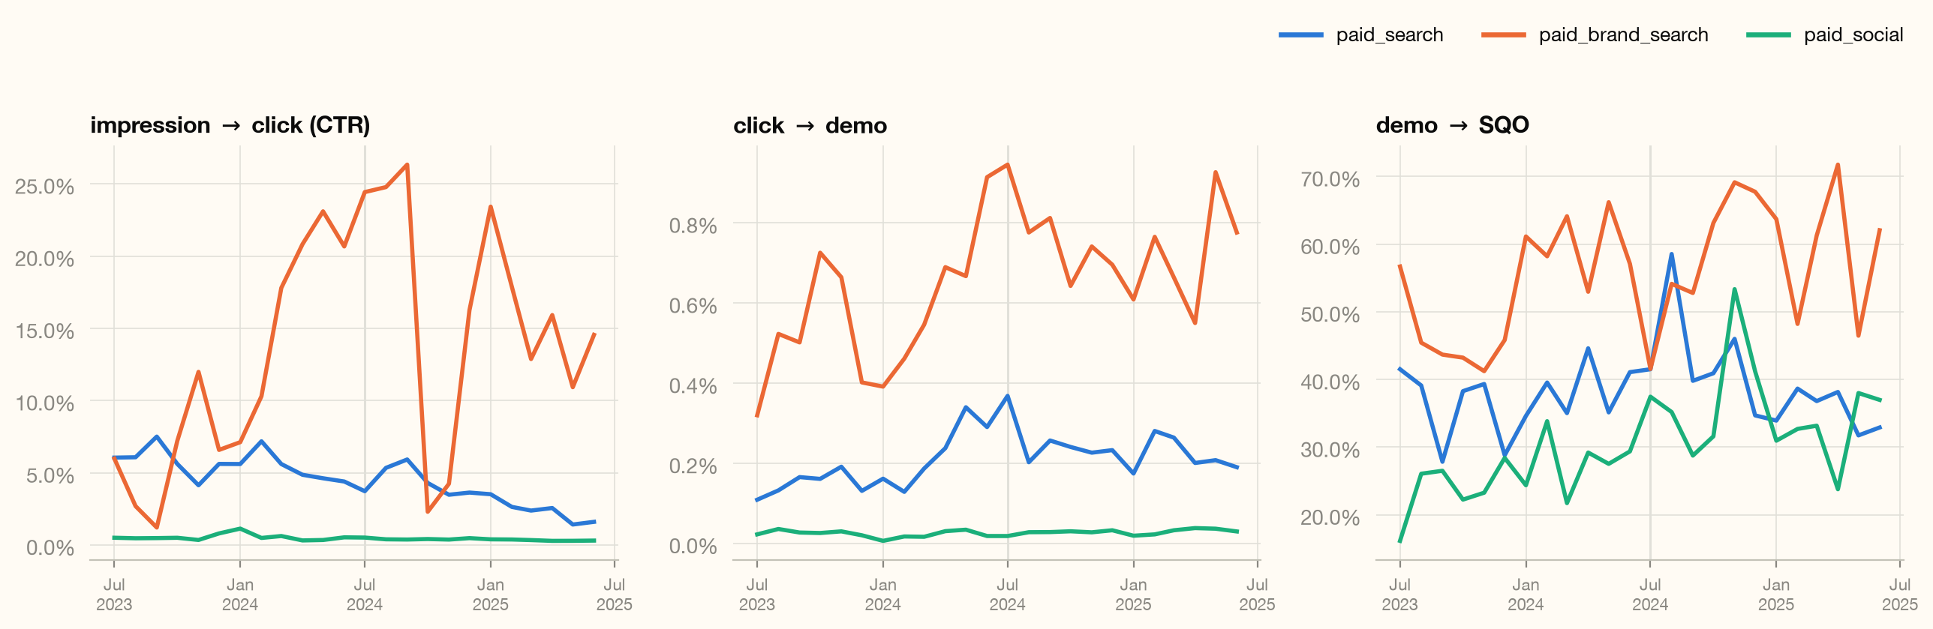
APPENDIX
Channel rate trends: CTR, click→demo, demo→SQO (monthly)

Slide 19
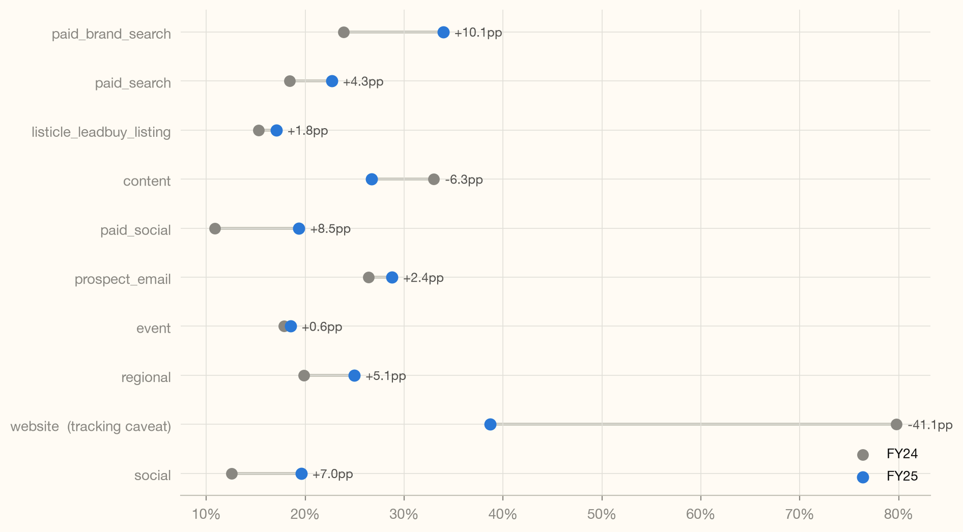
APPENDIX
SQO→Won by program: FY24 vs FY25 (≥100 attributed SQO in both years)

Slide 20
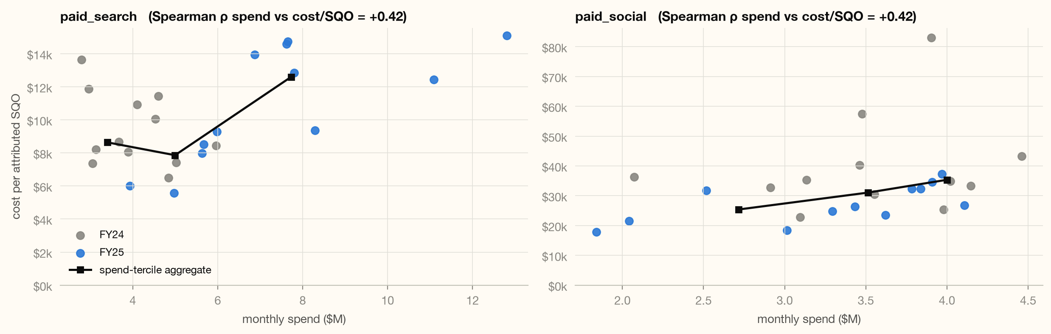
APPENDIX
Monthly spend vs cost per attributed SQO: points + spend-tercile aggregates
Association under scaling, not a causal response curve; seasonality, mix and auction conditions unmodeled.

Slide 21
APPENDIX
Brand/organic attributed demo & SQO, indexed to FY24 average = 100; website carries the Nov-23 tracking caveat

Slide 22
APPENDIX
Methodology & caveats
Attribution: SQO / Won are fractional multi-touch attributed credit, used as-is, phrased as attributed values, never as deals counted once.
Funnel lag: stages are not same-day cohorts (MQP > Prospects in ~13% of daily rows, Demo > MQP in ~29%). All rates at monthly grain or coarser; period ratios, not cohort rates.
MQP tracking starts Feb-24 (effectively zero before: one 2-unit row in Jan-24); analyzed from Mar-24 only, FY YoY suppressed. Detail: slide 12.
website demo definition shift Nov-23 (candidate tracking change, hypothesis). Detail: slide 12.
De-duplication: 52 duplicate (date, program) rows (26 keys, regional & website, Jun-18..30 2025; one real + one all-zero row each) aggregated by sum; the all-zero rows also carried a wrong team label, repaired to the program's majority team.
ooh & paid_other excluded (zero cost, zero outcomes); 35 clicks>impressions rows flagged and excluded from CTR only.
every assumption & cleaning decision: ASSUMPTIONS.md · reproduce end-to-end: ./run.sh (raw CSV → clean data → figures → this deck). All 75 headline numbers re-derived from the raw file in analysis/verify_numbers.py.

