Slide 1

Bank Marketing
Campaign Optimization
From broad outreach to prioritized campaigns: a data-driven path to higher term-deposit sales.
Paulo Eduardo Pereira Magalhaes, Aug 2026
Notes:
[Sources]
Visual on this slide was generated with Microsoft Copilot. Data story and audience framing are based on the prior analysis results in this conversation.

Slide 2
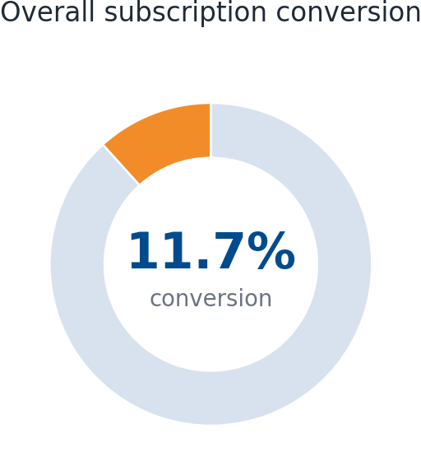
EXECUTIVE TAKEAWAY
The campaign has a clear conversion opportunity
Only a small share of contacts become subscribers, so better targeting can improve commercial efficiency.
45,211
11.7%
5,289
88.3%
customer contact records
overall conversion
subscribers
non-conversion pool
PRIMARY BUSINESS QUESTION
Which customer, financial, and campaign characteristics are most strongly associated with term deposit subscription?
Storyline: improve conversion by moving from broad outreach to prioritized, insight-driven campaigns.
Bank Marketing Case Study | 2
Notes:
[Sources]
Analysis computed from the Bank Marketing dataset provided in the conversation; dataset documentation: bank-names.txt, including citation request for Moro, Laureano and Cortez (2011).
Chart values shown: 45,211 records, 5,289 subscribers, 11.70% conversion.

Slide 3
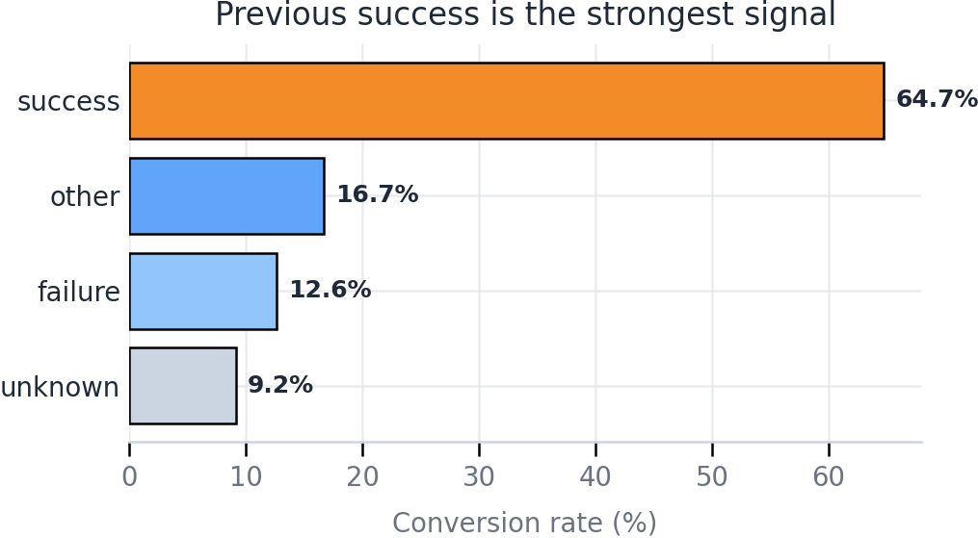
INSIGHT 1
Prioritize customers with proven response history
Previous campaign success is the clearest signal for future subscription.
64.7%
conversion after previous success
What this means
Past positive response is not just a historical attribute. It is a practical prioritization rule for campaign lists and sales follow-up.
Action: create a high-priority queue for customers with previous success.
Bank Marketing Case Study | 3
Notes:
[Sources]
Analysis computed from the Bank Marketing dataset provided in the conversation; dataset documentation: bank-names.txt, including citation request for Moro, Laureano and Cortez (2011).
Key claim supported by computed chart values: conversion rate by previous campaign outcome shows success at 64.73%, other at 16.68%, failure at 12.61%, and unknown at 9.16%.

Slide 4
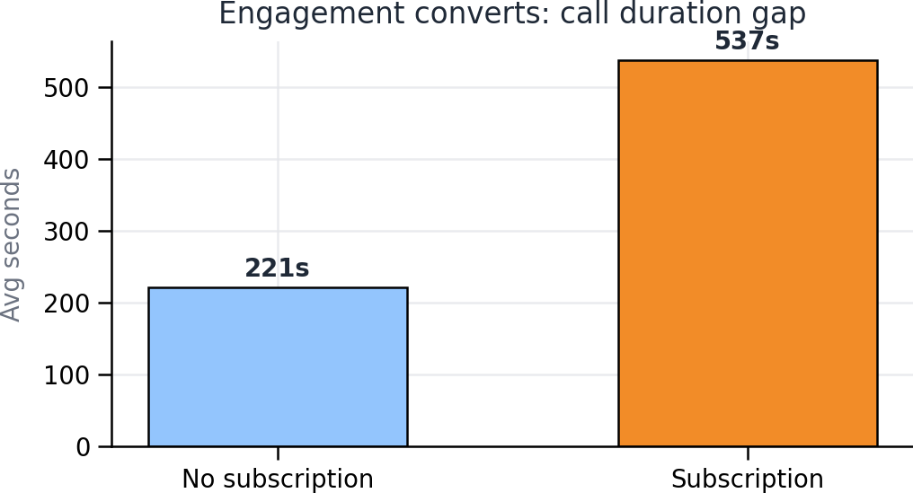
INSIGHT 2
Engagement quality matters more than contact volume
Subscribers stayed on calls more than twice as long on average.
537s
221s
avg subscriber call
avg non-subscriber call
Commercial interpretation
Longer conversations reflect stronger customer engagement and better opportunity to explain the value proposition.
Modeling caution
Call duration is known after contact. Use it for process learning but be careful if predicting before the call.
Bank Marketing Case Study | 4
Notes:
[Sources]
Analysis computed from the Bank Marketing dataset provided in the conversation; dataset documentation: bank-names.txt, including citation request for Moro, Laureano and Cortez (2011).
Key claim supported by computed values: average duration for subscribers = 537.3 seconds; average duration for non-subscribers = 221.2 seconds.

Slide 5
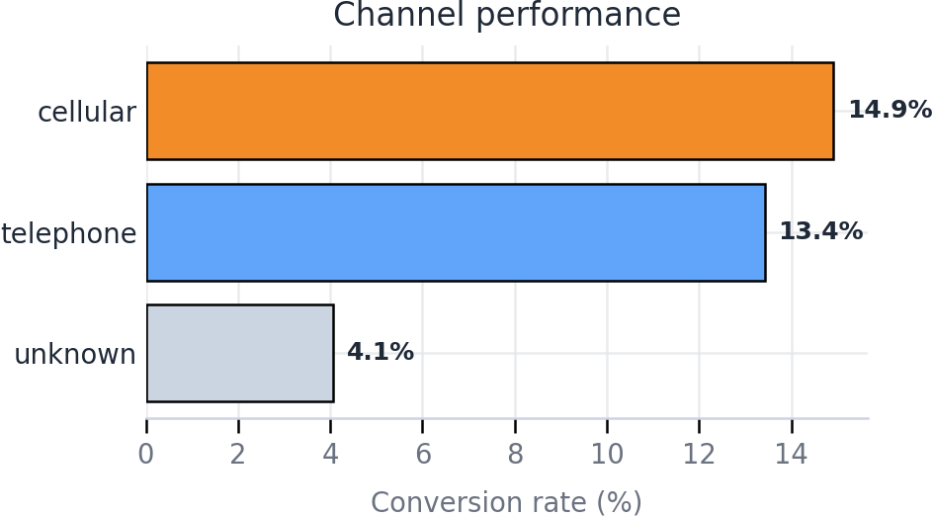
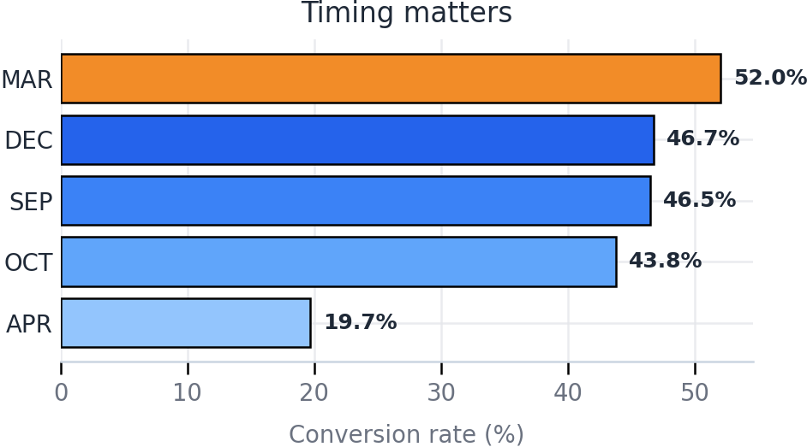
INSIGHT 3
Channel and timing should become active campaign levers
Cellular, March, December, September, and October show stronger observed conversion.
Campaign design should combine channel preference and seasonal timing, not treat all contacts as equal.
Bank Marketing Case Study | 5
Notes:
[Sources]
Analysis computed from the Bank Marketing dataset provided in the conversation; dataset documentation: bank-names.txt, including citation request for Moro, Laureano and Cortez (2011).
Key claim supported by computed values: contact conversion rates were cellular 14.92%, telephone 13.42%, unknown 4.07%. Highest month conversion rates shown: March 51.99%, December 46.73%, September 46.46%, October 43.77%, April 19.68%.

Slide 6
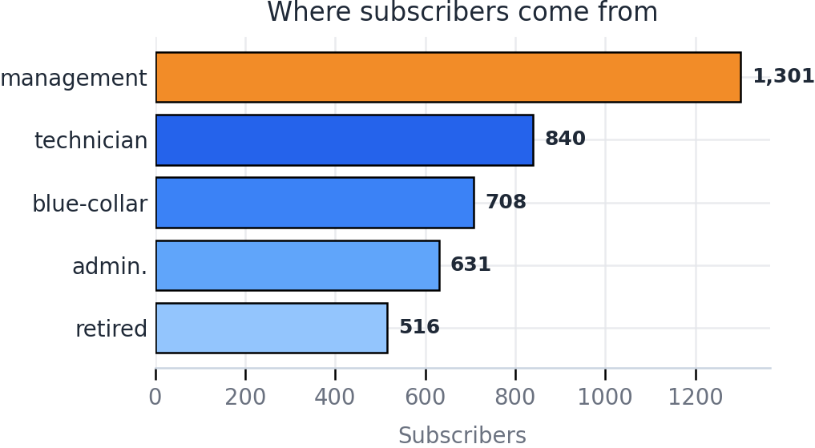
INSIGHT 4
Segment investment-product outreach by opportunity pools
Subscriber volume is concentrated in a few occupation groups.
High-opportunity pools
Management
1,301 subscribers
Largest subscriber pool
Technician
840 subscribers
Skilled-professional segment
Retired
516 subscribers
Retirement-income relevance
Next analytical layer: compare conversion rate and profitability by segment, not only subscriber count.
Bank Marketing Case Study | 6
Notes:
[Sources]
Analysis computed from the Bank Marketing dataset provided in the conversation; dataset documentation: bank-names.txt, including citation request for Moro, Laureano and Cortez (2011).
Key claim supported by computed values: top occupations among subscribers were management 1,301; technician 840; blue-collar 708; admin. 631; retired 516. Additional statement about next analytical layer is a recommendation based on the business context.

Slide 7
STAKEHOLDER PLAYBOOK
Turn the findings into coordinated business action
Each stakeholder group owns a different part of the conversion improvement system.
Stakeholder
Immediate decision
Primary KPI
Marketing
Prioritize audiences with prior success and high-response timing
Conversion rate by campaign
Sales Management
Use lead queues and call-quality coaching
Contact-to-conversion
efficiency
Product Team
Tailor investment-product messaging by segment
Take-up by segment
Executive Leadership
Allocate budget toward higher-probability campaigns
ROI and acquisition
cost
Decision principle: prioritize customers and campaigns using response history, channel performance, timing, and segment size.
Bank Marketing Case Study | 7
Notes:
[Sources]
Analysis computed from the Bank Marketing dataset provided in the conversation; dataset documentation: bank-names.txt, including citation request for Moro, Laureano and Cortez (2011).
Stakeholder actions are business recommendations derived from the analysis findings. They are not additional dataset claims.

Slide 8

RECOMMENDED ROADMAP
From insight to execution: three moves to increase conversion
Use the analysis as a repeatable targeting system, not a one-time report.
Prioritize
1
Build lead lists around previous success and high-response months.
Personalize
2
Adapt messaging by opportunity segment and channel.
Predict
3
Compare interpretable and tree-based models with recall-oriented metrics.
Final message: smarter prioritization can improve conversion efficiency before increasing campaign volume.
Bank Marketing Case Study | 8
Notes:
[Sources]
Visual on this slide was generated with Microsoft Copilot.
Analysis computed from the Bank Marketing dataset provided in the conversation; dataset documentation: bank-names.txt, including citation request for Moro, Laureano and Cortez (2011).
Recommended roadmap reflects business recommendations derived from the analysis findings.

