Slide 1


Direct
Marketing
Campaign
Paulo Reis

Slide 2
Agenda
Context
Challenges
Solution
Insights
Next Steps

Slide 3
Context
Overview
Keeping a high customer engagement is key for growing and consolidating the company’s position as the market leader.
Globally, the company had solid revenues and a healthy bottom line in the past 3 years, but the profit growth perspectives for the next 3 years are not promising... For this reason, several strategic initiatives are being considered to invert this situation. One is to improve the performance of marketing activities, with a special focus on marketing campaigns.
Motivation
The marketing department was pressured to spend its annual budget more wisely. The CMO perceives the importance of having a more quantitative approach and hires a data scientist to maximize the profit for the next direct marketing campaign.

Slide 4
Challenges
Limited Budget Allocation
Invest Wisely
Understand Cutomer Behavior
Who is our best shot?
Maintain Customer Engagement
Find Business Opportunities
Problem
Cause

Slide 5
Challenges
Limited Budget Allocation
Invest Wisely
Understand Cutomer Behavior
Who is our best shot?
Data Analysis
Customer Segmentation
Campaign Acceptance Detection
Problem
Solution

Slide 6
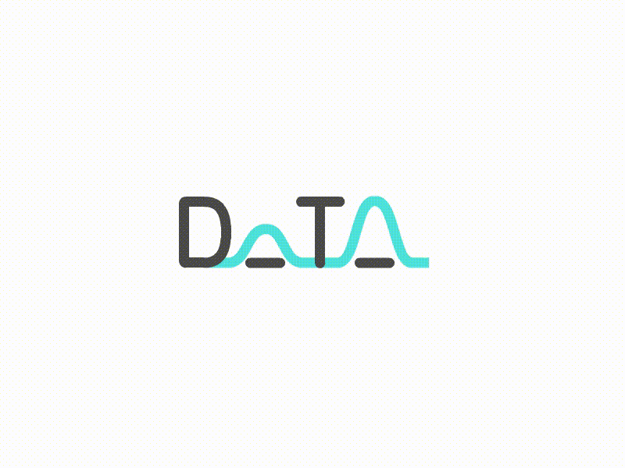
Solution – We need
Perform robust exploratory analysis
To understand how variables connect with response rates and take actions.
Create a predictive model
To predict customer behavior and to apply it to the rest of the customer base.
Describe a customer segmentation
To well comprehend customers needs and act accordingly.

Slide 7
Business Impact
Predictive Model
Precision: What proportion of the targets identifications was actually correct?
71% +/- 7
Worst Scenario:
R$ 15,675.73
Best Scenario:
R$ 19,104.80
ROI then: -45%
ROI now: 158%

Slide 8
Cluster Analysis
 | Count | Targets%
Targeted | 457 | 29%
Untargeted | 799 | 05%
Hidden Tagerts | 800 | 17%
Targeted – It concentrates more targets. Segment of Targets.
Untargeted – It concentrates fewer targets. Group We want ot avoid (or work on with another marketing strategy).

Slide 9

 | Targeted | Untargeted | Hidden Targets
Recency |  | More than 48 days since last pruchase | Less than 48 days since last pruchase
Income | Over R$ 45,000
Amount Spent on Wines | Over R$ 375 | Under R$ 505 | Under R$ 531
Amount Spent on Fruits |  | Under R$ 55 | Under R$ 60
Amount Spent on Meat |  | Under R$ 282 | Under R$ 300
Amount Spent on Fish |  | Under R$ 84 | Under R$ 90
Amount Spent on Sweets |  | Under R$ 58 | Under R$ 64
Amount Spent on Gold |  | Under R$ 99 | Under R$ 99
Number of Purchases | Have bought more than 10 products
Amount Spent | Over R$ 484
Cross
Selling
in the last 2 years(90% of customers)

Slide 10
 | Targeted | Untargeted | Hidden Targets
Recency |  | More than 48 days since last pruchase | Less than 48 days since last pruchase
Income | Over R$ 45,000
Amount Spent on Wines | Over R$ 375 | Under R$ 505 | Under R$ 531
Amount Spent on Fruits |  | Under R$ 55 | Under R$ 60
Amount Spent on Meat |  | Under R$ 282 | Under R$ 300
Amount Spent on Fish |  | Under R$ 84 | Under R$ 90
Amount Spent on Sweets |  | Under R$ 58 | Under R$ 64
Amount Spent on Gold |  | Under R$ 99 | Under R$ 99
Number of Purchases | Have bought more than 10 products
Amount Spent | Over R$ 484
in the last 2 years(90% of customers)

Slide 11
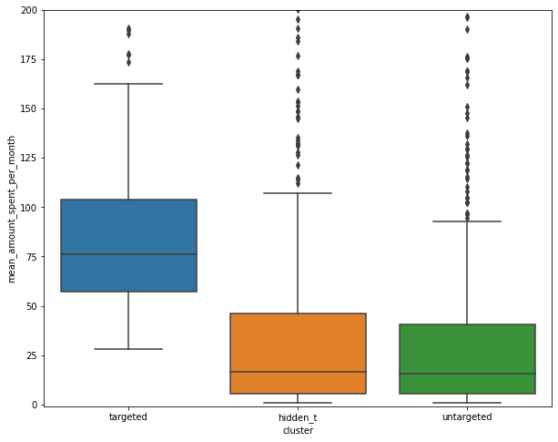
Amount Spent | Over R$ 484
Amount Spent Month | Over R$ 27
Cross Selling

Slide 12
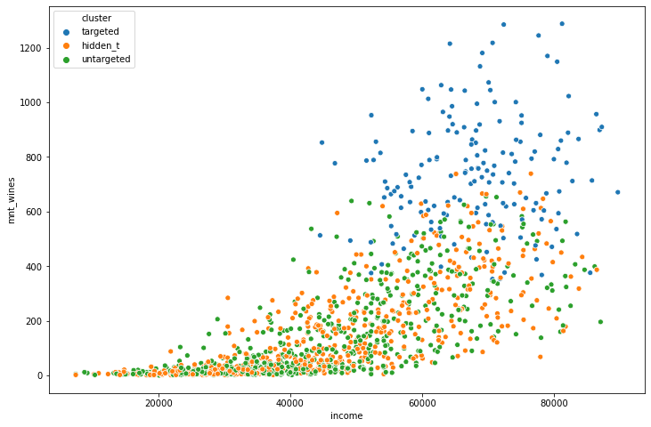
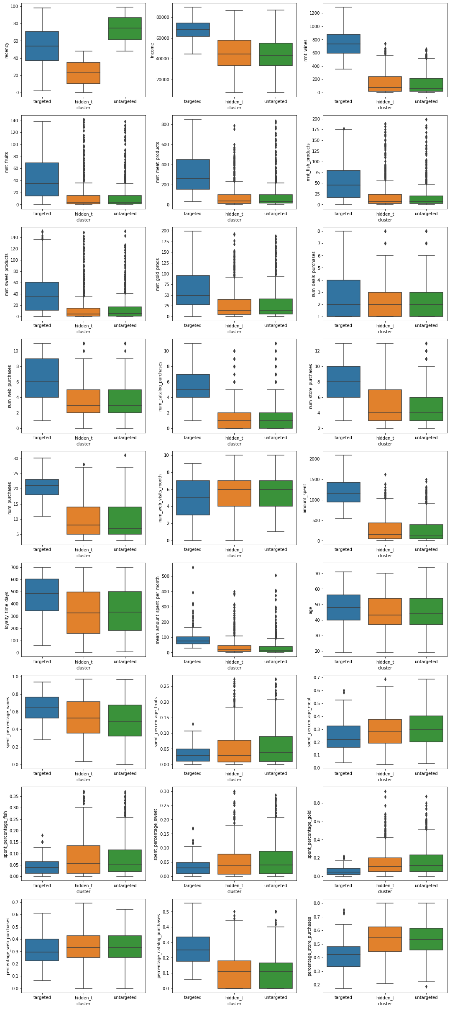
Greater Income and Spendings on Wine

Slide 13
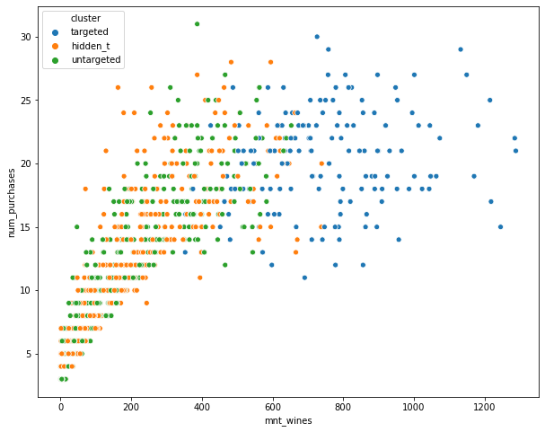
Higher number of Purchases

Slide 14
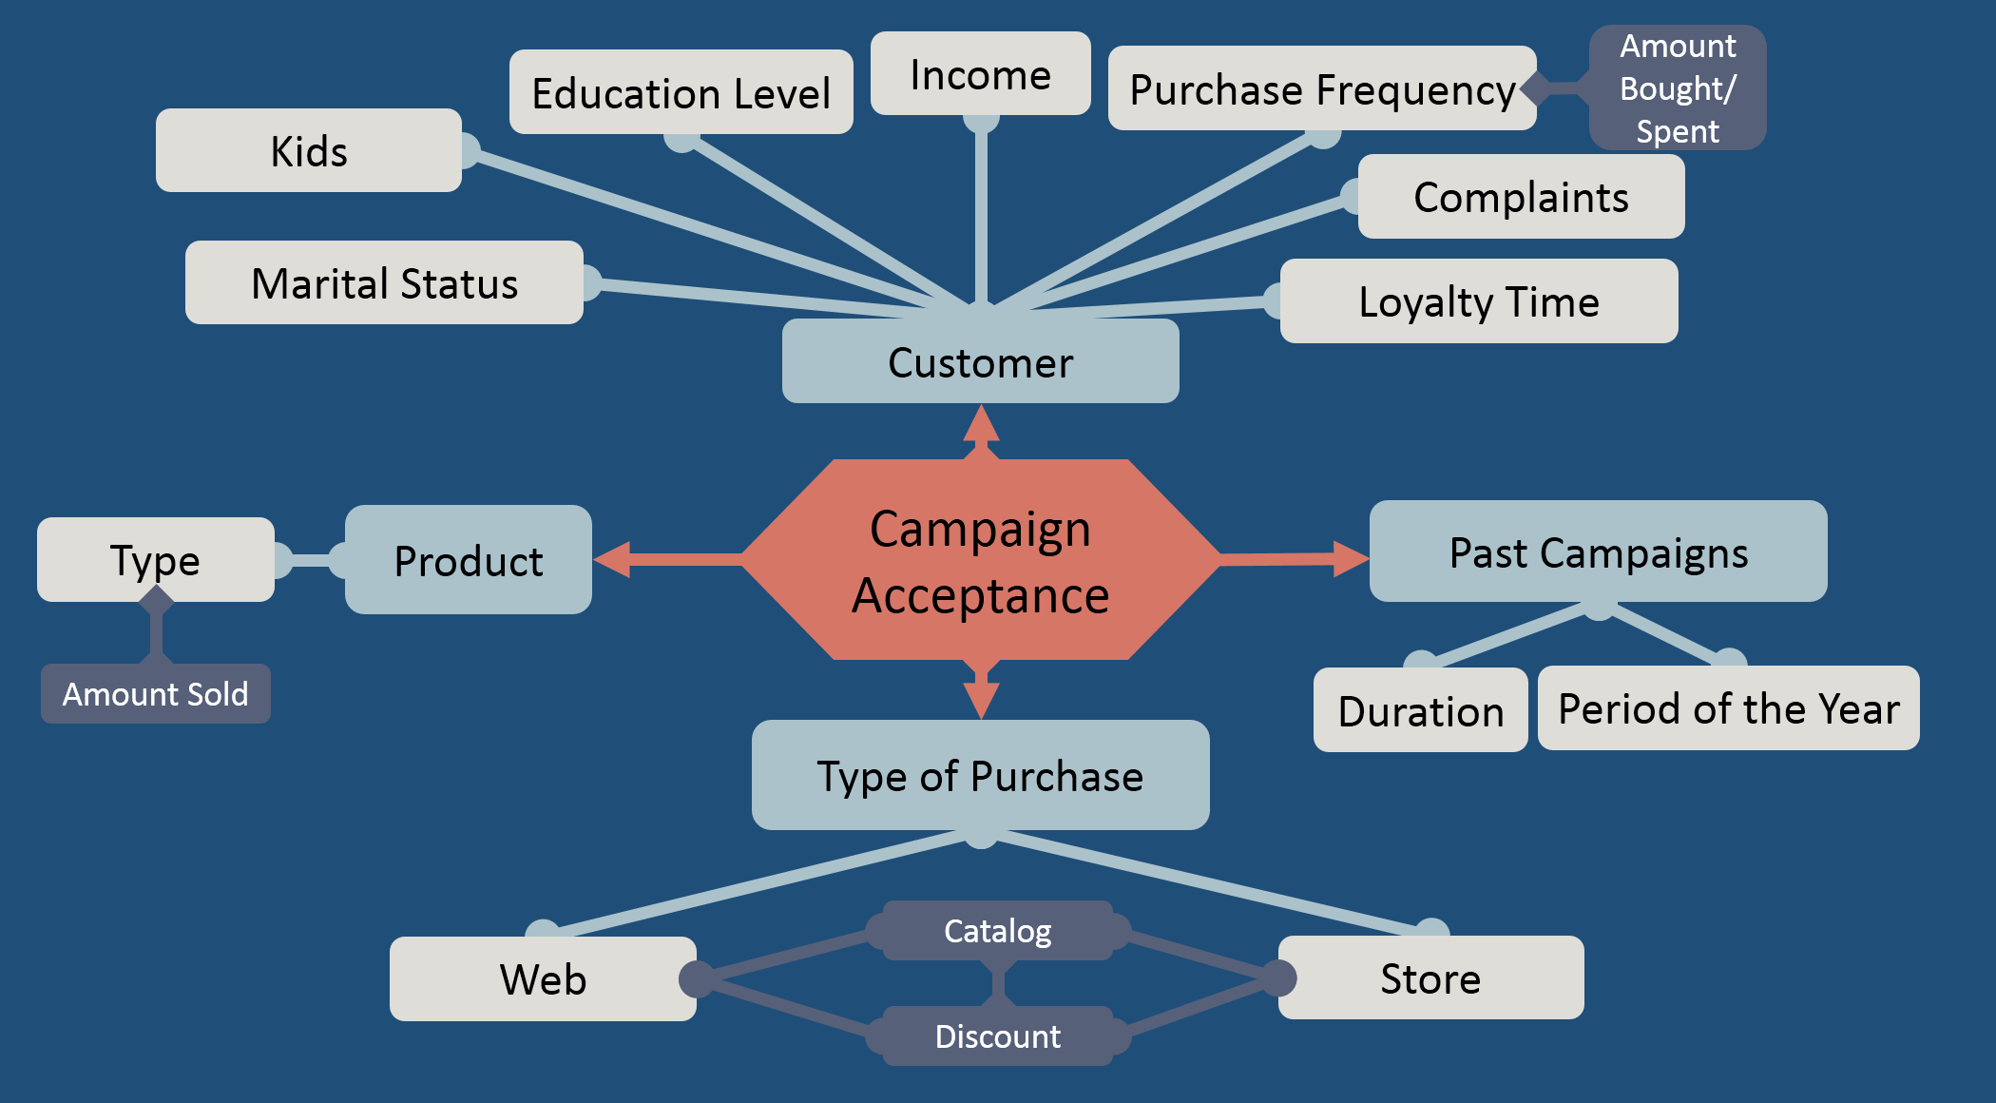
Insights

Slide 15
Insights
1% of customers has complained in the last 2 years
Web: 77% conversion rate (8425/10934)

Slide 16
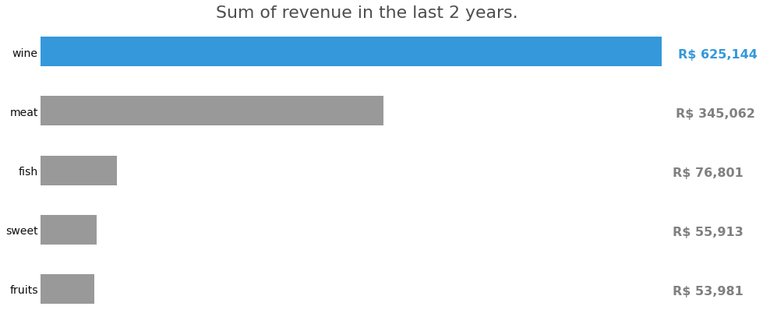
What type of product brings more revenue?

Slide 17
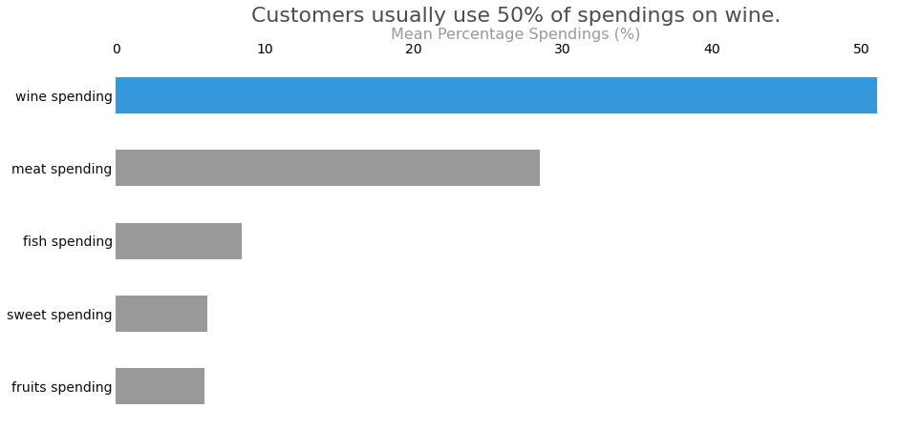
What type of product brings more revenue?
%
%
%
%
%
This may be a lead to a future campaign, project or innovation

Slide 18
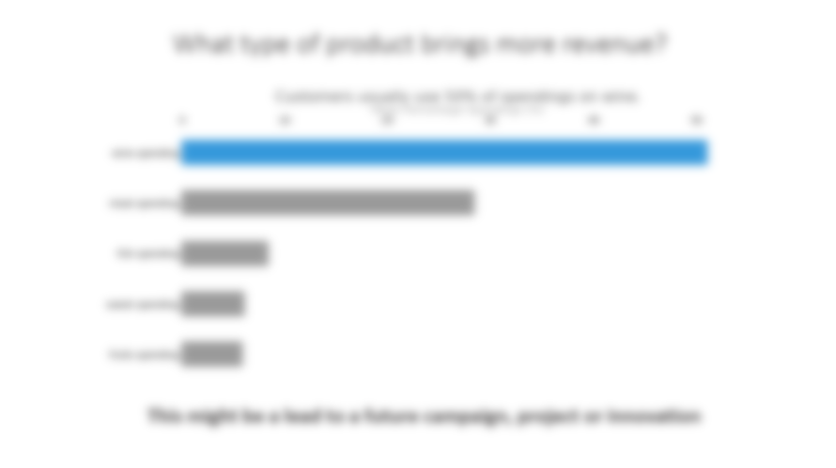
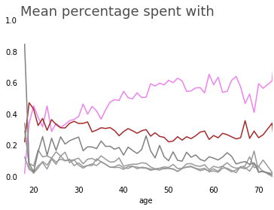
Wine
Meat
We can focus on marketing to make wine sales stronger or to bring other products to the race. Either way we need other types of data to be more accurate about which path to follow.

Slide 19
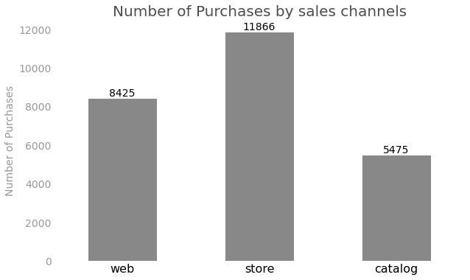
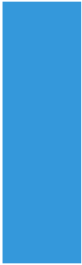
What purchase channel brings more revenue?
Monthly Revenue:
29%
R$ 24,650
44%
R$ 37,400
27%
R$ 22,950

Slide 20
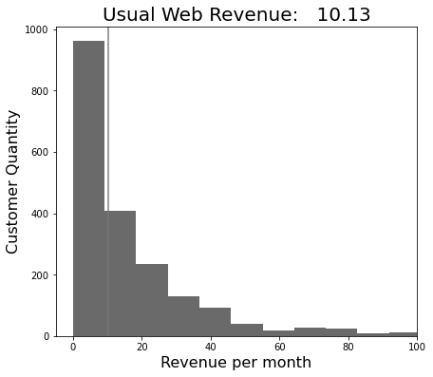
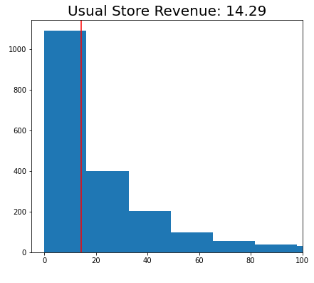
What purchase channel brings more revenue?
R$ 10.13
R$ 14.29
Usual Catalog Revenue: R$ 4.30
As web conversion rate is 77%, this might be a signal to attract people to web plataform.

Slide 21
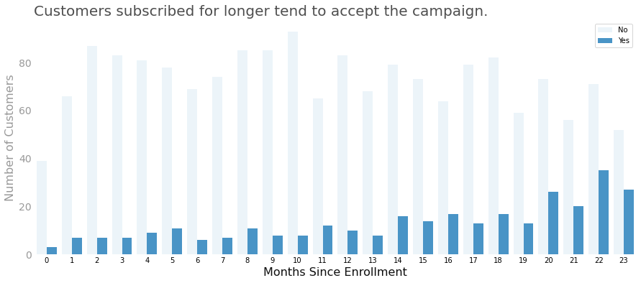
Older customers tend to accept the campaign.
Yes. In the target campaign we can see that most target customers are subscribed for longer. However, throughtout the campaigns there are no trend.

Slide 22
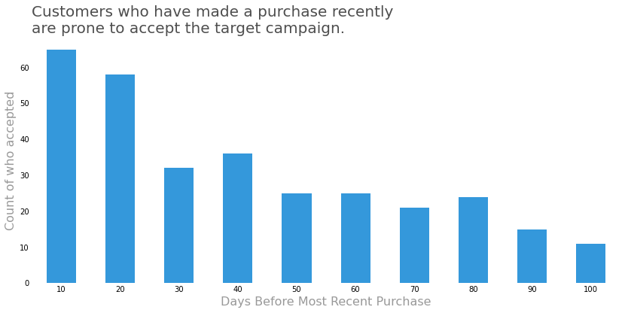
Customers who buy more frequently tend to accept the campaign.
No data about frequency or dates of purchases. However...

Slide 23
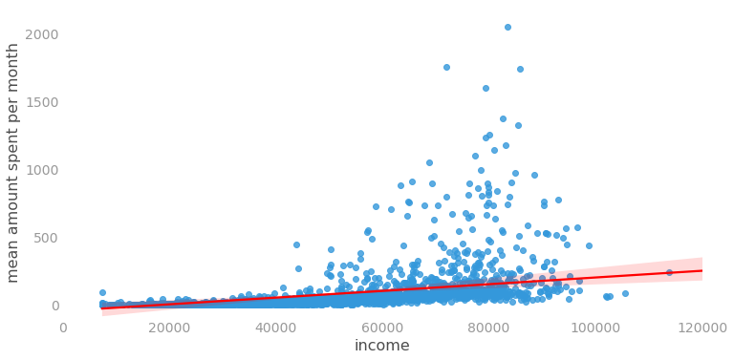
Customers with higher income bring more revenue.
Yes, but this correlation is not as strong as expected, which means that in terms of revenue the difference may not be that large (weak linear relationship).

Slide 24
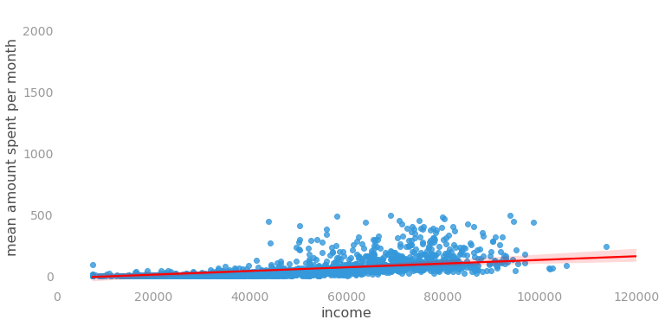
Customers with higher income bring more revenue.
Outliers R$ 200
Quantile 90%: R$ 144
500
Min R$ 0.27 R$ 0.64 R$ 0.68 R$ 0.68
Max R$ 497 R$ 95 R$ 484 R$ 496

Slide 25
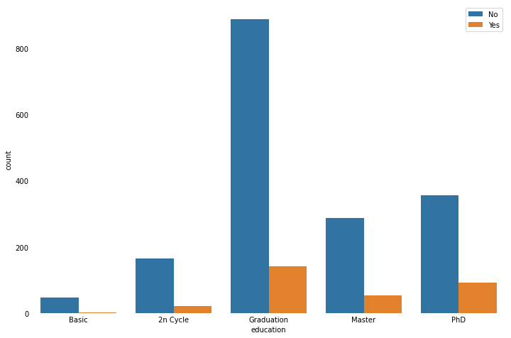
Customers with greater educational level tend to accept the campaign.
(Yes, but) Not quite, half of people are graduated, then this imbalance in data kind of undo any possible trend.

Slide 26
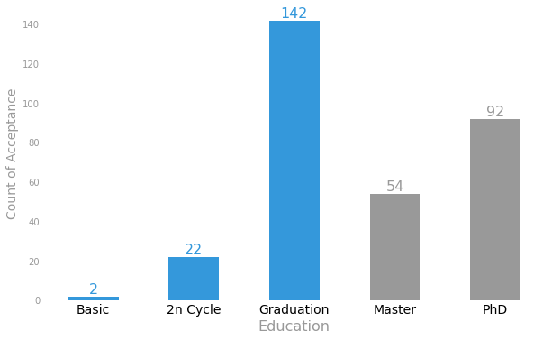
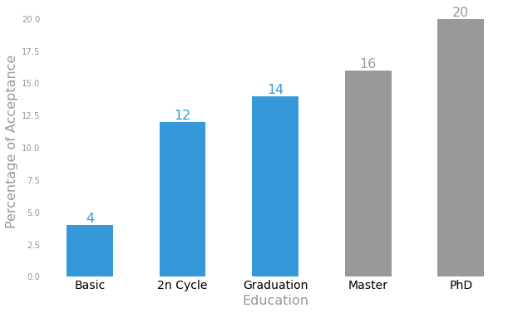
Customers with greater educational level tend to accept the campaign.
%
%
%
%
%
Using the percentage scale we can see there is a relation, but that doesn't mean the more PHDs the higher the chance the customer will accept the campaign.

Slide 27
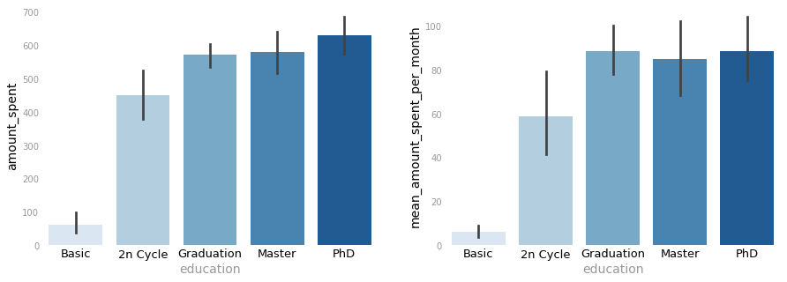
Customers with greater educational level bring more revenue.
Until a certain level we can say that's true. However, after graduate, that's not a rule.

Slide 28
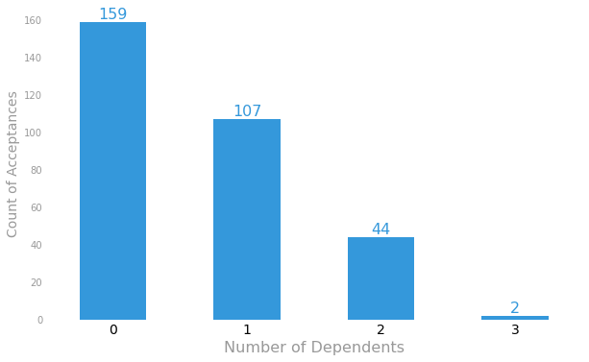
Customers with two kids tend to accept the campaign.
We need to Focus our efforts on those who has fewer dependents
Total Customers:
577 1043 388 48
No, the more the kids the lower is the chance of acceptance.

Slide 29
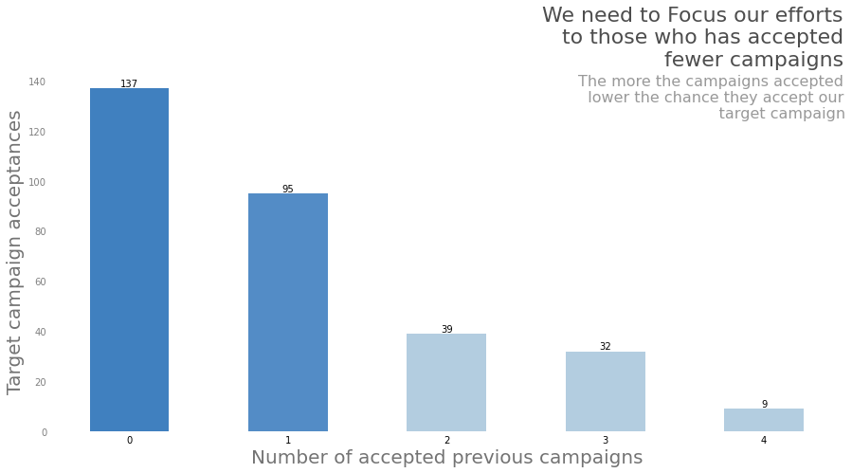
Previous Campaigns Acceptance
We need to Focus our efforts on those who has accepted fewer campaigns.
The more the campaigns accepted
lower the chance they accept our
target campaign.
When getting people from database to apply to the model, it's important to choose those who hasn't been chosen for a while or the ones who has participated in at most 1.

Slide 30
Next Steps
Deeper Analysis of Clusters.
Study our target behavior into each cluster.
Increase the numbers of clusters.
Outlier Analysis
Recommendation System

Slide 31
Questions?

Slide 32
Thank You.

Slide 33
Direct
Marketing
Campaign
Paulo Reis

