Slide 1
Age estimation based on facial images using Deep Learning techniques
Paulo Rijnberg (snr. 2033812), April 2020

Slide 2
Introduction
Significant role in different scenarios:
Law enforement
Social interactions
Approaches
Traditional ML techniques
Deep Learning techniques
‘To what extent can we apply deep learning techniques on age estimation using facial images?’

Slide 3

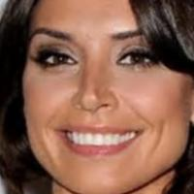

Experimental procedure
UTKFace (aligned&cropped)

Slide 4
Experimental procedure
Age class | Age range | Total samples (balanced) | Total samples (imbalanced)
0 | 1-10 | 3,492 | 1,183
1 | 11-20 | 1,682 | 1,183
2 | 21-30 | 7,806 | 1,183
3 | 31-40 | 4,345 | 1,183
4 | 41-50 | 2,103 | 1,183
5 | 51-60 | 2,226 | 1,183
6 | 61-70 | 1,183 | 1,183
UNDERSAMPLING
UTKFace (aligned&cropped)
75% training
SPLIT
20% validation
5% test

Slide 5
Experimental procedure/Results
LeNet-5
VGG16
ResNet-50

Slide 6
Experimental procedure/Results
Model architecture | Compiler | Acc
LeNet-5 architecture | Rmsprop, accuracy, categorial_crossentropy | 0.56
LeNet-5 architecture (with batch normalization) | Rmsprop, accuracy, categorial_crossentropy | 0.54
Modified LeNet-5 architecture Sithungu and Van der Haar (2019) | Rmsprop, accuracy, categorial_crossentropy | 0.56
VGG16 (imagenet/non-trainable) + trainable 3 dense (512, 512, 7). | Rmsprop, accuracy, categorial_crossentropy | 0.49
ResNet-50 (imagenet/non-trainable) + GlobalAveragePooling2D + dense (7) | Adam, accuracy, categorial_crossentropy | 0.15
ResNet-50 (no weights/trainable) + GlobalAveragePooling2D + dense (7) | Adam, accuracy, categorial_crossentropy | 0.51
ResNet-50 (imagenet/trainable) + GlobalAveragePooling2D + dense (7) | Adam, accuracy, categorial_crossentropy | 0.56
ResNet-50 (imagenet/non-trainable) + GlobalAveragePooling2D + dense (512, 512, 7) | Adam, accuracy, categorial_crossentropy | 0.14

Slide 7
Experimental procedure/Results
LeNet-5
VGG16
ResNet-50
0.56
0.49
0.56

Slide 8
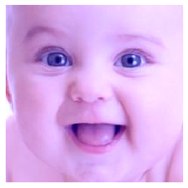

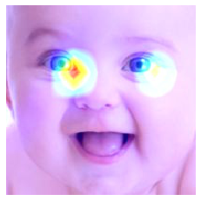
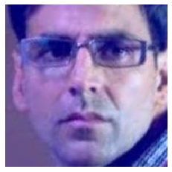
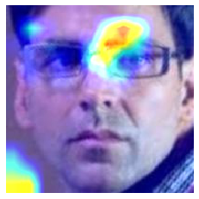
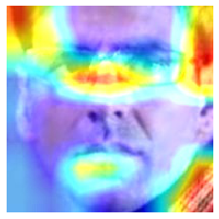
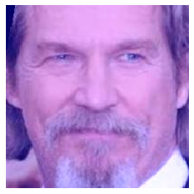
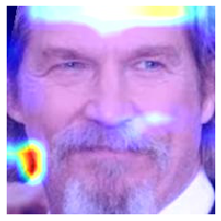

Activations modified LeNet-5, VGG16 & ResNet-50
Modified LeNet-5 (56%)
VGG16
(49%)
ResNet-50
(56%)

Slide 9

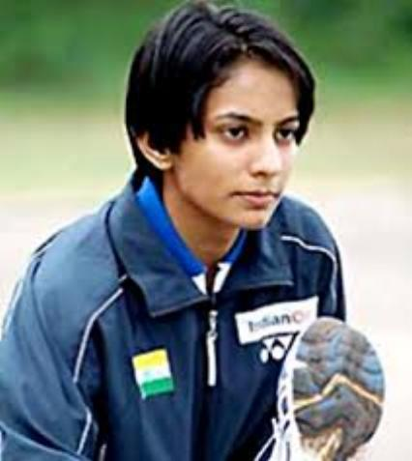
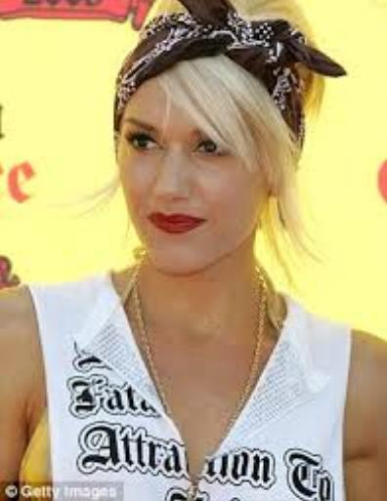
Questions
Validation error is high, but on the test set no activations?
I did most of this also with imbalanced data set & balanced dataset with face in the wild, should I also include this in the paper?

