Slide 1
Age estimation based on facial images using Deep Learning techniques
Paulo Rijnberg (snr. 2033812), April 2020

Slide 2
Introduction
Significant role in different scenarios:
Law enforement
Social interactions
Approaches
Traditional ML techniques
Deep Learning techniques
‘To what extent can we apply deep learning techniques on age estimation using facial images?’

Slide 3

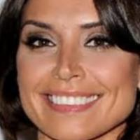
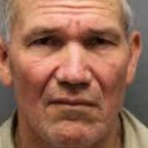
Experimental procedure
UTKFace (aligned&cropped)

Slide 4
Experimental procedure
Age class | Age range | Total samples (balanced) | Total samples (imbalanced)
0 | 1-10 | 3,492 | 1,183
1 | 11-20 | 1,682 | 1,183
2 | 21-30 | 7,806 | 1,183
3 | 31-40 | 4,345 | 1,183
4 | 41-50 | 2,103 | 1,183
5 | 51-60 | 2,226 | 1,183
6 | 61-70 | 1,183 | 1,183
UNDERSAMPLING
UTKFace (aligned&cropped)
75% training
SPLIT
20% validation
5% test

Slide 5
Experimental procedure/Results
Model architecture | Compiler | Highest accuracy | Run time 15 epochs
LeNet-5 architecture | Optimizer = rmsprop Metrics = accuracy Loss = categorial_crossentropy | 0.56 | 120 sec
LeNet-5 architecture (with batch normalization) | Optimizer = rmsprop Metrics = accuracy Loss = categorial_crossentropy | 0.54 | 180 sec
Modified LeNet-5 architecture Sithungu and Van der Haar (2019) | Optimizer = rmsprop Metrics = accuracy Loss = categorial_crossentropy | 0.56 | 30 min
VGG16 (weights = ‘imagenet’, include_top = False, layers set to non-trainable) and adding trainable three dense layers (512, 512, 7). | Optimizer = rmsprop Metrics = accuracy Loss = categorial_crossentropy | 0.49 | 7 hours
ResNet-50 (weights = ‘imagenet’, include_top = False, layers set to non-trainable) and adding GlobalAveragePooling2D and output dense layer with 7 nodes. | Optimizer = adam Metrics = accuracy Loss = categorial_crossentropy | 0.15 | 8 hours
ResNet-50 (weights = ‘None’, include_top = False, layers set to trainable) and adding GlobalAveragePooling2D and output dense layer with 7 nodes. | Optimizer = adam Metrics = accuracy Loss = categorial_crossentropy | 0.51 | 22 hours

Slide 6
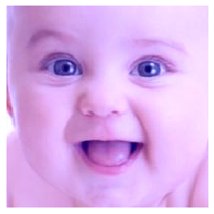
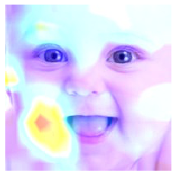
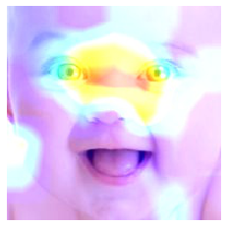
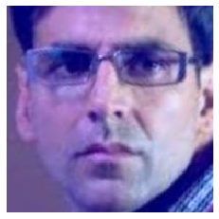
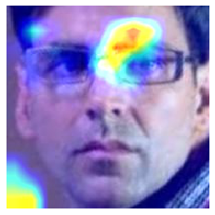
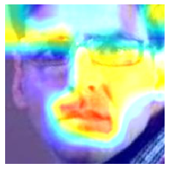
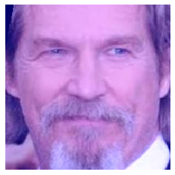
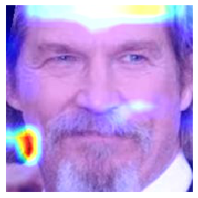
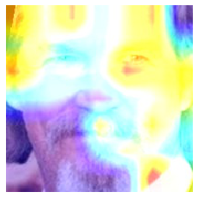
Activations modified LeNet-5, VGG16 & ResNet-50
Modified LeNet-5 (56%)
VGG16
(49%)
ResNet-50
(15%)

Slide 7

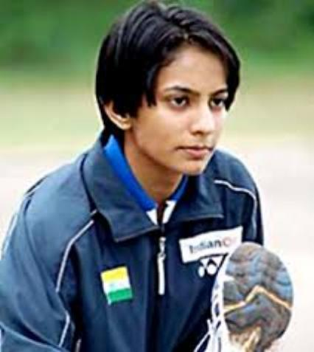
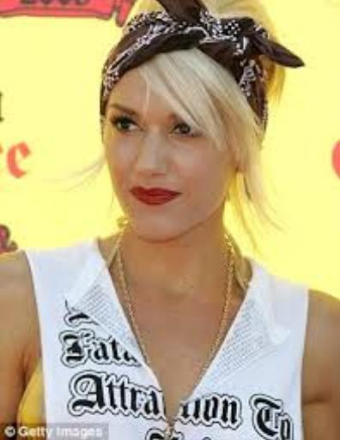
Questions
Validation error is high, but on the test set no activations?
I did most of this also with imbalanced data set & balanced dataset with face in the wild, should I also include this in the paper?

