Slide 1
PROOF OF CONCEPT
PRESENTATION BY
PAUL OYOM

Slide 2
PROBLEM STATEMENT
The problem statement for the Employee Attrition case is stated below:
The data is for company X which is trying to control attrition. There are two sets of data: “Existing employees” and “Employees who have left”. Following attributes are available for every employee.
Satisfaction Level
Last evaluation
Number of projects
Average monthly hours
Time spent at the company
Whether they have had a work accident
Whether they have had a promotion in the last 5 years
Departments (column sales)
Salary
Whether the employee has left

Slide 3
objectives
What type of employees are leaving?
Determine which employees are prone to leave next.

Slide 4
METHODOLOGY/TECHNIQUE
The Methodology is carried out in three stages:
Univariant analysis – involves analyzing the data from ‘employees who left’ and ‘Existing employees’ and visualizations to discover patterns.
Bi/Multivariant analysis – involves analyzing other attributes of data from ‘employees who left’ and ‘Existing employees’ to find out correlations.
Observations and Insights – Results from previous stages provides observations and recommendations.

Slide 5
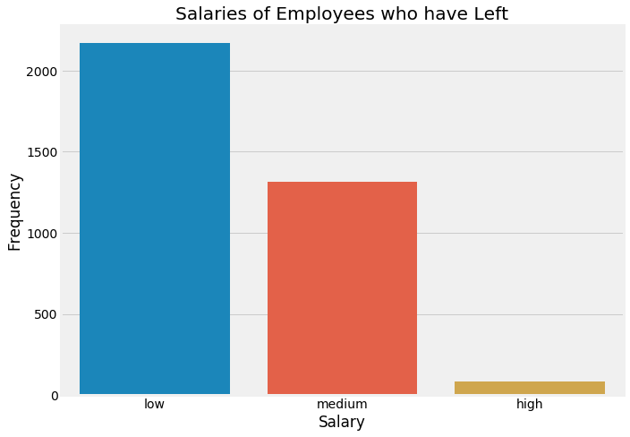
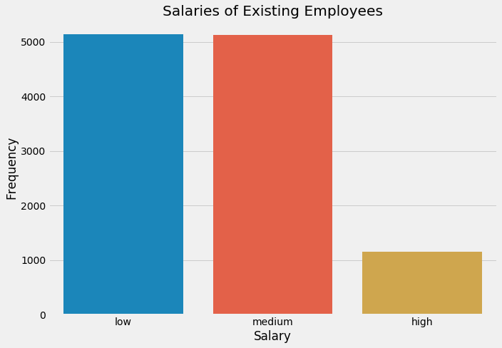
Stage 1: UNIVARIANT ANALYSIS
Each feature of the data is analyzed

Slide 6
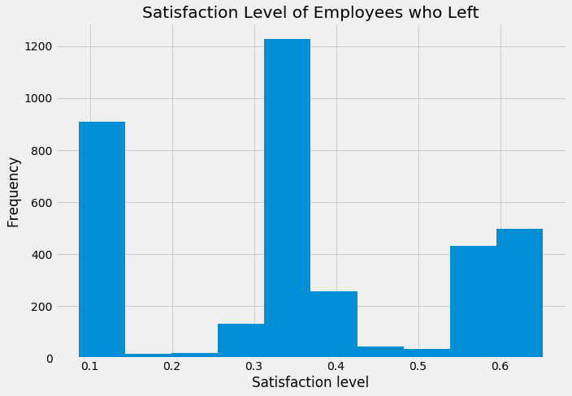
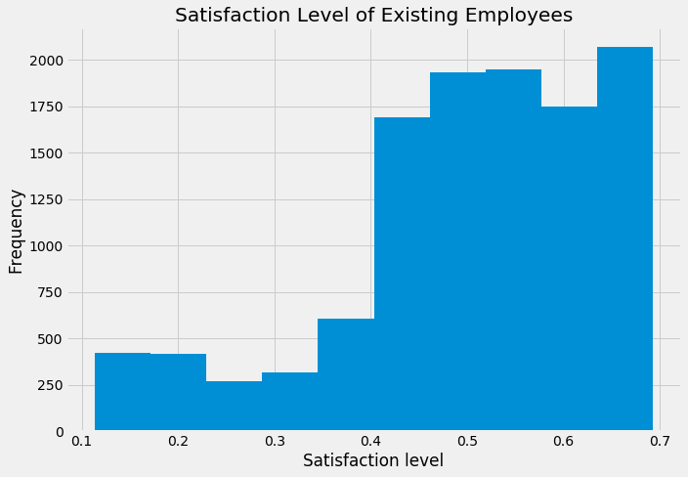
UNIVARIANT ANALYSIS CONT’D

Slide 7
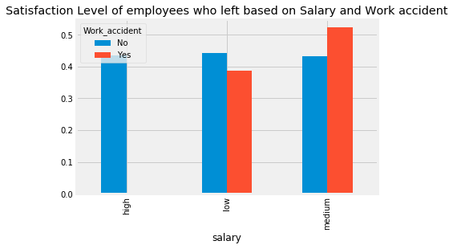
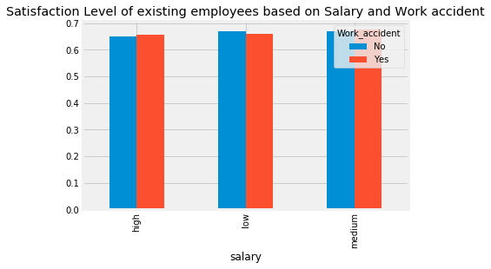
STAGE 2: BIVARIANT ANALYSIS

Slide 8
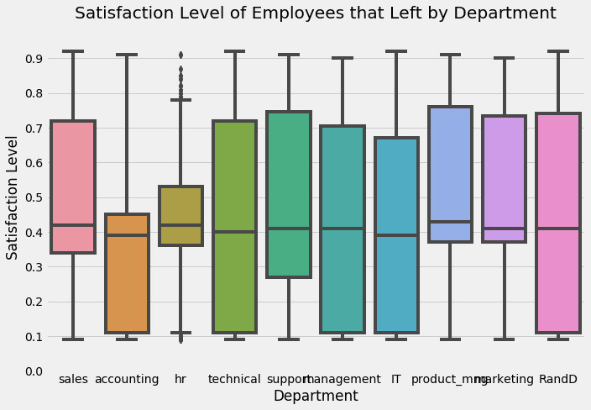
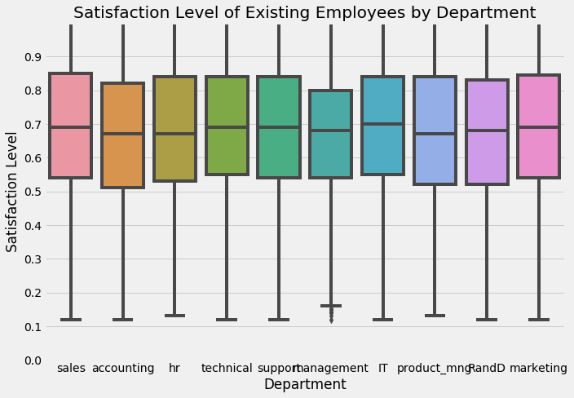
BIVARIANT ANALYSIS CONT’D

Slide 9
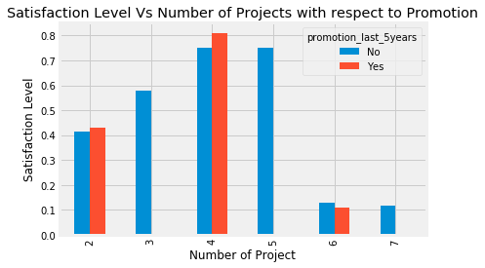
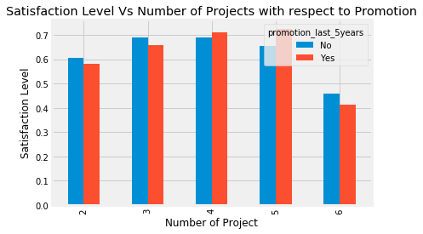
MULTIVARIANT ANALYSIS
Satisfaction level of employees that left based on the number of projects and promotion
Satisfaction level of existing employees based on the number of projects and promotion

Slide 10
STAGE 3: OBSERVATIONS AND INSIGHTS
Analyzing the data from the two sets of data reveals that:
In slide 6, the mean satisfaction level of employees who that left was about 40% while for existing employees it was 70%. Further analysis revealed that 65% of employees that left had less than 45% satisfaction level. Looking further into this revealed that from the employees with 45% satisfaction level who had left, it was further discovered that 100% of them didn’t receive promotion in the last 5 years.
Comparing this with existing employees 13% of them had a satisfaction level less than 45% and about 100% of them had not been promoted within the last 5 years which made them more likely to leave.
To control the attrition, it is advisable to identify these employees and have them remunerated in the best possible way to increase their satisfaction level.

Slide 11
STAGE 3: OBSERVATIONS AND INSIGHTS CONT’D
Slide 7 reveals that the salary structure of the employees who left as a result of work accident fell within the Low and Medium range and satisfaction level was around 50%. Similarly, the existing employees had their salary structure was distributed among low, medium and high range thereby improving the satisfaction level.
This should tell us that Company X maintained a good salary structure for those employees that had work accidents. salary structure of the employees who left as a result of work accident fell within the Low and Medium range and satisfaction level was around 50%. Similarly, the existing employees had their salary structure was distributed among low, medium and high range thereby improving the satisfaction level.
This should tell us that Company X maintained a good salary structure for those employees that had work accidents
A recommendation would be to allow the company maintain keep or increase the salary structure to increase satisfaction level.

Slide 12
STAGE 3: OBSERVATIONS AND INSIGHTS CONT’D
Slide 9 shows that as the number of projects of employees who left increased greater than 4, it led to a decrease in their satisfaction level.
A recommendation for this is to make sure the number of projects assigned to an employee do not overwhelm them to prevent a decrease in motivation and finding a reason to leave.

Slide 13
THANK YOU

