Slide 1

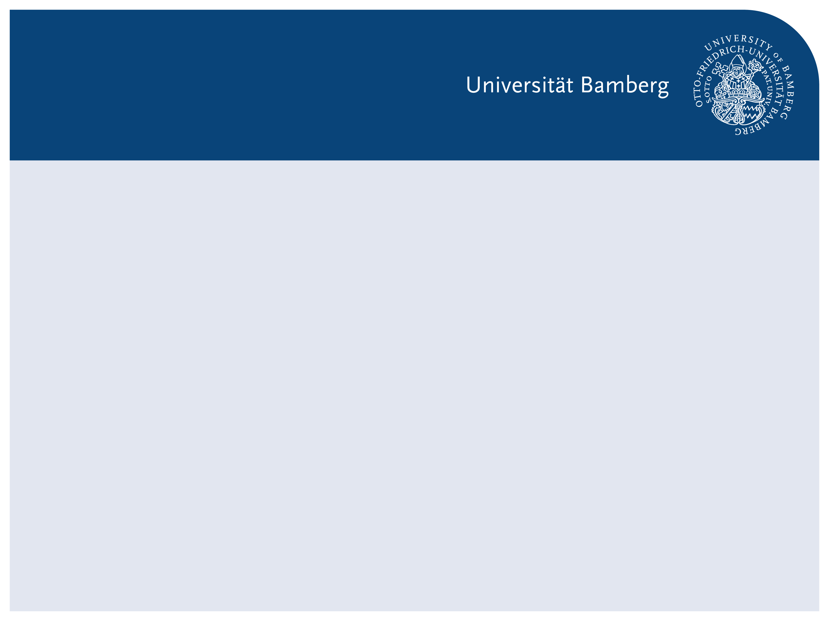
Direkte Varianzschätzung für einen nicht-linearen Indikator (Kapitel 4)
Nichtparametrischer Bootstrap vs. Jackknife
Vivivan Stehmans, Paulos Deifel
Small Area Estimation
Motivation
Data used
Methode
Umsetzung in R
Ergebnisse
Diskussion

Slide 2
Motivation

Slide 3
Data

Slide 4
Methode Non-parametric Bootstrap
“Bootstrap samples of the same size as the original sample are repeatedly drawn by sampling with replacement from the observed data” (Dixon et al. 1987, 1548)
Bootstrap for Variance from the Gini (Alfons and Templ 2013, 23)
Step: Draw independent bootstrap Samples from original data. Keep the sampling design in mind.
Step: Calculated Gini for the bootstrap samples
Step: Calculated the Variance of Gini-Index
Things to be aware of:
Sample size has to be large (n>100) (Dixon et al. 1987, 1550)

Slide 5
Methode Jackknife

Slide 6
Umsetzung in R

Slide 7
Ergebnisse

Slide 8
Diskussion

