Slide 1
INTRODUCTION
The Smart Electricity Management System ensures efficient energy use through real-time monitoring, analysis, and control. It integrates ACS712 and ZMPT101B sensors, Arduino Uno, ESP32, relay modules, and Firebase database to track voltage and current data, calculate units, and display insights on a web interface. Users can monitor consumption, control appliances remotely, and view dynamic cost calculations.

Slide 2
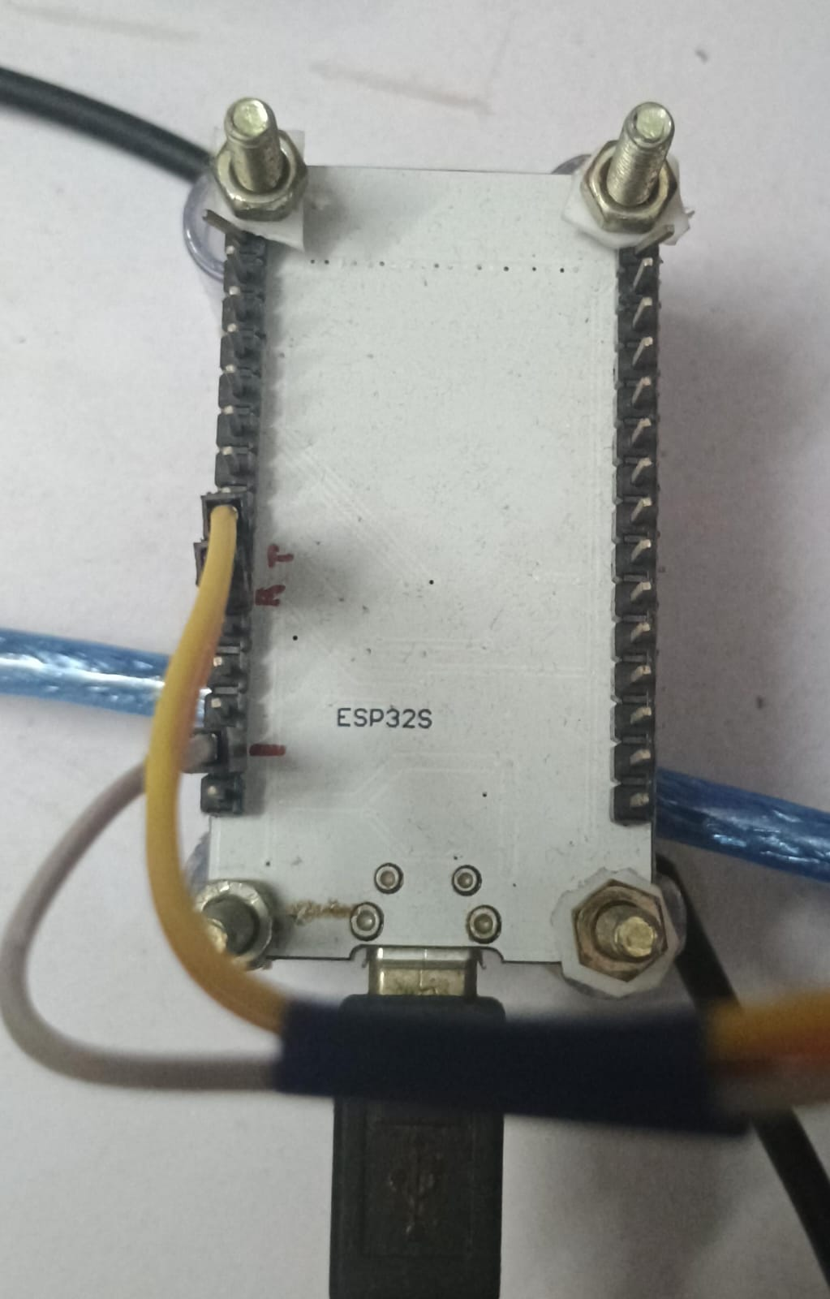
Hardware Components Used
ESP32: Acts as the primary microcontroller for data transmission between the Firebase Realtime Database and Arduino Uno. It collects sensor data, calculates power consumption in kW, sends the results to Firebase, and receives on/off commands to relay back to the Arduino Uno.
ACS712 Current Sensor: Measures the real-time current usage of connected appliances.
ZMPT101B Voltage Sensor: Monitors voltage levels to ensure accurate power analysis.
Relay Module: Facilitates remote control by enabling appliances to be switched on or off.
Arduino Uno: Collects data from the current and voltage sensors and forwards it to the ESP32. It also receives on/off commands from the ESP32 and controls the relay module accordingly.
esp32

Slide 3
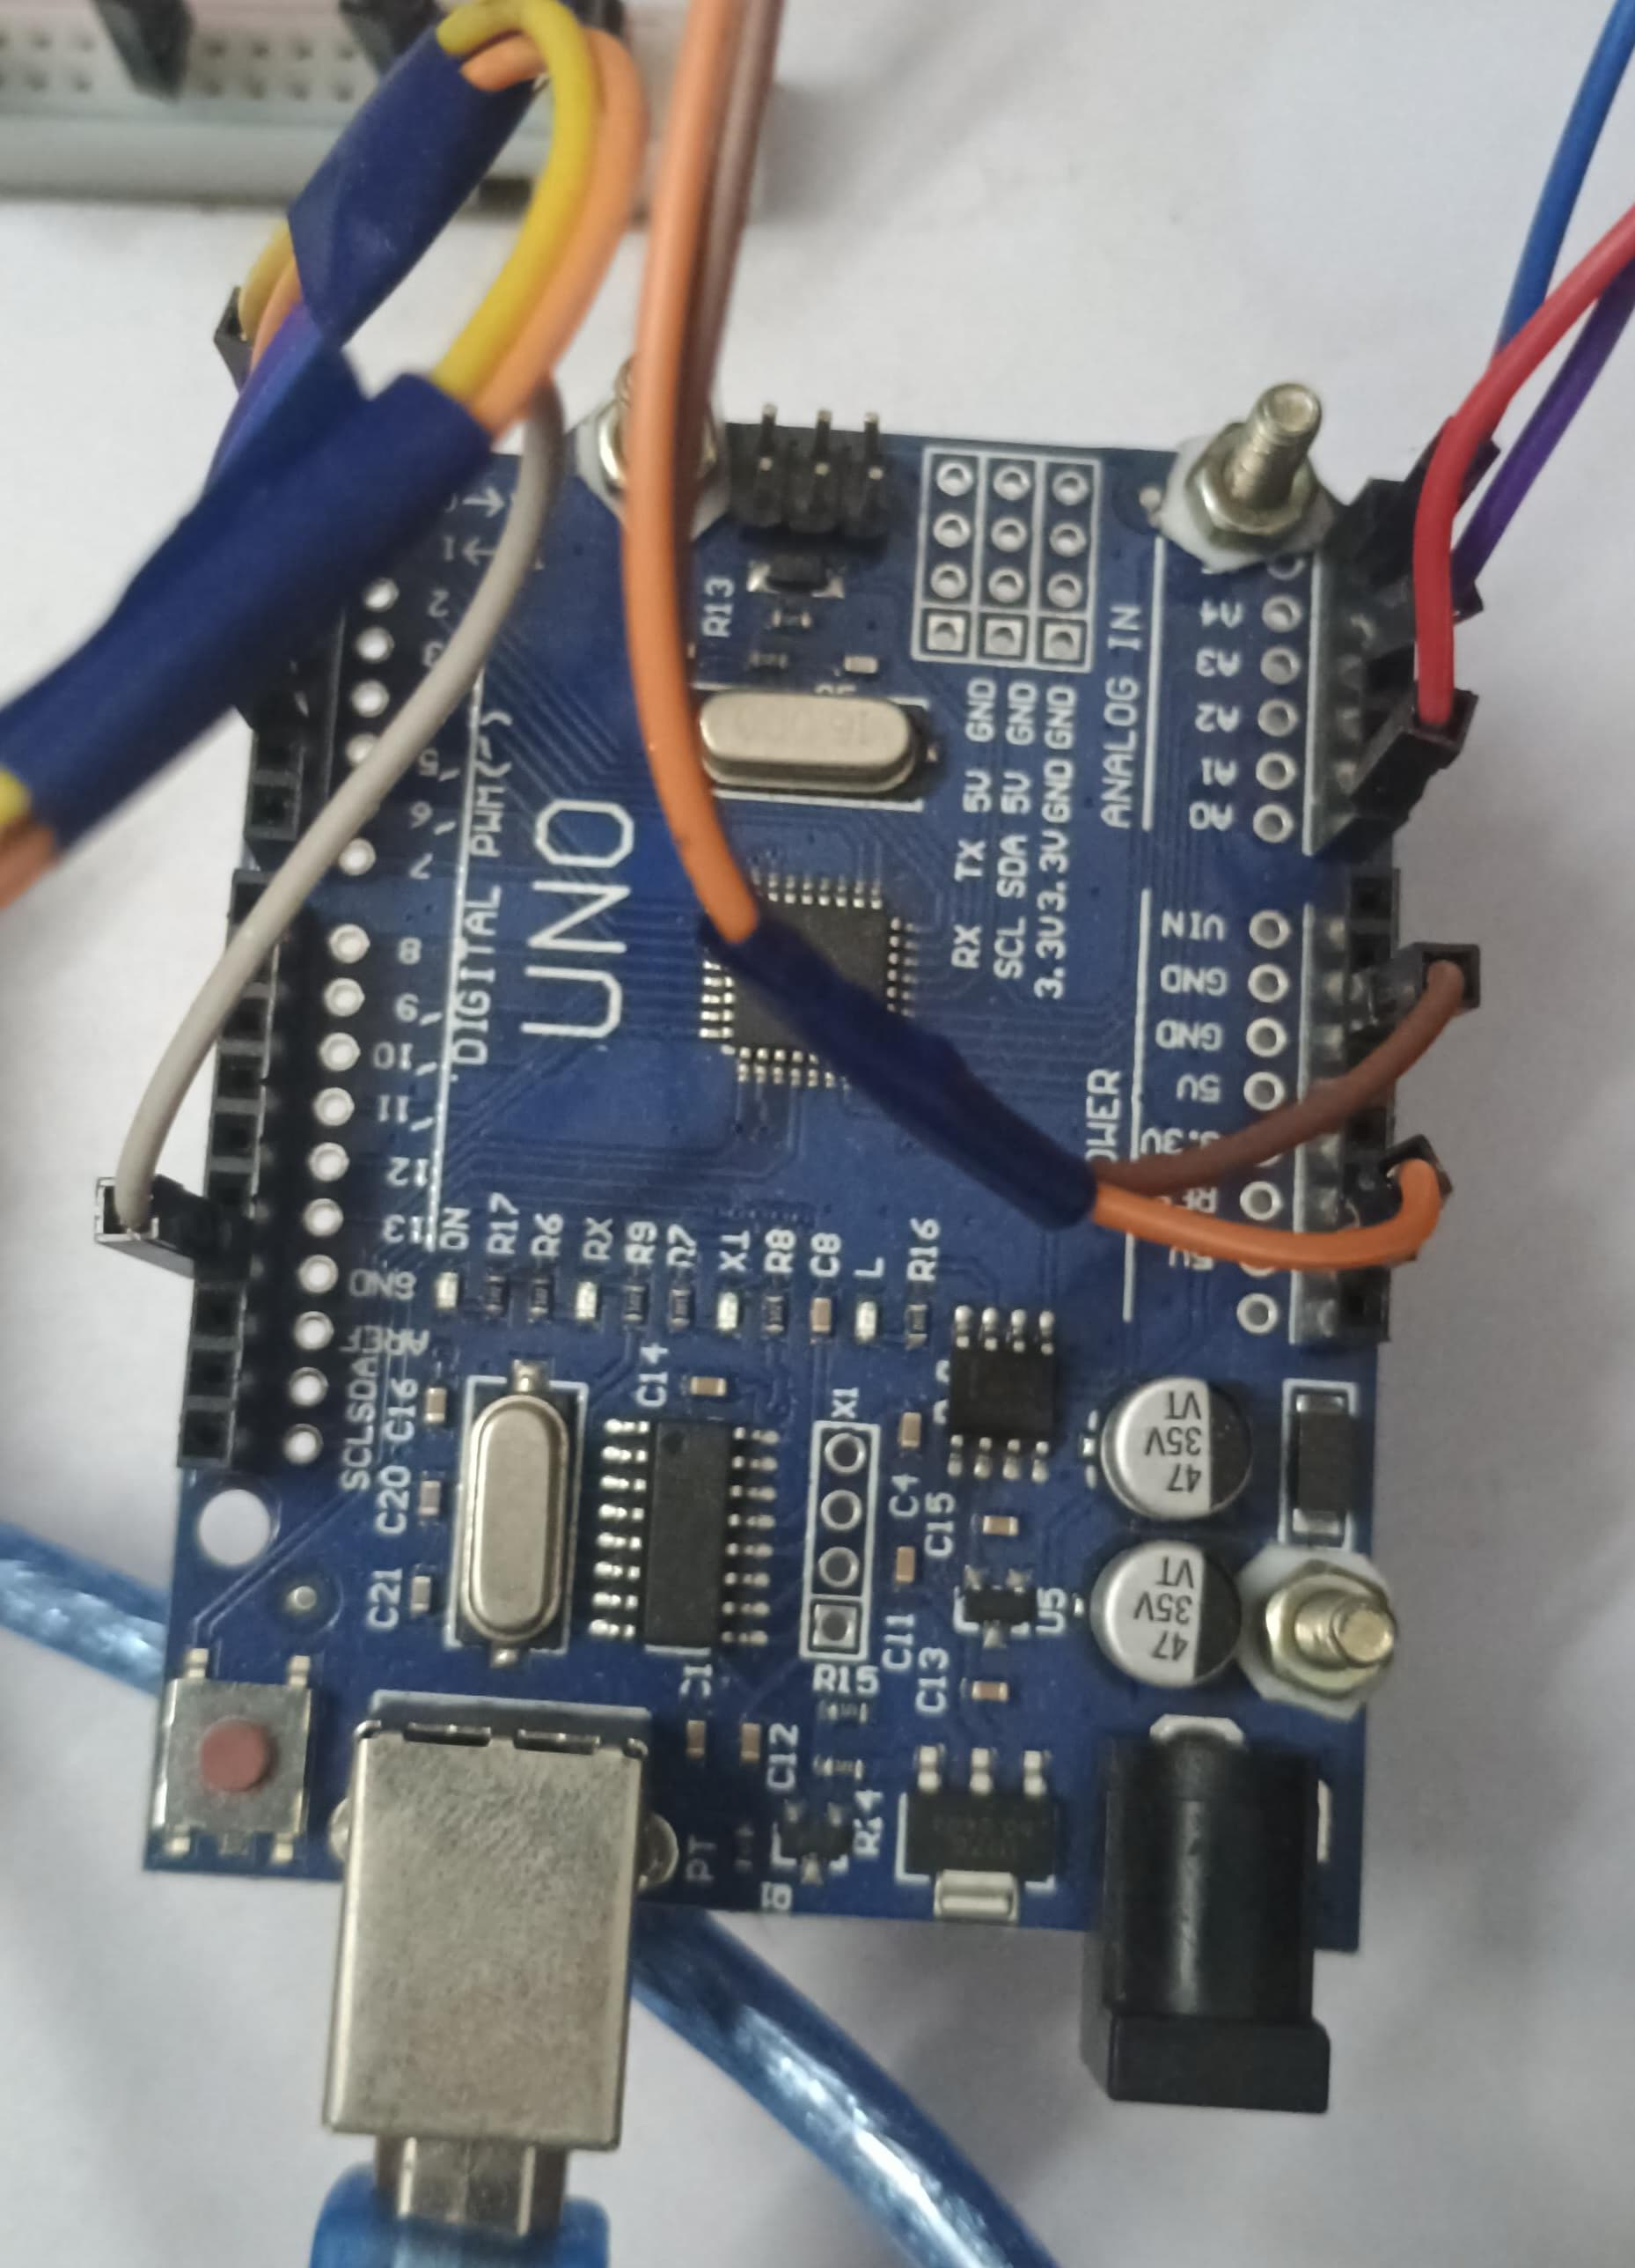
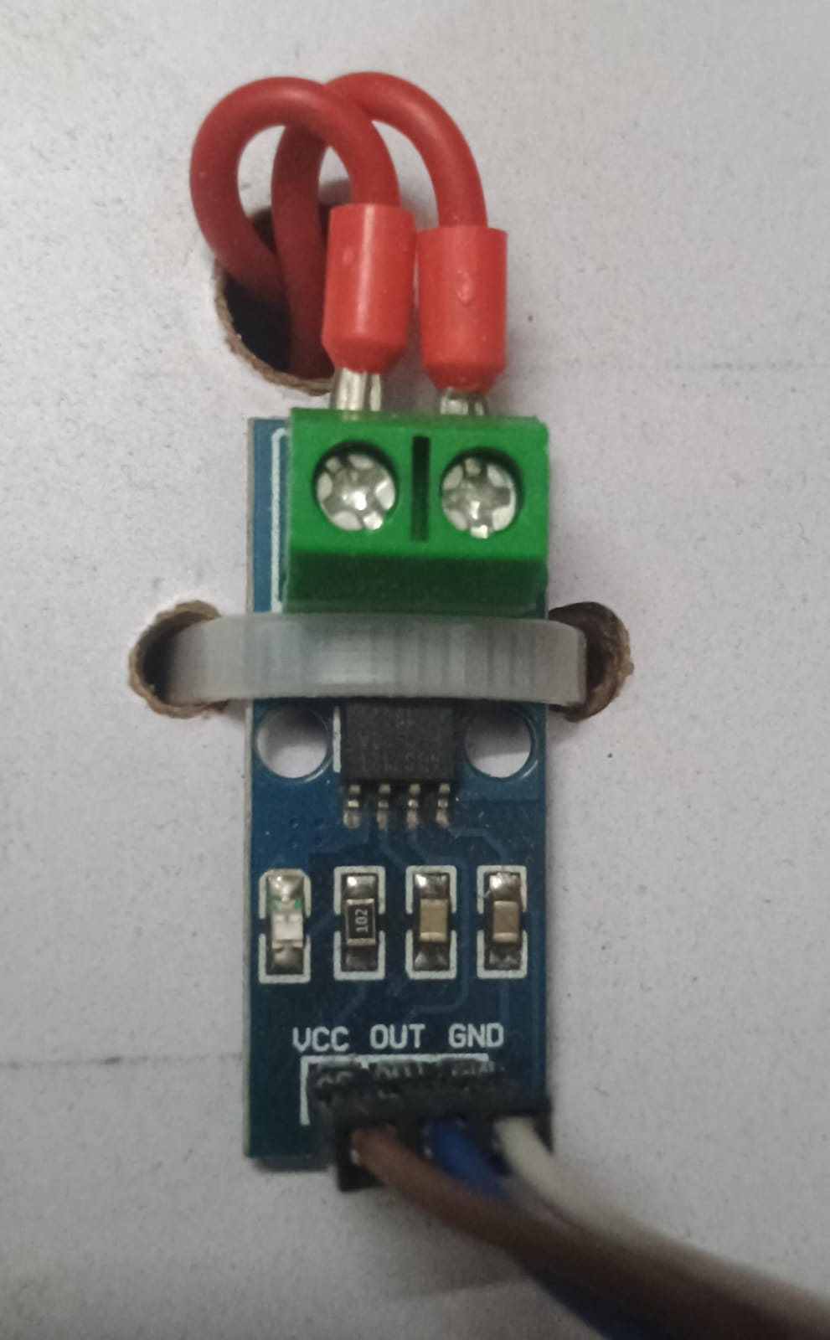
Ardino uno
ACS712 Current Sensor

Slide 4
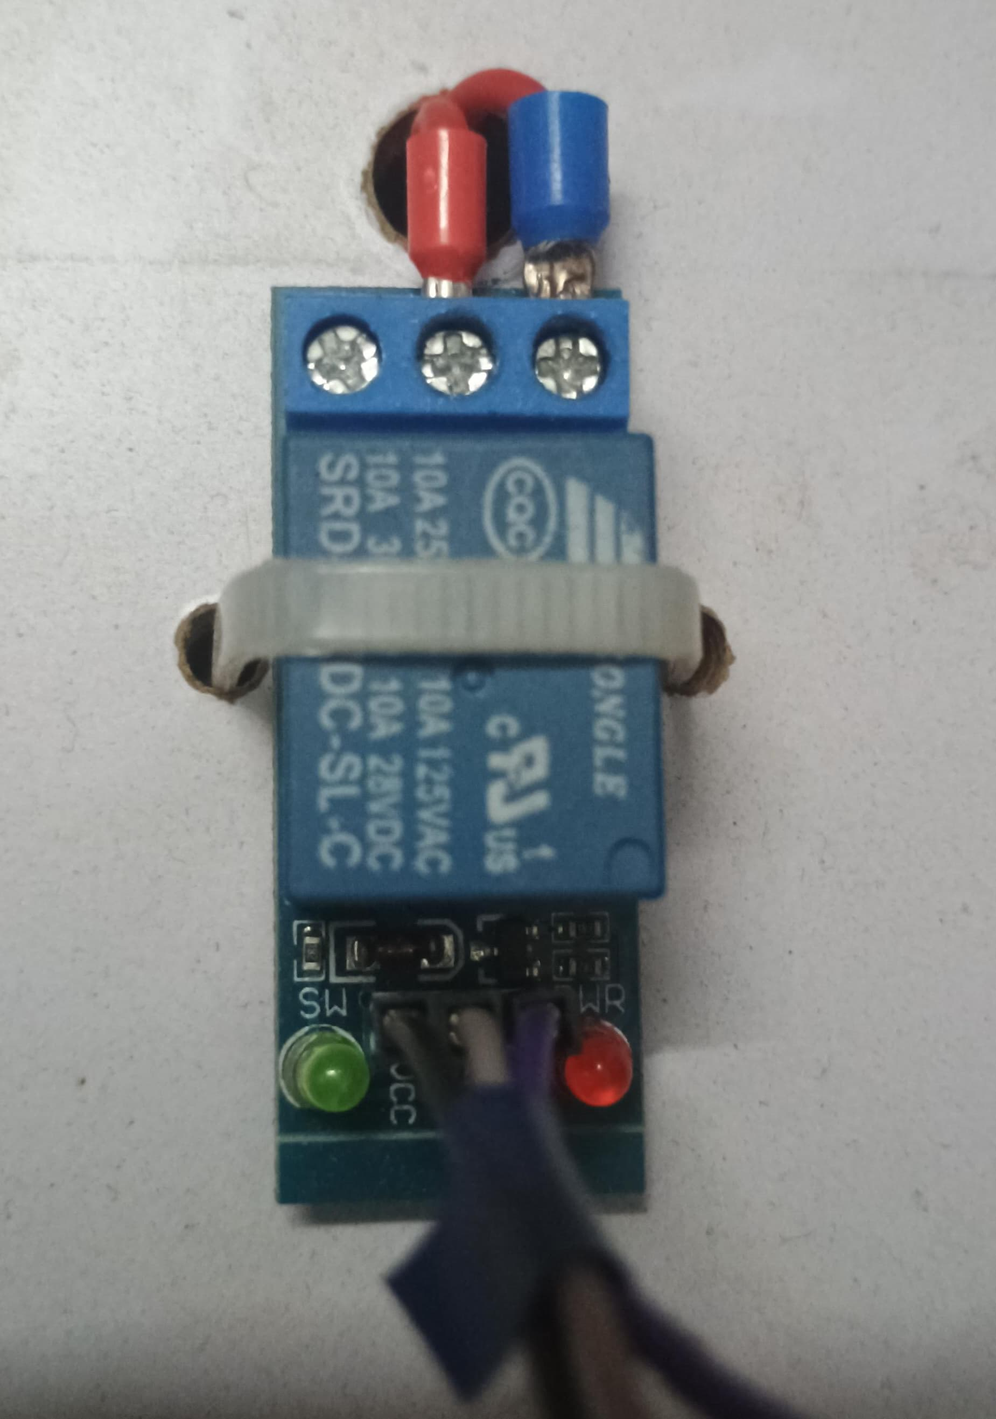
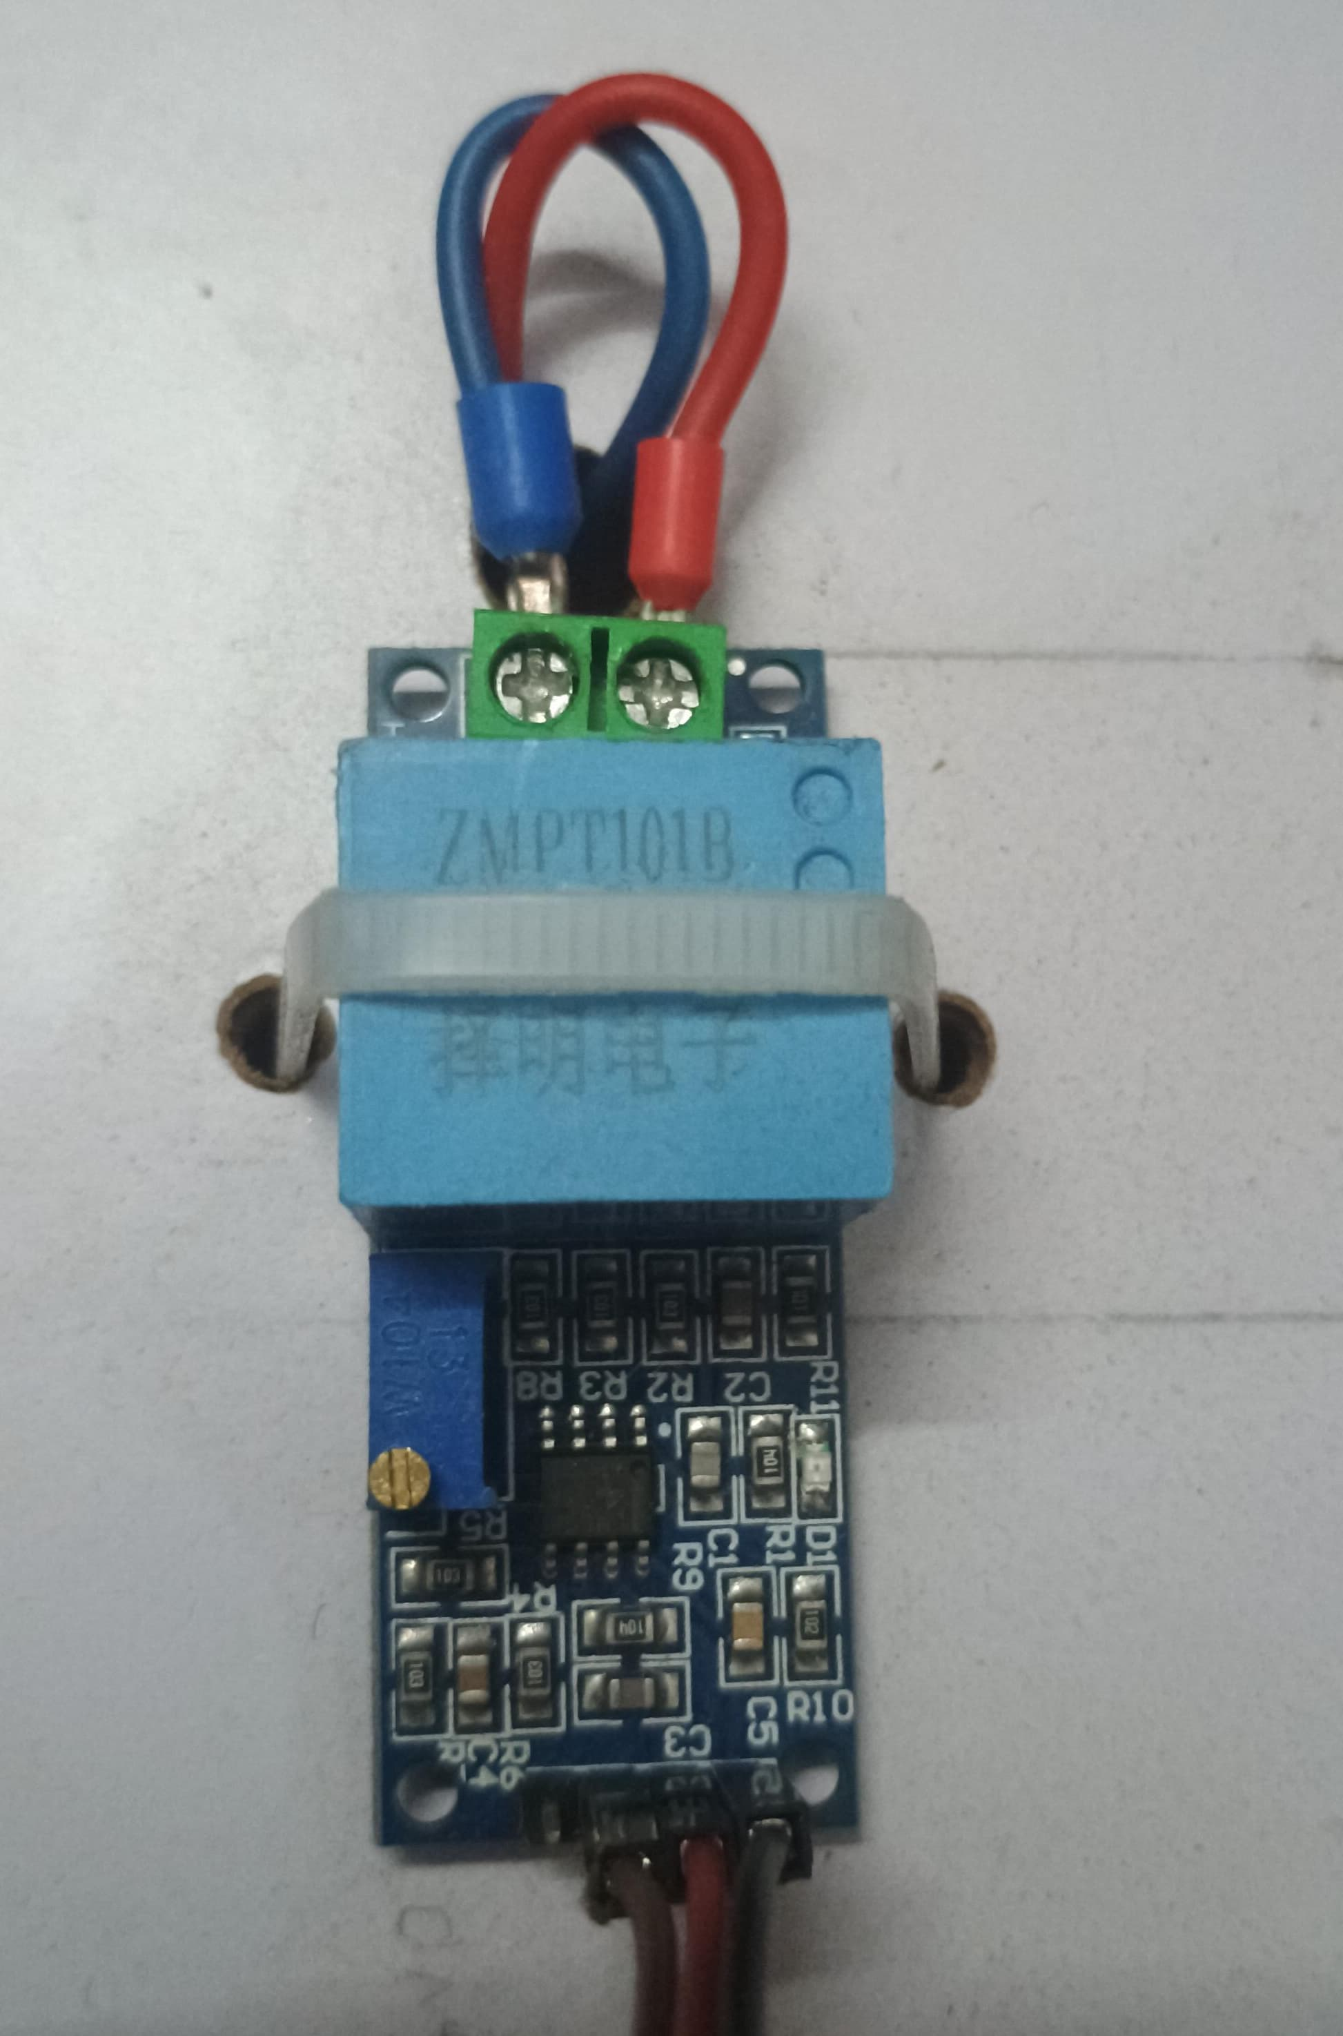
RELAY MODULE
ZMPT101B Voltage Sensor:

Slide 5
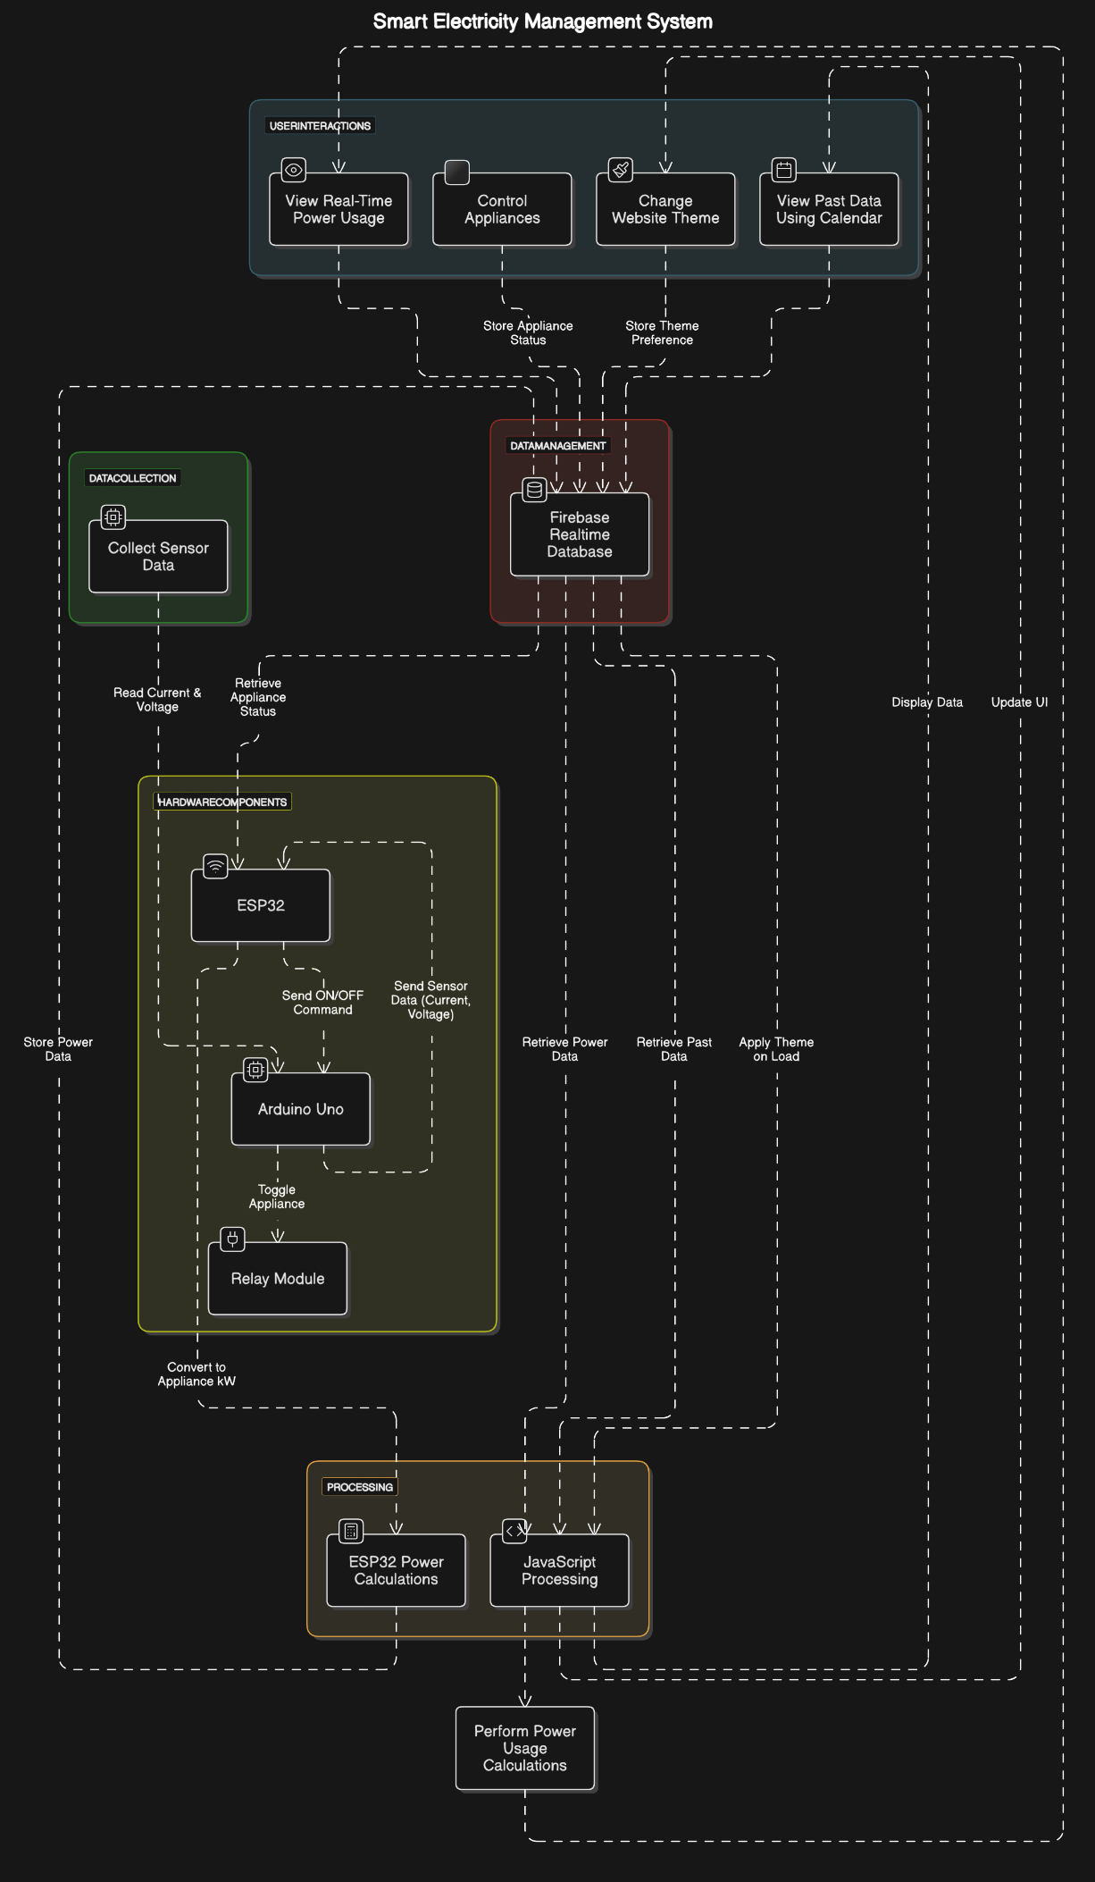

Slide 6
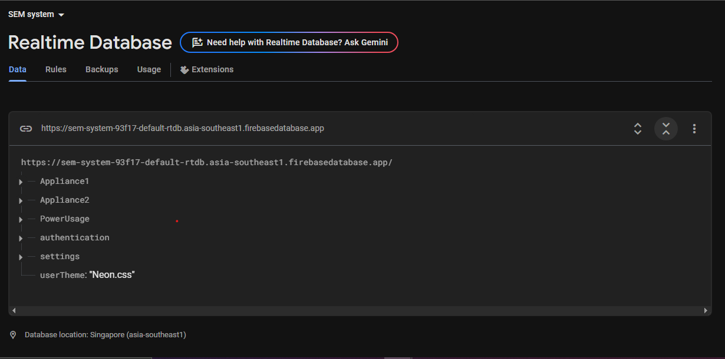
Database Design
We use Firebase Realtime Database to store electricity usage data, user authentication details, and system settings.
No backend is used. Data is fetched and updated using JavaScript in the front end and ESP32 directly.

Slide 7
Detailed Database Structure
Electricity Usage Data:
- DailyUnits (Daily energy consumption)
- MonthlyUnits (Total monthly usage)
- weeklyUsage (Weekly trends)
System Settings:
- notifications: true (Alerts enabled)
- theme: 'BlackAndYellow.css' (Default theme)
- userTheme: 'Neon.css' (User-selected theme)
Appliance Data:
• Appliance1
DesiredRelayState: "ON“
Power: 0.05882 kW
• Appliance2
DesiredRelayState: "OFF“
Power: 0 kW
User Authentication:
- users → user1
- name: 'User One'
- username: 'admin'
- password: '123' (Should be encrypted)
- uid: 'uniqueUserID'
Data Flow:
ESP32 → Firebase → Web UI (for data retrieval and display)
Web UI → Firebase → ESP32 (for relay ON/OFF control)

Slide 8
System Functionality (Website)
Settings:
Notification Management: Enable or disable system alerts.
Account Management: Change username and password.
Theme Customization: Select and apply user-defined themes.
Appliance Control:
Remote ON/OFF control for Appliance 1.
Remote ON/OFF control for Appliance 2.
Weekly Usage Graph:
Graphical representation of energy consumption for each day of the week
Energy Usage :
Realtime Usage: Displays current energy consumption for each appliance and the combined total.
Daily and Monthly Usage: Provides aggregated energy consumption statistics.
Cost Estimation: Calculates daily and monthly cost projections based on usage.
Historical Data Access:
Month and Year selection for viewing past data.
Calendar view of daily usage patterns.

Slide 9
Technologies Used
1. Hardware:
ESP32: Microcontroller for data transmission and relay control.
Current Sensors: Measure real-time electricity consumption.
Relays: Control appliances remotely via the web interface.
2. Software & Platforms:
Firebase: Cloud database for storing and retrieving real-time data.
HTML, CSS, JavaScript: Frontend development for the web UI.
3. Communication & Integration:
Wi-Fi: Enables ESP32 to send and receive data.
Realtime Data Flow: ESP32 ↔ Firebase ↔ Web UI for monitoring and control.

Slide 10
Existing System
Several smart energy monitoring solutions exist, such as smart plugs, energy meters, and IoT-based devices, but they come with limitations:
Smart plugs monitor single appliances but require multiple devices for full-home tracking and lack historical data analysis.
Standalone energy meters provide overall power consumption insights but do not track individual appliances or offer remote control.
IoT-based home automation systems integrate smart monitoring but are expensive and complex to install.
Our Smart Electricity Management System overcomes these limitations by offering real-time, appliance-level tracking, remote ON/OFF control, historical data analysis, and cost estimation in an affordable and user-friendly platform, ensuring efficient and data-driven energy management.

Slide 11
Future Scope
1. Mobile Interface:
Implement a responsive design for seamless access on smartphones.
2. Advanced User Alerts:
Enable SMS notifications for critical usage updates and alerts.
3. AI-Based Energy Optimization:
Utilize AI to analyze consumption patterns and suggest energy-saving actions.
4. Renewable Energy Integration:
Incorporate solar or other renewable sources to optimize electricity usage.

Slide 12
CONCLUSION
The Smart Electricity Management System enables real-time monitoring and analysis of electricity consumption, integrating ESP32, current sensors, and Firebase with a user-friendly web interface. It provides accurate energy usage data, cost calculations, and appliance control, helping users track, analyze, and optimize power consumption. With features like historical data access, notifications, and future AI-based energy optimization, the system enhances efficiency, reduces wastage, and promotes sustainable energy management.

