Slide 1



SPORTS DATA
ANALYSIS
PROJECT GUIDE
Mrs.P.Jayadharshini
Assistant Professor, AI
PROJECT MEMBER
Sathiyaseelan. S (22ADR096)
Pavul Chinnappan. D (22ADR076) Srinesh. S (22ADR103)

Slide 2
PROBLEM STATEMENT
To analyze FIFA player data to understand how different stats affect player performance and team success.
The goal is to find patterns that help with player selection and team strategies.
This analysis will reveal how various attributes influence
performance.

Slide 3
DATASET LINK
https://drive.google.com/drive/folders/1TJ5dSNoSgvifDo0P XAN33XlsVv7ngE5F?usp=sharing
DESCRIPTION:-
Content: The dataset contains information about FIFA players, including their stats and attributes.
Purpose: It’s meant for analyzing and exploring data, and for performing
statistical analysis.
Use: It helps in understanding player performance and team details in football.

Slide 4
DATA PREPROCESSING
Handling Missing Values: Checking for and filling in or removing any missing data.
Data Cleaning: Ensuring that the data is consistent, removing duplicates, and correcting any errors.
Feature Engineering: Creating or transforming features to improve
analysis, such as encoding categorical variables or scaling numerical data.

Slide 5
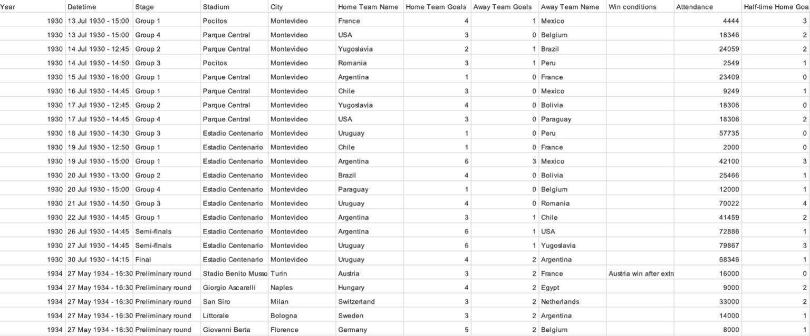
world cups matches.csv

Slide 6
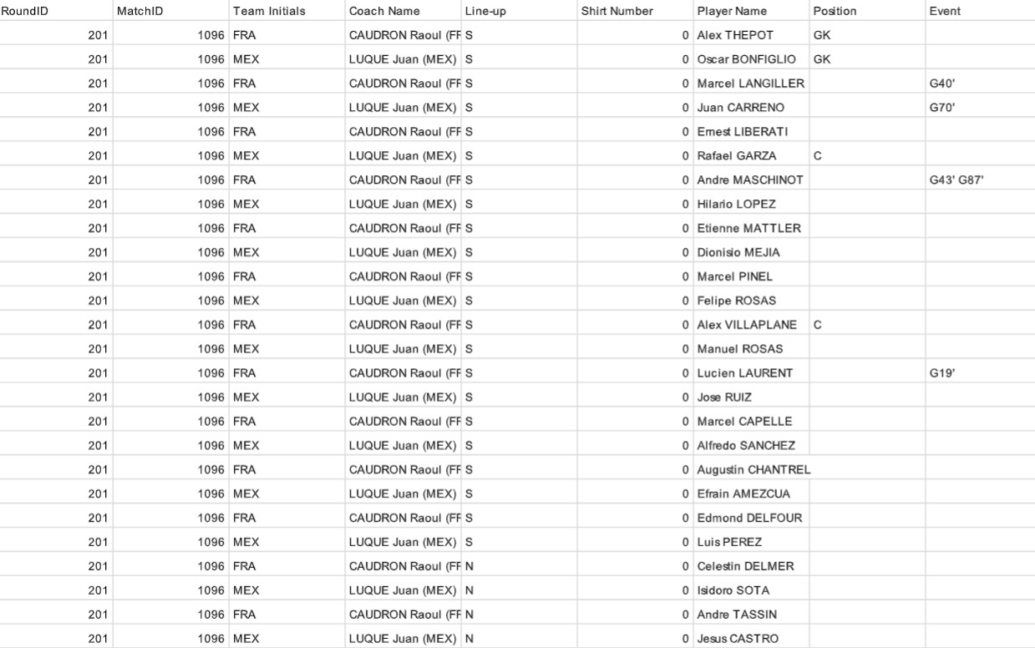
world cup players.csv

Slide 7
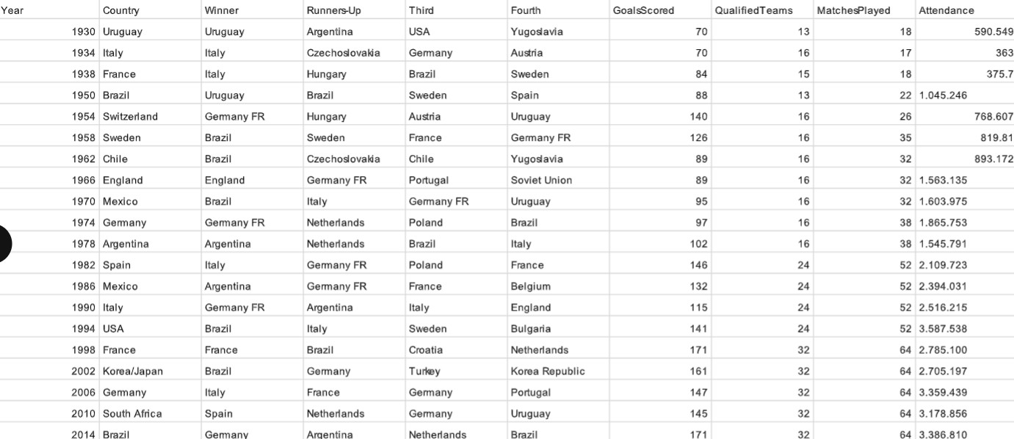
world cups.csv

Slide 8
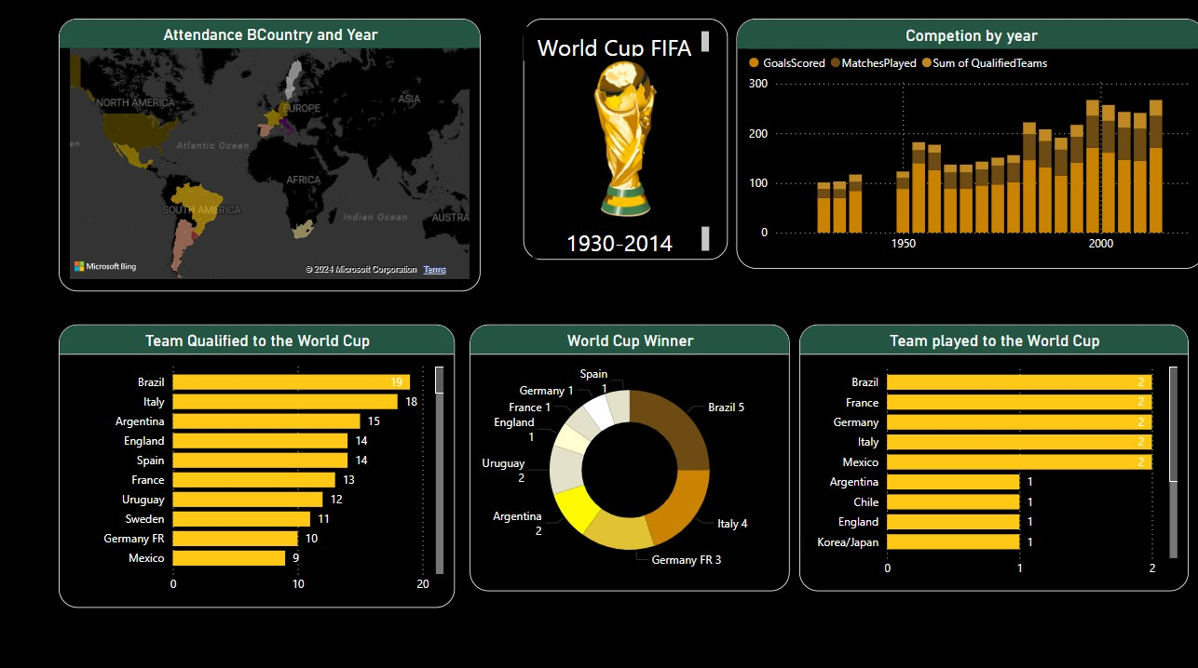
Visualization

Slide 9
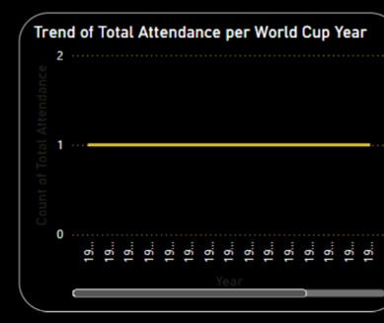
QUESTIONS FOR DATA ANALYSIS
1.Trend of Total Attendance per World Cup Year
INFERENCE:
Total attendance has generally increased over the years, with peaks during tournaments held in countries with large stadium capacities,
such as the USA in 1994.
Attendance dipped slightly in earlier years
due to fewer matches and
smaller venues but steadily rose as the tournament expanded.
The introduction of modern ticketing systems and global popularity in recent decades further boosted attendance figures.

Slide 10
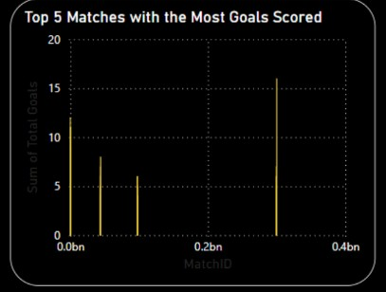
2.Which are the top 5 matches with the highest number of goals scored?
INFERENCE:
The highest-scoring matches include Brazil’s 7-1 victory over Germany in 2014 and Hungary’s 10-1 win against El Salvador in 1982.
These matches typically feature one-sided dominance, often in the group stages.
Such games highlight the performance gap between top-tier and lower-ranked teams during some tournaments.

Slide 11
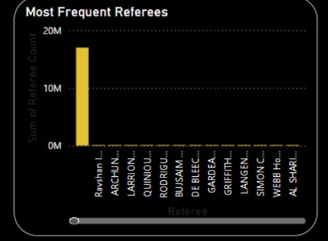
3.Who are the referees that officiated the most matches in World Cup history?
INFERENCE:
Top referees, like Pierluigi Collina and Sandor Puhl, officiated numerous matches due to their experience and trust from FIFA.
The most frequent referees often come from neutral countries to maintain fairness.
Referees with the highest match counts are often involved in multiple tournaments over decades.

Slide 12
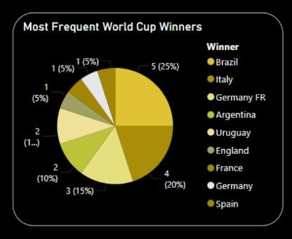
4.Which teams have won the most World Cups?
INFERENCE:
Brazil leads with five titles, followed by Germany and Italy with four each.
These teams have historically maintained strong squads with a balance of defense and attack.
Winning teams often excel in knockout matches, showcasing superior tactical execution.

Slide 13
INFERENCE:
Home teams consistently score slightly more goals than away teams,benefitting from crowd support and familiarity with conditions.
The gap in goals is more pronounced in earlier years, where travel challenges affected away teams' performance.
Modern tournaments show reduced disparity due to improved travel logistics and neutral playing conditions.

Slide 14
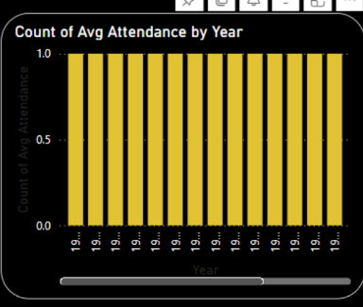
5.What was the average attendance per match for each World Cup
year?
INFERENCE:
Home teams consistently score slightly more
goals than away teams,
benefitting from crowd support and familiarity with conditions.
The gap in goals is more pronounced in earlier years, where travel
challenges affected away teams' performance.
Modern tournaments show reduced disparity due to improved travel
logistics and neutral playing conditions.

Slide 15
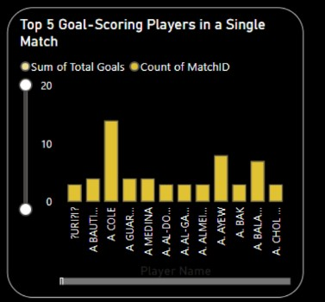
7. Top 5 Players Scoring the Most Goals in a Single Match
INFERENCE:
Players like Oleg Salenko (Russia, 1994) hold records for scoring 5+goals in a single match.
These performances are often against weaker opposition in the group stages.
Such feats highlight individual brilliance and goal-scoring efficiency under tournament pressure.

Slide 16

8. World Cup with the Highest Total Number of Goals Scored
INFERENCE:
The 2014 World Cup saw the highest total goals, with 171 goals scored in 64 matches.
This aligns with FIFA’s focus on attacking gameplay and rule modifications favoring more goals.
Increasing team quality and tactical advancements have contributed to such records.

Slide 17
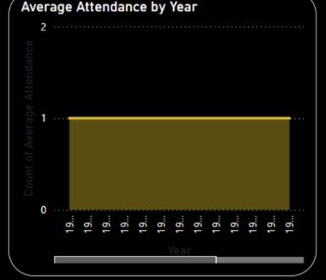
9. Changes in Average Match Attendance Over the Years
INFERENCE:
The 1950s saw modest averages due to smaller venues but steady growth followed with tournament expansion 32
Significant increases occurred in 1994 and beyond, driven by marketing efforts and improved stadiums.
Attendance is now closely linked to the host country’s infrastructure and global interest in the sport.

Slide 18

10. Match with the Highest Attendance in World Cup History
INFERENCE:
The 1950 final at Maracanã Stadium (Brazil vs. Uruguay) recorded over 173,000 attendees, the highest in history.
Such attendance reflects historical enthusiasm for football in South America.
Modern stadium regulations have since
capped attendance for safety reasons.

Slide 19
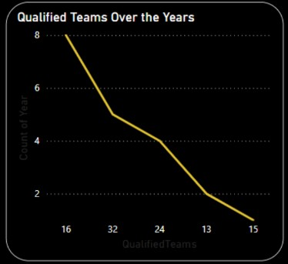
11. Changes in the Number of Teams Qualified Over the Years
INFERENCE:
The tournament expanded from 13 teams in 1930 to 32 teams by 1998, reflecting football’s growing global reach.
FIFA’s decisions to include more teams have provided representation to underdeveloped football nations.
Future plans for 48 teams aim to further
broaden participation.

Slide 20
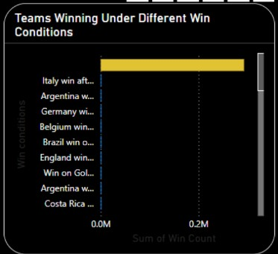
12. Teams Winning Under Different Win Conditions
INFERENCE:
Most World Cups are won in regular time, though extra-time and penalty victories have grown in recent tournaments.
Penalty shootouts have introduced unpredictability, emphasizing mental strength.
Teams adept in tactical resilience often succeed in extended formats.

Slide 21
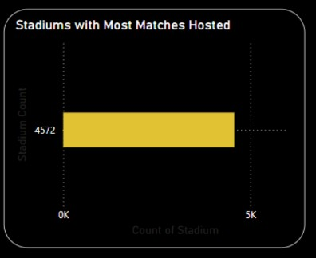
13. Stadiums Hosting the Most World Cup Matches
INFERENCE:
Estádio do Maracanã and Azteca Stadium are among the top venues,hosting multiple matches across different tournaments.
Large-capacity stadiums in host countries often serve as key venues for high-stakes games.
Venue selection impacts the cultural and financial success of the tournament.

Slide 22
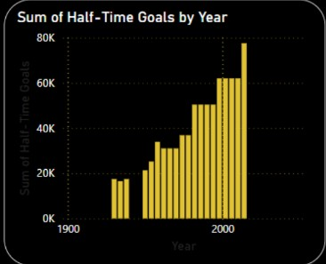
14. Goals Scored at Half-Time vs. Full-Time
INFERENCE:
Full-time goals consistently outnumber half-time goals due to tactical shifts and player fatigue in later stages.
The second half often sees higher scoring rates during knock out matches, where urgency escalates.
Teams adopt riskier strategies in the latter stages, resulting in more goals.

Slide 23
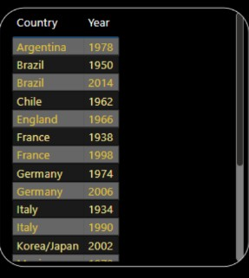
15. Host Country Performance Across World Cups
INFERENCE:
Host countries often perform better, with notable wins by Uruguay(1930), Italy (1934), and France (1998).
Home advantage includes crowd support, acclimatization, and reduced travel strain.
Performance varies based on the strength of the host nation’s
footballing history.

Slide 24
GITHUB LINK: https://github.com/paulpaulD/FIFA-power-BI
DASHBOARD LINK:
https://app.powerbi.com/groups/me/reports/0bdbf255-1d6b-4b60-9540-465c4c7ecf42/014b3f0c39c6d192f979?experience=power-bi

Slide 25
THANK YOU

