Slide 1
CS478 Assignment4 Presentation
Dec 15th, 2020

Slide 2
Project
Project Name
WhatBrand
Project Summary
Mobile application and flask server that make brand recognition thanks to neural network.

Slide 3
Team
Name and Responsibilities
Mina Barry : Flask server development + AI Development
Paul Raphanaud : React native app development + AI Development
Jérémie Dumez : AI development
Léo Huin : React native app development + AI Development
Lucas Zarka : AI development

Slide 4
Deliverables
Code Repo (if any) (URL):
Presentation Slides (URL):
Demo/Presentation Video URL (Optional): https://drive.google.com/file/d/1Dc9-Q3UcGL8hq22sRwOn6CymdOX3FqUy/view?usp=sharing

Slide 5
Project Summary
What it is and what research/investigation you did
You send a brand picture to the mobile application, and thanks to a CNN (Tensorflow), recognize the adequate brand in the datasets we made. The result gave us a brand description.
What results you got
We got full functional mobile application that recognize brand

Slide 6
Machine Learning Aspects
We start by making a dataset of the different brand. Then we have built CNN thanks to Tensorflow and trained it with the dataset.

Slide 7
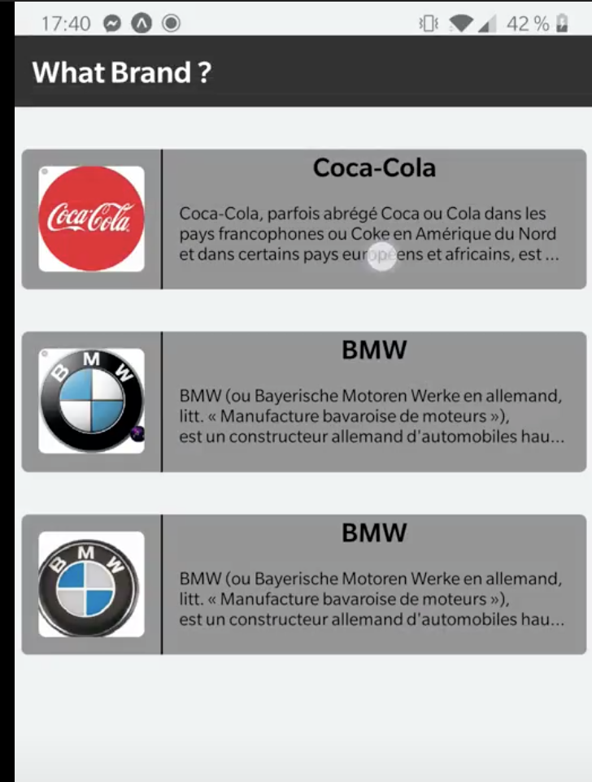
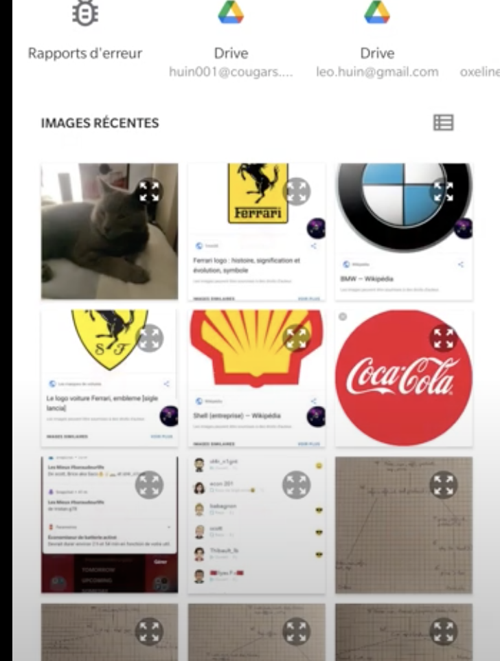
Software Aspects(multiple pages)
Architecture
Flask server that use the AI
React-native app
User Interface

