Slide 1


Dug
GO IMMERSIVE

Slide 2


THE CHALLENGE
What comes after the search bar?

Slide 3
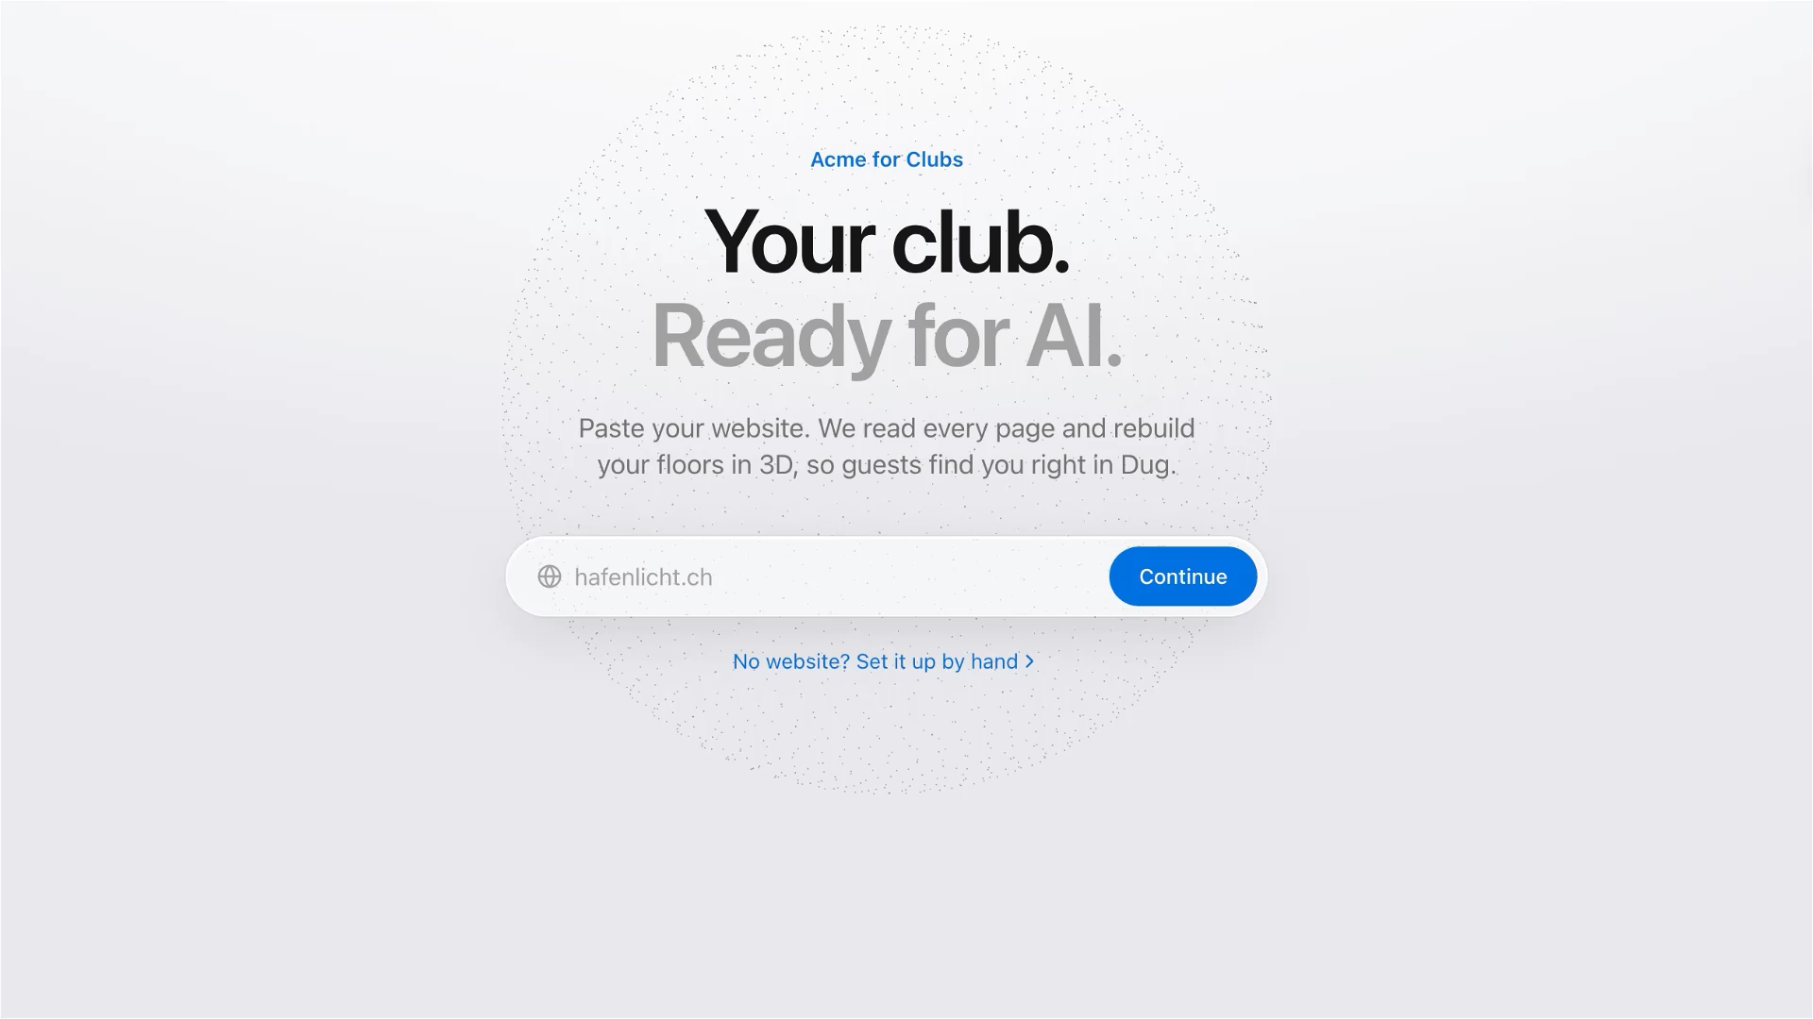

Slide 4


2 weeks later…

Slide 5


Slide 6
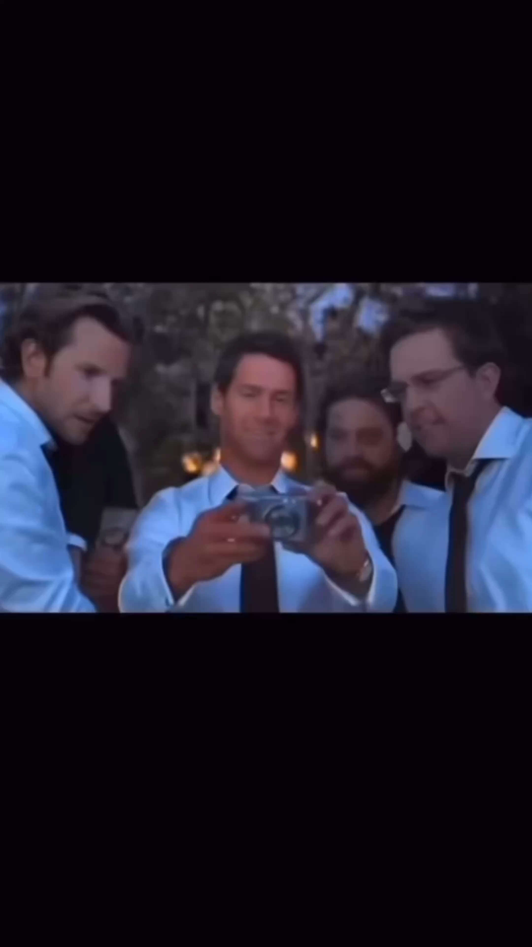

Slide 7
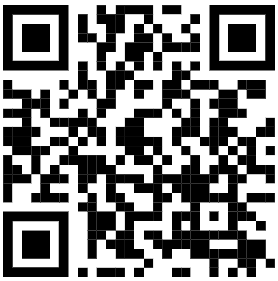
Thank you!
BASELHACK.VERCEL.APP

