Slide 1
Chapter 6 – Introduction to the Common Gateway Interface (CGI)
Outline
6.1 Introduction
6.2 Client and Web Server Interaction
6.2.1 System Architecture
6.2.2 Accessing Web Servers
6.2.3 HTTP Transactions
6.3 Simple CGI Script
6.4 Sending Input to a CGI Script
6.5 Using XHTML Forms to Send Input and Using Module cgi to Retrieve Form Data
6.6 Using cgi.FieldStorage to Read Input
6.7 Other HTTP Headers
6.8 Example: Interactive Portal
6.9 Internet and World Wide Web Resources

Slide 2
6.1 Introduction
Common Gateway Interface (CGI)
Web-page generation
  Dynamic : content generated each request
  Static : never changes unless document edited

Slide 3
6.2 Client and Web Server Interaction
Extensible Hypertext Markup Language (XHTML)
  Documents contain markup, or tags
  Requires syntactically correct documents
Uniform Resource Locator (URL) directs browser to resource
Hypertext Transfer Protocol (HTTP) for transferring requests and files over the Internet
Domain name system (DNS) server translates hostname into Internet Protocol (IP) address

Slide 4
6.2.1 System Architecture
Multi-tier applications
  Information tier
    Also called data tier or bottom tier
    Maintains data for application
  Middle tier
    Implements presentation logic and enforces business rules
    Controller logic processes client requests and retrieves data
  Client tier
    Also called top tier
    Application’s user interface

Slide 5

6.2.1 System Architecture
Fig. 6.1 Three-tier application model.

Slide 6
6.2.2 Accessing Web Servers
Request documents from local or remote Web servers
Ways to request a document
  Local Web server : machine name or localhost
  Remote Web server: specify server’s domain name or IP address
Domain name
  Represents groups of hosts on the Internet
  combines with top-level domain (TLD) to form fully qualified hostname

Slide 7
6.2.2 HTTP Transactions
HTTP request types
  Get : sends form content as part of URL
  Post : users cannot see sent data
HTTP headers
  provide additional information about data sent in response to request
  Multipurpose Internet Mail Extensions (MIME) : Internet standard that specifies how messages should be formatted

Slide 8
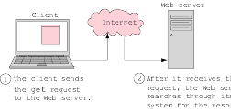
6.2.2 HTTP Transactions
Fig. 6.2 Client interacting with server and Web server. Step 1: The request, GET /books/downloads.html HTTP/1.1.

Slide 9

6.2.2 HTTP Transactions
Fig. 6.2 Client interacting with server and Web server. Step 2: The HTTP response, HTTP/1.1 200 OK.

Slide 10
6.2.2 Simple CGI Script
Two types of scripting
  Server-side scripting (i.e., CGI scripts) manipulate server resources
  Client-side scripting (i.e, JavaScript) accesses browser features, manipulates browser documents, validates user input, etc.
Server-side scripts
  Execute on server
  Usually generate custom responses for clients
  Wider range of programmatic capabilities than client-side scripts

Slide 11
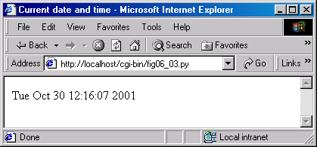
fig06_03.py
1 #!c:\Python\python.exe
2 # Fig. 6.3: fig06_03.py
3 # Displays current date and time in Web browser.
4
5 import time
6
7 def printHeader( title ):
8 print """Content-type: text/html
9
10 <?xml version = "1.0" encoding = "UTF-8"?>
11 <!DOCTYPE html PUBLIC
12 "-//W3C//DTD XHTML 1.0 Strict//EN"
13 "DTD/xhtml1-strict.dtd">
14 <html xmlns = "http://www.w3.org/1999/xhtml">
15 <head><title>%s</title></head>
16
17 <body>""" % title
18
19 printHeader( "Current date and time" )
20 print time.ctime( time.time() )
21 print "</body></html>"
Directive specifies location of server’s Python interpreter
Print HTTP header
Blank line signifies end of HTTP header
Print XML declaration
Print XHTML document header
Returns seconds since epoch
Formats seconds to human-readable time

Slide 12
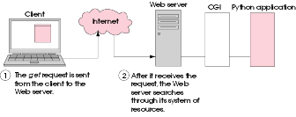
6.3 Simple CGI Script
Fig. 6.4 Step 1: The GET request, GET /cgi-bin/fig06_02.py HTTP/1.1. (Part 1 of 4.)

Slide 13
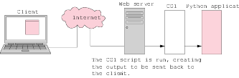
6.3 Simple CGI Script
Fig. 6.4 Step 2: The Web server starts the CGI script. (Part 2 of 4.)

Slide 14
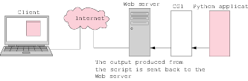
6.3 Simple CGI Script
Fig. 6.4 Step 3: The output of the script is sent to the Web server. (Part 3 of 4.)

Slide 15
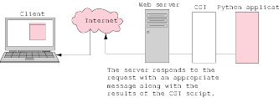
6.3 Simple CGI Script
Fig. 6.4 Step 4: The HTTP response, HTTP/1.1 200 OK. (Part 4 of 4.)

Slide 16
fig06_05.py
1 #!c:\Python\python.exe
2 # Fig. 6.5: fig06_05.py
3 # Program displaying CGI environment variables.
4
5 import os
6 import cgi
7
8 def printHeader( title ):
9 print """Content-type: text/html
10
11 <?xml version = "1.0" encoding = "UTF-8"?>
12 <!DOCTYPE html PUBLIC
13 "-//W3C//DTD XHTML 1.0 Strict//EN"
14 "DTD/xhtml1-strict.dtd">
15 <html xmlns = "http://www.w3.org/1999/xhtml">
16 <head><title>%s</title></head>
17
18 <body>""" % title
19
20 rowNumber = 0
21 backgroundColor = "white"
22
23 printHeader( "Environment Variables" )
24 print """<table style = "border: 0">"""
25
26 # print table of cgi variables and values
27 for item in os.environ.keys():
28 rowNumber += 1
29
30 if rowNumber % 2 == 0: # even row numbers are white
31 backgroundColor = "white"
32 else: # odd row numbers are grey
33 backgroundColor = "lightgrey"
34
Module os provides access to environment variables
Module cgi provides form processing and text formatting capabilities
Start table with <table> tag
os.environ acts like a dictionary of environment variables and values

Slide 17
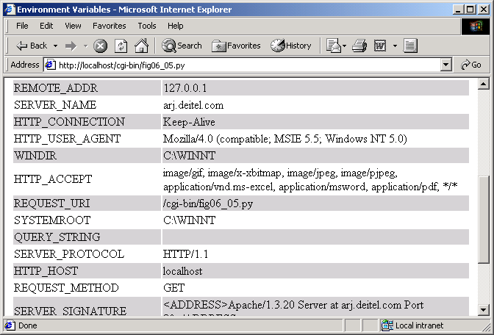
fig06_05.py
35 print """<tr style = "background-color: %s">
36 <td>%s</td><td>%s</td></tr>""" % ( backgroundColor,
37 cgi.escape( item ), cgi.escape( os.environ[ item ] ) )
38
39 print """</table></body></html>"""
Table row for each environment variables and its value
Function cgi.escape takes a string and returns a properly formatted XHMTL string
Close table, body of XHMTL document and XHTML document

Slide 18
6.4 Sending Input to a CGI Script
QUERY_STRING variable contains extra information appended to a URL in a GET request, following a question mark (?)
Question mark (?) serves as delimiter between source and query string
Name-value pairs in the query string separated by ampersands (&)

Slide 19
fig06_06.py
1 #!c:\Python\python.exe
2 # Fig. 6.6: fig06_06.py
3 # Example using QUERY_STRING.
4
5 import os
6 import cgi
7
8 def printHeader( title ):
9 print """Content-type: text/html
10
11 <?xml version = "1.0" encoding = "UTF-8"?>
12 <!DOCTYPE html PUBLIC
13 "-//W3C//DTD XHTML 1.0 Strict//EN"
14 "DTD/xhtml1-strict.dtd">
15 <html xmlns = "http://www.w3.org/1999/xhtml">
16 <head><title>%s</title></head>
17
18 <body>""" % title
19
20 printHeader( "QUERY_STRING example" )
21 print "<h1>Name/Value Pairs</h1>"
22
23 query = os.environ[ "QUERY_STRING" ]
24
25 if len( query ) == 0:
26 print """<p><br />
27 Please add some name-value pairs to the URL above.
28 Or try
29 <a href = "fig06_06.py?name=Veronica&amp;age=23">this</a>.
30 </p>"""
31 else:
32 print """<p style = "font-style: italic">
33 The query string is '%s'.</p>""" % cgi.escape( query )
34 pairs = cgi.parse_qs( query )
35
Contains information appended to URL in GET request
Parses query string and returns dictionary of its name-value pairs

Slide 20
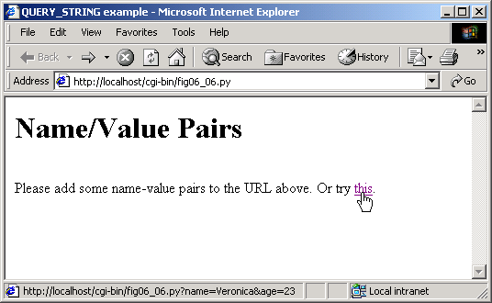
fig06_06.py
36 for key, value in pairs.items():
37 print "<p>You set '%s' to value %s</p>"" % \
38 ( key, value )
39
40 print "</body></html>"

Slide 21
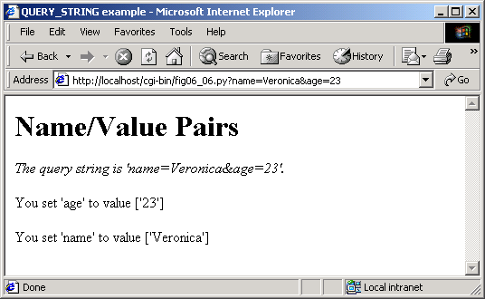
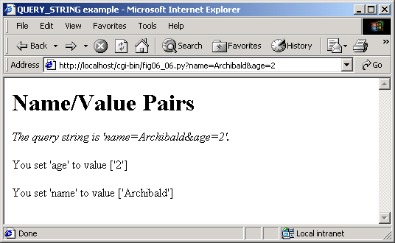
fig06_06.py

Slide 22
6.5 Using XHMTL Forms to Send Input and Using Module cgi to Retrieve Form Data
Web page forms provide an intuitive way for users to input information to CGI scripts
<form> and </form> tags surround an XHTML form
  Attribute action specifies operation to perform when users submit the form
  Attribute method : either get or post
    Get sends data to CGI script via QUERY_STRING environment variable
    Post sends data to CGI script via standard input and sets environment variable CONTENT_LENGTH to number of characters that were posted

Slide 23
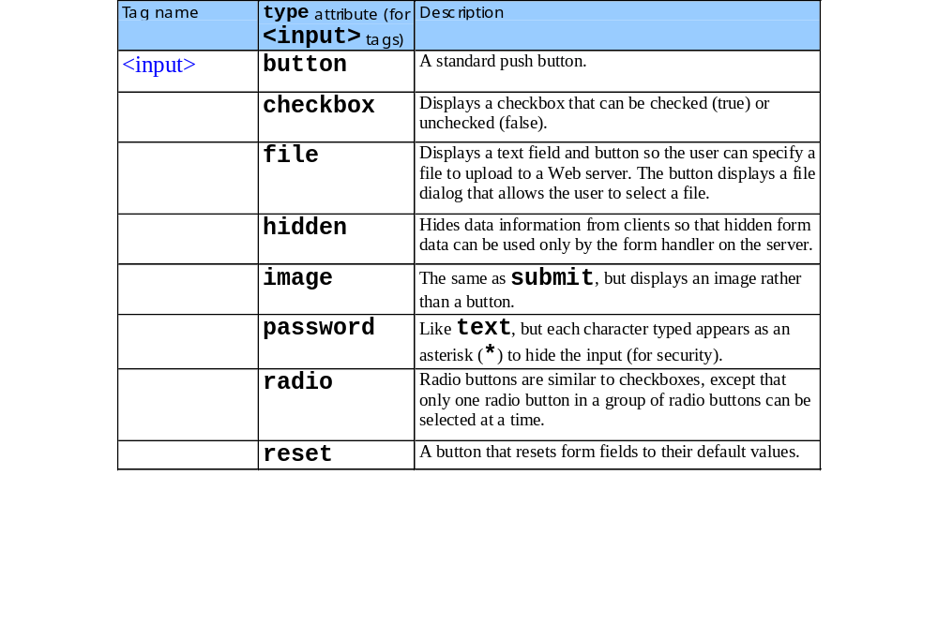
6.5 Using XHMTL Forms to Send Input and Using Module cgi to Retrieve Form Data

Slide 24
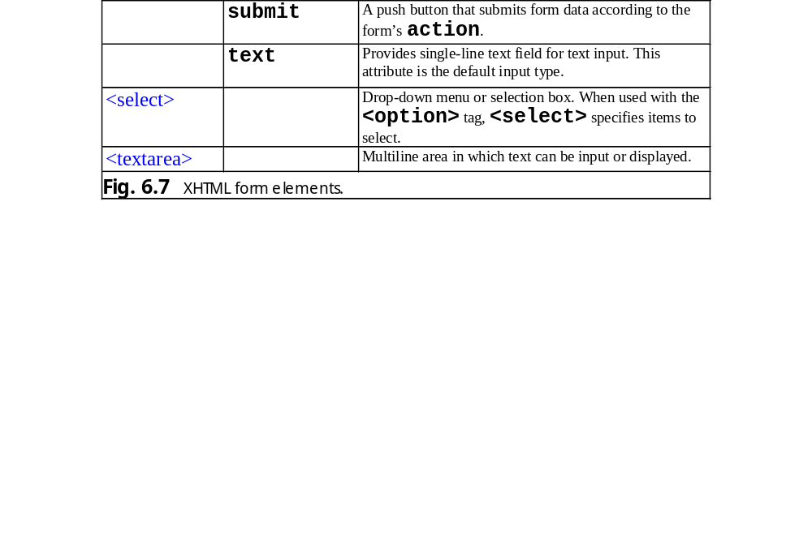
6.5 Using XHMTL Forms to Send Input and Using Module cgi to Retrieve Form Data

Slide 25
fig06_08.py
1 #!c:\Python\python.exe
2 # Fig. 6.8: fig06_08.py
3 # Demonstrates get method with an XHTML form.
4
5 import cgi
6
7 def printHeader( title ):
8 print """Content-type: text/html
9
10 <?xml version = "1.0" encoding = "UTF-8"?>
11 <!DOCTYPE html PUBLIC
12 "-//W3C//DTD XHTML 1.0 Strict//EN"
13 "DTD/xhtml1-strict.dtd">
14 <html xmlns = "http://www.w3.org/1999/xhtml">
15 <head><title>%s</title></head>
16
17 <body>""" % title
18
19 printHeader( "Using 'get' with forms" )
20 print """<p>Enter one of your favorite words here:<br /></p>
21 <form method = "get" action = "fig06_08.py">
22 <p>
23 <input type = "text" name = "word" />
24 <input type = "submit" value = "Submit word" />
25 </p>
26 </form>"""
27
28 pairs = cgi.parse()
29
30 if pairs.has_key( "word" ):
31 print """<p>Your word is:
32 <span style = "font-weight: bold">%s</span></p>""" \
33 % cgi.escape( pairs[ "word" ][ 0 ] )
34
35 print "</body></html>"
Parse form data and return a dictionary
Input data keyed by name attribute of input element
Called in case form data includes special characters

Slide 26
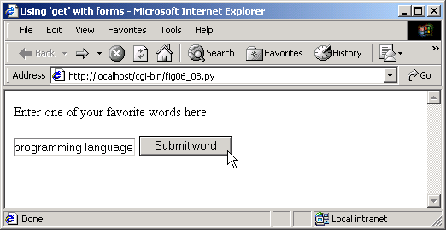
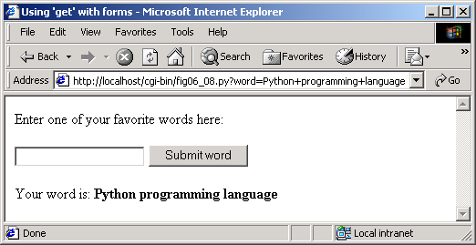
fig06_08.py

Slide 27
fig06_09.py
1 #!c:\Python\python.exe
2 # Fig. 6.9: fig06_09.py
3 # Demonstrates post method with an XHTML form.
4
5 import cgi
6
7 def printHeader( title ):
8 print """Content-type: text/html
9
10 <?xml version = "1.0" encoding = "UTF-8"?>
11 <!DOCTYPE html PUBLIC
12 "-//W3C//DTD XHTML 1.0 Strict//EN"
13 "DTD/xhtml1-strict.dtd">
14 <html xmlns = "http://www.w3.org/1999/xhtml">
15 <head><title>%s</title></head>
16
17 <body>""" % title
18
19 printHeader( "Using 'post' with forms" )
20 print """<p>Enter one of your favorite words here:<br /></p>
21 <form method = "post" action = "fig06_09.py">
22 <p>
23 <input type = "text" name = "word" />
24 <input type = "submit" value = "Submit word" />
25 </p>
26 </form>"""
27
28 pairs = cgi.parse()
29
30 if pairs.has_key( "word" ):
31 print """<p>Your word is:
32 <span style = "font-weight: bold">%s</span></p>""" \
33 % cgi.escape( pairs[ "word" ][ 0 ] )
34
35 print "</body></html>"
Post request attaches form content to the end of a HTTP request

Slide 28
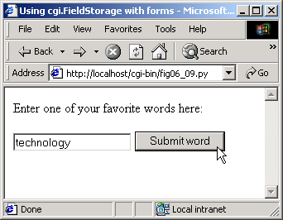
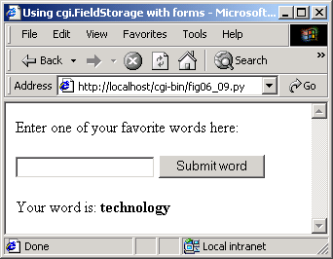
fig06_09.py

Slide 29
6.5 Using cgi.FieldStorage to Read Input
Module cgi provides class FieldStorage to parse forms

Slide 30
fig06_10.py
1 #!c:\Python\python.exe
2 # Fig. 6.10: fig06_10.py
3 # Demonstrates use of cgi.FieldStorage an with XHTML form.
4
5 import cgi
6
7 def printHeader( title ):
8 print """Content-type: text/html
9
10 <?xml version = "1.0" encoding = "UTF-8"?>
11 <!DOCTYPE html PUBLIC
12 "-//W3C//DTD XHTML 1.0 Strict//EN"
13 "DTD/xhtml1-strict.dtd">
14 <html xmlns = "http://www.w3.org/1999/xhtml">
15 <head><title>%s</title></head>
16
17 <body>""" % title
18
19 printHeader( "Using cgi.FieldStorage with forms" )
20 print """<p>Enter one of your favorite words here:<br /></p>
21 <form method = "post" action = "fig06_10.py">
22 <p>
23 <input type = "text" name = "word" />
24 <input type = "submit" value = "Submit word" />
25 </p>
26 </form>"""
27
28 form = cgi.FieldStorage()
29
30 if form.has_key( "word" ):
31 print """<p>Your word is:
32 <span style = "font-weight: bold">%s</span></p>""" \
33 % cgi.escape( form[ "word" ].value )
34
35 print "</body></html>"
cgi.FieldStorage object stores form data in a dictionary
Form data keyed by the value of each input element’s name attribute

Slide 31
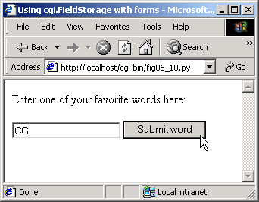
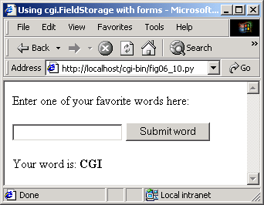
fig06_10.py

Slide 32
6.5 Other HTTP Headers
Content-type header specifies how document is processed
Refresh header redirects client to new location or refreshes current page
Location header indicates redirection performed on server side
Status header tells server to output status-header line

Slide 33
fig06_11.html
1 <?xml version = "1.0" encoding = "UTF-8"?>
2 <!DOCTYPE html PUBLIC
3 "-//W3C//DTD XHTML 1.0 Strict//EN"
4 "DTD/xhtml1-strict.dtd">
5 <!-- Fig. 6.11: fig06_11.html -->
6 <!-- Bug2Bug Travel log-in page. -->
7
8 <html xmlns = "http://www.w3.org/1999/xhtml">
9 <head><title>Enter here</title></head>
10
11 <body>
12 <h1>Welcome to Bug2Bug Travel</h1>
13
14 <form method = "post" action = "/cgi-bin/fig06_12.py">
15
16 <p>Please enter your name:<br />
17 <input type = "text" name = "name" /><br />
18
19 Members, please enter the password:<br />
20 <input type = "password" name = "password" /><br />
21 </p>
22
23 <p style = "font-size: em - 1; font-style: italic" >
24 Note that password is not encrypted.<br /><br />
25 <input type = "submit" />
26 </p>
27
28 </form>
29 </body>
30 </html>
CGI script called when user submits form

Slide 34
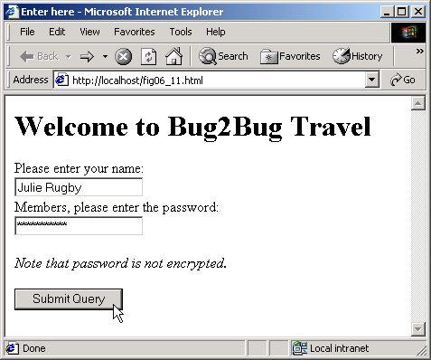
fig06_11.html

Slide 35
fig06_12.py
1 #!c:\Python\python.exe
2 # Fig. 6.12: fig06_12.py
3 # Handles entry to Bug2Bug Travel.
4
5 import cgi
6
7 def printHeader( title ):
8 print """Content-type: text/html
9
10 <?xml version = "1.0" encoding = "UTF-8"?>
11 <!DOCTYPE html PUBLIC
12 "-//W3C//DTD XHTML 1.0 Strict//EN"
13 "DTD/xhtml1-strict.dtd">
14 <html xmlns = "http://www.w3.org/1999/xhtml">
15 <head><title>%s</title></head>
16
17 <body>""" % title
18
19 form = cgi.FieldStorage()
20
21 if not form.has_key( "name" ):
22 print "Location: /fig06_11.html\n"
23 else:
24 printHeader( "Bug2Bug Travel" )
25 print "<h1>Welcome, %s!</h1>" % form[ "name" ].value
26 print """<p>Here are our weekly specials:<br /></p>
27 <ul><li>Boston to Taiwan for $300</li></ul>"""
28
29 if not form.has_key( "password" ):
30 print """<p style = "font-style: italic">
31 Become a member today for more great deals!</p>"""
32 elif form[ "password" ].value == "Coast2Coast":
33 print """<hr />
34 <p>Current specials just for members:<br /></p>
35 <ul><li>San Diego to Hong Kong for $250</li></ul>"""
User did not enter login name
User entered password

Slide 36
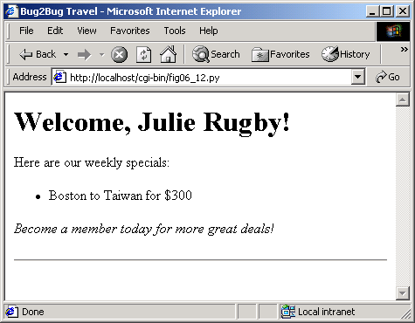
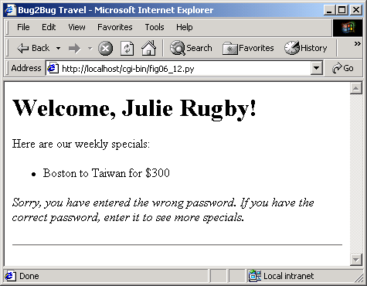
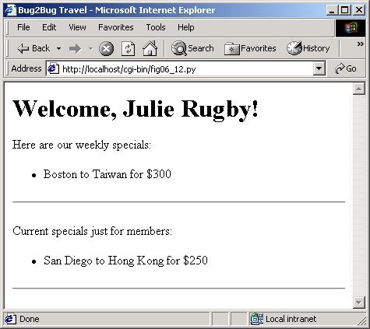
fig06_12.py

