Slide 1
A bunch of ways to get started in open source
Andy Lester, http://petdance.com/

Slide 2
A bunch of ways to get started in open source
Andy Lester, http://petdance.com/
(...but I'm Asheesh Laroia
http://asheesh.org/ )

Slide 3
(Goals of this talk)

Slide 4

You are worthy

Slide 5
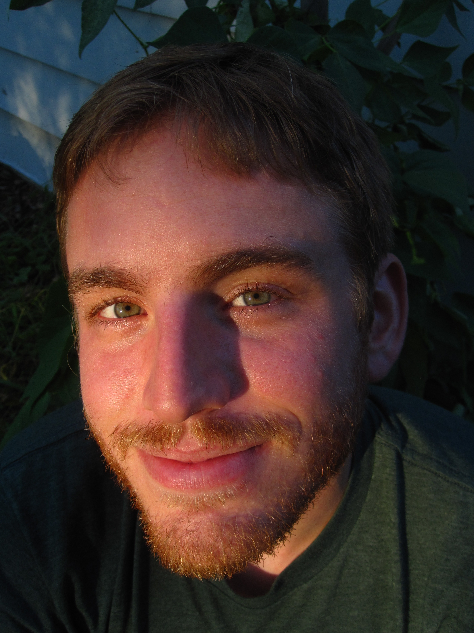

Slide 6
Part 1.
Find a community

Slide 7
What’s a good project to help out with?

Slide 8
Best project to help on: one you use.

Slide 9
2nd best: one you want to use.

Slide 10
Listen & learn

Slide 11
Listen & learn
What is the project's workflow?

Slide 12
Listen & learn
What's being worked on?

Slide 13
Listen & learn
What does the project value?

Slide 14
Listen & learn
Is the project active?

Slide 15
Listen & learn
Join a mailing list.
Read blogs of leaders, or the “Planet”.
Join IRC channel.
Attend a user group meeting.

Slide 16
Go to a user group meeting

Slide 17
...or start a new user group.

Slide 18
Introduce yourself (and have a plan).

Slide 19
“The best place for us to have a meeting... would be a Western suburb of Detroit.”

Slide 20
“We also don't need to be drunk within 10 minutes, maybe 30.”

Slide 21
Welcome a newcomer

Slide 22
Part 2.
Bugs

Slide 23
Bug management

Slide 24
Close a ticket

Slide 25
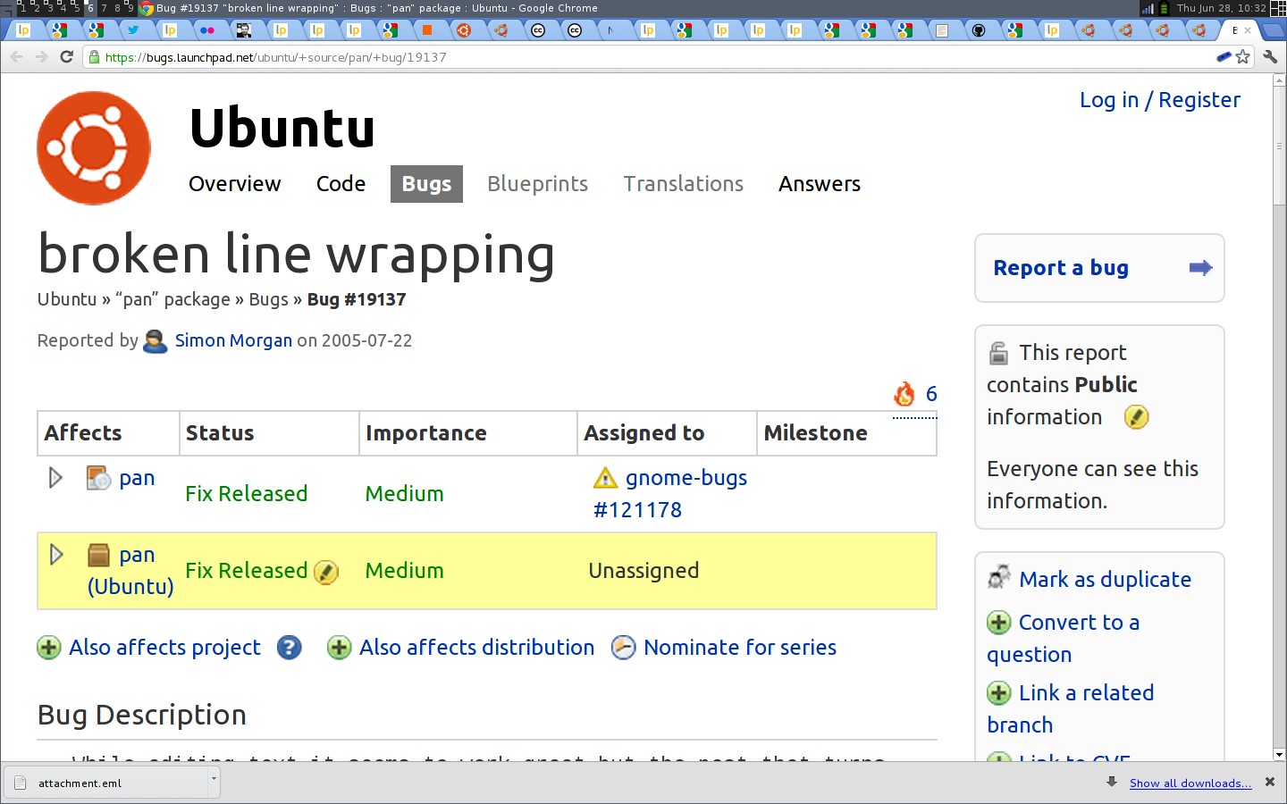

Slide 26
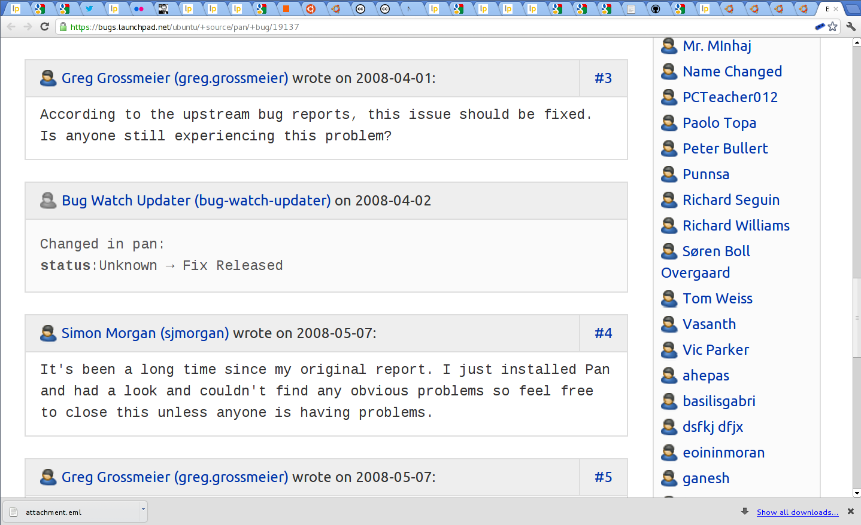

Slide 27
File a bug.

Slide 28
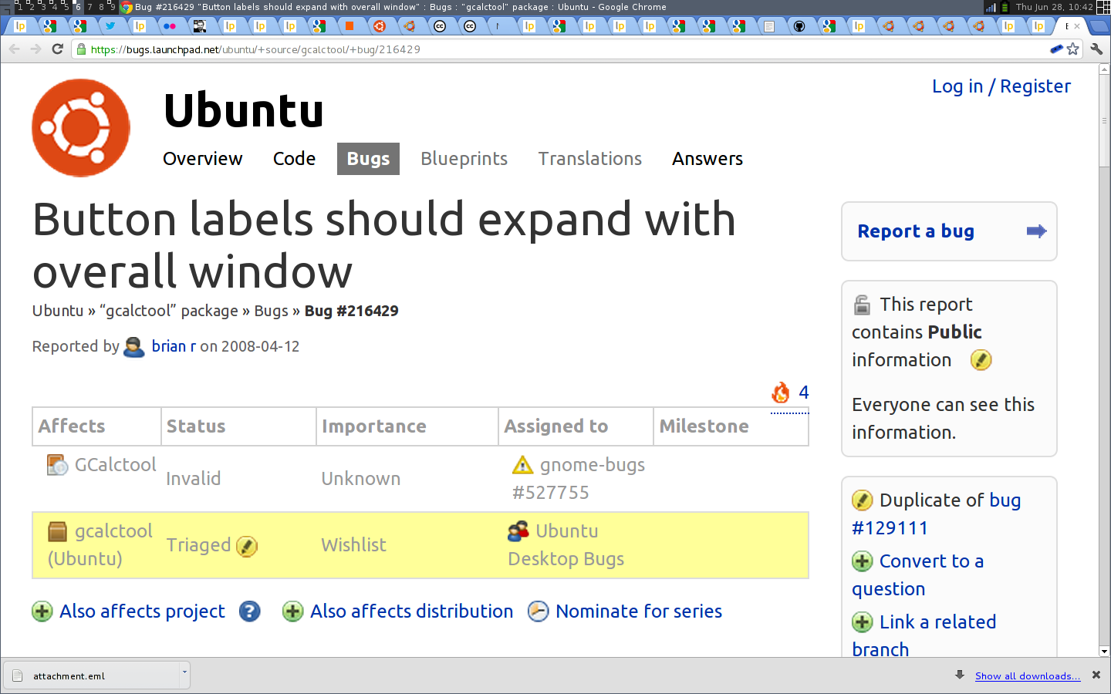

Slide 29
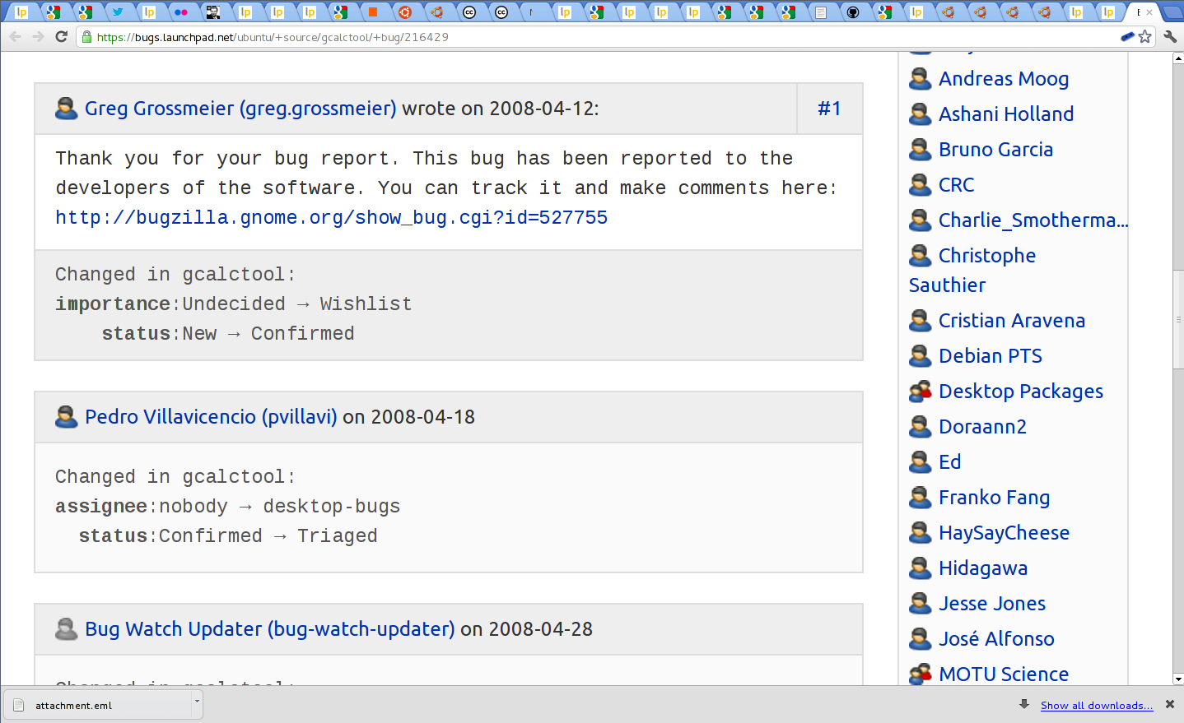

Slide 30
Enhance a bug report.

Slide 31
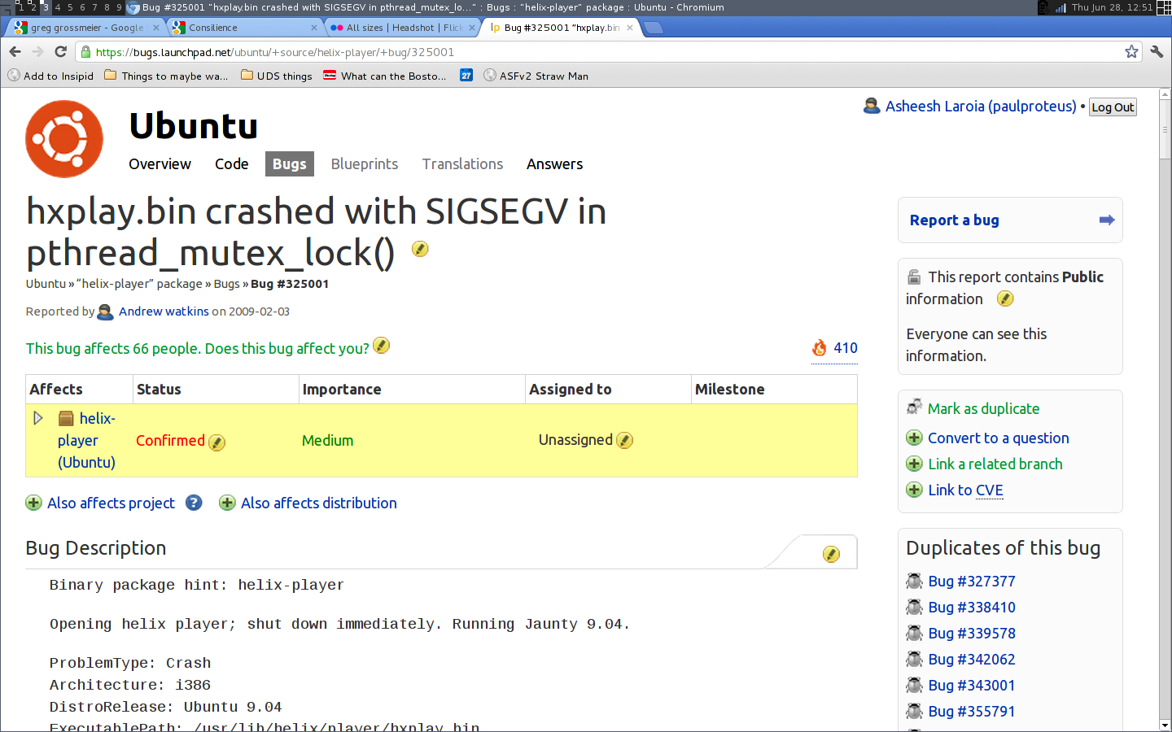

Slide 32
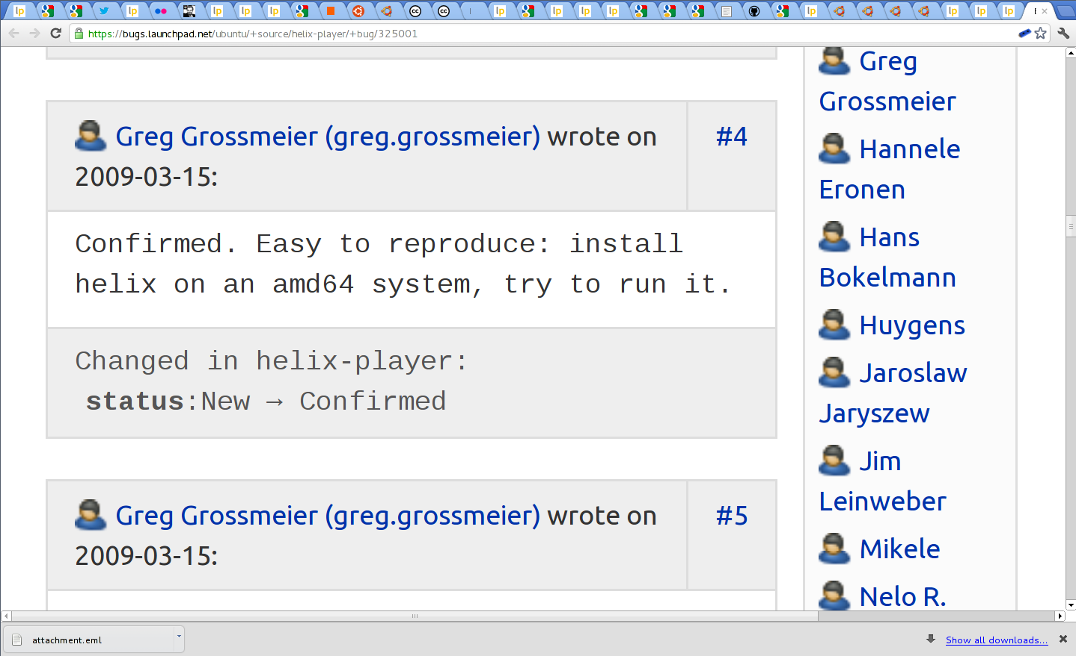

Slide 33
Enhance a bug report.
“I recreated this on Ubuntu with the 1.6 release per the ticket. On Mac OS X, it also failed, but with a different error message and with a stack trace.”
(And give the message and contents of the stack trace!)

Slide 34
Thank someone.

Slide 35
Isolate a bug.

Slide 36
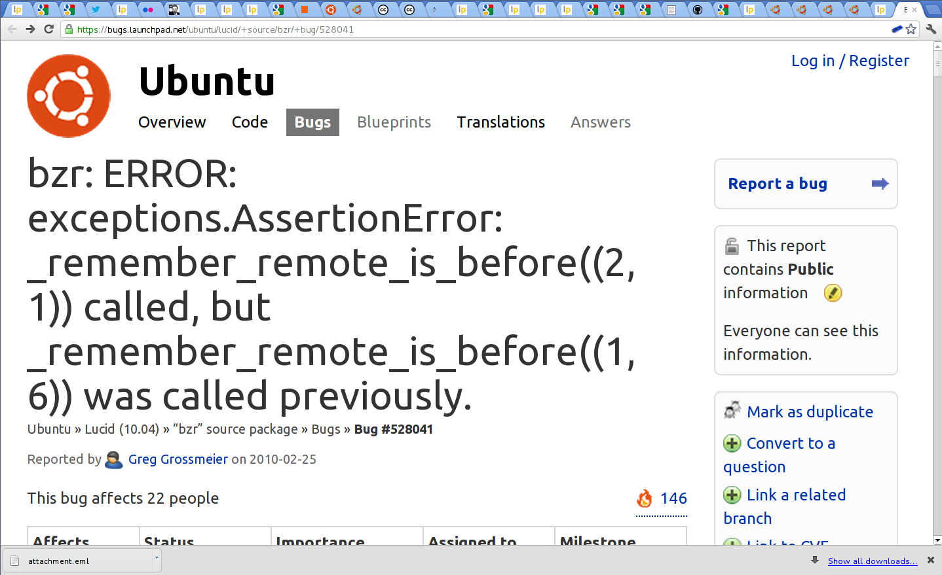

Slide 37
“Very few things are as tempting as a link to the problem.” sscce.org

Slide 38
A bug ticket is not a static document.
Bugs matter!

Slide 39
Part 3.
Publicity

Slide 40
Tweet/dent some news

Slide 41
Write a blog post

Slide 42
How did you use the project?
What worked?
What didn’t?

Slide 43
Talk at a user group

Slide 44
Part 4.
My path as a newbie

Slide 45
Learn that open source exists

Slide 46
Learn to use some open source software

Slide 47
Report a bug.

Slide 48
Test a beta or release candidate

Slide 49
Answer a question

Slide 50
Document a process

Slide 51
Fix the website

Slide 52
Part 5.
Even more ways

Slide 53
Silence a compiler warning.

Slide 54
Document an API: Examples!

Slide 55
Write a test

Slide 56
Translate something.

Slide 57
Draw a logo

Slide 58
Part 6.
If you're feeling timid

Slide 59
You are invited.
(That's why everything is done in public.)

Slide 60
Training missions openhatch.org/ missions/

Slide 61
Thank you for listening. http://speakerdeck.com/u/ paulproteus/ asheesh@asheesh.org

