Slide 1
OpenDocument and Sandstorm
Asheesh Laroia
asheesh@sandstorm.io

Slide 2
OpenDocument and Sandstorm
1. EtherCalc running on Sandstorm
2. Google Docs' native file format
3. How ODF can play a bigger part

Slide 3
OpenDocument and Sandstorm
1. EtherCalc running on Sandstorm
2. Google Docs' native file format
3. How ODF can play a bigger part

Slide 4
OpenDocument and Sandstorm
1. EtherCalc running on Sandstorm
2. Google Docs' native file format
3. How ODF can play a bigger part

Slide 5
<1>
EtherCalc running on Sandstorm

Slide 6
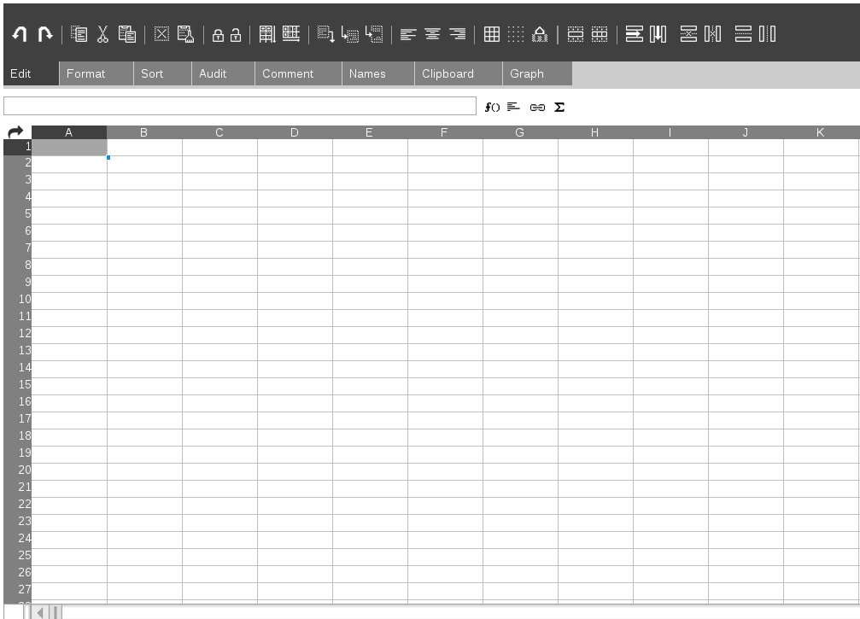

Slide 7
Sandstorm

Slide 8
Sandstorm
https://demo.sandstorm.io/

Slide 9
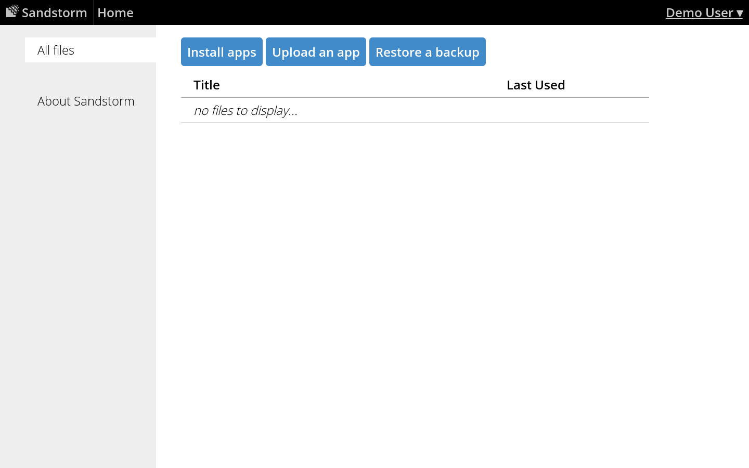

Slide 10
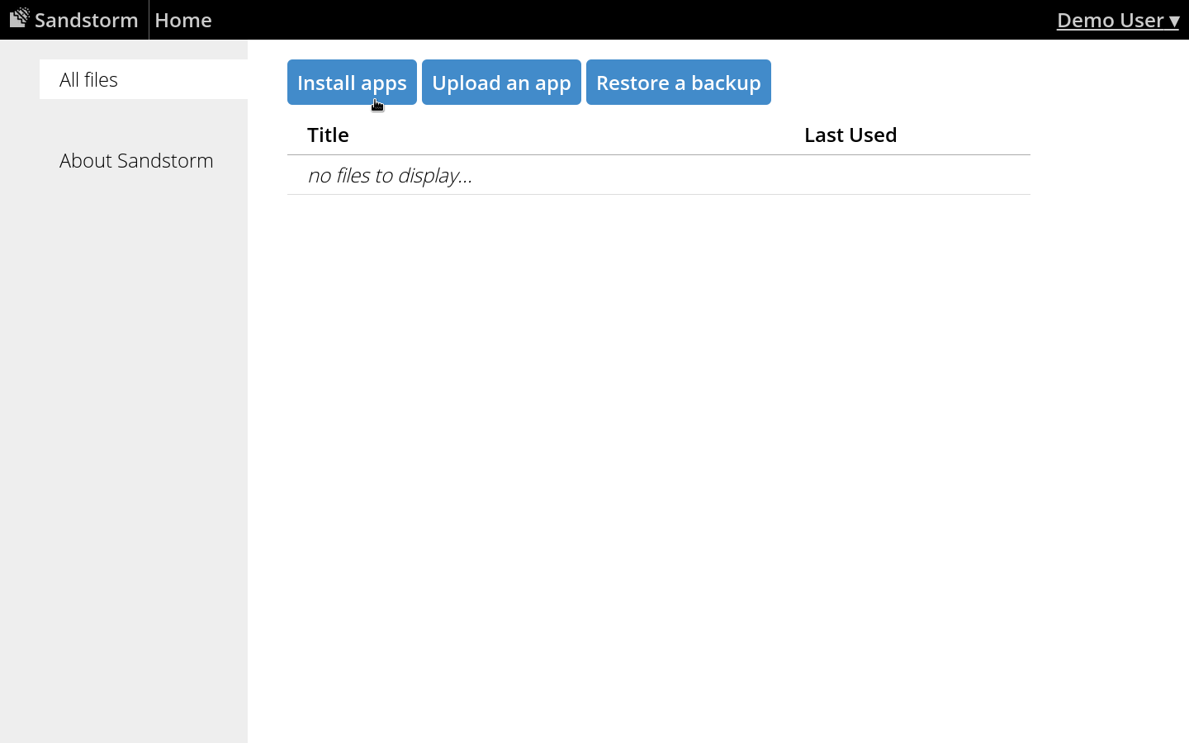

Slide 11
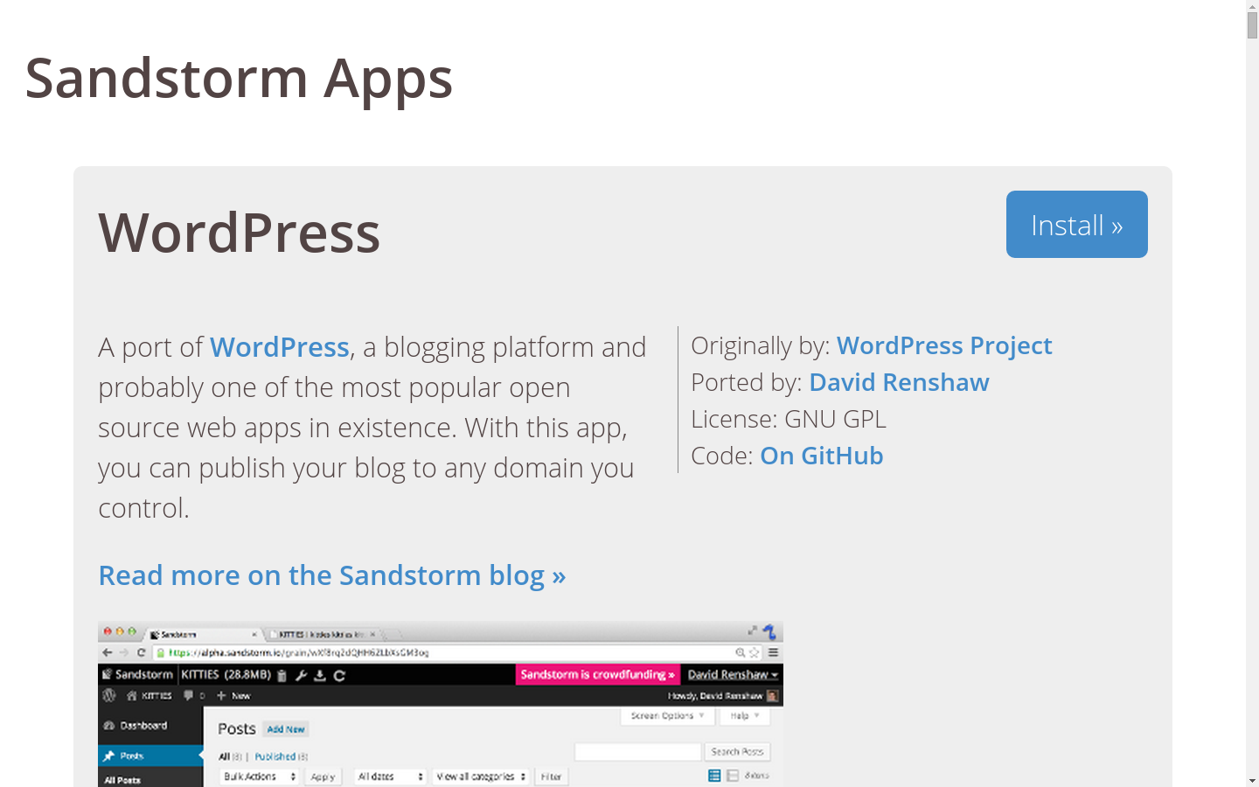

Slide 12
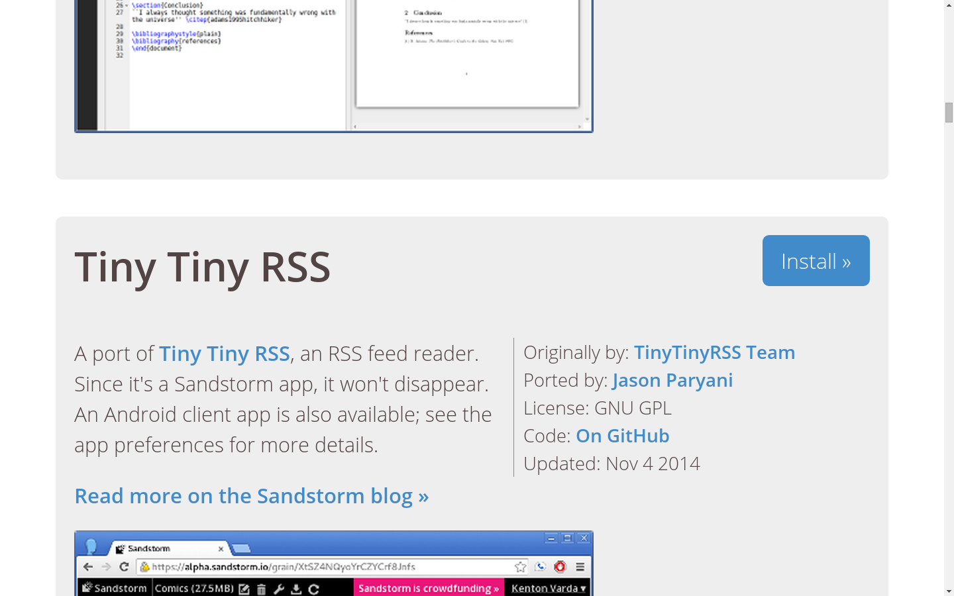

Slide 13
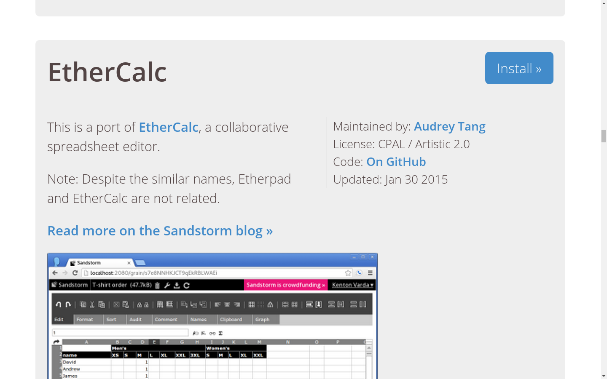

Slide 14


Slide 15
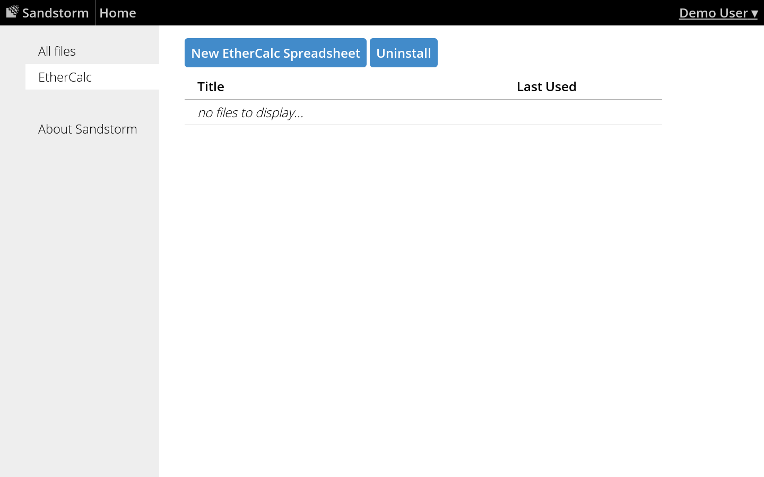

Slide 16


Slide 17
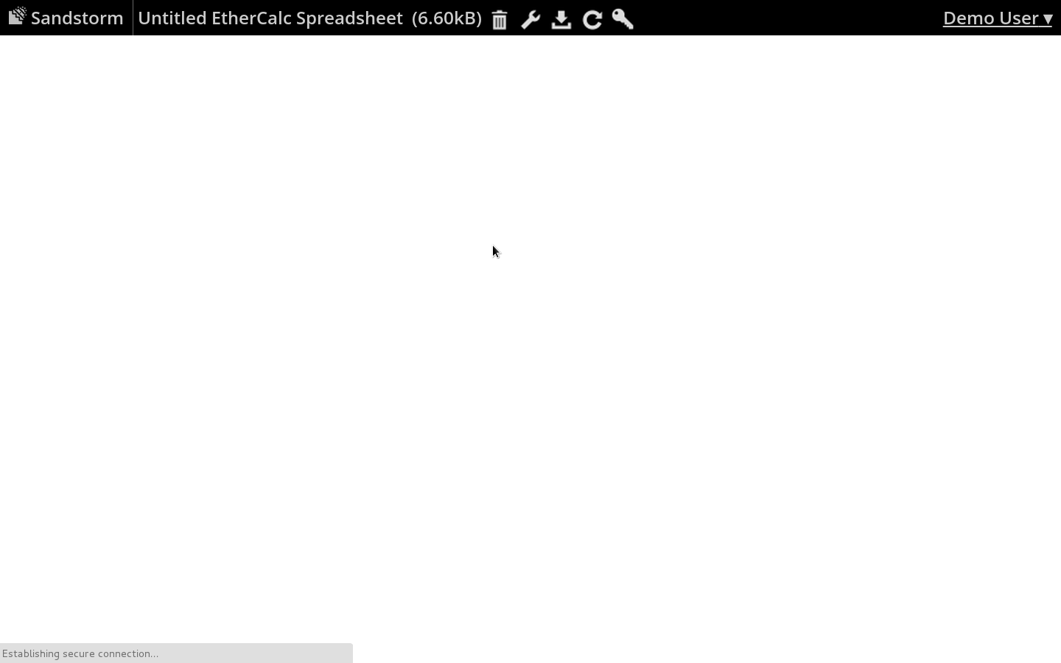

Slide 18
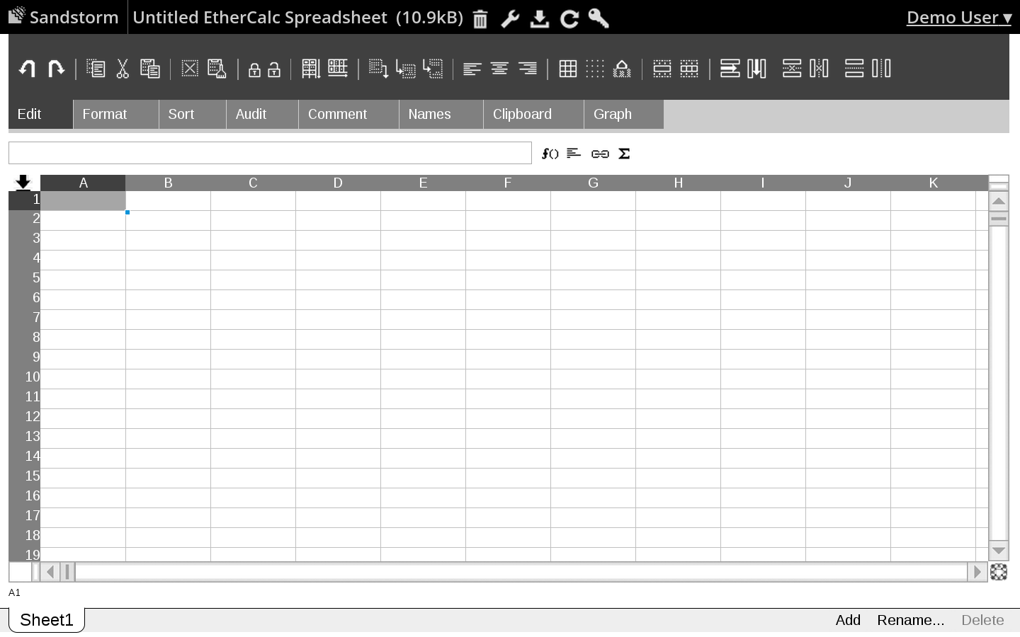

Slide 19
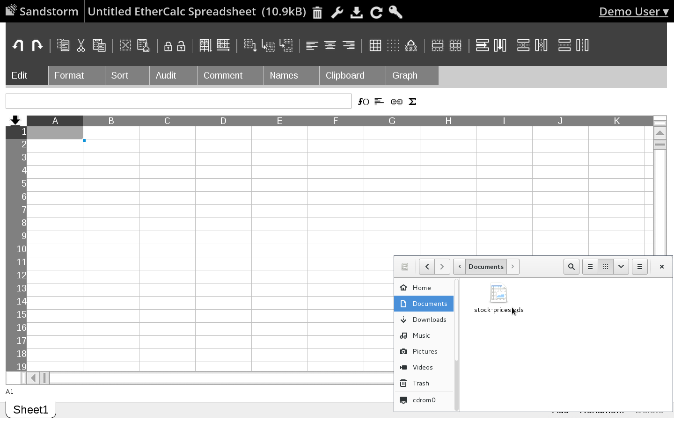

Slide 20
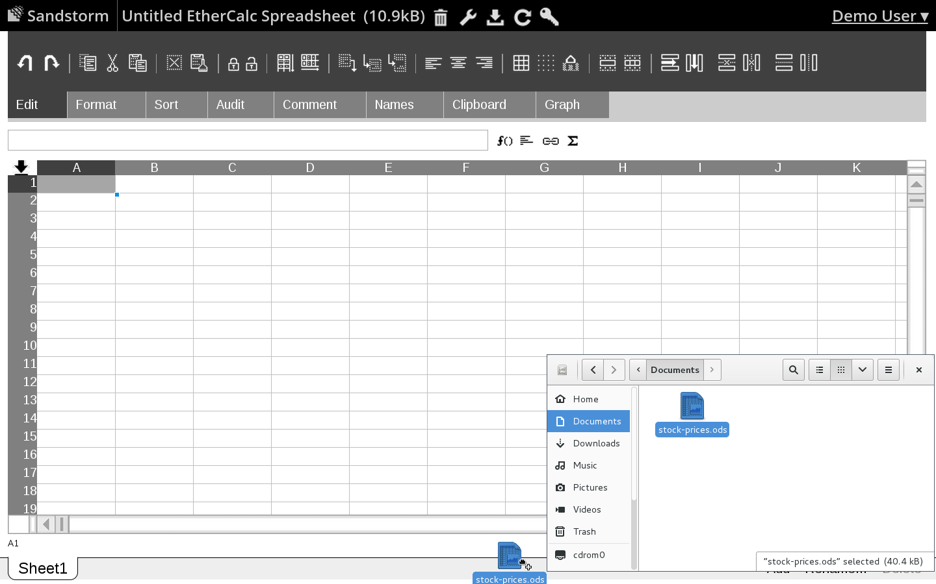

Slide 21
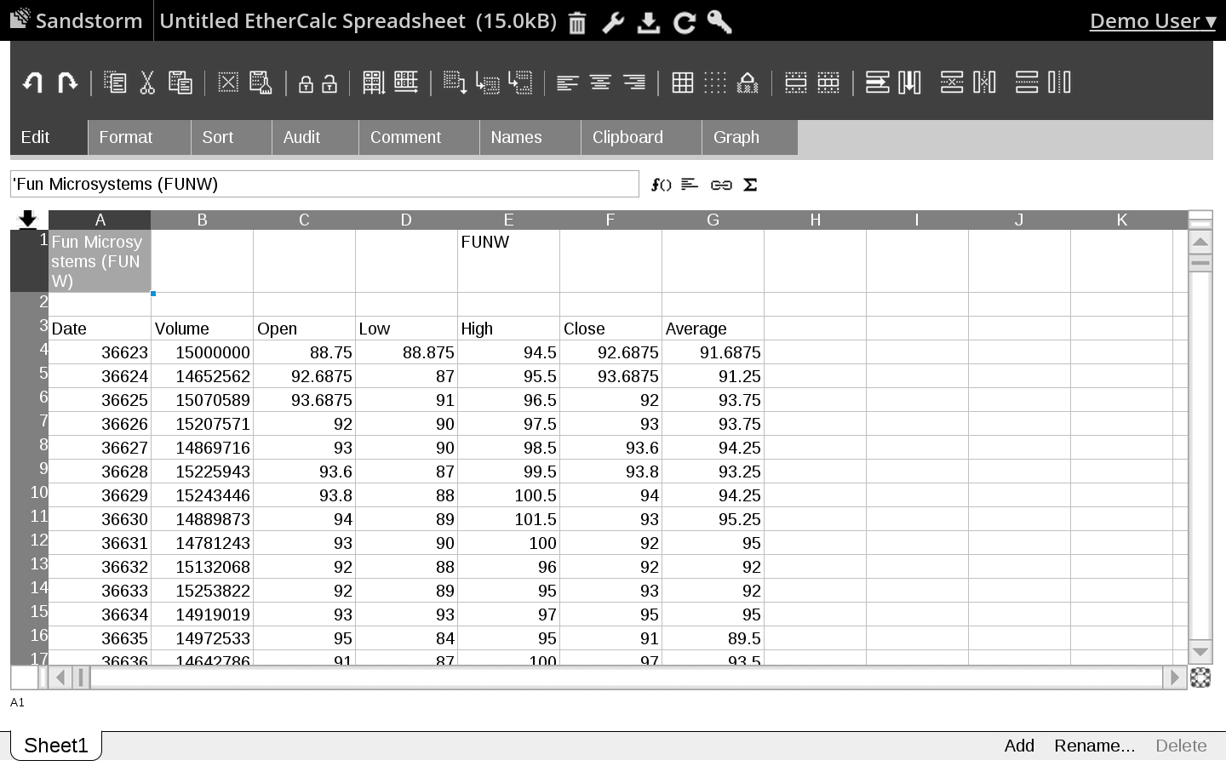

Slide 22
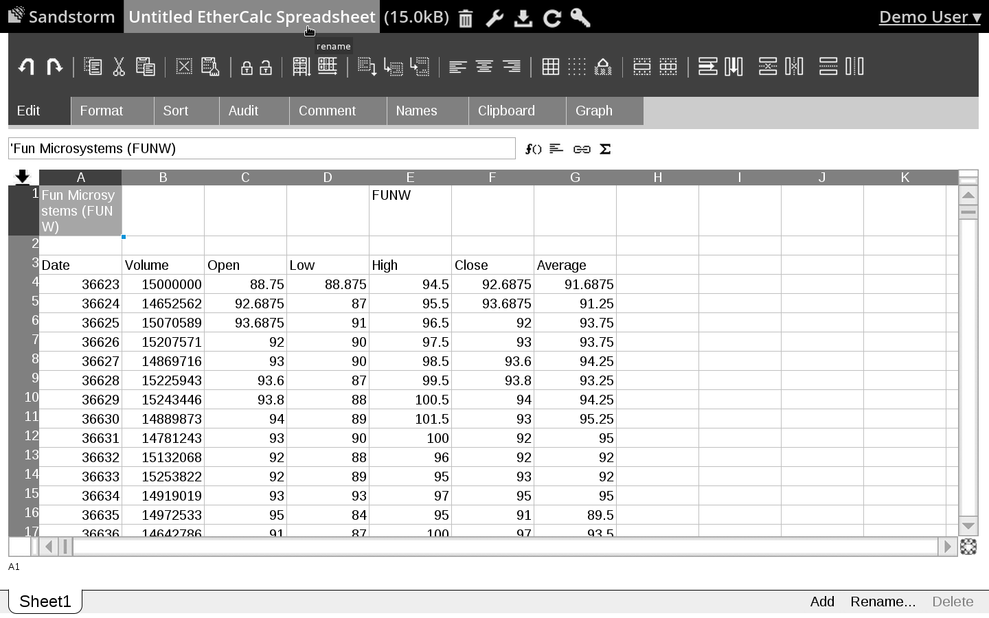

Slide 23
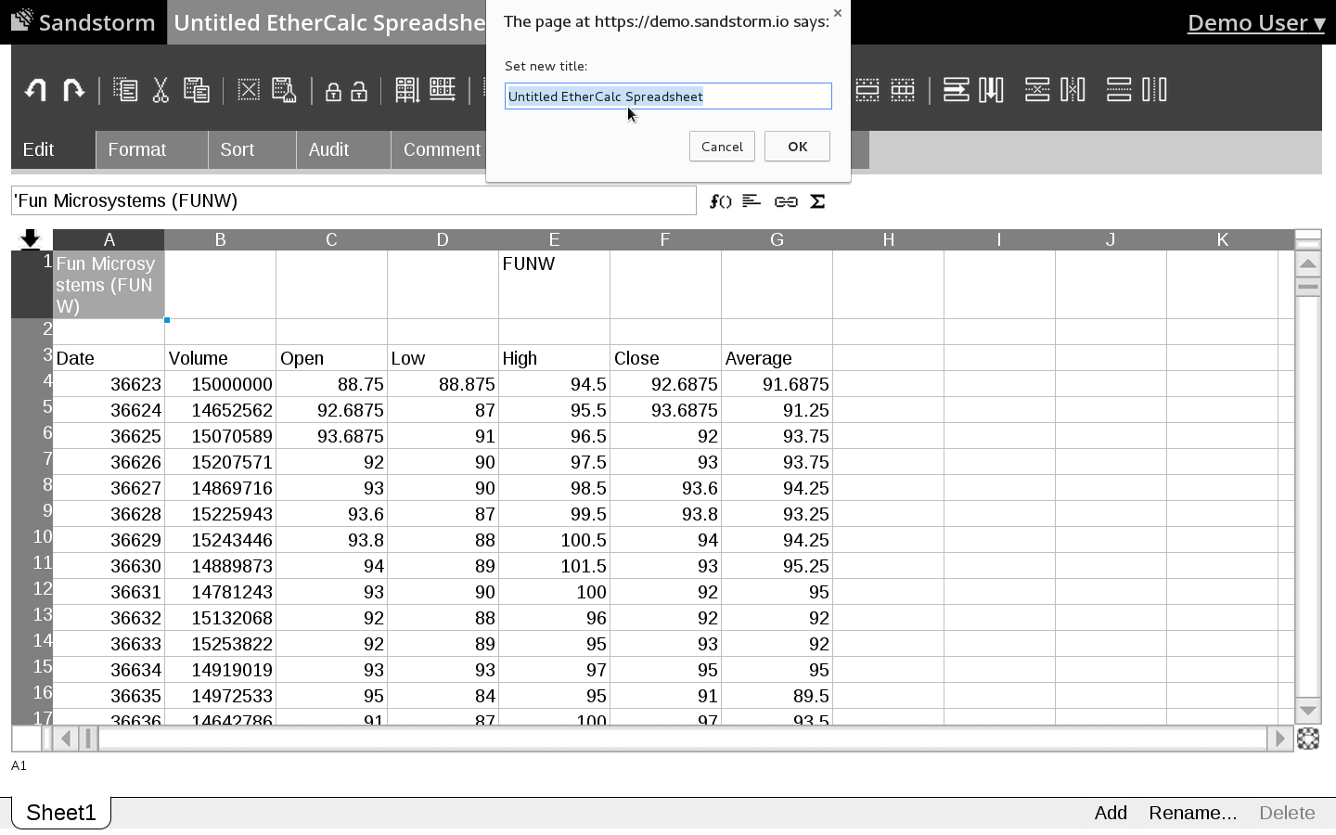

Slide 24
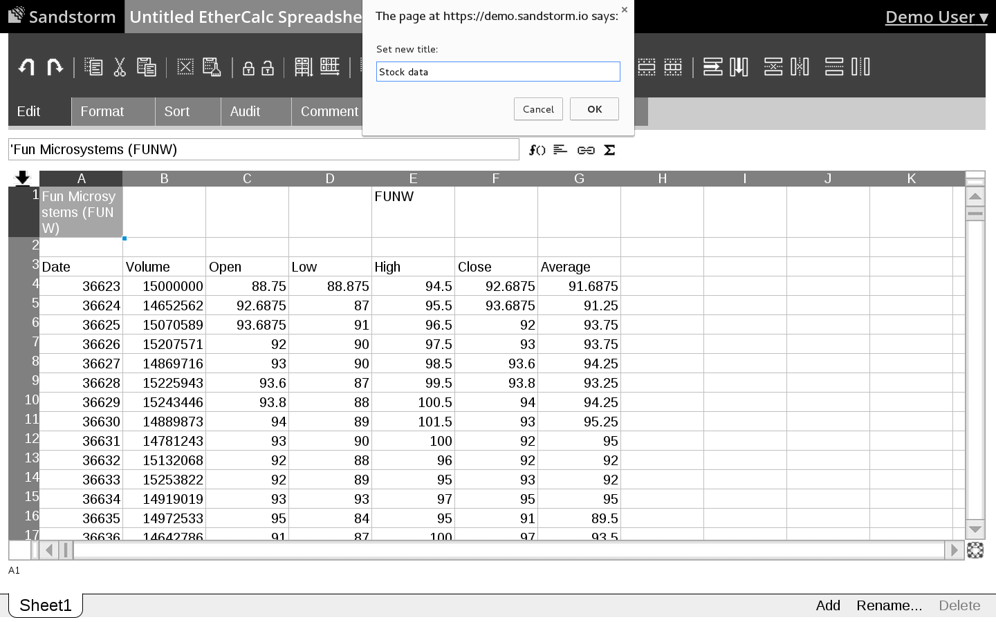

Slide 25
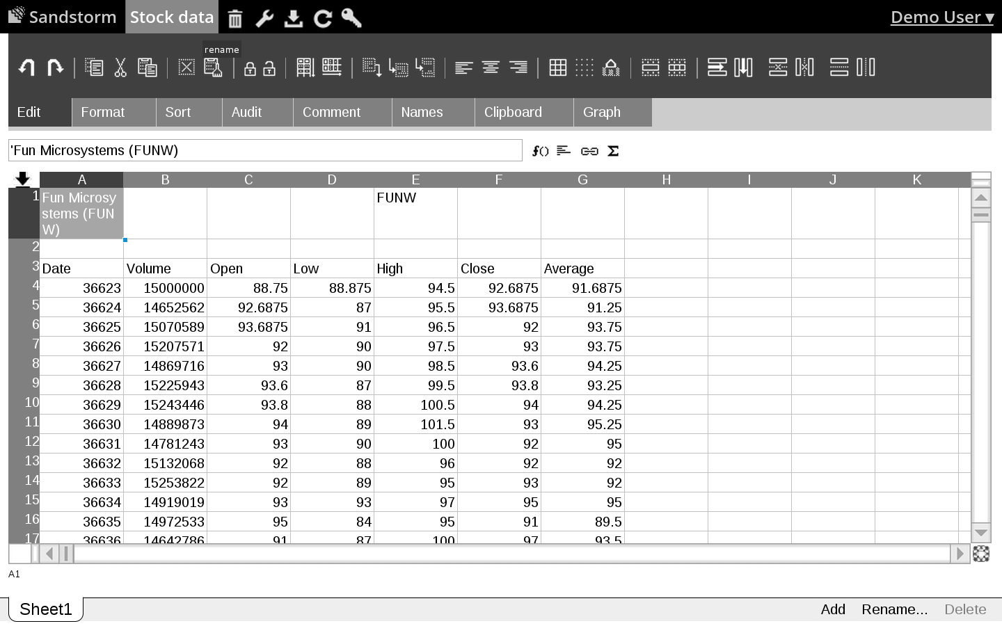

Slide 26
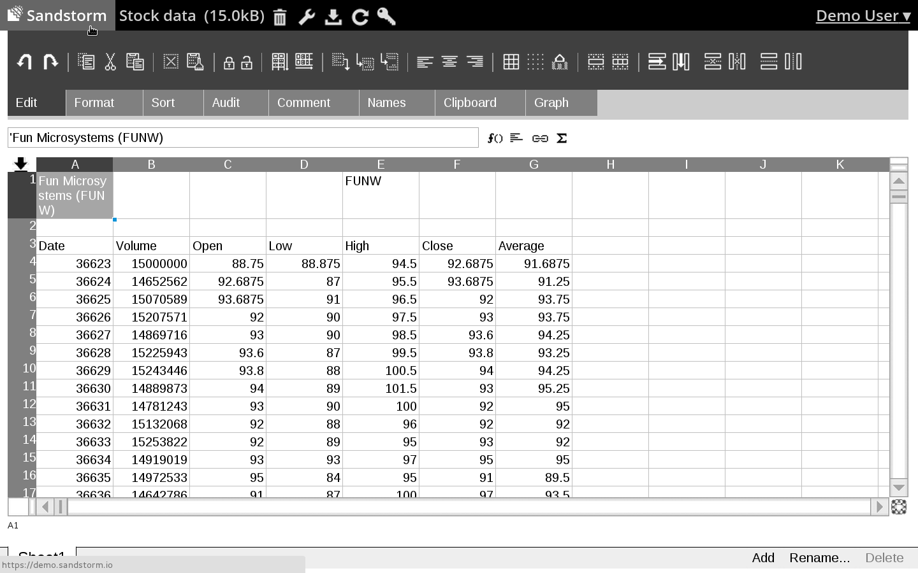

Slide 27
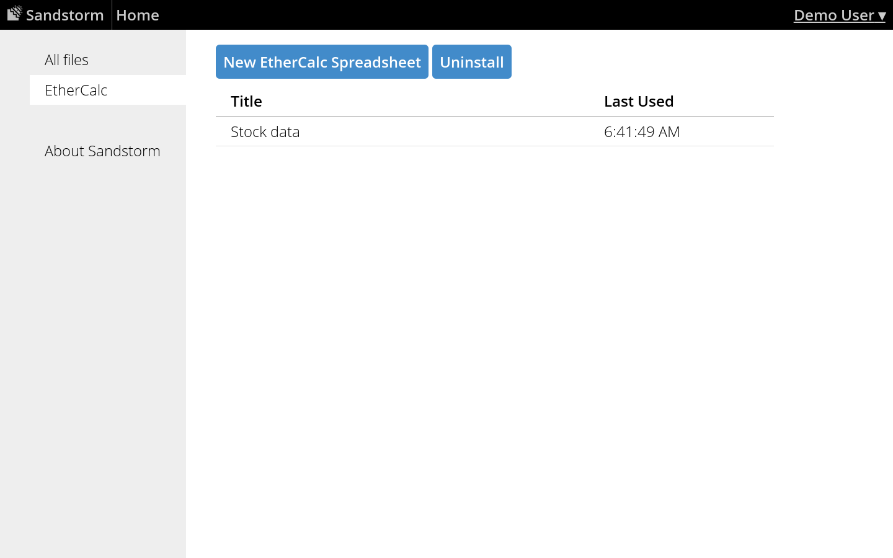

Slide 28
<2>
Google Docs' native file format

Slide 29
“We do not expose our native file formats.”

Slide 30
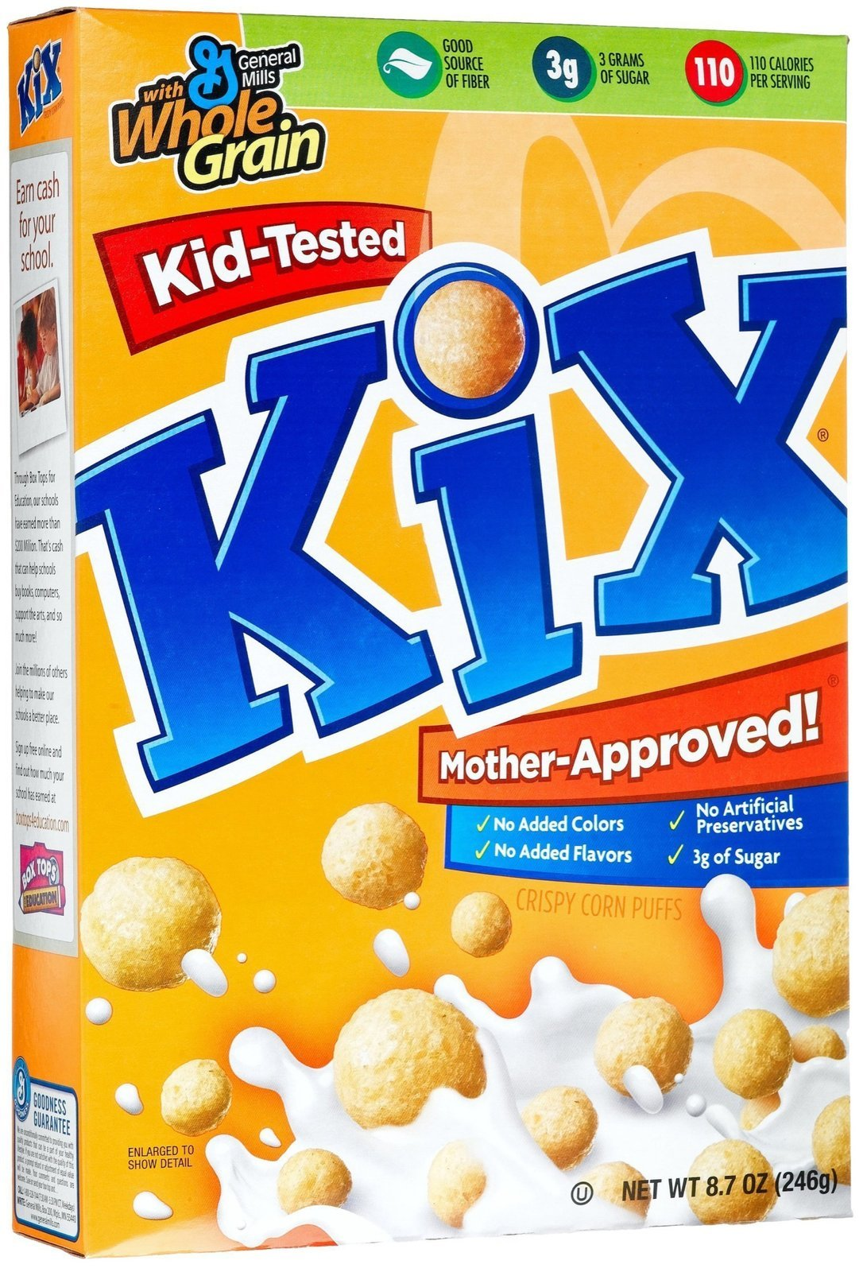
“We do not expose our native file formats.”

Slide 31
<3>
ODF and Sandstorm

Slide 33
1. EtherCalc imports ODS
2. Google Docs: no file interchange
3. In Sandstorm, apps are easy to install, so formats matter
– Asheesh Laroia, asheesh@asheesh.org
#sandstorm on freenode

Slide 34
P.S. Licensing & credits
Text in this presentation © Asheesh Laroia, 2014. Re-use permitted under the terms of CC Zero <https://creativecommons.org/publicdomain/zero/1.0/> or Apache License 2.0, at your option. Images are under the same license, except:
* Image of Kix: Used as fair use.
Other credits:
* Thanks to Audrey Tang of EtherCalc for ODS support, and to the SheetJS authors for js-xlsx, which powers the ODS support.
* Thanks to Sandstorm for sending me to FOSDEM.
* Thanks to Thorsten Behrens for the chance to give the lightning talk.
* Thanks to bm@openoffice.org for “Fun Microsystems – FUNW” stock chart sample ODS file: https://wiki.openoffice.org/wiki/File:StockChart.ods

