Slide 1
Python packaging simplified
for end users,
app developers,
and open source contributors
Asheesh Laroia

Slide 2
Changes
No Debian vs. ???
No compiled code talking,
except wheel
No focus on Django apps

Slide 3
Goals
1. Be able to install
2. Be able to distribute
3. Know how to learn more

Slide 4
Goals
1. Be able to install
2. Be able to distribute
3. Know how to learn more

Slide 5
Goals
1. Be able to install
2. Be able to distribute
3. Know how to learn more

Slide 6
Installation

Slide 7
$ python

Slide 8
$ python
>>> import numbers

Slide 9
$ python
>>> import numbers
>>> numbers
<module 'numbers' from '/usr/lib/python2.7/numbers.pyc'>

Slide 10
>>> import sys
>>> sys.path

Slide 11
>>> import sys
>>> sys.path
['',
'/usr/lib/python2.7',
'/usr/lib/python2.7/plat-x86_64-linux-gnu',
'/usr/lib/python2.7/lib-tk',
'/usr/lib/python2.7/lib-old',
'/usr/lib/python2.7/lib-dynload',
'/home/me/.local/lib/python2.7/site-packages',
'/usr/local/lib/python2.7/dist-packages',
'/usr/lib/python2.7/dist-packages',
'/usr/lib/python2.7/dist-packages/PIL',
'/usr/lib/python2.7/dist-packages/gst-0.10',
'/usr/lib/python2.7/dist-packages/gtk-2.0',
'/usr/lib/pymodules/python2.7',
]

Slide 12
>>> import sys
>>> sys.path
['',
'/usr/lib/python2.7',
'/usr/lib/python2.7/plat-x86_64-linux-gnu',
'/usr/lib/python2.7/lib-tk',
'/usr/lib/python2.7/lib-old',
'/usr/lib/python2.7/lib-dynload',
'/home/me/.local/lib/python2.7/site-packages',
'/usr/local/lib/python2.7/dist-packages',
'/usr/lib/python2.7/dist-packages',
'/usr/lib/python2.7/dist-packages/PIL',
'/usr/lib/python2.7/dist-packages/gst-0.10',
'/usr/lib/python2.7/dist-packages/gtk-2.0',
'/usr/lib/pymodules/python2.7',
]

Slide 13
$ python
>>> import numbers
>>> numbers
<module 'numbers' from '/usr/lib/python2.7/numbers.pyc'>

Slide 14
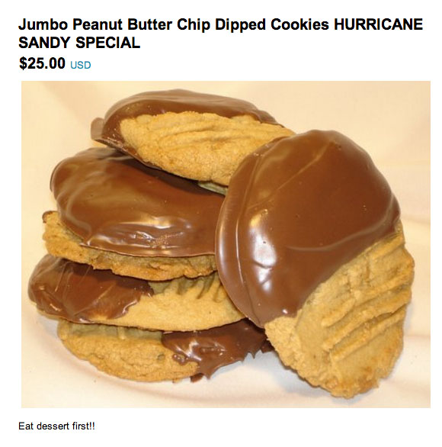


Slide 15
>>> import etsy

Slide 16
>>> import etsy
cheeseshop
pypi.python.org

Slide 17
>>> import etsy
cheeseshop
pypi.python.org
[etsy wrapper]

Slide 18
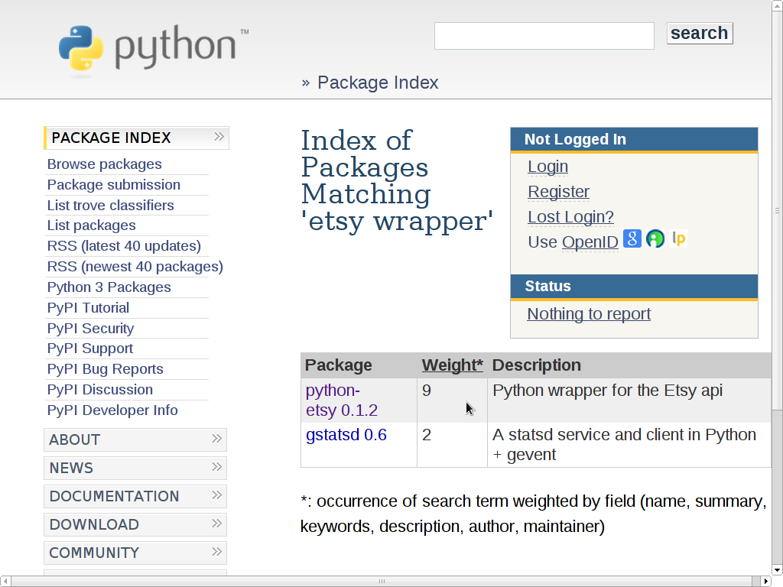

Slide 19
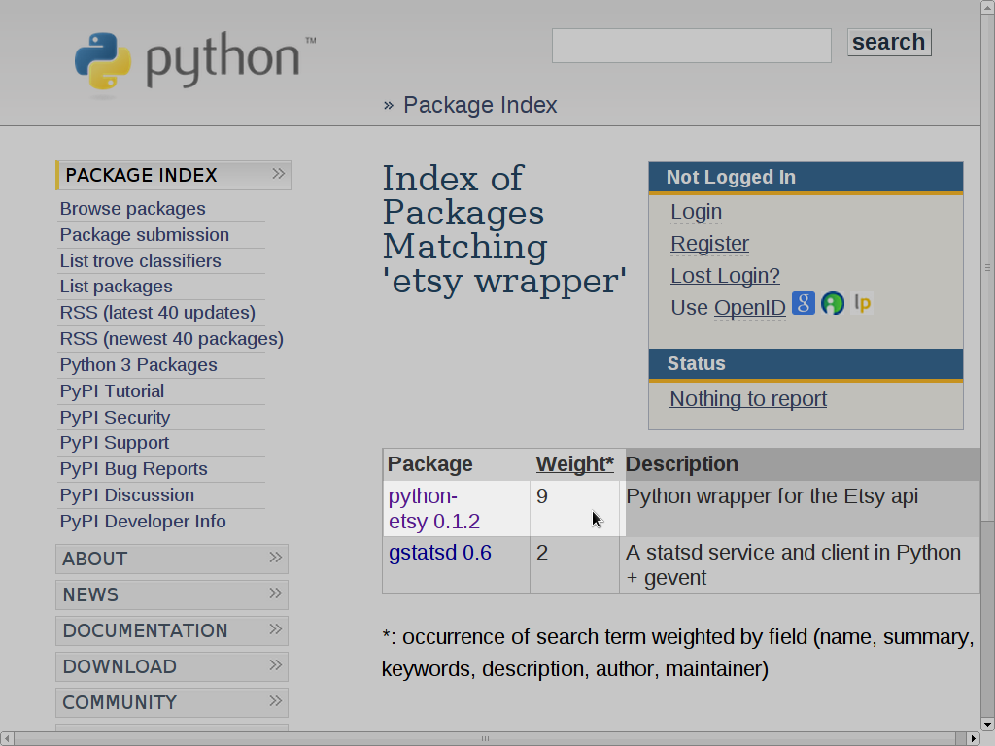

Slide 20
>>> import python-etsy
File "<stdin>", line 1
import python-etsy
^
SyntaxError: invalid syntax

Slide 21
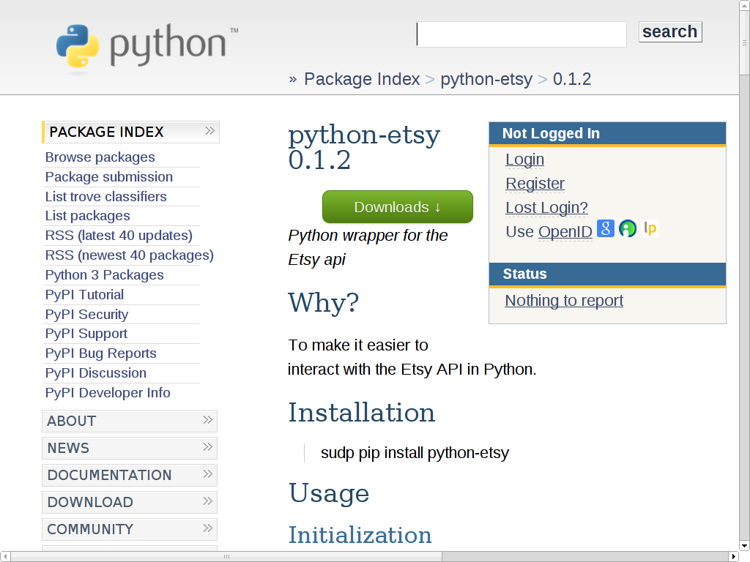

Slide 22
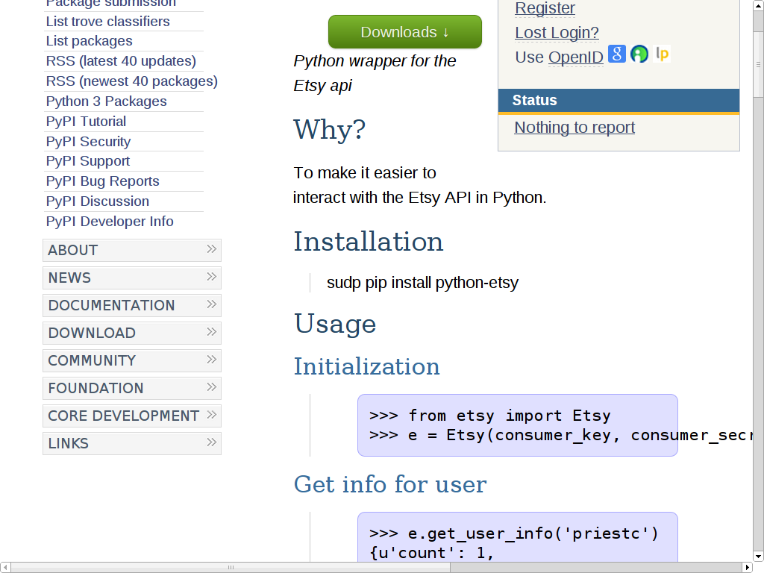

Slide 23
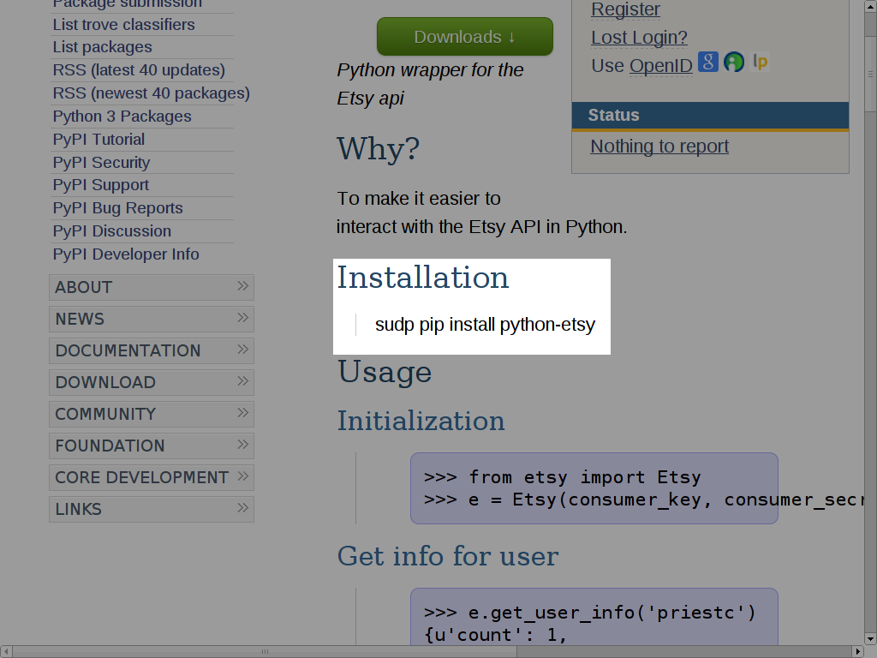

Slide 24
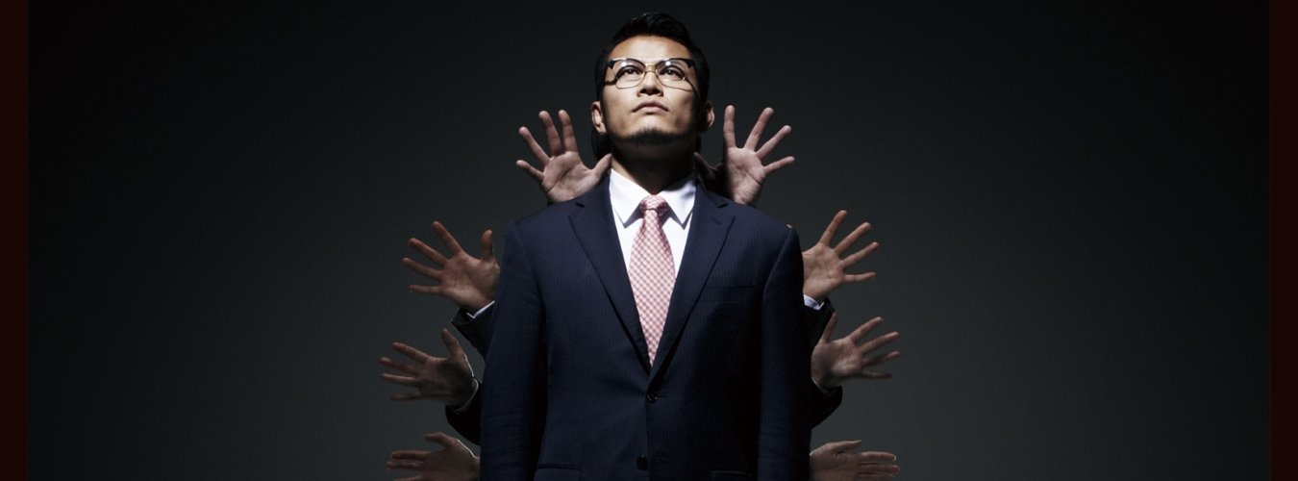
$ sudp pip install python-etsy

Slide 25
$ sudp pip install python-etsy
Genki Sudo World Order

Slide 26
>>> import sys
>>> sys.path
['',
# ...
'/home/me/.local/lib/python2.7/
site-packages',
]

Slide 27
$ pip install --user python-etsy

Slide 28
$ pip install --user python-etsy
Downloading/unpacking python-etsy
Downloading python-etsy-0.1.2.tar.gz

Slide 29
$ pip install --user python-etsy
Downloading/unpacking python-etsy
Downloading python-etsy-0.1.2.tar.gz
Successfully installed python-etsy
Cleaning up...

Slide 30
$ pip install --user python-etsy
Downloading/unpacking python-etsy
Downloading python-etsy-0.1.2.tar.gz
Successfully installed python-etsy
Cleaning up...
$ python
>>> import etsy

Slide 31
$ pip install --user python-etsy
Downloading/unpacking python-etsy
Downloading python-etsy-0.1.2.tar.gz
Successfully installed python-etsy
Cleaning up...
$ python
>>> import etsy
>>> etsy
<module 'etsy' from '/home/me/.local/lib/python2.7/
site-packages/etsy/__init__.pyc'>

Slide 32


Slide 33
# module
>>> import etsy

Slide 34
# module
>>> import etsy
# distribution
$ pip install --user python-etsy

Slide 35
# module
>>> import etsy
# distribution
$ pip install --user python-etsy
# tools
$ pip install --user

Slide 36
# module
>>> import etsy
# distribution
$ pip install --user python-etsy
# tools
$ pip install --user
# no sudo, no virtualenv

Slide 37


Slide 38
$ pip install --user etsy

Slide 39
$ pip install --user etsy
ValueError: Invalid IPv6 URL

Slide 40
PyPI:
Wrong or missing
download URLs

Slide 41
PyPI:
Wrong or missing no
download URLs verification

Slide 42
PyPI:
Wrong or missing no
download URLs verification
(fixed w/ pip 1.5) (remains)

Slide 43
pip:
under python 3.2:
$ pip install --user jinja2
Downloading/unpacking jinja2

Slide 44
pip:
under python 3.2:
$ pip install --user jinja2
Downloading/unpacking jinja2
# ...

Slide 45
File "jinja2/runtime.py",
line 44
SyntaxError: invalid syntax

Slide 46
File "jinja2/runtime.py",
line 44
SyntaxError: invalid syntax
Successfully installed jinja2
Cleaning up...

Slide 47
>>> import jinja2

Slide 48
>>> import jinja2
File "…/jinja2/environment.py", line 639
u'...'.encode('iso-8859-15')
^
SyntaxError: invalid syntax

Slide 49
Uninstallation

Slide 50
$ python
>>> import etsy

Slide 51
$ python
>>> import etsy
$ pip uninstall etsy
Cannot uninstall requirement etsy, not installed

Slide 52
$ python
>>> import etsy
$ pip uninstall etsy
Cannot uninstall requirement etsy, not installed
$ pip uninstall python-etsy

Slide 53
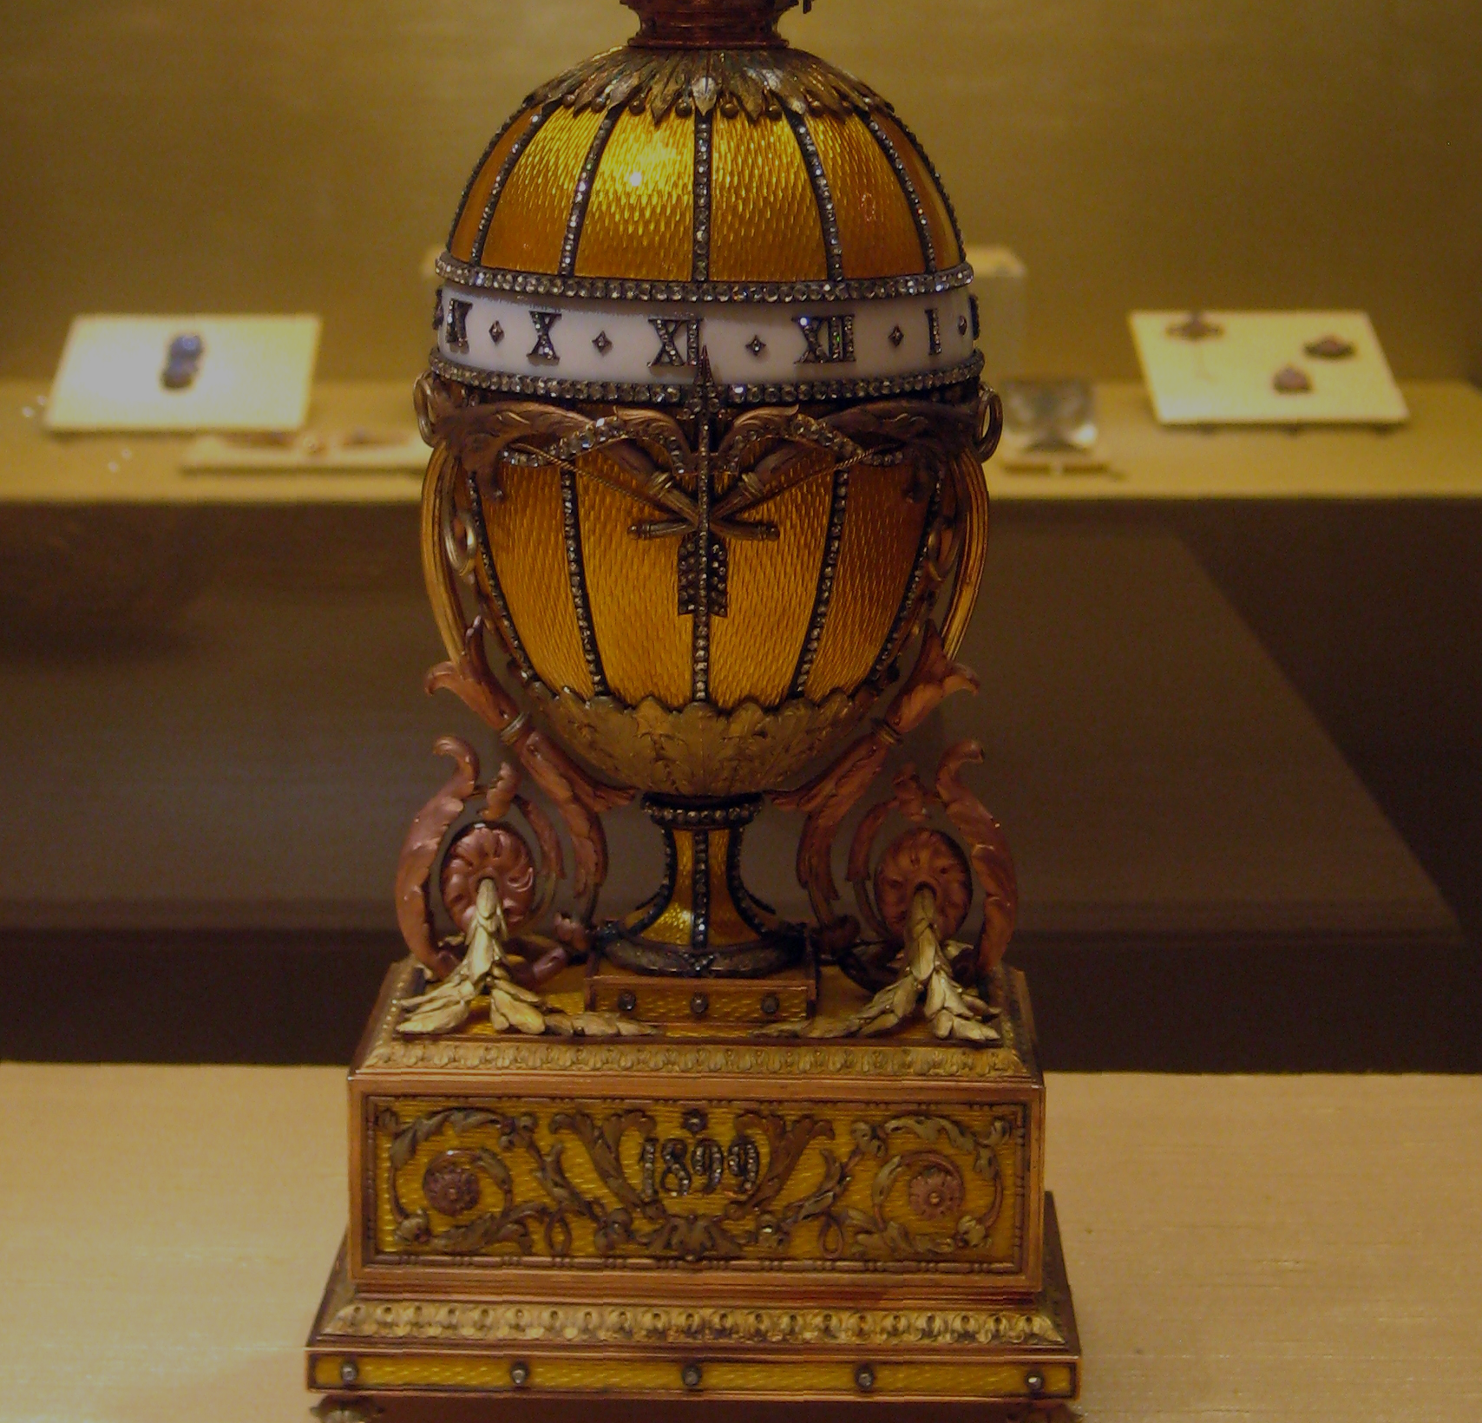
.../site-packages/
python_etsy*.egg-info/
PKG-DATA

Slide 54
.../site-packages/
python_etsy*.{dist,egg}-info/
{METADATA,PKG-INFO}

Slide 55
.../site-packages/
python_etsy*.{dist,egg}-info/
{METADATA,PKG-INFO}
Name: python-etsy
Version: 0.1.2
Summary: Python wrapper for the Etsy api

Slide 56
$ pip install --user python-etsy
# ...
Running setup.py egg_info
for package python-etsy

Slide 57
$ pip install --user python-etsy
# ...
Running setup.py egg_info
for package python-etsy

Slide 58
Installation
of pip

Slide 59
$ pip
pip: Command not found.

Slide 60
$ pip
pip: Command not found.
$ # download get-pip.py

Slide 61
$ pip
pip: Command not found.
$ # download get-pip.py
$ python get-pip.py --user

Slide 62
$ pip
pip: Command not found.
$ # download get-pip.py
$ python get-pip.py --user
$ pip
pip: Command not found.

Slide 63
$ pip
pip: Command not found.
$ # download get-pip.py
$ python get-pip.py --user
$ pip
pip: Command not found.
$ PATH=~/.local/bin:$PATH

Slide 64
$ pip
pip: Command not found.
$ # download get-pip.py
$ python get-pip.py --user
$ pip
pip: Command not found.
$ PATH=~/.local/bin:$PATH
$ pip --version
pip 1.5.4 from /home/me/.local/lib/python2.7/
site-packages (python 2.7)

Slide 65
Distributing
your code

Slide 66
~ $ cd get-octopi

Slide 67
~ $ cd get-octopi
~/get-octopi $ ls
octopi_getter.py

Slide 68
~ $ cd get-octopi
~/get-octopi $ ls
octopi_getter.py
# time passes

Slide 69
~ $ cd get-octopi
~/get-octopi $ ls
octopi_getter.py
# time passes
~/get-octopi $ ls
octopi_getter.py setup.py LICENSE

Slide 70
$ python setup.py register
running register
running check
Registering wikimarkup to https://pypi.python.org/pypi

Slide 71
$ python setup.py register
running register
running check
Registering wikimarkup to https://pypi.python.org/pypi

Slide 72
$ python setup.py register
running register
running check
Registering get-octopi to https://pypi.python.org/pypi

Slide 73
$ python setup.py sdist upload
python setup.py sdist upload
running sdist
running check
creating wikimarkup-1.0
creating dist
Creating tar archive
running upload

Slide 74
$ python setup.py sdist upload
python setup.py sdist upload
running sdist
running check
creating wikimarkup-1.0
creating dist
Creating tar archive
running upload

Slide 75
$ python setup.py sdist upload
python setup.py sdist upload
running sdist
running check
creating get-octopi-1.0
creating dist
Creating tar archive
running upload

Slide 76
$ python setup.py sdist upload
python setup.py sdist upload
running sdist
running check
creating get-octopi-1.0
creating dist
Creating tar archive
running upload
Submitting dist/get-octopi-1.0.tar.gz to https://pypi.python.org/pypi

Slide 77
from distutils.core import setup
setup(
name='get-octopi',
version='1.0',
packages=['octopi_getter'],
)

Slide 78
from distutils.core import setup
setup(
name='get-octopi',
version='1.0',
py_modules=['octopi_getter'],
)

Slide 79
from distutils.core import setup
if __name__ == '__main__':
setup(
name='get-octopi',
version='1.0',
py_modules=['octopi_getter'],
)

Slide 80
from distutils.core import setup
setup(
name='get-octopi',
version='1.0',
py_modules=['octopi_getter'],
)

Slide 81
from distutils.core import setup
setup(
name='get-octopi',
version='1.0',
py_modules=['octopi_getter'],
author='Asheesh Laroia',
email='asheesh@asheesh.org',
)

Slide 82
>>> import octopi_getter
>>> octopi_getter.main
<function main at 0x7f2d64849500>

Slide 83
from distutils.core import setup
# within setup()
entry_points = {
'console_scripts': [
'get-now = octopi_getter:main',
],
},

Slide 84
from distutils.core import setup
# within setup()
entry_points = {
'console_scripts': [
'get-now = octopi_getter:main',
],
},
# finally
$ pip install --user .

Slide 85
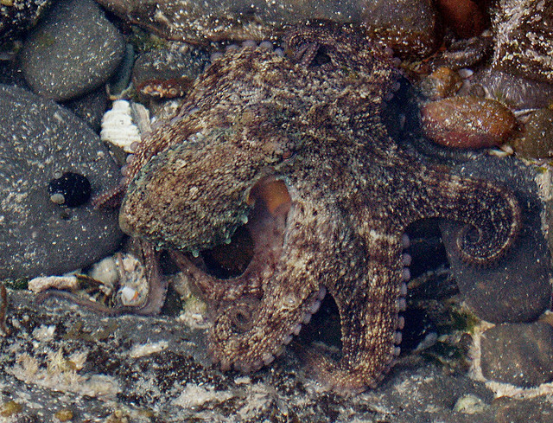
$ get-now

Slide 86
$ get-now
get-now: Command not found.

Slide 87
$ get-now
get-now: Command not found.
$ PATH=$PATH:~/.local/bin

Slide 88
$ get-now

Slide 89
$ get-now
Logging into Etsy...

Slide 90
$ get-now
Logging into Etsy...
Identifying octopi...

Slide 91
$ get-now
Logging into Etsy...
Identifying octopi...
Purchasing...

Slide 92
$ get-now
Logging into Etsy...
Identifying octopi...
Purchasing...
Purchased. You spent $325.21.

Slide 93
$ get-now

Slide 94
$ get-now
ImportError: No module named etsy

Slide 95
from distutils.core import setup
setup(
name='get-octopi',
version='1.0',
py_modules=['octopi_getter'],
)

Slide 96
from distutils.core import setup
setup(
name='get-octopi',
version='1.0',
py_modules=['octopi_getter'],
install_requires=[
'python-etsy',
],
)

Slide 97
zc.buildout vs
requirements.txt vs
setup(
install_requires=[
'python-etsy',
],
)

Slide 98
Developing
your code

Slide 99
$ pip install --user .

Slide 100
$ pip install --user .
$ python
>>> import octopi_getter
>>> octopi_getter
<module ... from '.../site-packages/octopi_getter.pyc'>

Slide 101
$ pip install --user --editable .
# aka setup.py develop --user
$ python
>>> import octopi_getter
>>> octopi_getter
<module ... from '/home/me/
get-octopi/octopi_getter.pyc'>

Slide 102
$ pip install --user --editable .
# aka setup.py develop --user
$ python
>>> import octopi_getter
>>> octopi_getter
<module ... from '/home/me/
get-octopi/octopi_getter.pyc'>

Slide 103
from distutils.core import setup
from setuptools import setup
from distribute import setup

Slide 104
from distutils.core import setup
from setuptools import setup
from distribute import setup

Slide 105
from distutils.core import setup
## safe and featureless
from setuptools import setup
## pip provides this for free
from distribute import setup

Slide 106
from distutils.core import setup
setup(
name='get-octopi',
version='1.0',
py_modules=['octopi_getter'],
install_requires=[
'python-etsy>0.1.1',
],
)

Slide 107
$ pip install --user --editable .
# ...
CONFLICT

Slide 108
$ pip install --user --editable .
# ...
CONFLICT
$ virtualenv .
New python executable in ./bin/python
Installing setuptools, pip...done.
$ source bin/activate
(get-octopi) $

Slide 109
$ pip install --user --editable .
# ...
CONFLICT
$ virtualenv .
New python executable in ./bin/python
Installing setuptools, pip...done.
$ source bin/activate
(get-octopi) $ pip install --editable .

Slide 110
$ pip install --user --editable .
# ...
CONFLICT
$ virtualenv .
New python executable in ./bin/python
Installing setuptools, pip...done.
$ source bin/activate
(get-octopi) $ pip install -e .

Slide 111
(get-octopi) $ pip install --user --editable .

Slide 112
(get-octopi) $ pip install --user --editable .
Can not perform a '--user' install. User site-packages are not visible in this virtualenv.

Slide 113
(get-octopi) $

Slide 114
(get-octopi) $
(new terminal window)
$

Slide 115
vendor/
[kitsune vendor library]

Slide 116
(get-octopi) $ pip install lxml
unable to execute 'x86_64-linux-gnu-gcc': No such file or directory
error: command 'x86_64-linux-gnu-gcc' failed with exit status 1

Slide 117
$ sudo apt-get install python-lxml
$ python
>>> import lxml
>>>
$ pip install lxml
Requirement already satisfied (use --upgrade to upgrade): lxml in /usr/lib/python2.7/dist-packages
Cleaning up...

Slide 118
$ sudo apt-get install python-lxml
$ python
>>> import lxml
>>>
$ source bin/activate
(get-octopi) $ python
>>> import lxml
ImportError: No module called lxml.

Slide 119
$ sudo apt-get install python-lxml
$ python
>>> import lxml
>>>
$ source bin/activate
(get-octopi) $ python
>>> import lxml
ImportError: No module called lxml
$ sudo apt-get build-dep python-lxml

Slide 120


Slide 121
Vagrant: 150MB
VirtualBox: 102MB
precise32.box: 300MB

Slide 122
Vagrant: 150MB
VirtualBox: 102MB
precise32.box: 300MB
1.5 hours @ 100KB/s

Slide 123
Vagrant: 150MB
VirtualBox: 102MB
precise32.box: 300MB
1.5 hours @ 100KB/s
$ vagrant provision

Slide 124

new engineers

Slide 125
new engineers
new contributors

Slide 126
new engineers
new contributors
save your self

Slide 127
openhatch/
oh-mainline
django in 5 min

Slide 128
- no virtualenv

Slide 129
- no virtualenv
- no pip install

Slide 130
- no virtualenv
- no pip install
- no C compiler

Slide 131
- no virtualenv
- no pip install
- no C compiler
- purely sqlite

Slide 132
# No compiler, no problem
# Load Python Imaging Library
import Image

Slide 133
# No compiler, no problem
# Load Python Imaging Library
try:
import Image
except:

Slide 134
# No compiler, no problem
# Load Python Imaging Library
try:
import Image
except:
import sys
sys.modules['Image'] = (
sys.modules['sys'])

Slide 135
# No compiler, no problem
# Load Python Imaging Library
try:
import Image
except:
# beloved Django ImageField
import sys
sys.modules['Image'] = (
sys.modules['sys'])

Slide 136
# No compiler, no problem
@skipIf(base.depends.Image is None)
def test():
# ...

Slide 137
# No virtualenv
vendor/

Slide 138
# No virtualenv
vendor/
>>> sys.path.append(...)

Slide 139
# No virtualenv
vendor/
>>> sys.path.append(...)
search for: [kitsune vendor library]

Slide 140
# settings.py
DATABASES = {
'default': {
'NAME': 'site.db',
'ENGINE': 'sqlite3',
},
}

Slide 141
# settings.py
DATABASES = {
'default': {
'NAME': 'site.db',
'ENGINE': 'sqlite3',
},
}
if os.environ.get('USE_MYSQL', ''):
DATABASES['default'] = (
OTHER_DATABASES['mysql'])

Slide 142
<openhatch_jenkins>
Make sure the install
instructions work (daily)
build #230:
SUCCESS in 2 min 51 sec

Slide 143
<openhatch_jenkins>
Make sure the install
instructions work (daily)
build #230:
SUCCESS in 2 min 51 sec
+ humans

Slide 144
$ time pip install twisted
41.277s total

Slide 145
$ time pip install twisted
41.277s total
$ time pip install twisted
5.653s total

Slide 146
$ time pip install twisted
41.277s total
$ time pip install twisted
5.653s total
PIP_DOWNLOAD_CACHE
PIP_FIND_LINKS
PIP_USE_WHEEL
PIP_WHEEL_DIR

Slide 147
$ time pip install twisted
41.277s total
$ time pip install twisted
5.653s total
glyph.im/pip

Slide 148
O WHEELY
also conda

Slide 149
Goals
1. Be able to install
2. Be able to distribute
3. Know how to learn more

Slide 150
asheesh.org/scratch/Preso
packaging.python.org
glyph.im/pip
Stick around for coderanger!
asheesh.org
@asheeshlaroia

Slide 151
(apologies & thanks)
asheesh.org/scratch/Preso
packaging.python.org
glyph.im/pip
Stick around for coderanger!
asheesh.org
@asheeshlaroia

Slide 152
(apologies & thanks)
asheesh.org/scratch/Preso
packaging.python.org
glyph.im/pip
Stick around for coderanger!
asheesh.org
@asheeshlaroia

