Slide 1
Sample Interactive Document Slides

Slide 2
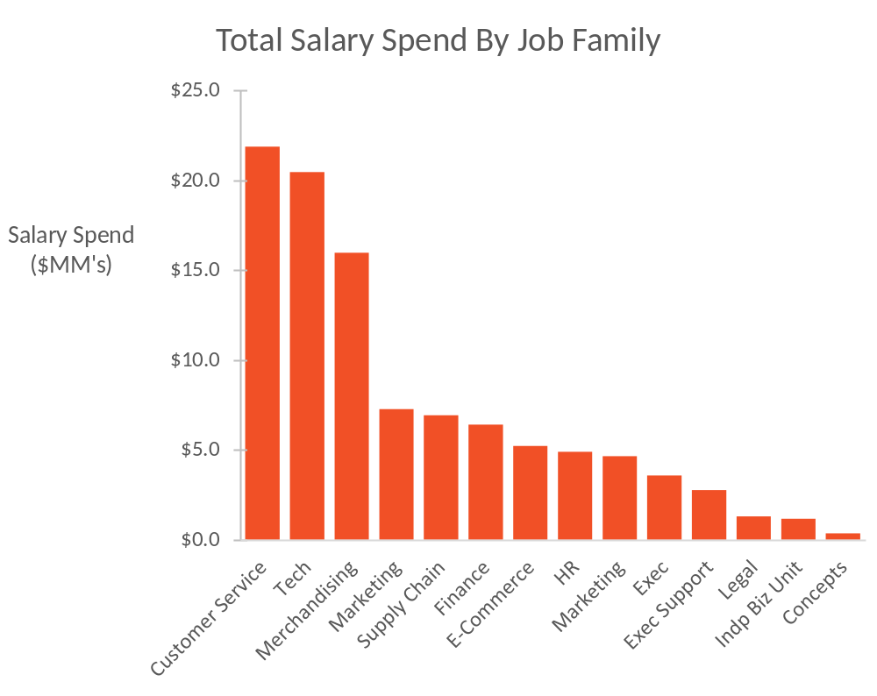
Base Salary (Local Currency) Values as a Percent of Total
This chart illustrates total salary spend (Sum of annual salary for FTE employees; not full C&B expense) by job family group
  Customer Service and Tech constitute ~42% of all spend
  The median Tech salary is about 3x the median CS salary
Tech salary spend as a share of total spend has grown by about 6% over the last 5 years

Slide 3
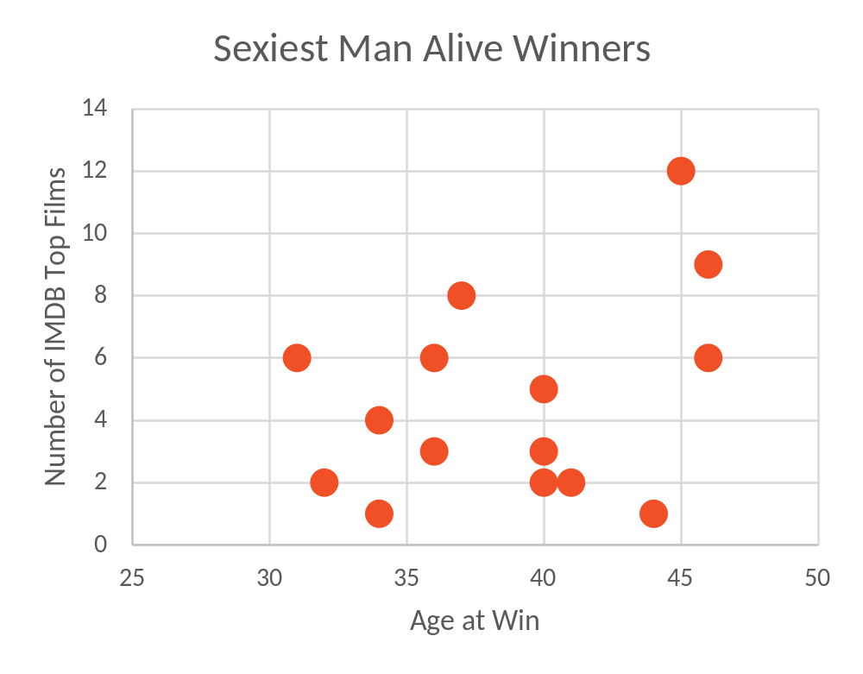
Sexiest Man Alive Award Statistics
This chart lists the number of IMDB top films and age of 21st century “Sexiest Man Alive” winners
  The age range is fairly tightly clustered between 31 and 47
  All winners of the award had at least one IMDB top film at the time of their win
Both the average age of “Sexiest Man” and “Sexiest Woman” winners are statistically 5-10 years higher than the average population-wide “Age at the time of first child” figures

Slide 4
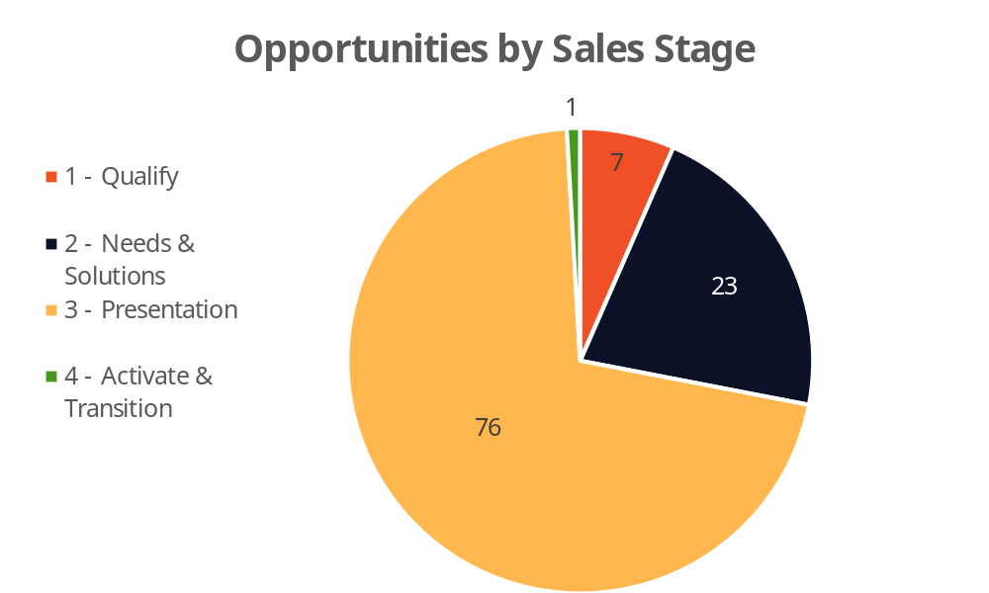
Our Sales Pipeline
The current sales pipeline is skewed towards phase 3 (Presentation)
  107 total opportunities
  76 phase 3 opportunities
  65% of estimated pipeline revenue is in stage 3
What are some strategies we can come up with to prioritize lead generation and opportunity qualification to re-up the top of the sales funnel?

