Slide 1


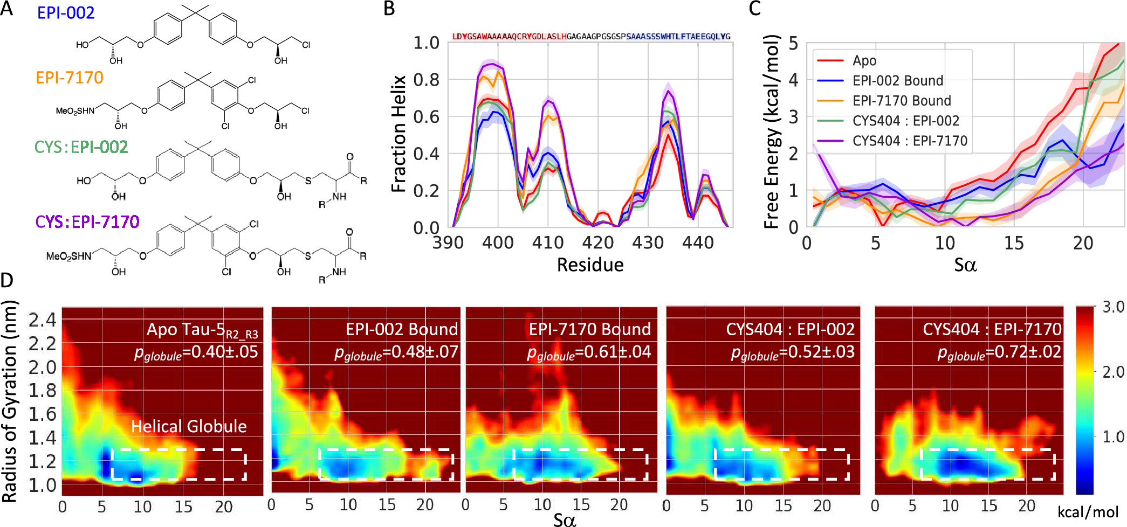
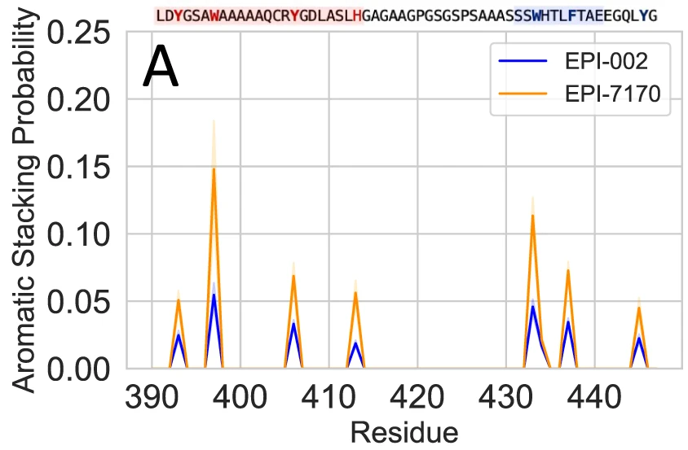
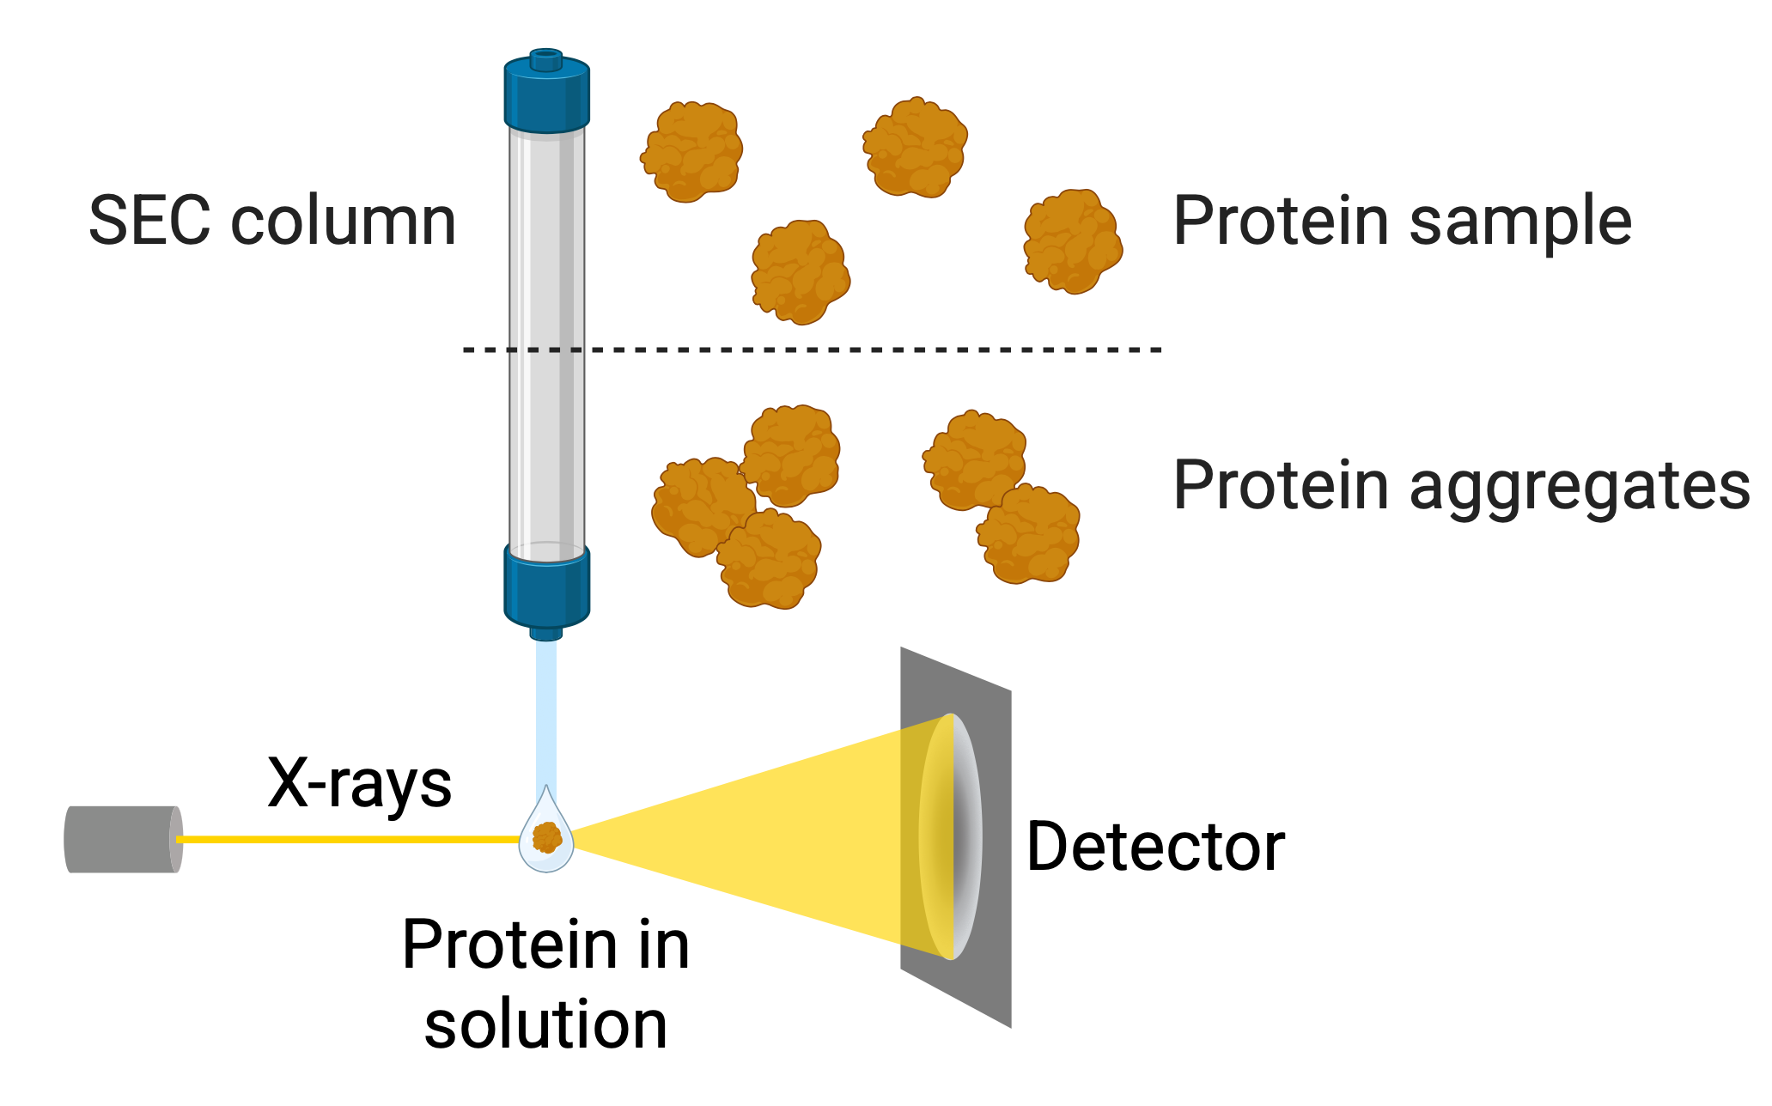
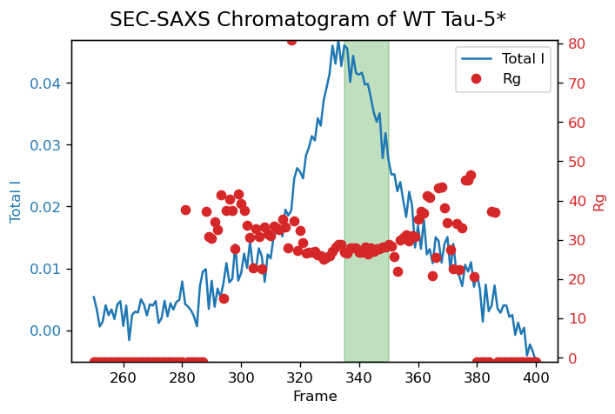
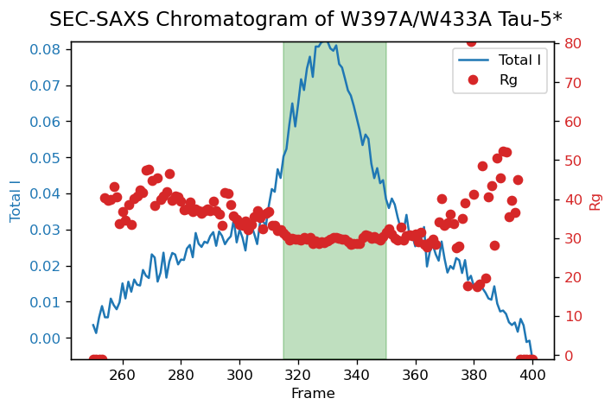
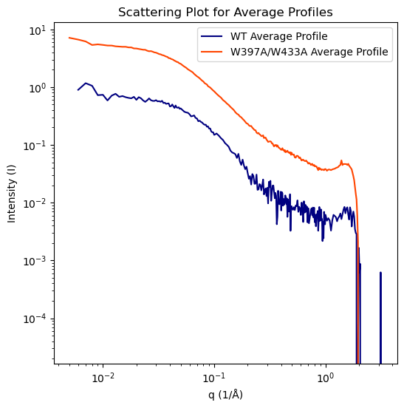
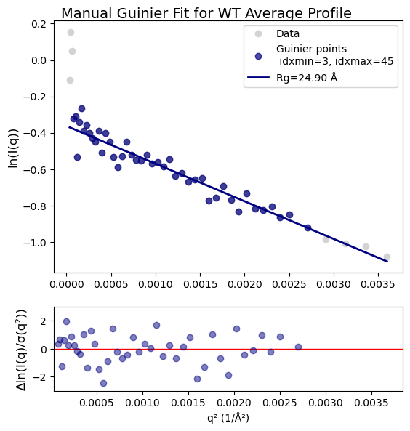
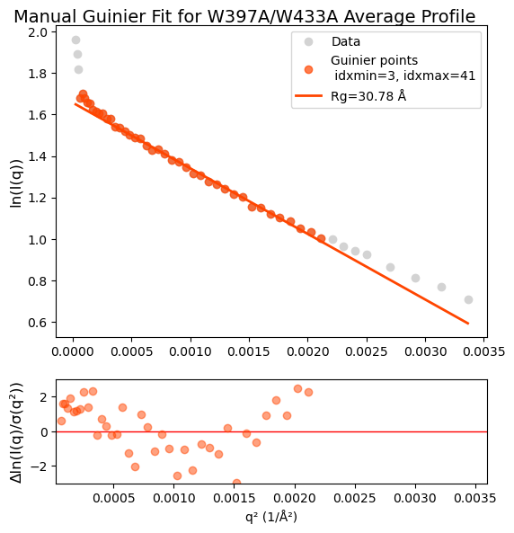
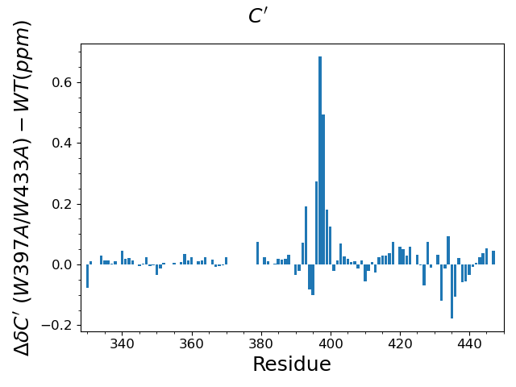
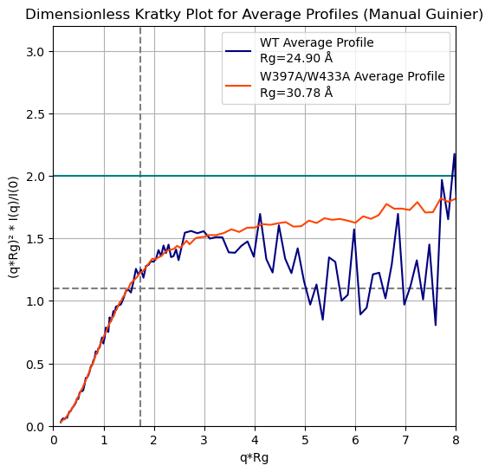
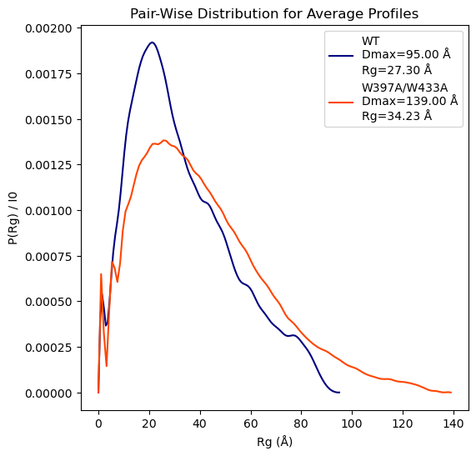
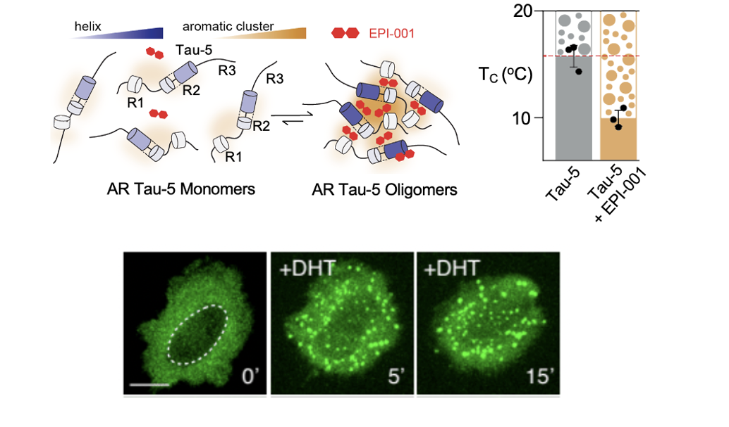
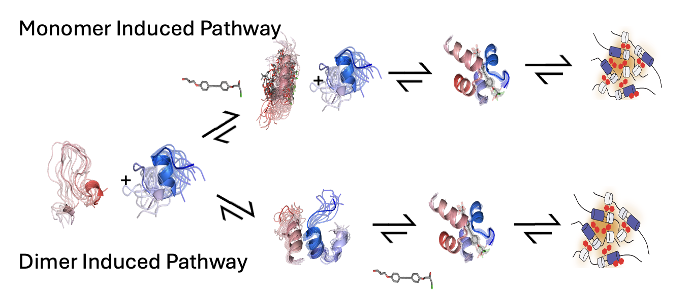
Dissecting the Dynamic Binding Mechanism of a Small Molecule to the Disordered Androgen Receptor Activation Domain
Funding
Natalie Loui, Korey Reid, Vaishnavi Katragadda, Michelle Garcia, Maria Pelligrini, Paul Robustelli
Dartmouth College, Department of Chemistry
Introduction
Results
Pathogenic Androgen Receptor Domain Organization
Molecular Dynamics Simulations Identify Aromatic Binding Sites between EPI-001 and Tau-5 R2-R3, Primarily at W397 and W433
Use of SEC-SAXS to Isolate and Characterize
Global Properties of Monomer Tau-5*
R2
R3
Size Exclusion Chromatography (SEC)
in conjunction with Small-Angle X-ray Scattering (SAXS)
Castration-resistant prostate cancer (CRPC) affects ~30% of patients who do not respond to current ligand-binding domain (LBD) therapies; AR splice variants like AR-V7 retain the intrinsically disordered N-terminal domain (NTD) and drive transcriptional activity.
EPI-002 (Ralaniten) was designed to target the disordered NTD and entered Phase 1 clinical trials in 2015 but failed due to insufficient potency.
kcal/mol
Zhu, Robustelli, Nat. Comms 2022
Aromatic to Aliphatic Mutations Alter the Global Properties of Tau-5* Conformational Ensemble
Tau-5 + EPI-002 Conformational Ensembles
Generated from MD Simulation
Chemical Shift Perturbations from 3D NMR Backbone Assignment Indicate Local Ensemble Properties
EPI-001
R1
R2
R3
Simulated Bound Fraction: 53 ± 3 %
Simulations of the Tau-5 region reveal a heterogeneous conformational ensemble with transient helices and potential small-molecule binding sites.
EPI-001 stabilizes oligomeric Tau-5* species and forms phase-separated condensates
Reid, Loui, Katragadda, Garcia, Pellegrini, Robustelli, Unpublished Data
Reid, Loui, Katragadda, Garcia, Pellegrini, Robustelli, Unpublished Data
W397A/W433A Tau-5* monomer has a larger average radius of gyration than WT Tau-5*.
W397A/W433A Tau-5* Binds EPI-001 More Weakly than WT Tau-5*
Mutation of key aromatic residues W397 and W433 increased transient helicity in R2 region
Aromatic residues W397 and W433 seem to promote collapsed helical conformations necessary for greater ligand interaction
Future Directions to Dissect Possible Binding Mechanisms
Salvatella, Sci Advances 2026

