Slide 1
Bacchus Winery Module 11.2 Project Forum Assignment: Milestone #4
Group 5
William Renard
Julie Sakai
Paul Romer
Tazmin Somerville

Slide 2
Group Introduction
Group Members:
William Renard – From Dallas, Texas, Majoring in Software Development
Julie Sakai – From Honolulu, Hawai'i, Majoring in Software Development
Paul Romer – From Fort Worth, Texas, Majoring in Software Development
Tazmin Somerville – Majoring in Software Development BS

Slide 3
Bacchus Winery: Case Study
The Bacchus Winery was recently inherited by Stan and Davis Bacchus and are encountering operational challenges. They aim to modernize the business by implementing new methods for supply chain management and distribution. The owners are looking for data to assess the winery's performance in areas in chain management, sales, and employee productivity. By analyzing information on supplier's deliveries, wine sales, and employee work hours, they can identify area for improvement to make informed decisions to enhance their products and customer service.

Slide 4
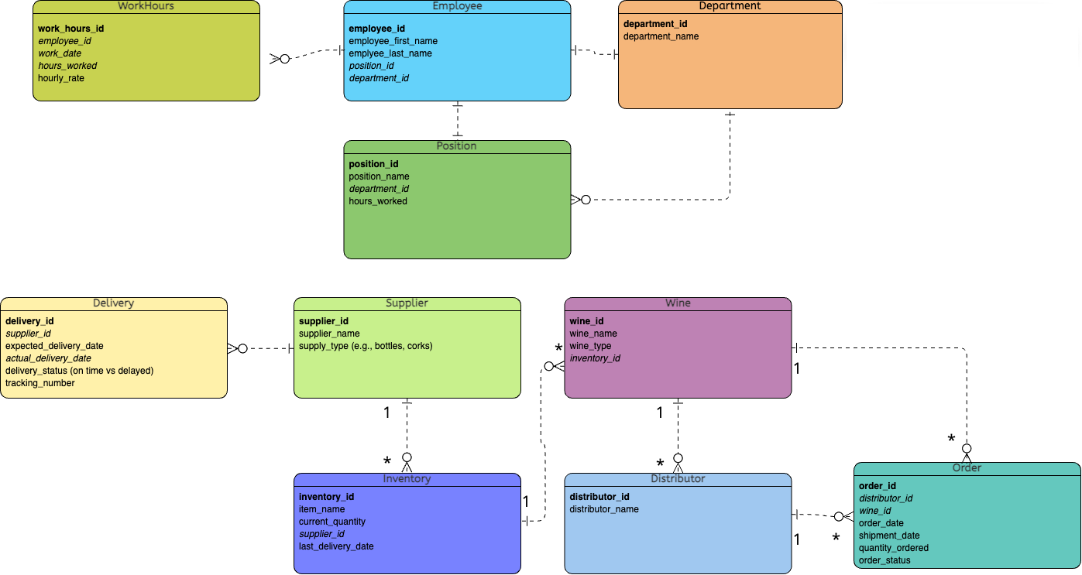
Bacchus Winery: Finalized ERD

Slide 5
Bacchus Winery: Reports
Supplier Delivery Performance Report
• Purpose: This report tracks the delivery times of Bacchus Winery's suppliers, comparing the expected delivery date with the actual delivery date.
• Value: It identifies delays and helps Bacchus Winery improve supplier management by pinpointing problematic suppliers and quantifying the delays.
Wine Sales Performance Report
• Purpose: This report analyzes the sales performance of different wines (Merlot, Cabernet, Chablis, Chardonnay) to identify underperforming wines and track which distributors carry each wine.

Slide 6
Bacchus Winery: Reports (Con't)
Wine Sales Performance Report (Con't)
• Value: It helps the winery understand market trends and sales distribution, providing insight for optimizing inventory and marketing efforts.
Employee Work Hours Report
• Purpose: This report tracks the number of hours worked by each employee, including any overtime, over the past four quarters.
• Value: It highlights work patterns and overtime trends, which allows Bacchus Winery to manage labor costs and staffing more effectively.

Slide 7
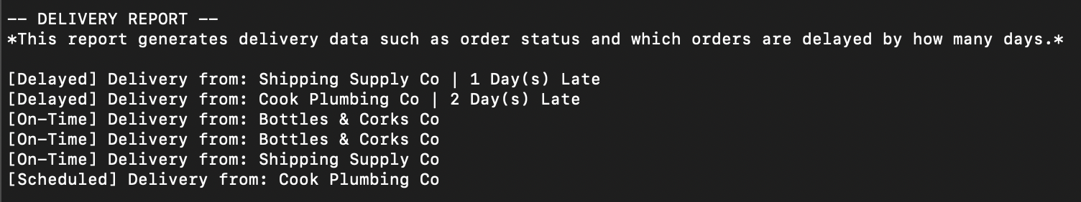
Bacchus Winery: Supplier Delivery Performance Report
This report will track the delivery times of each supplier, comparing expected delivery dates with actual delivery dates to identify any delays. It also reports which suppliers are causing delays and by how many days.

Slide 8
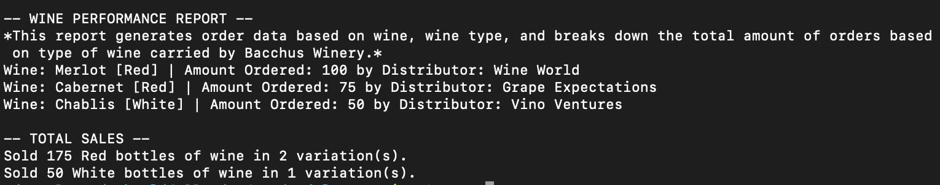
Bacchus Winery: Wine Sales Performance Report
This report will analyze the sales performance of each type of wine (Merlot, Cabernet, Chablis, and Chardonnay), identifying which wines are underperforming and which distributors are carrying each wine. It generates order data based on wine type and breaks down the total amount of orders for each type of wine carried by Bacchus Winery. The report also provides a summary of total sales which includes the number of red and white wine bottles sold and their variations.

Slide 9
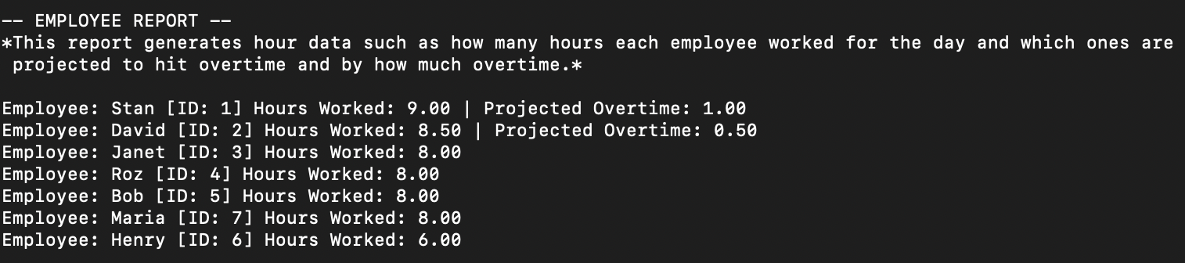
Bacchus Winery: Employee Work Hours Report
This report will track the number of hours worked by each employee over the last four quarters including applicable overtime, helping to identify any patterns or issues with employee work hours. It generates data on the daily hours worked by each employee and includes those who are projected to have overtime, specifying the amount of overtime expected.

Slide 10
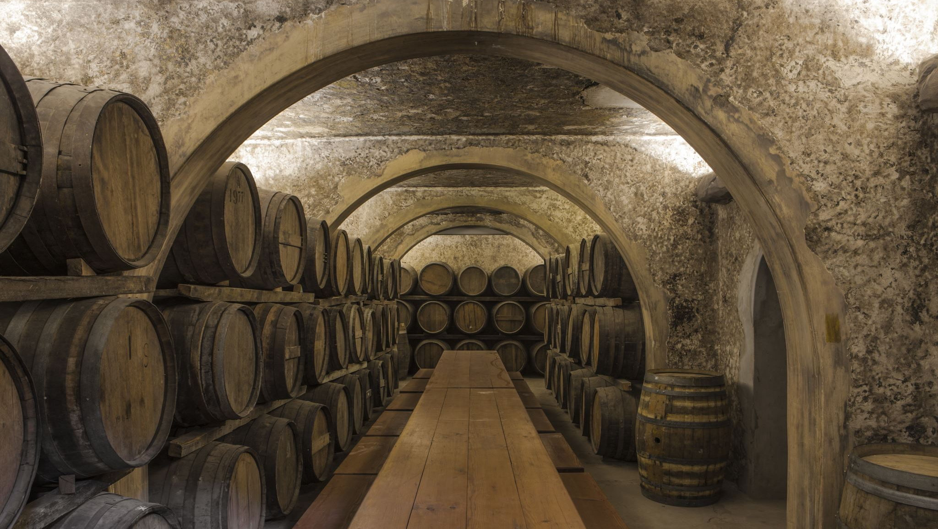
Bacchus Winery: Assumptions
Supplier Behavior: Assumed that suppliers would deliver components monthly and that delays would occur occasionally.
Wine Sales: Assumed that sales performance would vary by wine type and distributor.
Employee Work Hours: Assumed overtime would be necessary during certain quarters based on demand and operational requirement.

