Slide 1

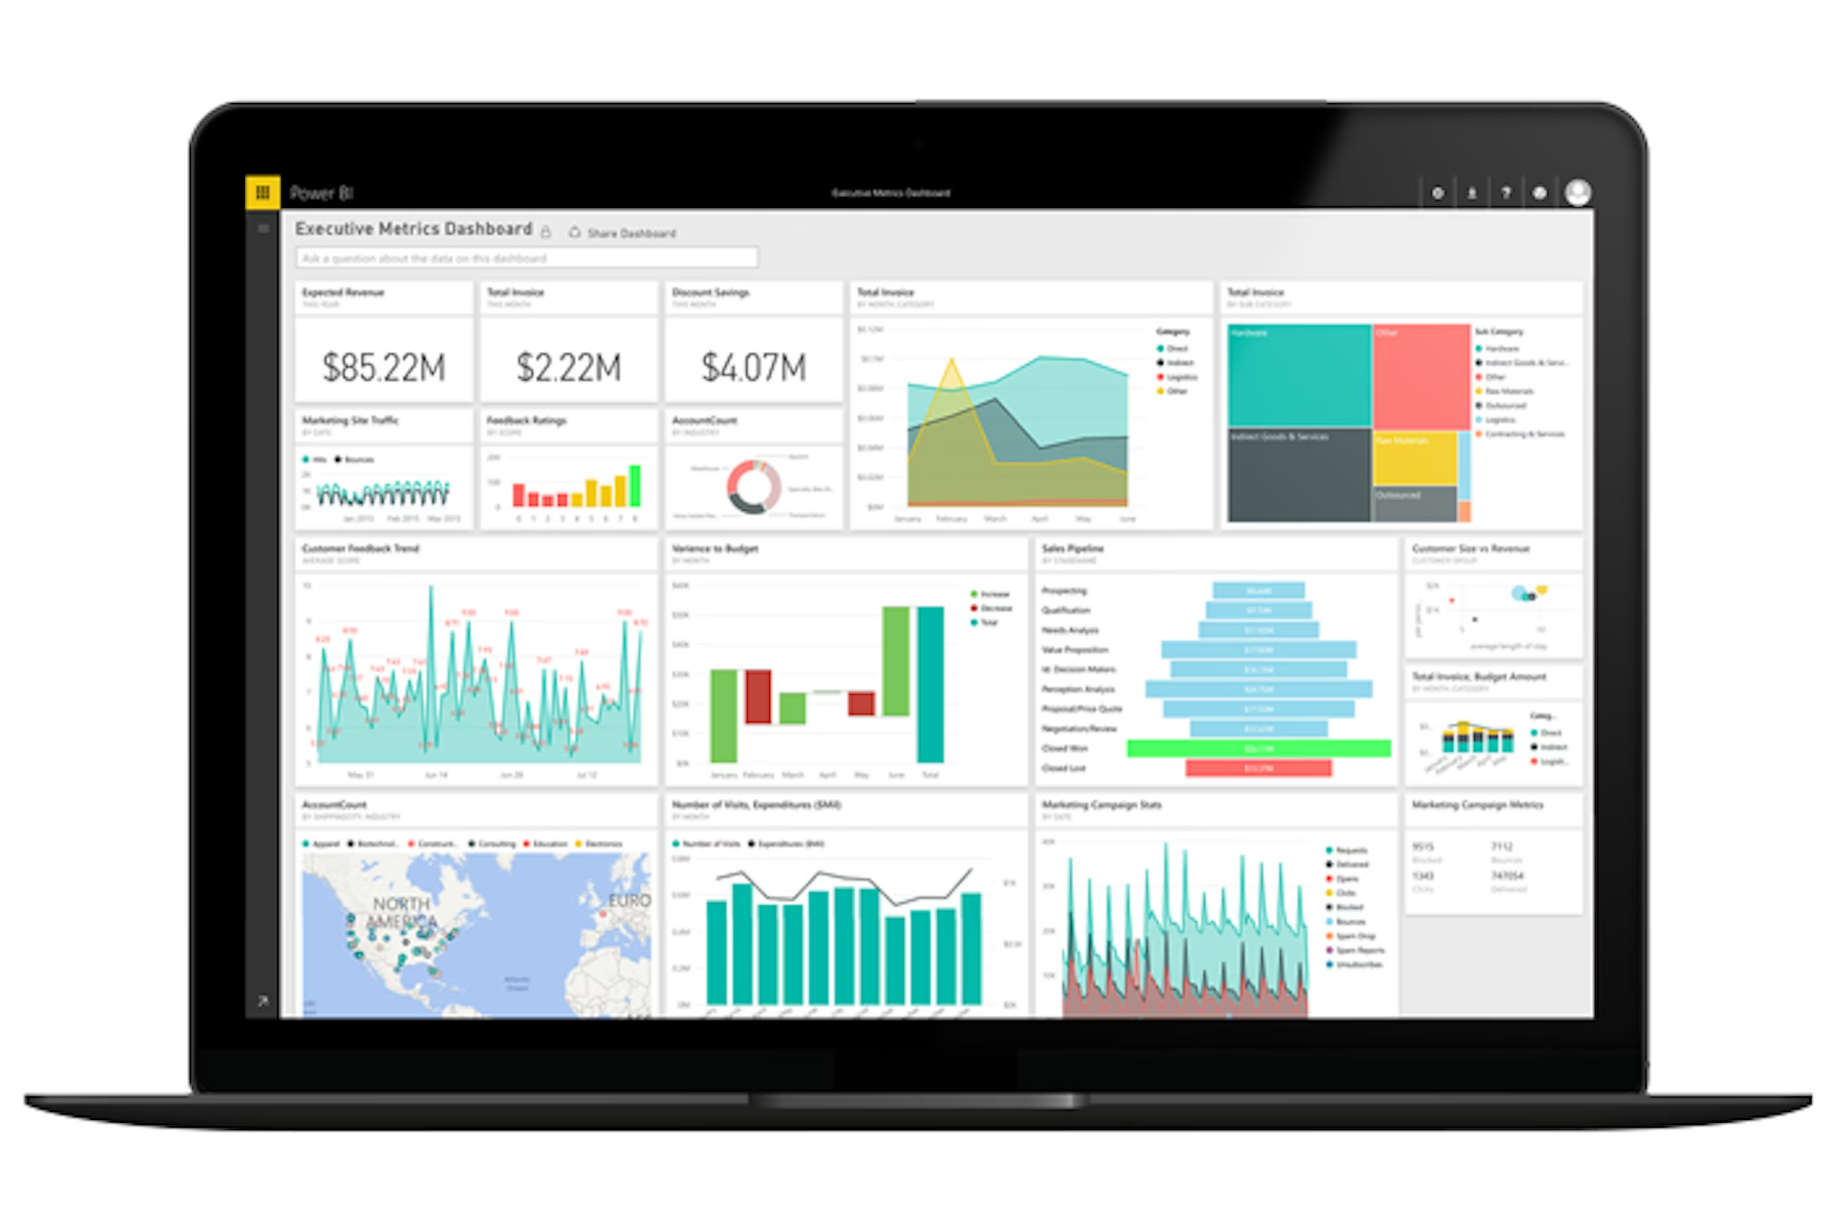
Introduction
Power BI is Microsoft's business analytics platform that helps you turn data into actionable insights. Whether you're a business user, report creator, or developer, Power BI offers integrated tools and services to connect, visualize, and share data across your organization.

Slide 2
Product Overview
1. What is Power BI?
Cloud‑based analytics and BI platform
Turns raw data into interactive dashboards and reports
Supports both self‑service and enterprise analytics
2. Key Capabilities
Connect to 100+ data sources
Clean and transform data with Power Query
Build semantic models using DAX
Rich visualization's and interactive reporting
AI‑powered insights and natural language Q&A
3. Core Components
Power BI Desktop – report creation
Power BI Service – sharing & governance
Power BI Mobile – on‑the‑go access
Gateway – on‑premises connectivity
Fabric Integration – unified analytics platform
4. Why Organization's Choose Power BI
Cost‑effective licensing
Easy for beginners, powerful for analysts
Deep integration with Microsoft 365 & Azure
Scales from small teams to global enterprises
Continuous monthly updates

Slide 3
SWOT Analysis
Strengths
Deep integration with Microsoft ecosystem
Works seamlessly with Excel, Azure, SQL Server, Teams, SharePoint, and Office 365
Cost Effective
Power BI is free, and Pro licensing is relative inexpensive compared to Tableau or Qlik.
Strong data modelling capabilities
Uses DAX and Power Query, enabling robust transformations and analytics.
Frequent Updates
Monthly enhancements keeping the platform modern and competitive.
Large community & learning resources
Huge user base, tutorials, forums, templates, and community visuals.
AI-powered features
Smart narratives, Q&A natural language queries, automated insights.
Weaknesses
Learning curve for DAX and modelling
Beginners often struggle with relationships, star schemas, and DAX functions.
Performance issues with very large datasets
Import mode can hit memory limits; DirectQuery can be slow depending on the source
Limited advanced customisation vs. Tableau
Visuals are powerful but sometimes less flexible for highly bespoke dashboards
Complex governance at scale
Managing workspaces, permission, and deployment pipelines can get messy without strong governance.

Slide 4
SWOT Analysis
Opportunities
Growing demand for self-service BI
Organization's want non-technical users to build dashboards – Power BI fits perfectly
Expansion into AI & Copilot integration
Microsoft is embedding more generative AI into Power BI, making insights easier to produce.
Enterprise adoption via Fabric
Power BI is now part of Microsoft Fabric, opening opportunities for unified data engineering.
Increasing cloud migration
As companies move to Azure, Power BI becomes the natural analytics layer.
Threats
Strong competition
Tableau, Qlik, Looker, and even open-source tools challenge Power BI’s market share
Dependence on Microsoft ecosystem
Organization's heavily invested in AWS or Google Cloud may prefer native tools.
Data privacy & compliance concerns
Some industries restrict cloud-based analytics, limiting Power BI’s deployment options.
Rapid evolution of AI analytics
New AI-driven BI tools could disrupt traditional dashboarding platforms.
Notes:
Market Share as at 19th February 2026
Power BI – 23.07%
Tableau – 17.82%
Notion – 7.18%
NetSuite – 5.72%
SAP Crystal Solutions – 5.51%

Slide 5
Market Analysis
Shift to Cloud Analytics
Organizations are rapidly moving from on-premises BI to cloud-native platforms. Both Power BI and Tableau benefit, but Power BI gains more from Azure-centric cloud strategies
Rise of Self-Service BI
Business users increasingly demand tools that allow them to build dashboards without IT dependency. Power BI’s lower learning curve gives it an edge here
AI-Driven Insights
Demand for automated insights, natural lingual queries, and predictive analytics is accelerating. Power BI’s AI features and Copilot integration position it strongly in this trend.
Unified Data Platforms
The market is shifting towards end-to-end analytics ecosystems.
Microsoft Fabric strengthens Power BI’s position as part of a unified data stack.
Cost Optimization
Enterprises are under pressure to reduce BI spend.
Power BI’s pricing model is a major competitive advantage over Tableau.
Notes:
Why Power BI Dominates
Based on industry analysis and usage trends:
• Deep integration with Microsoft 365 and Azure
• Lower cost of entry compared to Tableau and Qlik
• Strong enterprise adoption
• Rapid feature updates
• Part of Microsoft Fabric, expanding its role in end‑to‑end analytics
What This Means
Power BI’s market leadership signals:
• High demand for self‑service analytics
• Strong adoption across small businesses and large enterprises
• A growing ecosystem of training, community support, and integrations

Slide 6
Deployment Costs by Organization Size
Size | Users | Licensing | Initial setup (data modelling, dashboards) | Training | Ongoing maintenance
Small | 1-50 | £650 - £5,000 /year | £5,000 - £25,000 | £1,000 - £5,000 | £2,000 - £10,000/year
Medium | 50-500 | £10,000 - £150,000/year | £30,000 - £250,000 | £10,000 to £50,000 | £20,000 to £100,000/year
Large | 500+ | £200,000 - £2M+/year | £250,000 - £300,000 | £50,000 - £300,000 | £100,000 - £1M+/year
Notes:
Power BI
Power BI Pro
- £10.80 per user/month
- Full authoring + sharing capabilities
- Most common licence for individual analysts
Power BI Premium Per User (PPU)
- £18.50 per user/month
- Adds advanced AI, larger datasets, and Premium features
Lowest entry cost: £10.80/month
Tableau
Tableau licences are split into three roles:
Tableau Creator
• ~£55 per user/month
• Required for building dashboards and data models
• Closest equivalent to Power BI Pro
Tableau Explorer
• ~£34 per user/month
• For interacting with dashboards (not full creation)
Tableau Viewer
• ~£12 per user/month
• For read‑only access
Lowest entry cost for a creator: ~£55/month

Slide 7
Conclusion
Power BI continues to be the Market Leader in today’s analytics landscape. It delivers the most comprehensive value across the full analytics lifecyle.
Seamless connectivity with Microsoft 365, Azure, Dynamics 365, Teams, and SharePoint.
Supported by a massive global community and monthly updates.
AI power insights, natural language Q&A, and Copilot integration.
Scalable for small, medium and large enterprises.
Single end-to-end analytics platform.
Notes:
Power BI stands out as the most balanced, scalable, and cost‑effective BI platform in today’s analytics landscape. While competitors like Tableau, Notion, NetSuite, and SAP Crystal Solutions each offer strengths, Power BI delivers the most comprehensive value across the full analytics lifecycle.

