Slide 1

Color Sensor
Paul-Dacian Rotar

Slide 2
What is cis ?
cis
Color Interaction Sensor
Cis is a real life color picker device specially created for digital artist. Connected to your computer/laptop through USB, an RGB color sensor attached to a marker-like 3D printed object, detects the color of any surface, providing accurate color information and displaying it on a browser web page. Here you will have the possibility to create your own custom library by saving your scans and add additional comments for later access. Based on the color information, the web app will provide a list of suggestions for what type of object you scanned. Furthermore, if you want to change one of your scans, a virtual color picker will appear so you can make any adjustment you want.

Slide 3
My idea
The cis idea came after seeing a playful Arduino project on their project hub website. This project determined me to think of other different and really useful possibilities based on color sensors. Various concepts came into my mind, including a system developed for color blind people or a creative one for kids. My final idea was based on the environment I live in, a tool helpful for digital designers. I’m sure some of you thought, at least once, about trying to replicate virtually a color seen on a physical object (t-shirt, furniture, soda can, etc.). It’s really hard to guess the exact information. Let’s say that you want to create a poster design for Coca-Cola using their widely known shade of red (without using Google). Cis is here to help you. Just plug in the Arduino system, buy a Coca-Cola can/bottle (if you don’t have one already), approach the sensor and open your browser. Here you have it, enjoy designing your poster.

Slide 4
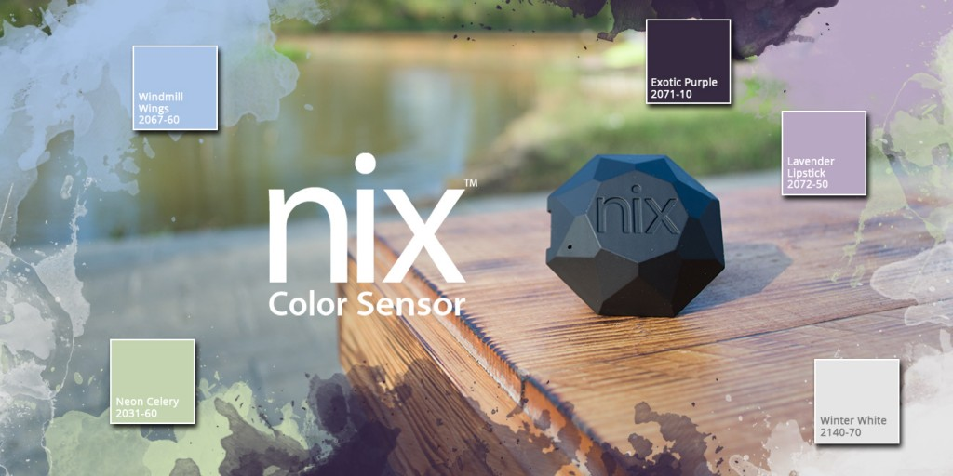
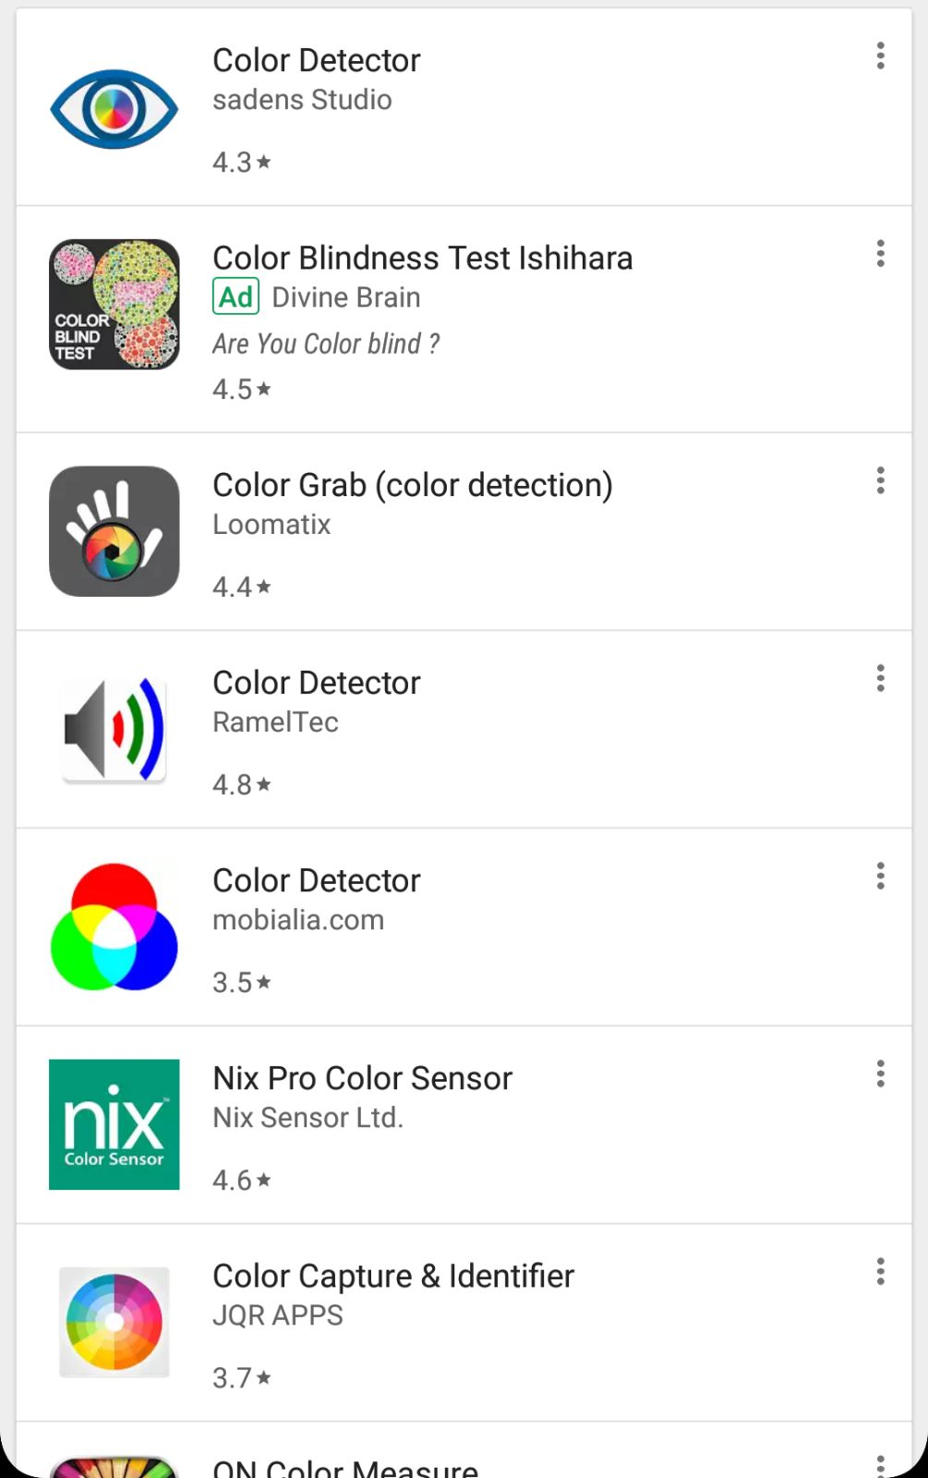
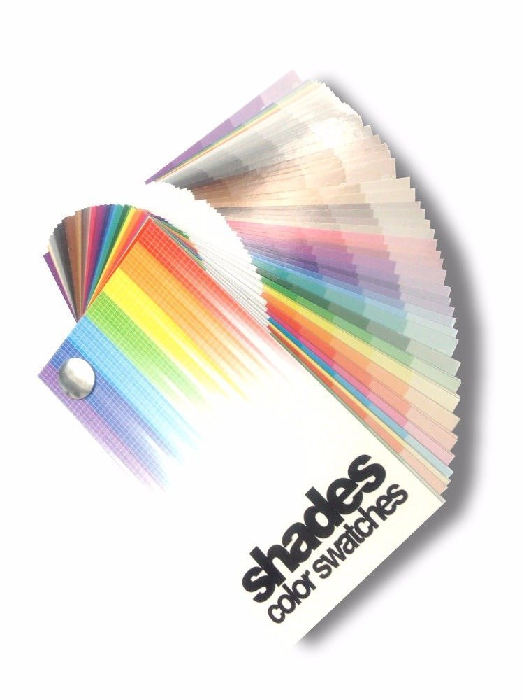
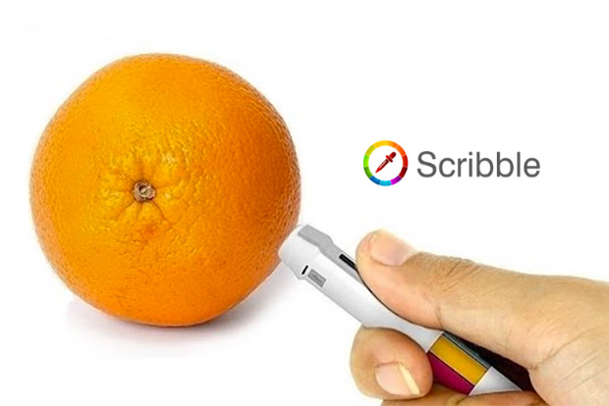
Similar products on the market
Truth is, there are already some variations of this idea out there, created long before I even thought about this. Some are far more advanced/complicated and some are horrible interpretations.
Nix
Color swatches Mobile apps
Scribble

Slide 5
Differences
The mentioned projects have, without doubts, lots of positive features and are leading technologies in this area. One aspect of their development that can be approached in a different way is the platform. While these companies created their products almost entirely for mobile/tablet usage, cis is designed for computers/laptops.

Slide 6
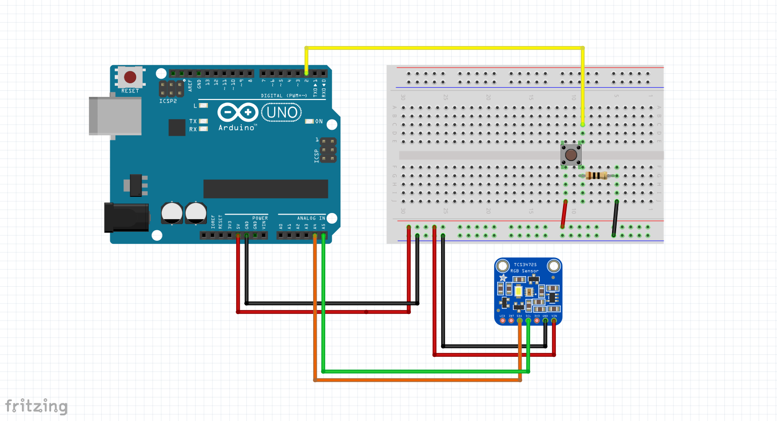
System diagram
Resources needed:
Arduino Uno | Breadboard | Wires
Button | 10Ω Resistor | Adafruit TCS34725 RGB Color Sensor
2 3D printed cases
(Arduino + breadboard will receive one bigger case | Sensor + button will receive a marker-like case)

Slide 7
Development process
Exploring different ideas
Refine main concept
Gather resources
Code Arduino and Web platform
Test if everything is working as expected
( If there is time, add extra features)
Produce 3D model
Print 3D model
Assemble the product
Test again

Slide 8
References
Development process links
https://www.arduino.cc/en/Tutorial/Button
https://github.com/EmergingTechnologyAdvisors/node-serialport/blob/4.0.1/README.md
http://danialk.github.io/blog/2014/04/12/arduino-and-nodejs-communication-with-serial-ports/
http://crisp-code.com/blog/a-simple-color-sensor
http://johnny-five.io/api/sensor/
https://github.com/adafruit/Adafruit_TCS34725
https://learn.adafruit.com/adafruit-color-sensors
Research links
https://www.scribblepen.com/
https://www.cnet.com/uk/news/the-pen-that-can-write-in-any-color-on-earth/
https://www.theguardian.com/artanddesign/architecture-design-blog/2014/aug/13/scribble-pen-that-lets-you-draw-in-16-million-colours
https://nixsensor.com/
https://www.kickstarter.com/projects/nixsensor/nix-color-sensor
https://thegadgetflow.com/blog/thanks-to-the-wonderful-nix-pro-color-sensor-scanning-colors-has-become-super-easy/
https://www.pantone.com/
http://htmlcolorcodes.com/
https://en.wikipedia.org/wiki/Color_picker

