Slide 1


COMMUNITY PARTNERSHIP PROPOSAL
Creating Educational Opportunity.
Strengthening Communities.
Preparing Future Leaders.
Canyon State Institute · College & Career Preparatory High School Program
[Date] · Presented by [Name, Title]
Notes:
Opening slide. Introduce yourself and Canyon State Institute as a veteran-owned institution. Fill in the date and presenter line before sending. Frame the meeting as exploring a shared-facility partnership, not a sales pitch.

Slide 2

WHO WE ARE
Canyon State Institute
A private College & Career Preparatory High School Program · Grades 9–12 · Arizona and Texas
We combine things that are usually separate:
Students graduate with a diploma, credentials employers recognize, and a path forward.
1
A personalized high school education
2
Hands-on STEM and innovation learning
3
College prep
4
Job training, access, and real workforce certifications
OUR MISSION
5
Clear paths into college and careers
Give students and adult learners a real shot at a good future, with local partners helping make it happen.
Canyon State Institute · Community Partnership
2
Notes:
Establishes what the institution is. The five numbered items are the differentiator — most schools do one or two of these, not all five. Confirm the states served (Arizona and Texas) and grade range before presenting; state authorization for enrolling minors varies by state.

Slide 3
THE OPPORTUNITY
Why Canyon State Institute, Why Now?
Communities across Arizona and Texas need expanded educational opportunities that address:
1
Growing student populations
2
Demand for personalized learning environments
3
Increased interest in STEM education
4
Workforce skill shortages
5
Need for career-connected education
6
Students seeking alternative pathways to success
Families are looking for schools where students are:
✓ Known
✓ Supported
✓ Challenged
✓ Prepared for the future
Canyon State Institute · Community Partnership
3
Notes:
The 'why now' case. Six documented pressures on the region's schools. If the partner serves a specific community, name the local version of these pressures here.

Slide 4
OUR VISION
Education Is More Than Academics
At Canyon State Institute, we believe education is about more than academics.
We focus on developing
Every student deserves access to
✓
Confident learners
✓
Mentorship
✓
Ethical leaders
✓
Opportunity
✓
Innovative thinkers
✓
Guidance
✓
Career-ready graduates
✓
Real-world experiences
✓
Community contributors
✓
A pathway to success
Canyon State Institute · Community Partnership
4
Notes:
The values slide. Keep it brief when presenting — it sets tone rather than making an argument.

Slide 5
WHAT MAKES US DIFFERENT
A Modern Education Model
High School Program · Grades 9–12
A program of Canyon State Institute
Students experience:
1
College-preparatory academics
2
STEM education
3
Technology integration
4
Career exploration
5
Leadership development
6
Individualized academic support
Canyon State Institute · Community Partnership
5
Notes:
The academic model. Note the framing: the high school is a PROGRAM of Canyon State Institute, not a separate school — one institution, one set of policies, one catalog.

Slide 6
BEYOND THE DIPLOMA
Postsecondary & Certification Programs
Canyon State Institute will also provide:
1
2
3
4
Professional certifications
Workforce training
Career advancement opportunities
Industry-aligned credentials
Recognized credentials that carry weight with employers.
Practical skills aligned to regional employer demand.
Pathways for adults returning to education mid-career.
Curriculum built with employer input, not in isolation.
High school graduates can continue directly into Canyon State Institute certificate programs — one institution, every stage of the journey.
Canyon State Institute · Community Partnership
6
Notes:
This is the internal-pathway argument: a student can enter at grade 9 and continue into certificate programs without leaving the institution. It is a genuine differentiator and reinforces the single-institution structure.

Slide 7

COMMUNITY NEED
Families Need More Educational Choices
Many communities face:
Overcrowded schools
Limited specialized programs
Students needing more individualized support
Canyon State Institute provides an additional option that supports:
Growing demand for STEM and career preparation
Students
Workforce development challenges
▼
Families
▼
Employers
▼
Communities
Canyon State Institute · Community Partnership
7
Notes:
The need argument, then the ripple effect: serving students serves families, employers, and the wider community. That chain is what makes this a community-partnership conversation rather than a school-enrollment one.

Slide 8
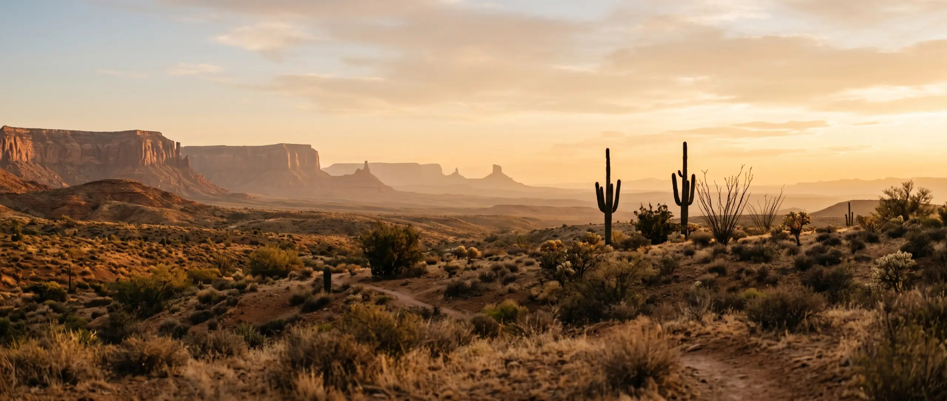
PARTNERSHIP VISION
Creating a Community Education Hub
Canyon State Institute is seeking a community partner to establish a shared educational facility that will serve as a:
1
2
3
4
5
High school resource and location
STEM learning center
Workforce development hub
Community resource location
Postsecondary training site
We are online, but want heavy student support
Hands-on labs and innovation space
Training aligned to regional employers
A space the neighborhood can use
Certificate programs for adult learners
Together, we can transform existing space into a center of opportunity.
Notes:
The core ask, stated as a shared vision rather than a request for space. The five roles let the partner see their building doing more than one job.

Slide 9
WHAT WE ARE SEEKING
Facility Partnership Opportunity
Canyon State Institute is seeking
Ideal facility characteristics
1
Occasional classroom space
✓
Classrooms or a computer room
✓
Small administrative space
2
Shared-use facility arrangements
✓
Technology infrastructure
3
Long-term facility partnership
✓
Student gathering areas
✓
Parking availability
4
Community campus collaboration
✓
Safe and accessible environment
Canyon State Institute · Community Partnership
9
Notes:
Be explicit that the ask scales — occasional classroom use is a real starting point, not a lesser option. Let the partner self-select the arrangement that fits their space.

Slide 10
BENEFITS TO THE COMMUNITY PARTNER
A Partnership That Creates Shared Impact
Partner organizations benefit through:
1
2
3
Community Impact
Facility Utilization
Shared Mission Alignment
Expanding educational access
Supporting youth success
Strengthening workforce pipelines
Activating unused or underutilized space
Creating ongoing community engagement
Serving families
Developing leaders
Improving community outcomes
Canyon State Institute · Community Partnership
10
Notes:
Frame this from the partner's side of the table. If they own underused space, 'Facility Utilization' is usually the argument that lands first — the building starts working for the community again.

Slide 11
BENEFITS TO STUDENTS & FAMILIES
What Students Gain
Personalized education
STEM opportunities
Career exposure
Industry connections
✓
✓
✓
✓
Mentorship
College preparation
Workforce skills
Leadership development
✓
✓
✓
✓
Students graduate prepared for:
College
Careers
Certifications
Entrepreneurship
Community leadership
Canyon State Institute · Community Partnership
11
Notes:
The student-outcome case. Eight gains, five destinations — this is the slide families care about most.

Slide 12

WHY PARTNER WITH CANYON STATE INSTITUTE
Together We Can Create Lasting Impact
A partnership with Canyon State Institute provides an opportunity to:
1
Invest in the next generation
“
2
Strengthen workforce readiness
Education is one of the strongest investments a community can make.
3
Expand educational access
4
Support families
5
Create measurable community impact
Notes:
The emotional close before the ask. Pause on the quote. Canyon State Institute is veteran-owned — that commitment to service is the same instinct behind this partnership.

Slide 13


NEXT STEPS
Let’s Build the Future Together
We are seeking community partners who share our commitment to:
Next steps:
✓
Student success
1
Facility discussion and site evaluation
✓
Workforce development
2
Partnership alignment meeting
✓
Innovation
3
Space utilization planning
✓
Community growth
4
Launch timeline development
Building pathways. Creating opportunities. Transforming lives.
[Contact name, title] · [Phone] · [Email] · [Website]
Notes:
Close by proposing a specific next action — a site visit is the easiest yes. Fill in the contact line before sending; it currently holds bracketed placeholders.

