Slide 1




PES UNIVERSITY — MTECH PROGRAM
Submitted by Samir Paul
Big Mart Sales
EDA Summary
Exploratory Data Analysis | MTech Python Assignment
A comprehensive executive presentation covering project objective, data cleaning methodologies, performance patterns, commercial drivers, and strategic next analytical steps.
8,523
12
Mixed
Total Rows
Raw Fields
Product + Outlet Attributes

Slide 2








EXECUTIVE SUMMARY
PES UNIVERSITY — MTECH
The dataset supports a clear retail story: outlet format matters, price matters, and cleaning was essential before interpretation.
Format Dominance
Key Drivers
Data Quality
Supermarket Type3 delivers the strongest average sales performance, significantly outperforming others, while Grocery Store is the weakest format by a wide margin.
Item_MRP is the strongest positive numeric signal for sales (correlation ≈ +0.57). Surprisingly, item visibility shows a mildly negative correlation with sales.
Raw data contained significant missing values and inconsistent labels. A disciplined cleaning step was necessary to ensure accurate analysis and modeling.
Top Format
Strongest Driver
Largest Cleaning Issue
Supermarket Type3
Item_MRP
Missing Outlet_Size
≈ 3,694 avg sales
Corr ≈ +0.57
2,410 rows affected
Big Mart Sales EDA Summary
2

Slide 3






Project Scope & Dataset
PES UNIVERSITY — MTECH
This project used a retail sales dataset large enough to support cleaning, descriptive analysis, grouping, and relationship discovery.
Raw Data Issues
Missing Values
Significant gaps found in Outlet_Size (2,410 rows) and Item_Weight.
Why This Dataset Works
Assignment Compliant
Satisfies the assignment need for a reasonably large file (8,523 records).
Inconsistent Labels
Item_Fat_Content contained mixed labels like 'LF', 'low fat', and 'Low Fat'.
Rich Attribute Mix
Combines numeric fields (Weight, MRP, Sales) with categorical fields (Item Type, Outlet Type, Location).
Dual Insight Potential
Logic Errors
Supports both operational (cleaning/inventory) and commercial (sales/revenue) analytical insights.
Item_Visibility contained zero values, which is physically impossible for products in a store.
Conclusion
"Cleaning was mandatory before any reliable analysis could begin."
INSPECT
CLEAN
ANALYZE
Audit Quality
Impute & Fix
Extract Insights
Big Mart Sales EDA Summary
3

Slide 4









Cleaning Actions Applied
PES UNIVERSITY — MTECH
Data was converted into an analysis-ready version using consistent imputation rules and simple feature engineering.
Cleaning Impact
0
Standardized Labels
Missing Values
Unified Item_Fat_Content (LF / low fat → Low Fat).
0
Imputed Weights
Filled missing Item_Weight using item-level median, then overall median.
Duplicates
Filled Outlet Size
4
Inferred missing Outlet_Size using outlet patterns and group mode.
New Features Created
Corrected Visibility
Replaced zero Item_Visibility with non-zero item medians.
"The cleaning process removed null-driven distortion, making subsequent charts easier to interpret and explain in business terms."
Feature Engineering
Derived 4 new features: Outlet_Age, Item_Category, MRP_Band, Visibility_Band.
Big Mart Sales EDA Summary
4

Slide 5
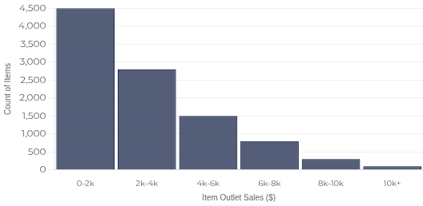
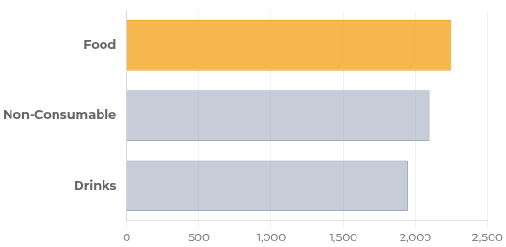



Sales Distribution & Product Mix
PES UNIVERSITY — MTECH
Sales values are right-skewed, and food products lead average sales among broad item categories.
Sales Distribution
Histogram
Avg Sales by Product Category
Comparison
Right-skewed
Key Insight
Food items drive the highest average sales across all product categories, indicating they are the primary revenue engine.
Big Mart Sales EDA Summary
5

Slide 6


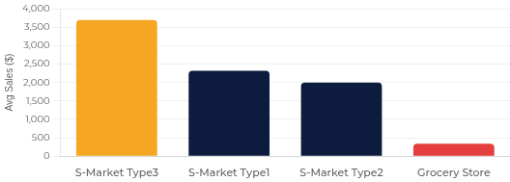
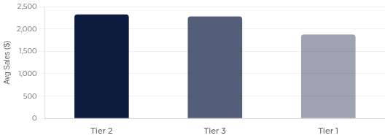




Outlet Performance Differences
PES UNIVERSITY — MTECH
Store format and location tier explain substantial average-sales differences across the retail network.
Average Sales by Outlet Type
Sales by Location Tier
Leader: Type3
Executive Readout
Strongest Format
Weakest Format
Location Insight
Supermarket Type3 outperforms all others significantly (~3.7k avg).
Grocery Stores materially trail supermarkets, showing minimal volume.
Tier 2 leads marginally, with Tier 3 close behind; Tier 1 lags.
Big Mart Sales EDA Summary
6

Slide 7

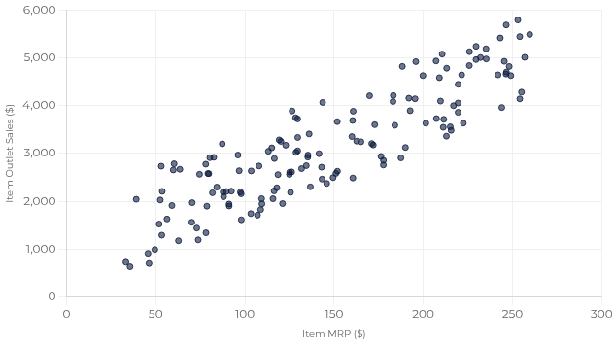



Price & Numeric Drivers of Sales
PES UNIVERSITY — MTECH
The strongest numeric relationship is between item price and sales; other numeric signals are much weaker.
Correlation Matrix
Item_MRP vs. Item_Outlet_Sales
Scatter Plot
FEATURE PAIR | CORRELATION | STRENGTH
Item_MRP ↔ Sales | +0.57 | STRONG POSITIVE
Item_Visibility ↔ Sales | −0.13 | WEAK NEGATIVE
Item_Weight ↔ Sales | ~0.01 | NEGLIGIBLE
Outlet_Age ↔ Sales | ~0.05 | NEGLIGIBLE
Clear Trend:
Higher Price → Higher Sales Volume
Driver Signal Strength
+0.57
−0.13
~0.00
"Price is the single most important numeric predictor."
Price (MRP)
Visibility
Others
Big Mart Sales EDA Summary
7

Slide 8
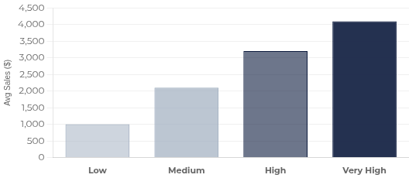
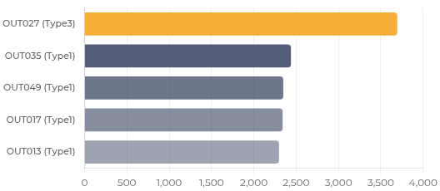

Commercial Hotspots
PES UNIVERSITY — MTECH
Higher price bands and a small set of top outlets account for the strongest average sales signatures in the dataset.
Average Sales by MRP Band
Price Analysis
Top Outlets by Avg Sales
Ranked List
Commercial Insight
Higher MRP bands consistently outperform lower price bands in average item sales, indicating premium items drive revenue efficiency.
Big Mart Sales EDA Summary
8

