Slide 1
CHATBOT, AN APPLICATION OF DEEP LEARNING AND NATURAL LANGUAGE PROCESSING
Under the guidance of, DR.ASOKE NATH
511, Prashant Gomes 549, Sanchita Paul

Slide 2
INTRODUCTION
PURPOSE OF THE PROJECT :
This project leverages NLP and Deep Learning technologies, for building a Retrieval-Based Chatbot . The retrieval based chatbot on face of a query, selects from a predefined response dataset, to provide a response, based on pattern identification. This pattern identification is facilitated by the use of Deep learning techniques. Since, the chatbot is based on textual input , leading to a textual response, Natural Language Processing techniques are leveraged. Chatbot is finetuned to work on a dataset, which for this project is a Cyber Security based.
● Leveraging NLP to deal with text-based problems
● Deploy a Retrieval-Based chatbot to construct a question-answer framework
● Help answer knowledge-based queries regarding cybersecurity
● Delve into the concepts of Deep Learning and integrate them into the application of this project

Slide 3
SCOPE OF THE PROJECT
● Implements the usage of deep learning and feedforward neural network to build the retrieval-based chatbot
● Includes NLP techniques for text manipulation
● The dataset used consists of carefully tailored tags, patterns and responses natural language sentences and words for the training of the model
● The model is a simple feed-forward neural network
● The model takes in cybersecurity knowledge level queries and returns a respective
Output
● The chatbot interface is used to provide a better conversational environment

Slide 4
PROJECT REQUIREMENTS
SOFTWARE REQUIREMENTS
i. Python 3.9.5 or higher
ii. pip 24.0
iii. OS : Windows 11 or higher / MAC OS / Linux
iv. Nvidia CUDA libraries for Nvidia GPU utilization OR
V. OpenCL library for AMD GPU utilization
HARDWARE REQUIREMENTS
These are the minimum hardware requirements for executing this project:
i. CPU – Intel Core I3, For Mac: M1, M2
ii. RAM – At Least 4 GB of Memory
iii. Nvidia CUDA libraries for Nvidia GPU utilization
iv. 5GB of HDD space
v. A valid internet connection
LIBRARY REQUIREMENTS
i. json5==0.9.17
ii. jupyter==1.0.0
iii. matplotlib==3.8.3
iv. numpy==1.26.3
v. pandas==2.2.1
vi. nltk==3.8.1
vii. scikit-learn==1.4.1.post1
viii. streamlit==1.31.1
ix. torch==2.2.0

Slide 5
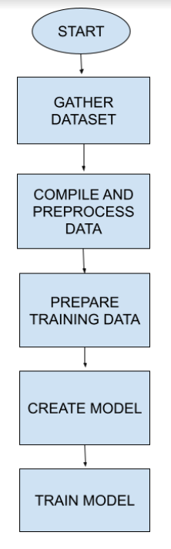
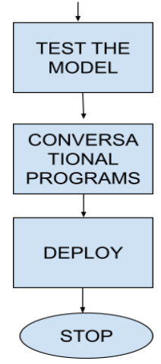
PROJECT WORKFLOW
A
A

Slide 6
DATASET DESCRIPTION
The dataset used is nothing but a JSON file, named ‘intents.json’, which is a common format used for data exchanges between servers and web applications
The dataset had been carefully compiled and hand-crafted from various websites, repositories and books, so as to properly exploit the JSON format, within the domain of cybersecurity, making it ideal for this project
A wide range of cyber security topics has been covered in the dataset.
The data samples are structured as:
- TAGS : Labels or identifiers for topics on Cybersecurity within the dataset
- Patterns : Sample queries for learning, so as to provide accurate responses
- Response : The predefined responses, the chatbot will need to select from and provide, based on pattern identification

Slide 8
WHY JSON?
Pattern matching
Knowledge level
Scalability and adaptability
Enhanced user experience

Slide 9
DATA PREPROCESSING
For the purpose of the project, the NLP pipeline steps, namely ‘Stemming’ and ‘Tokenisation’ is used.
This is required as the model is a neural network, which needs to learn from patterns and labels, so we cannot risk over or underfitting and confusion.
These steps provide a structure to the raw textual data
Tokenization aids in reducing the pattern sentences into smaller units for easier handling, while, Stemming reduces pattern words to their root form, so that the model can concentrate on the semantics of a word rather then superficial suffixes, distincting, verbs, adjectives, etc.
Example : The pattern sentence : “What is Eavesdropping in Cyber security?”
Firstly, we remove symbols such as “?” and also remove duplicate pattern and label items
result of tokenization : “What”, “is”, “Eavesdropping”, “in”, “Cybersecurity?”
result of stemming : “What”, “is”, “eavesdrop”, “in”, “Cybersecurity”

Slide 10
DATA PREPROCESSING
Three lists ‘all_words’. ‘xy’ and ‘tags’ are initialized
After tokenization and stemming, the unique stemmed words across all patterns are stored in, ‘all words’, while the unique tags are stored in “tags’ and lastly ‘xy’ holds types of format ‘(tokenized and stemmed words, tag)’ for each pattern sentence. The tag correspond to the tokenized and stemmed words from patterns.
DATA PREPROCESSING

Slide 11


VECTOR SUMMARY

Slide 12
PREPARING THE TRAINING SET
For the machine learning classification model, we need to convert the textual data, into numerical form. For this purpose we use The BAG OF WORDS representation.
The BOW representation for the sake of this project represents presence or absence of each word in the sentence.
For facilitating this we loop over the pattern sentences from all ‘xy’.
Each BOW vector corresponds to pattern sentence and each BOW index corresponds to a word in the sentence, where if a word from ‘all_words’ is present in the current pattern sentence, then the corresponding BOW vector index is set to 1, else 0.

Slide 13
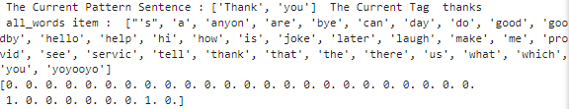
PREPARING TRAINING SET
Suppose ‘all_words’ is [‘hello’,’how’,’are’,’you’,’goodbye’]
Pattern sentence : “How are you?”
Bag of words representation : [0,1,1,1,0]

Slide 14
PREPARING TRAINING SET
The processed bag of words vectors are stored in ‘X_train’
The corresponding tags are stored at ‘y_train’
Now the training data is ready.

Slide 15
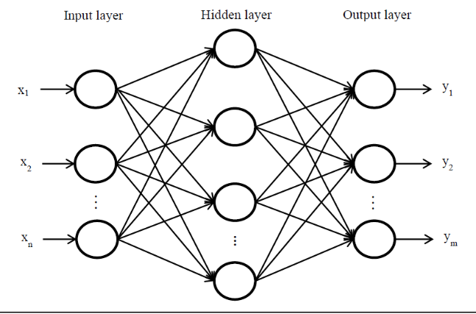
MODEL
The machine learning model selected for the project is MULTILAYERED FEED FORWARD NEURAL NETWORK . The reasons being :
- Perfect for smaller to medium sized datasets
- Excel at learning patterns and relationships in data
- Efficiently handle variable length sequences by representing them as fixed sized vectors
- Scalable, as number of neurons and hidden layers can be adjusted .
- capable of generalizing unseen data

Slide 16
MODEL
LAYERS: 1 INPUT LAYER, 2 HIDDEN LAYERS, 1 OUTPUT LAYER
ACTIVATION FUNCTION : ReLU
DEFINED PARAMETERS: INPUT SIZE, HIDDEN SIZE AND OUTPUT SIZE

Slide 17
MODEL
We define our hyper parameters such as batch_size, epochs and learning rate
We also define our loss function, to identify difference between predicted class and actual;ground truth. The loss function in our case is Cross Entropy Loss
We define our optimization algorithm, which is needed to update the weights, biases and parameters after the gradients have been computed. In our project we have chosen Adam Optimizer
The input Layer, accepts the BOW representations, and passes it to the hidden layers for computation. The number of neurons is equal to the number of unique stemmed words.
Each input Neuron then computes the wighted sum of its inputs and passes it through the ReLU layer and eventually the next layer.
The hidden Layers extract meaningful features from the BOW representations.. These vectors are put through Linear Transformations to compute weighted sum, for each neuron.. With each hidden layer the network extracts more meaningful features.

Slide 18
MODEL
The output is then passed onto the ReLU function
Then finally, THE OUTPUT LAYER, where each neuron is associated with a particular class or tag, gives the final prediction based on the highest probability among classes (we don’t use softmax explicitly because we use Pytorch cross entropy loss.
Steps 4,5,6,7 and 8 fall under FORWARD PROPAGATION, where the input of one layer, comes as the output of the previous layer.
Now the difference between predicted probabilities and actual ground truth, i.e, loss is calculated, by the loss function and this loss is propagated backwards into the network.
The gradients are thus computed, w.r.t, Weights and Biases. Adam Optimizer updates these parameters to minimize the loss. ( BACKPROPAGATION )
This process continues for the duration of the number of epochs.
The state of this model is finally saved in file “data.pth”, using Pytorch function torch.save()

Slide 19
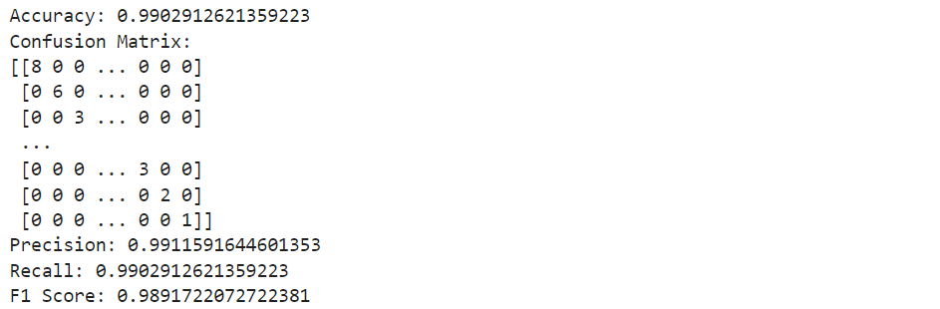
MODEL SUMMARY

Slide 20
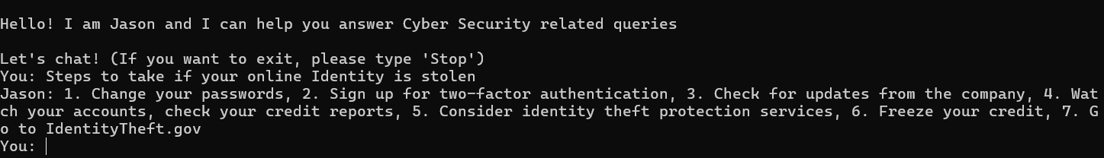
INTERFACE
COMMAND PROMPT BASED

Slide 21
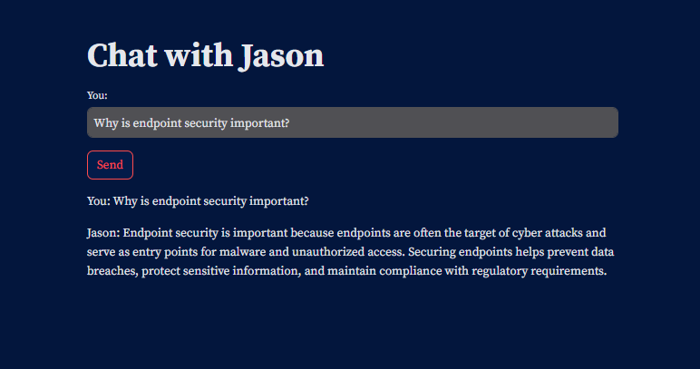
INTERFACE
STREAMLIT BASED

Slide 22
INTERFACE
Incase the chosen class has a probability lower than the threshold value (0.75) a default message is displayed, i.e,
I'm sorry, but I'm having difficulty understanding as the question seems to be beyond my expertise."

Slide 23
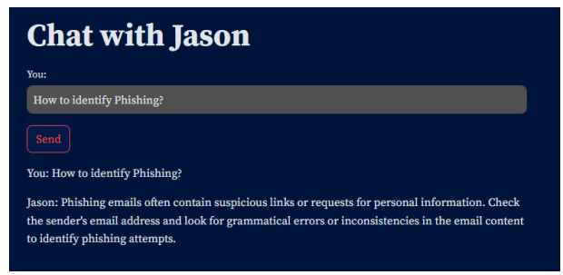
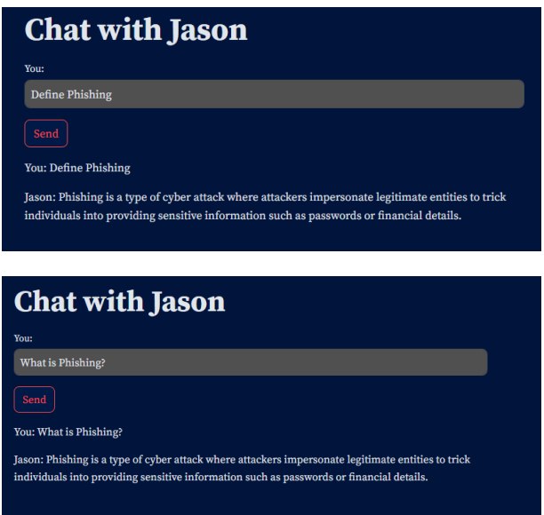
RESULTS
The system was able to respond to various database stored queries.
Also when the queries were in different formats.For example,
Moreover, the responses were generated very quickly, 45 milliseconds at max. Hence, we can
conclude that the system functions smoothly and successfully

Slide 24
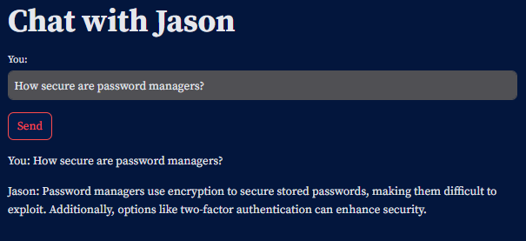
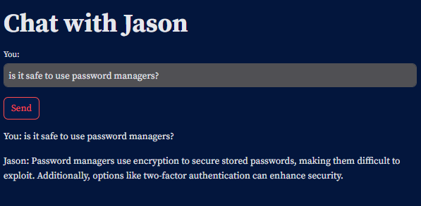

Slide 25
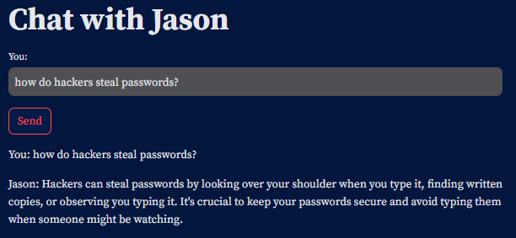
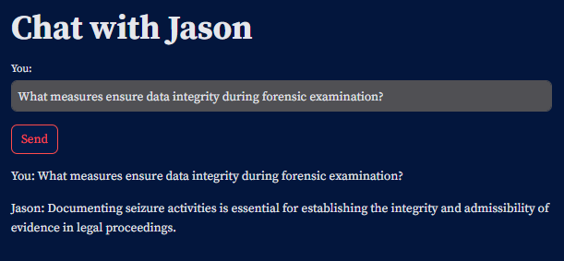
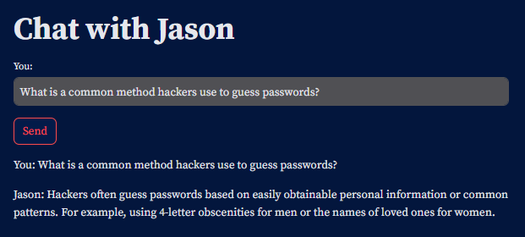
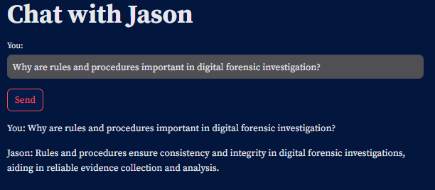
The chatbot can answer different queries regarding the same topic

Slide 26
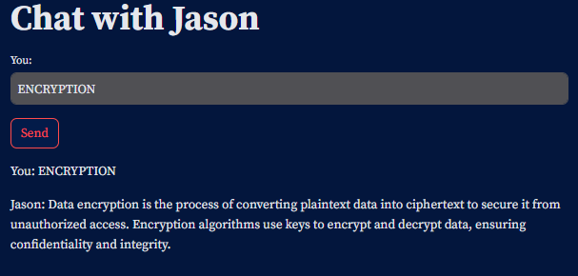
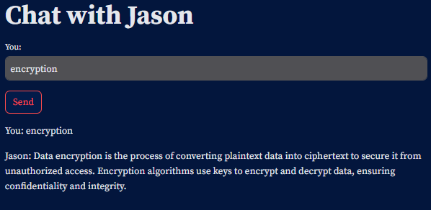
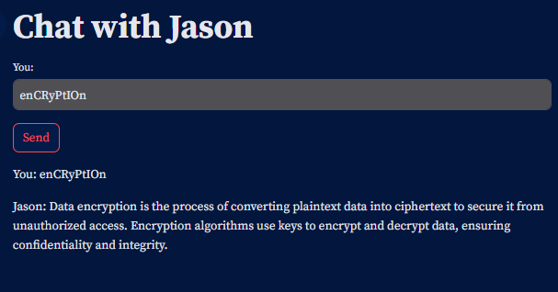
THE BOT IS NOT CASE SENSITIVE

Slide 27
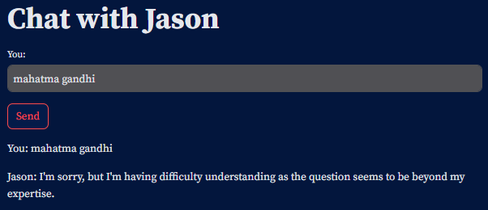
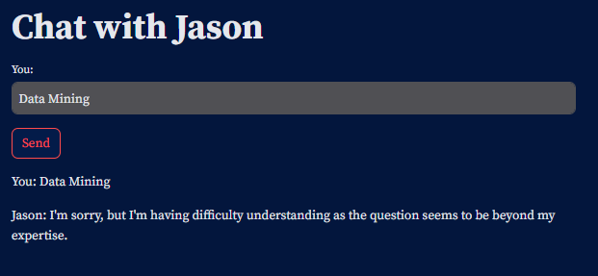
The bot also responds appropriately to out of scope questions

Slide 28
LIMITATIONS
Pattern recognition and contextual understanding
Possible incorrect results as relying on pattern recognition can lead to incorrect answers when inputs vary or patterns are interpreted incorrectly
Domain restriction of cybersecurity
Limited creativity in responses

Slide 29
FUTURE SCOPE
Improve Accuracy
Contextual Intelligence
Wider Knowledge Coverage
Diverse Training Data
Advanced Adaptability
Continuous Improvement

Slide 30
CONCLUSION
This dissertation focused on creating a chatbot for cybersecurity using NLP and Deep Learning. While effective, it's limited to pattern recognition and lacks emotional intelligence. However, it's versatile, with potential in education, corporate settings, and more. Future research could expand its use beyond cybersecurity to areas like customer support and finance, improving accessibility to information across different fields

Slide 31
REFERENCES
[1] E. Cambria, B. White, N. Jumping, "NLP curves: a review of natural language processing research," IEEE Comput. Intell. Mag., vol. 10, no. 3, pp. 48-57, Aug. 2015.
[2] K. R. Chowdhary, "Natural Language Processing for Word Sense Disambiguation and Information Extraction," Ph.D. dissertation, JNV University, Jodhpur, India, 2018.
[3] R. Caruana, "Multitask learning," Machine Learning, vol. 28, no. 1, pp. 41-75, Jul. 1997.
[4] A. Vaswani et al., "Attention is all you need," in Proc. Adv. Neural Inf. Process. Syst., Long Beach, CA, USA, Dec. 2017, pp. 6000-6010.
[5] Y. Wu et al., "Response selection with topic clues for retrieval-based chatbots," in Proc. 55th Annu. Meeting Assoc. Comput. Linguist., Vancouver, BC, Canada, Jul. 2017, pp. 1037-1047.
[6] K. Moore, S. Zong, "A comprehensive solution to retrieval-based chatbot Construction," in Proc. 20th Conf. Eur. Assoc. Comput. Linguist., Paris, France, Apr. 2017, pp. 487-496.
[7] X. Zhou et al., "Multi-turn response selection for chatbots with deep attention matching network," in Proc. 56th Annu. Meeting Assoc. Comput. Linguist., Melbourne, Australia, Jul. 2018, pp. 476-486.
[8] R. Eldan, O. Shamir, "The Power of Depth for Feedforward Neural Networks," in Proc. 29th Annu. Conf. Learn. Theory, Barcelona, Spain, Jun. 2016, pp. 907-940.
[9] M. M. Lopez, J. Kalita, "Deep Learning applied to NLP," arXiv:1703.03091, Mar. 2017.
[10] H. Akkineni, "Design and Development of Retrieval-Based Chatbot Using Sentence Similarity," J. Artif. Intell. Res., vol. 12, no. 4, pp. 567-579, Dec. 2019.
[11] K. Moore, S. Jhong, N. Jindal, "A comprehensive solution to retrieval-based chatbot construction," J. Comput. Linguist., vol. 8, no. 2, pp. 123-135, Feb. 2018.
[12] W. Wu et al., "Learning matching models with weak supervision for response selection in retrieval-based chatbots," in Proc. 26th Int. Conf. Comput. Linguist., Osaka, Japan, Aug. 2016, pp. 789-798.
[13] D. Whang et al., "An effective domain adaptive post-training method for BERT in response selection," in Proc. Annu. Meet. Soc. Natural Lang. Process., Hong Kong, China, Nov. 2019, pp. 678-689.
[14] H. Wang, H. Fang, "An adaptive response matching network for ranking multiturn chatbot responses," in Proc. 33rd Annu. Conf. Neural Inf. Process. Syst., Vancouver, BC, Canada, Dec. 2019, pp. 456-467.

Slide 32
THANK YOU

