Slide 1

Traffic Signage Systems By Saswata Paul

Slide 2
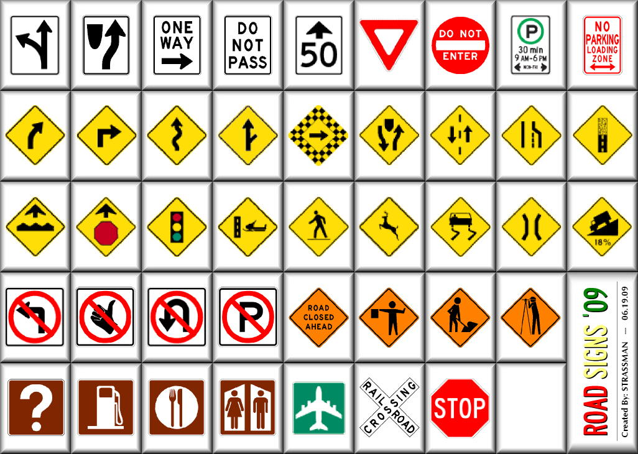
A Collection of Common Signs Used in The System

Slide 3
System Aspects
PURPOSE - To help drivers follow the traffic rules and navigate easily to their destination
ELEMENTS- Consists of several symbols, signs, shapes , words and lights that are used to convey coherent information
ROUTINELY works to provide a seamless FLOW of information to the drivers.
Information is arranged in a HIERARCHICAL manner so as to avoid “information overload”
STABLE system that is robust enough to convey all the necessary information that may be required by the drivers.

Slide 4
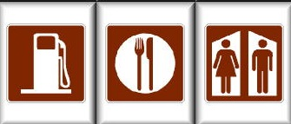
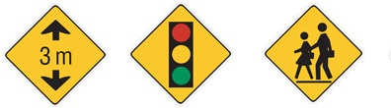
Semiotic Aspects
Uses symbols that derive inspiration from real life objects.
Helps convey information unequivocally
Easy to understand.
Simple in nature.

Slide 5
Design Principles Applied
Fonts
Sign Colors
Sign Symbols
Sign Placement
Information Grouping

Slide 6
Cognitive Principles Applied
Similarity
Figure-ground
Grouping
Continuity
Focal point
Closure

Slide 7

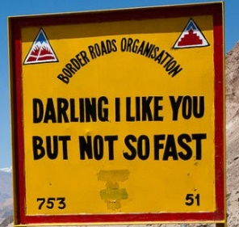
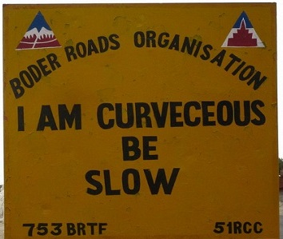
Punny signs from an authority in India.

Slide 8
THANK YOU !!!

