Slide 1

BIKE SHARING DEMAND ANALYSIS
Excel Analytics • Dashboard • Forecasting • Anomaly Detection
NEXTHIKES IT SOLUTIONS
By
SAYAN PAUL

Slide 2
Project Objectives
Analyze bike-sharing demand using Excel-based data preparation and statistical functions.
Clean, classify and transform the dataset using formulas and structured tables.
Summarize demand by time, weekday, month, weather and user type using PivotTables.
Build an interactive dashboard with charts, heatmap, slicers and timeline.
Apply forecasting and anomaly detection to generate decision-support insights.

Slide 3
Dataset & Workbook Structure
1,000
Records
58,304
Total Users
58.30
Average / Record
249
Max / Record
Main analysis table: BikeData.
Supporting sheets include source/cleaned datasets, Calculations, Pivot_Analysis, Dashboard and Demand_Forecast.
Coverage: 01 January 2011 to 14 February 2011 (45 dates).
Key fields include time, season, month, hour, holiday, weekday, weather, temperature, humidity, wind speed, casual users, registered users and total users.

Slide 4
Data Loading, Cleaning & Transformation
Datasets were organized into cleaned analysis tables and connected query structures.
Dates and numeric fields were standardized for calculations and PivotTables.
Duplicate Instant values were checked to support record uniqueness.
Missing temperature values were handled using an average-value replacement approach.
Derived fields were created for Day_Type and Demand_Level.
LEFT, RIGHT, LEN and TEXT were included as explicit Excel function demonstrations.

Slide 5
Conditional Logic & Lookup Functions
Day_Type: IF logic classifies Weekday values 0/6 as "Weekend" and the remaining values as "Weekday".
Demand_Level: records are classified as Low, Medium or High using Total_User thresholds.
VLOOKUP demonstrates retrieval of a matching value from a cleaned table.
INDEX + MATCH demonstrates flexible lookup and extraction using a common Instant key.
These formulas provide auditable evidence for the project’s conditional-logic and lookup requirements.

Slide 6
Statistical Analysis
4,921
Casual Users
53,383
Registered Users
91.56%
Registered Share
1–249
Demand Range
COUNT / SUM / AVERAGE: 1,000 records, 58,304 total users, 58.30 average users.
STDEV.S: used to measure demand variability.
CORREL Temperature vs Total_User: r = 0.229.
CORREL Humidity vs Total_User: r = -0.254.
CORREL Wind Speed vs Total_User: r = 0.104.

Slide 7
Time-Based Demand Analysis
Average Demand by Hour
0
1
2
3
4
5
6
7
8
9
10
11
12
13
14
15
16
17
18
19
20
21
22
23
Highest average hour: 17:00 (140.20 users).
Next strongest: 08:00 (128.29) and 18:00 (122.86).

Slide 8
Monthly, Weekday & Weather Findings
Monthly Total Demand
Weekday Average Demand
Weather Average
1
2
Thursday
Tuesday
Friday
Wednesday
Monday
Sunday
Saturday
1
2
4
3
Weekday average: 63.34; Weekend average: 48.09.
Highest weekday average: 67.66.
Weather category 1 has the highest average demand (61.67).

Slide 9
Demand Level Classification
501
Low Demand
422
Medium Demand
77
High Demand
Demand_Level is generated automatically from Total_User.
The classification supports dashboard segmentation and funnel-style visualization.
It provides an easy operational view of how many records fall into lower, moderate and higher demand conditions.

Slide 10
Interactive Dashboard
KPI cards summarize total users, average demand, maximum demand and registered users.
Line chart: hourly demand pattern.
Bar charts: monthly demand, weather demand and user/demand composition.
Weekday × hour heatmap highlights relatively high and low demand combinations.
Slicers and timeline provide dynamic filtering for dashboard exploration.
The dashboard is designed as the management-facing layer of the Excel project.

Slide 11
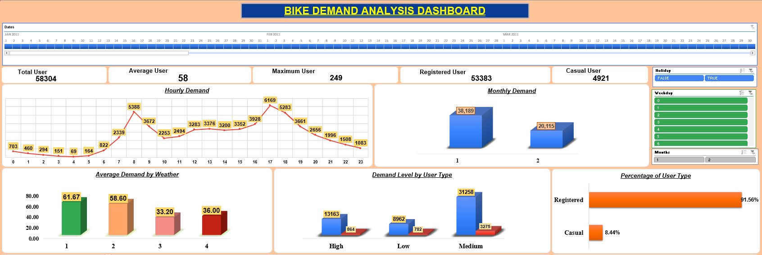
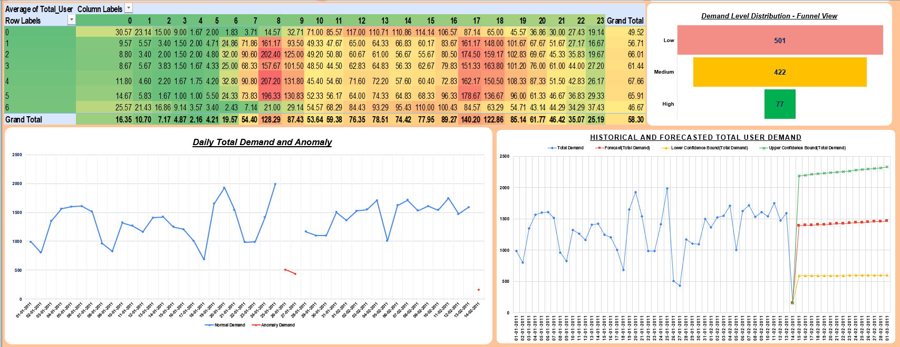

Slide 12
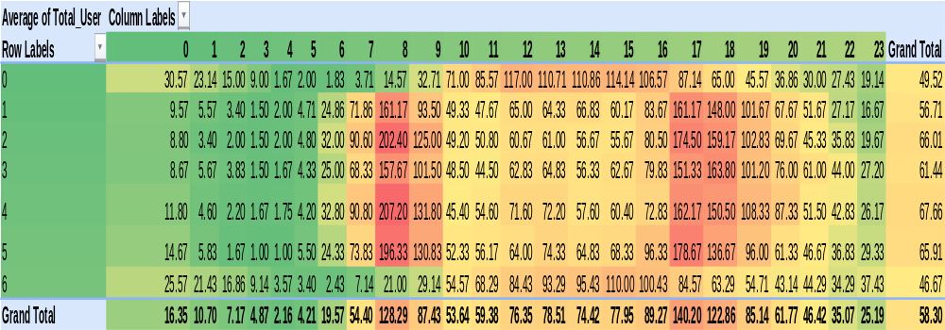
Weekday × Hour Heatmap
Darker cells represent relatively higher average demand.
The heatmap is based on Average Total_User, making weekday/hour cells comparable.

Slide 13
Forecasting
Daily demand is aggregated from the hourly records before forecasting.
Excel Forecast Sheet is used to estimate future demand from the historical series.
The final workbook includes forecast values with confidence bounds.
Forecast outputs are intended for planning support rather than guaranteed predictions.
Because the sample covers only 45 dates, forecast results should be treated cautiously and refreshed as more history becomes available.

Slide 14
Anomaly Detection
1295.64
Daily Mean
392.65
Std. Deviation
3
Flagged Anomalies
Rule: flag daily demand below 510.35 or above 2080.94 (mean ± 2×STDEV).
The final sample contains three unusually low-demand days.
Anomalies should be reviewed for weather, events, operational disruption or data-quality explanations.
This is a transparent statistical anomaly method rather than a claim of a machine-learning model.

Slide 15
Daily total demand was analyzed using a statistical threshold based on the mean and standard deviation. A record was classified as an anomaly when its demand differed from the average by more than two standard deviations. This method helps to identify unusually high or low demand periods and provides an additional analytical layer for detecting irregular patterns in the dataset.

Slide 16
Key Findings
Overall demand: 58,304 users across 1,000 hourly records.
Registered users dominate the sample at 91.56% of total users.
Highest average hourly demand occurs at 17:00 (140.20).
Weekday demand (63.34) is higher than weekend demand (48.09).
Temperature has a weak positive relationship with demand (r=0.229); humidity has a weak negative relationship (r= - 0.254).
Forecasting and anomaly detection add forward-looking and exception-monitoring capability.

Slide 17
Recommendations & Conclusion
Prioritize operational readiness around the highest-demand period (17:00) and other strong periods.
Use the weekday/hour heatmap to plan bike availability, redistribution and maintenance.
Protect service quality for registered users because they represent the majority of recorded demand.
Review anomaly dates before using them in planning models; investigate operational or external causes.
Refresh the forecast and dashboard as more dates are added. A longer multi-season history is needed for stronger seasonal conclusions.
Overall, the final workbook provides a complete Excel analytics workflow from cleaning and formulas to interactive Dashboard, forecasting and anomaly monitoring.

Slide 18
THANK YOU

