Slide 1

0/5
Introduction to NetSuite
Notes:
Time: Lecture: 30 – 40 minutes, Lab: 15 – 20 minutes
Intent: To introduce the Import Assistant tool for importing data into the NetSuite application.
Flow: An overview of the data migration tasks are presented with two of those tasks as the focus of this module. Next, the type of records that can be imported using the Import Assistant is highlighted. The module then introduces the Import Assistant and its features. A large part of the module covers how to prepare the data for import: field mapping values that are required, guidelines for CSV file formatting, and import (data handling) options. Next, the tasks for importing data are featured. The module concludes with some best practices for importing data.
Key Terms:
Data Migration
Data Handling
Field Mapping
Import Assistant
CSV Files
Character encoding
Reference Type
Internal ID
External ID
Default Value
Null Value

Slide 2

Module Objectives
After completing this module you will be able to:
  Determine the appropriate strategy for importing data
  Prepare the data for import
  Use the Import Assistant to import data from CSV files for common record types
  Define and save Import Assistant templates for reuse
  Apply best practices for successful data imports
Why you need to know:
  Importing data into the NetSuite application is one of the major tasks required for an implementation
Notes:
Each objective and “why you need to know” should be stated aloud.

Slide 3
Data Migration Overview
The data migration task involves
  Data extraction from legacy systems
  Data cleansing to ensure data integrity
  Data transformation to a format acceptable to the NetSuite application
  Data loading into your NetSuite account
Focus of this module
Notes:
Addressing historical data and identifying known data dependencies are some data migration considerations.
Data cleansing is covered in the next module. Module sequence for this course assumes records have been imported first, data cleansing occurs afterwards.
9

Slide 4
Types of Data to Import
Set-up data required to support application configuration
Entity data required for ongoing operations
Transactional data that must be migrated from the legacy application

Slide 5
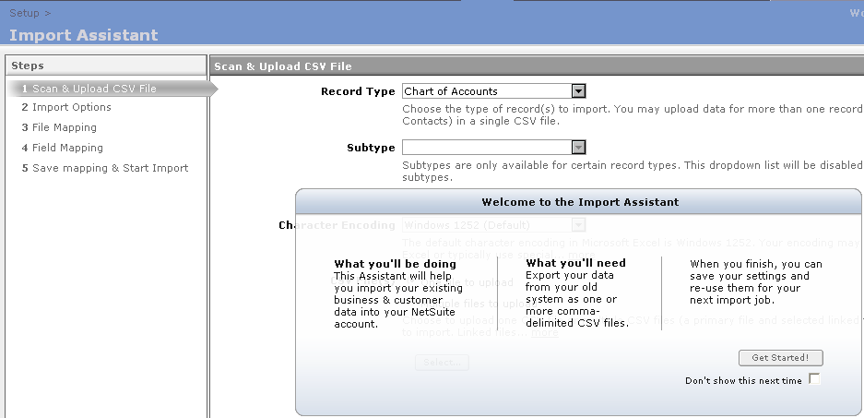
NetSuite Import Assistant Overview
A wizard that guides the user step-by-step with the import process for most CSV records
  Provides verification at each step and only allows user to progress when a step is completed successfully
Users are guided following a certain task sequence
Notes:
The Import Assistant is a new feature for the 2007 release and replaces the prior, template-based CSV import process in most cases. Alert the students to the exceptions which can be performed using template-based imports, found in the student note.
From Help:
The Import Assistant is available for most imports of CSV file data into NetSuite. The Assistant lists the import’s numbered steps in its left pane and includes a page for each step, displayed one at a time, in sequence, in its right pane. As you complete each page, the numbered step is checked off in the left pane. After you complete tasks on a page, you click the Next button to proceed. The Assistant provides verification of each step and does not let you proceed to the next page if it encounters errors.
9

Slide 6
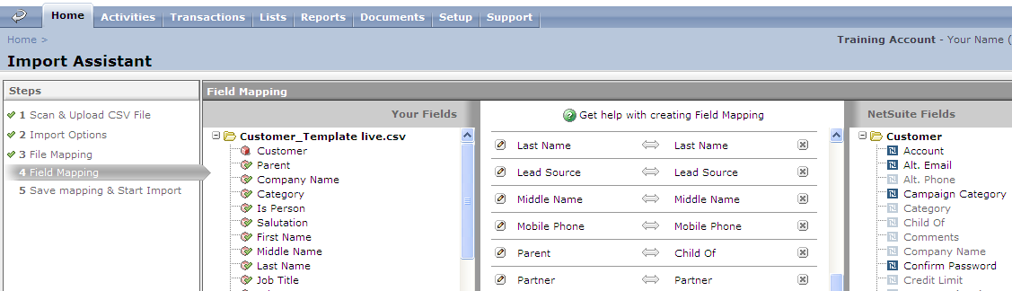
NetSuite Import Assistant Overview (Continued)
Drag and drop functionality for field mapping
  Maps each CSV file’s column headers to field names for the selected NetSuite record type, so that data can be imported into the appropriate NetSuite fields
Fields that appear on the mapping page are the same as what the user would see on their preferred form
Notes:
First define field mapping. Simply put, it involves mapping CSV file fields to NetSuite fields. The next few slides provide more detail on Import Assistant features.

Slide 7
NetSuite Import Assistant Features
One or multiple files can be imported
  Each import is of one record type with the exception of Entity and Contact records which can be imported together
    Customers and Contacts
    Leads and Contacts
    Prospects and Contacts
Character encoding options:
  Windows 1252 (Default) used for MS Excel
  UTF-8
  MacRoman
  Shift-JIS
Some error handling and validation is performed
Imported data can become new records in the NetSuite application or update existing NetSuite records
Notes:
From Help:
For entities (Leads, Prospects, and Customers) and Contacts only, you can import data into two NetSuite records at once. The sequence of features presented somewhat follow the sequence of steps in the Import Assistant.
9

Slide 8
Preparing Data for Import
Save data from other applications into CSV files using separate files for different record types
  Exception is Customer and related type of records which can be imported together
Apply CSV file formatting guidelines
  Adjust data in files for import to conform to NetSuite file conventions and record type definitions
Specify field mapping values
Determine import (data handling) options
Notes:
Use this as a structuring slide. Bullets 2 – 4 are detailed in the following slides. These are very important steps that the students must understand to ensure the success of not only the import, but more importantly, the integrity of the data imported into the NetSuite application.

Slide 9
CSV File Formatting Guidelines
Any data without column headers is not imported
Commas
  Fields that contain commas within their data will cause errors
  Extra trailing commas at the end of fields or rows are ignored
Use “TRUE” or “FALSE” values for check boxes and radio button fields to ensure successful import
  Check boxes accept all forms of True or False
    For example, True, true, TRUE, T, yes, Yes, YES
  Radio button fields do not accept any other Boolean values
Notes:
The guidelines address how the data is formatted within the CSV file.
9

Slide 10
CSV File Formatting Guidelines (Continued)
Format cells in the spreadsheet as text rather than numbers
  Many spreadsheet programs do not display or allow leading zeros
Format long numbers as text in Excel as they are saved in rounded form resulting in incorrect values
  For example, UPC codes have long numbers
Specify countries by name in CSV files
  Country codes or internal codes are not imported successfully
Use field delimiters
  Colon indicates a hierarchical relationship
  Pipe (I) indicates a multi-select
Notes:
From Help:
Be careful when entering numbers into a CSV file. Many spreadsheet programs do not allow or do not show leading zeros by default, which can be a problem if your data needs those leading zeros. You can work around this problem by formatting the cells in the spreadsheet program as text rather than numbers.
If you plan to import a CSV file created in Excel, be aware that Excel uses scientific notation to save long numbers to CSV files, so these numbers will be imported into NetSuite in rounded form, resulting in incorrect values. You can work around this issue by formatting long numbers such as UPC codes as “Text” in Excel before doing a CSV import.

Slide 11
Specify Field Mapping Values
Provide a means to set specify values for fields or establish relationships between field values in a record
  Default Values
  Null Values
  Reference Types
Notes:
This is a structuring slide and frames the discussion for the different field mapping values to teach.
9

Slide 12
Field Mapping: Default Values
A default provides a consistent value for that field which will be used for every record in that import instance
Useful for required fields on a record
  Every NetSuite required field must be mapped
  Provides a consistent value for data integrity
For example, when importing new lead records from a tradeshow, set the default value for the Lead Status column = “LEAD-New”
Notes:
Another example from Help:
The user could elect to default values into NetSuite fields. For example, in the case of a customer import, the user may wish to default the Individual field to “No”. This can be achieved by clicking on the pencil icon next to the source field in the Individual row. This allows the user to set the appropriate default value for that field which will be used for every record in that import.

Slide 13
Field Mapping: Null Values
An empty value is assigned to fields previously filled with data
  Useful when a field has been assigned with a default value and is no longer required
  For example, when a lead record is entered, the Sales Rep field automatically defaults to the logged in user name
    Outcome of importing 10,000 records displays logged in user name for the Sales Rep field
Null values are also useful for fields without values in the CSV file
  For imports that updateNetSuite data, set fields with no values in CSV files to null instead of enabling the Overwrite Missing Fields advanced option
Notes:
9

Slide 14
Field Mapping: Reference Types
Provides the ability to map a column in an imported CSV file to a NetSuite field that has one or more list values
  For example dropdown or multi-select fields
Reference types include
  Internal IDs
  External IDs
  Name
Notes:
Use this as a structuring slide. Details follow for each of the reference types listed. Details for reference types are presented in the next few slides.

Slide 15
Reference Type: Internal IDs
When used as a reference type, the Import Assistant references numbers for the mapped field
  For example “123”
Recommended for:
  Update import (data handling) option
  Data exported to an external application for manipulation and then re-imported into the NetSuite application
  Development, to verify that the internal ID values submitted on requests match the records expected as displayed in the UI
    Preferences can be set to display internal IDs
Internal ID can be added to data in a results column of a saved search, then exported to a CSV file
Notes:
The Internal ID Field example can also be achieved using NetSuite’s Mass Update feature (covered in the next module) or using Direct List Editing (covered in an earlier module).
Internal ID fields can be used for making mass updates to information already contained in the NetSuite application
9

Slide 16
Reference Type: External IDs
When used as a reference type, Import Assistant finds and references a specified ID string for the mapped field
  For example, “xyz”
Recommended for:
  Add or Add or Update import (data handling) options
  Records with parent/child relationships, and records with auto-generated numbers
  Ongoing integration with external databases, where external data is regularly imported into the NetSuite application
    The foreign key to the external system is stored in NetSuite, allowing for upfront record references during data migration
Notes:
From Help:
Some record types, such as custom lists or custom records, do not support the use of External IDs as reference types.
External ID field: Import each record’s unique identifier from the external system into the NetSuite application. The presence of the external identifier will enable you to identify the appropriate records that need to be updated from the internal system.

Slide 17
Reference Type: Name
When used as a reference type, the Import Assistant references text strings for the mapped field
  For example “Aaron Wolfe”
Reference types such as External ID or Internal ID are preferable to specifying name references
  Requirements for name references are affected by auto-generated numbering preferences
  If used, data value for fields must be written exactly as they appear in dropdown lists in the NetSuite record form
  External ID is recommended if user is unsure or unable to verify the name reference for a record
Notes:
The main teaching point to emphasize is that while “Name” as a reference type is available, the best practice is to use either an Internal ID or an External ID.
9

Slide 18
Import (Data Handling) Options
Add: Adds the records from the source file to the database
Update:
  Searches the NetSuite database for records containing the same information as the source file
  Then updates those records with the information contained in the source file
Add or Update:
  Performs an update on a record match found
  Adds records not found through the matching process
Notes:
Import options are presented again during the task portion of the module. This concludes the discussion on preparing the files and the data for import

Slide 19
Importing Data Task
Determine the records to import
Select import (data handling) options
Map multiple files (if needed)
Map fields
Review field mapping results
Perform import or save import template
Notes:
This is a structuring slide. Do not teach the steps or concepts here because the following slides cover them in detail.
Inform the students again that the Import Assistant also guides the user through each step. At a high level, this entails the user
Indicate data record type(s)
Select file(s) to import
Set data handling options
Refine field mappings for data
9

Slide 20
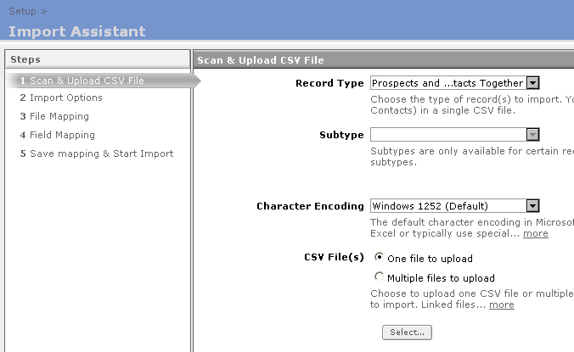
1. Determine Records to Import
Navigate to Setup > Import/Export > Import CSV records
Selection determines records and fields to be updated by the import
Subtype fields display based on Record Type selected
Default displayed is used by the Excel source file and applies to most imports
Single or multiple CSV files can be uploaded

Slide 21
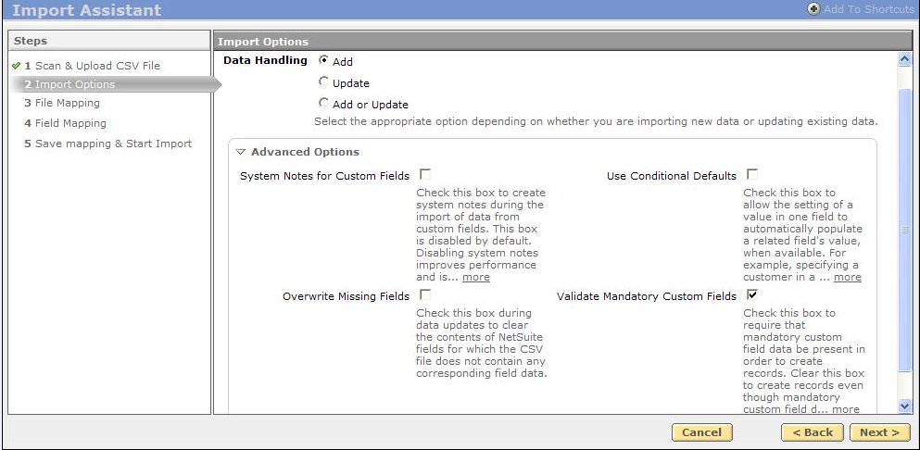
2. Select Import (Data Handling) Options
Option chosen indicates how the imported data impacts existing data in the NetSuite application
  Add, Update, or Add or Update
Set advanced options for import
Notes:
9

Slide 22
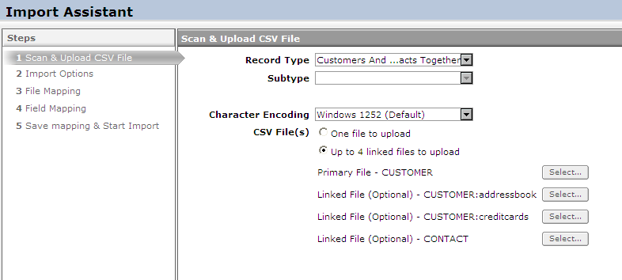
3. Map Multiple Files (If Needed)
For multiple files, the user needs to
  Choose a primary key from the multiple files
  Select key columns to link data in multiple files
Required only for multiple file imports
For each file to import, click the Select button
Notes:
The user can then click the Select button to browse to the source file. In the event that more than one source file will be used, choose the multiple files radio button (as shown on the slide). The screen changes enabling you to select more than one file.
Once the file or files have been selected the user clicks next to proceed to the next step.
Go over the File Mapping step which comes into play only when dealing with multiple file imports. The primary key (see student note) should also be explained.
Used for multiple file imports. Select key columns to link data in multiple files.

Slide 23
4. Map Fields
User can add, edit, or remove the selections
  Add by drag and dropping appropriate fields
Import Assistant performs
  Some automated mapping based on the names of column headers in the source file
  Some validation before the user proceeds to the next step
Drag and drop from source file to middle column
Drag and drop from NetSuite fields to middle column
Notes:
The Field Mapping page displays the available sublists for each import at the bottom of the NetSuite Fields pane, based on the related features that are enabled. You can map sublist fields in the same manner that you map other fields. Currently, up to five instances are supported for each sublist. For more information, see Importing Sublist Data.
SHOULD THIS COVERED? yes
• NetSuite fields shown in the right pane of the Field Mapping page are dependent upon the fields available on the user’s preferred form for that record type. If the user’s preferred form does not allow access to certain NetSuite fields, those fields will not display or be available to map.
• For example, If the 'Access' tab of the preferred Customer/Lead/Prospect form is set to 'show' = F, the following fields will not be available to be mapped to any imported CSV fields: 'Confirm Password', 'Password', and 'Give Access'. Is that accurate – I understood there was a problem with importing customer center access and could only be done via web services?
• To allow a user to import data for fields that do not display on the user’s preferred form, create a new role for the user that has a preferred record type form displaying all the fields that need to be available for import. The user can log in with this new role in order to perform CSV imports.
• An exception to this rule occurs if Marketing Automation is enabled and you choose the “Add” data handling option on the Import Assistant’s Import Options page. You are required to map the Unsubscribe field on the Field Mapping page, even if this field is not displayed on your preferred form for the record type.
9

Slide 24
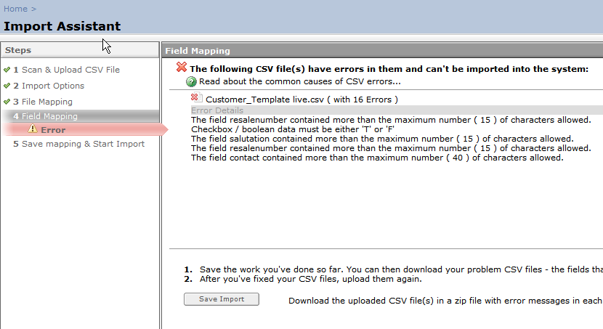
5. Review Field Mapping Results
Certain fields are required and need to be mapped to proceed
  For example, Individual and Unsubscribe fields on a Customer record
Error displays if there is a problem with mapping
Notes:
In the event that it determines a problem with the mapping, it will display an error, enabling the user to rectify the problem before proceeding through the entire import process.

Slide 25
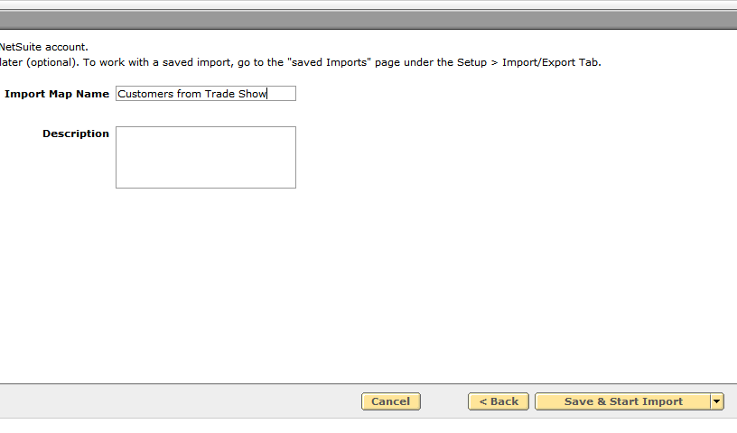
6. Perform Import or Save Import Template
Saving the import map creates a customizable import template available for future use
Click Save & Start Import to save the import as a template and import task is run
Notes:
From Help:
The final step is to name the import map, save, perform import or save and perform import. The ability to save import maps gives the user the option to create customizable import templates. For instance, if you go to trade shows and receive the file of people you met there in a standard format, you can create an import map to re-import each file using the same map.
9

Slide 26
Best Practices for Importing Data
Schedule the import tasks to occur during off-peak hours
Determine how long the imports will take
  Break large jobs into smaller chunks to improve performance
    25,000 records is the limit per imported file
Identify where the imports will happen
  For example, main account, sandbox, and so on

Slide 27
Summary
This module showed you how to:
  Determine the appropriate strategy for importing data
  Prepare the data for import
  Use the Import Assistant to import data from CSV files for common record types
  Define and save Import Assistant templates for reuse
  Apply best practices for successful data imports
Notes:
Review Question: What are the three import (data handling) options using the Import Assistant?
Answer: Add, Update, Add or Update
Review Question: What type of records can be imported together in a CSV file?
Answer: Customers and Contacts, Leads and Contacts, Prospects and Contacts
9

Slide 28
Lab Exercises
Lab 9-1: Map and import a list of leads into the NetSuite application using the Import Assistant
Notes:
Lab Instructions here: Total number of labs should be completed in 20 – 30 minutes.

