Slide 1
Baseball Most Talented Players
Big Contracts in Major League Baseball are Good for Players
Multi-million-dollar contracts
Multi-year contracts
Are They Good for the Owners of Baseball
Is there a Return on Investment
What is their Future Yearly Performance

Slide 2
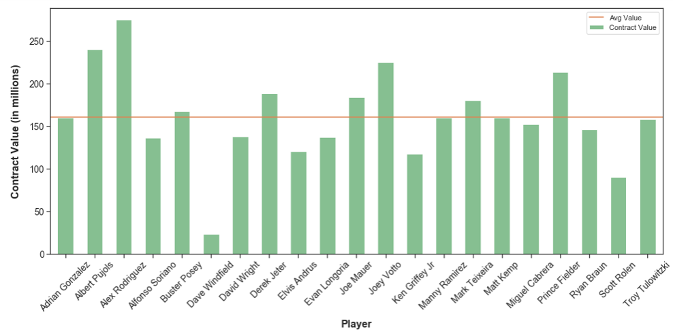
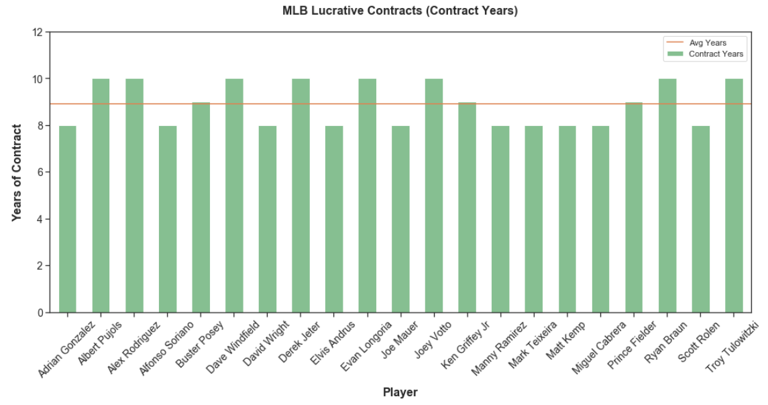
Baseball Most Lucrative Contracts
Source: Fox Sports Article

Slide 3
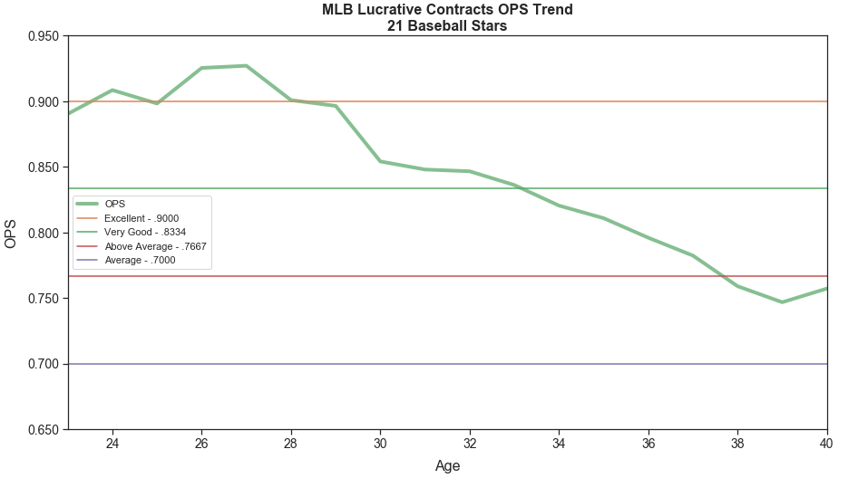
Combined Player Performance
Average Signing Age: 28
Average Contract Years: 8.9
Average Contract Value: $160 million
Performance Declines at Age 28
Continues to Decline Rapidly
Source: Fox Sports Article

Slide 4
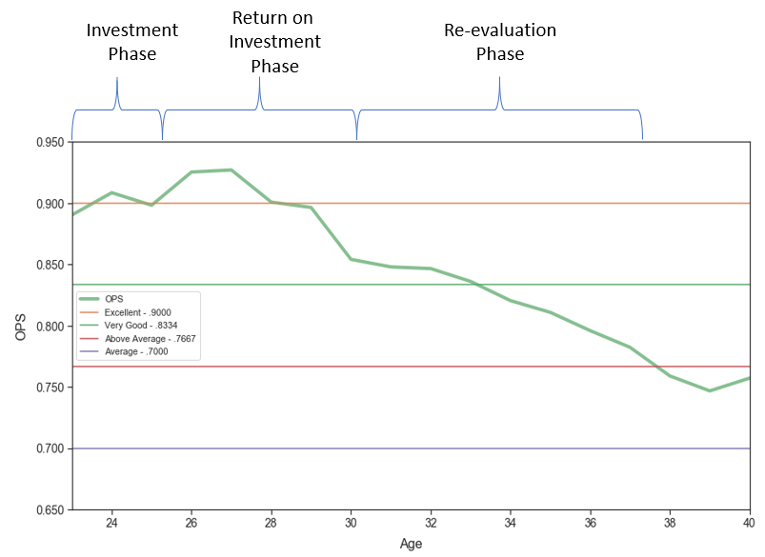
Is There a Better Way
Investment Period
Initially Sign 2 to 4 Years
Track Performance
Return On Investment Period
Sign to Multi-Year Contract
Sign to Multi-Million Dollar Contract
Less Dollar Value but Substantial
Sign During Optimal Years
Re-Evaluate Contract
Declining Years
Still May be Value
Source: Fox Sports Article

Slide 5
Keys to Success
Predict Performance
Predict ROI Period – Five Years
Given 2 to 4 Years of Known Performance
Create Baseline Predictive Model
OPS Predictive Model
Career OPS Predictive Model
One Year Look Ahead
Create Five Year Projections
Explore Techniques
Input into Predictive Model
Analyze Results
Source: Fox Sports Article

Slide 6
Process
Acquire and Process Data
Lahman Baseball Statistics Data
Yearly Baseball Statistics
1871 to 2018
Format Data into Usable Format
Validate Data Against FanGraphs
Perform Exploratory Data Analysis
Understand the Data
Look for Insight in Data
Statistical Analysis
What Does Performance Data Look Like Statistically
Helps to Better Understand Data
Use Statistical Techniques
Predictive Models
Predict OPS (On Base Plus Slugging)
Predict Career OPS

Slide 7
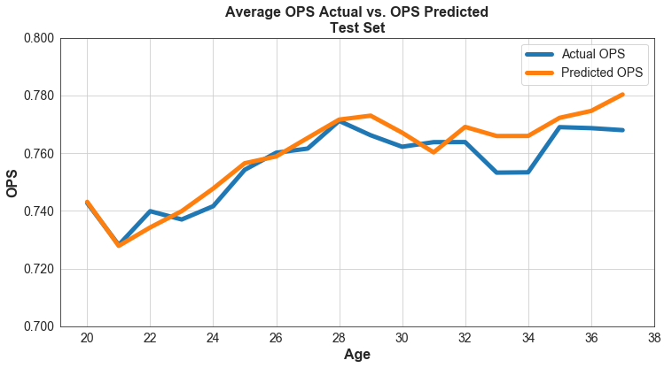
OPS Predictive Results - Charts
One Year Predictions (only)
Averaged Over All Players
Sample Required 300+ Yearly At Bats
Later Years Have Greater Variation
Easier To Predict Early Years

Slide 8
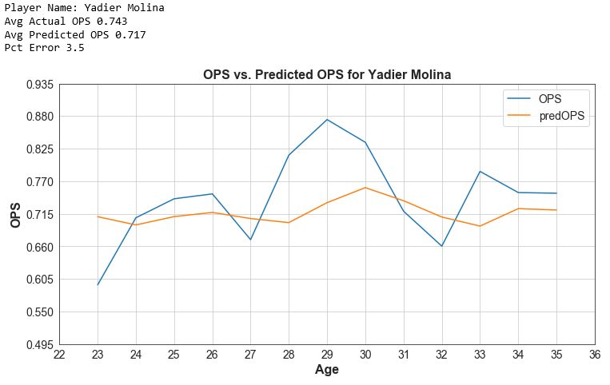
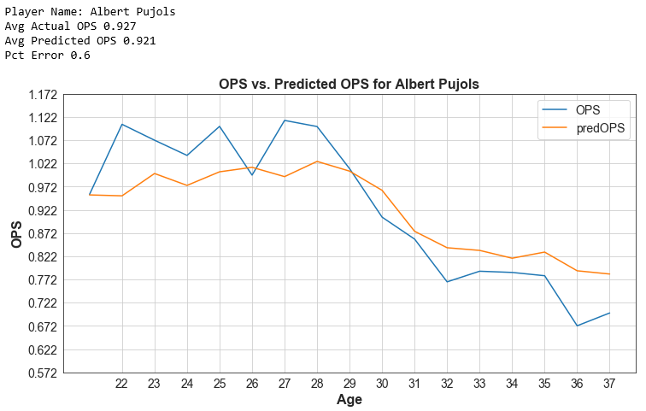
OPS Predictive Results – Selected Players
Some players can reasonably be predicted. Some are not.

Slide 9
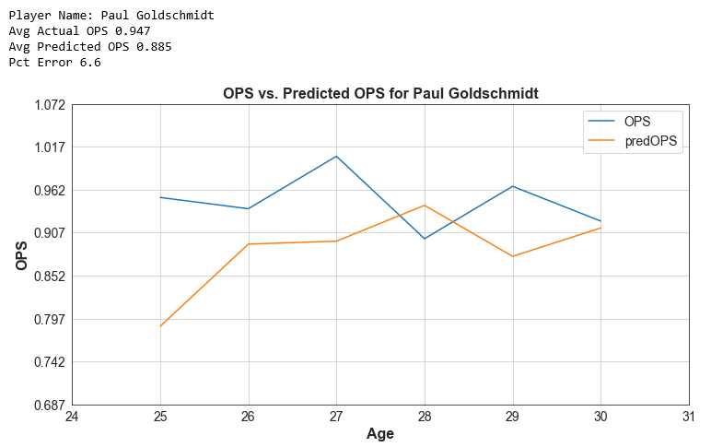
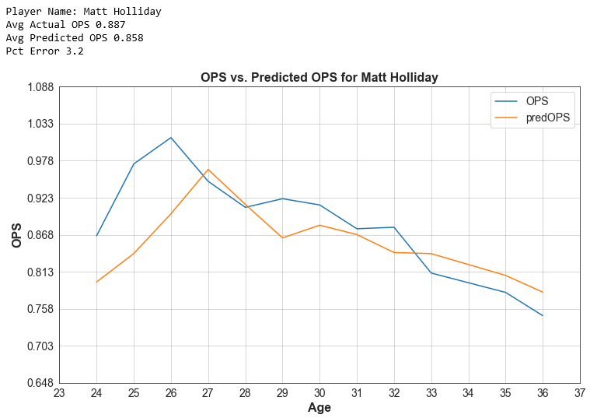
OPS Predictive Results – Selected Players
Some players can reasonably be predicted. Some are not.

Slide 10
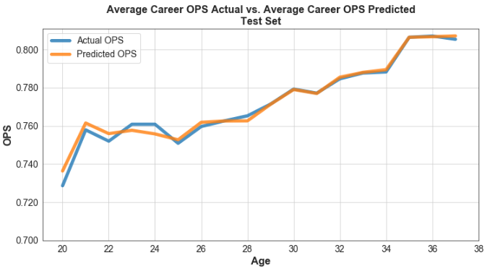
Career OPS Predictive Results - Charts
One Year Predictions
Averaged Over all Players
Sample Required 300+ At Bats
Low Variability
Stable Model

Slide 11
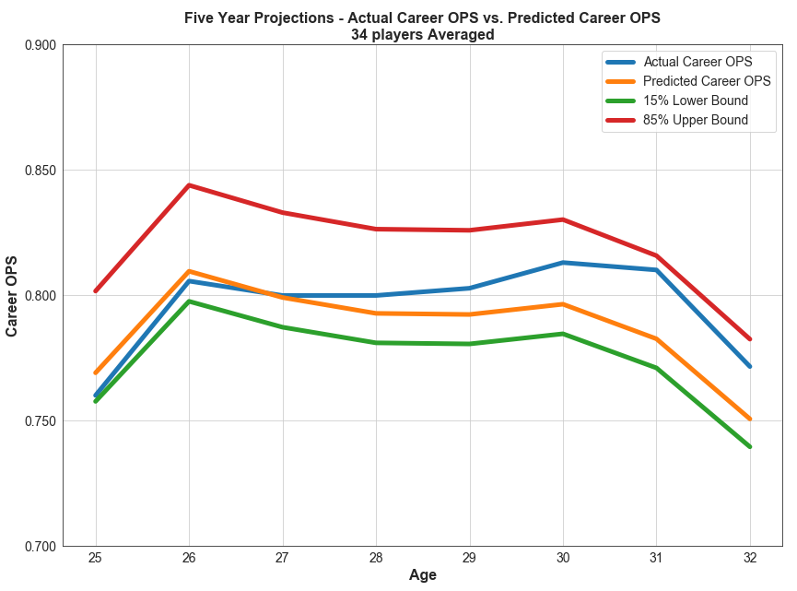
Career OPS Five Year Predictive Results - Charts
Five Year Predictions
Averaged Over 34 Players (randomly selected)
Sample Required 300+ Yearly At Bats
Prediction Capability
Good for 70% Certainty
Early Years Are More Accurate
Works for Two Known Years of Performance

Slide 12


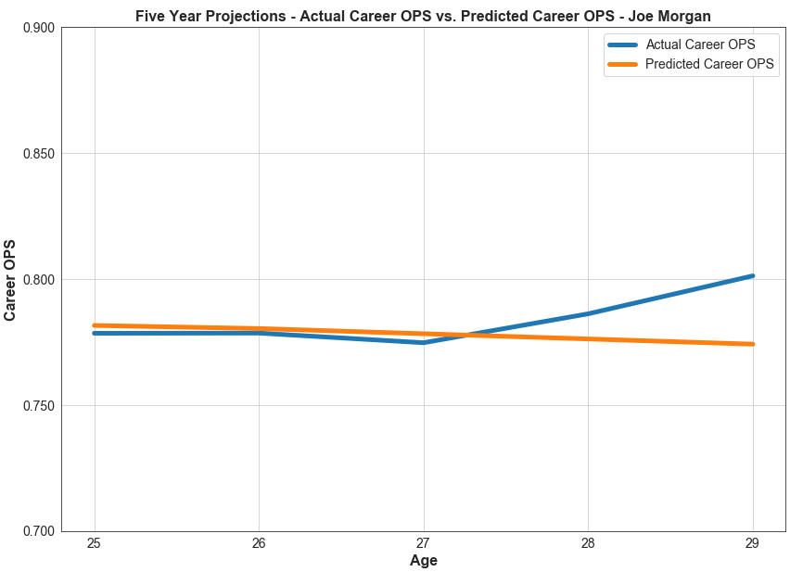
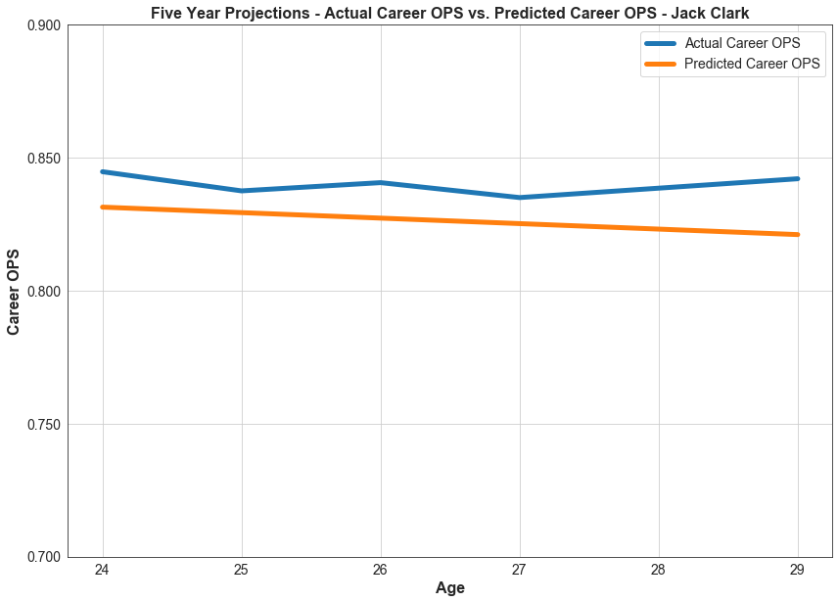
Career OPS Predictive Results – Selected Players
Five Year Projections – Two Known Years
Note that the average five-year career OPS actual vs. predicted error is as good as one year for OPS.

Slide 13
Steroid Era in Baseball
Steroid Era Timeframe
ESPN says Late 1980’s to Mid 2000
Other Definitions 1994 to 2004
Steroid Testing Implemented in 2004
Was There Benefit
Did Players Benefit From Steroids
Is There Clear Evidence

Slide 14
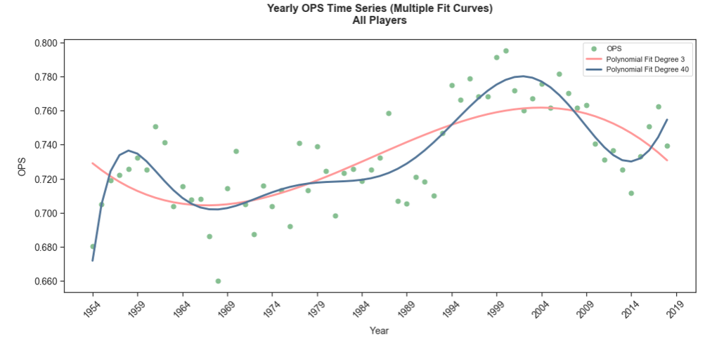
Steroid Era in Baseball
Two Curves Charted (one properly fitted, one overfitted)
Trend Shows OPS Performance Increase Starting in Late 1960’s, Early 1970’s
Continues to Trend Upward Through Early 2000’s
Cannot Say Conclusively Steroid Era Benefited Players Compared to Other Timelines
More Research Necessary

Slide 15
Thank You!

