Slide 1
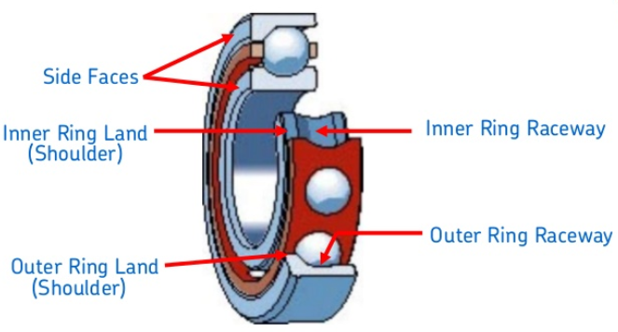
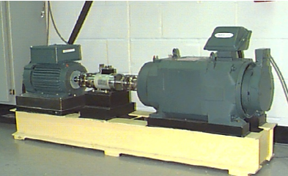
Summary of Project
Accelerometer Sensor Data (Case Western Reserve University)
12,000 samples per second
Inner raceway bearing sensor – drive end
Data segmented into fixed sizes of 256 samples
14,234 segments total
6,633 Baseline (normal) segments
7,601 Faulty segments
Classification Problem
4 Baseline (normal) classes
16 Faulty classes
20 Total classes
Contemporary Approach : 1D CNN
Classic Approach : Engineered Features
Fast Fourier Transform
Discrete Wavelet Transform
Fast Fourier Transform + Discrete Wavelet Transform
Fast Fourier Transform + Discrete Wavelet Transform + 1D CNN
SVM, XGBoost, Gradient Boosting, Random Forests

Slide 2
Summary of Project – Data Class Descriptions
Label | Segments | Data Type | Data Description | File Name
0 | 952 | Baseline Data | 0 HP workload normal | 97.mat
1 | 1890 | Baseline Data | 1 HP workload normal | 98.mat
2 | 1894 | Baseline Data | 2 HP workload normal | 99.mat
3 | 1897 | Baseline Data | 3 HP workload normal | 100.mat
4 | 473 | Faulty Data | 0 HP workload .007 inches EDM | 105.mat
5 | 475 | Faulty Data | 0 HP workload .014 inches EDM | 169.mat
6 | 477 | Faulty Data | 0 HP workload .021 inches EDM | 209.mat
7 | 471 | Faulty Data | 0 HP workload .028 inches EDM | 3001.mat
8 | 476 | Faulty Data | 1 HP workload .007 inches EDM | 106.mat
9 | 475 | Faulty Data | 1 HP workload .014 inches EDM | 170.mat
10 | 474 | Faulty Data | 1 HP workload .021 inches EDM | 210.mat
11 | 474 | Faulty Data | 1 HP workload .028 inches EDM | 3002.mat
12 | 477 | Faulty Data | 2 HP workload .007 inches EDM | 107.mat
13 | 475 | Faulty Data | 2 HP workload .014 inches EDM | 171.mat
14 | 475 | Faulty Data | 2 HP workload .021 inches EDM | 211.mat
15 | 474 | Faulty Data | 2 HP workload .028 inches EDM | 3003.mat
16 | 480 | Faulty Data | 3 HP workload .007 inches EDM | 108.mat
17 | 475 | Faulty Data | 3 HP workload .014 inches EDM | 172.mat
18 | 476 | Faulty Data | 3 HP workload .021 inches EDM | 212.mat
19 | 474 | Faulty Data | 3 HP workload .028 inches EDM | 3004.mat
EDM - electro-discharge machining was used to create faulty bearings

Slide 3
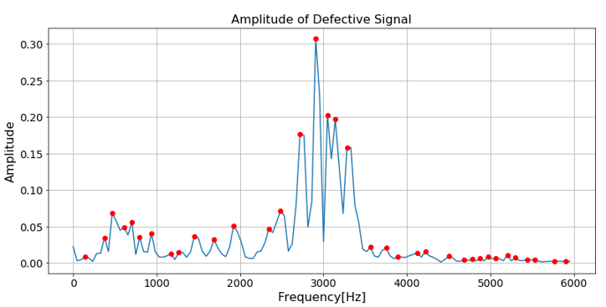
Engineered Features using FFT
Amplitude
Plot
FFT
Feature Extraction
Classification
ML
Algorithms
Raw Signal
PSD
Plot
Autocorrelation
Plot
PSD – Power Spectral Density
Feature Extraction selects top n peaks of each plot

Slide 4
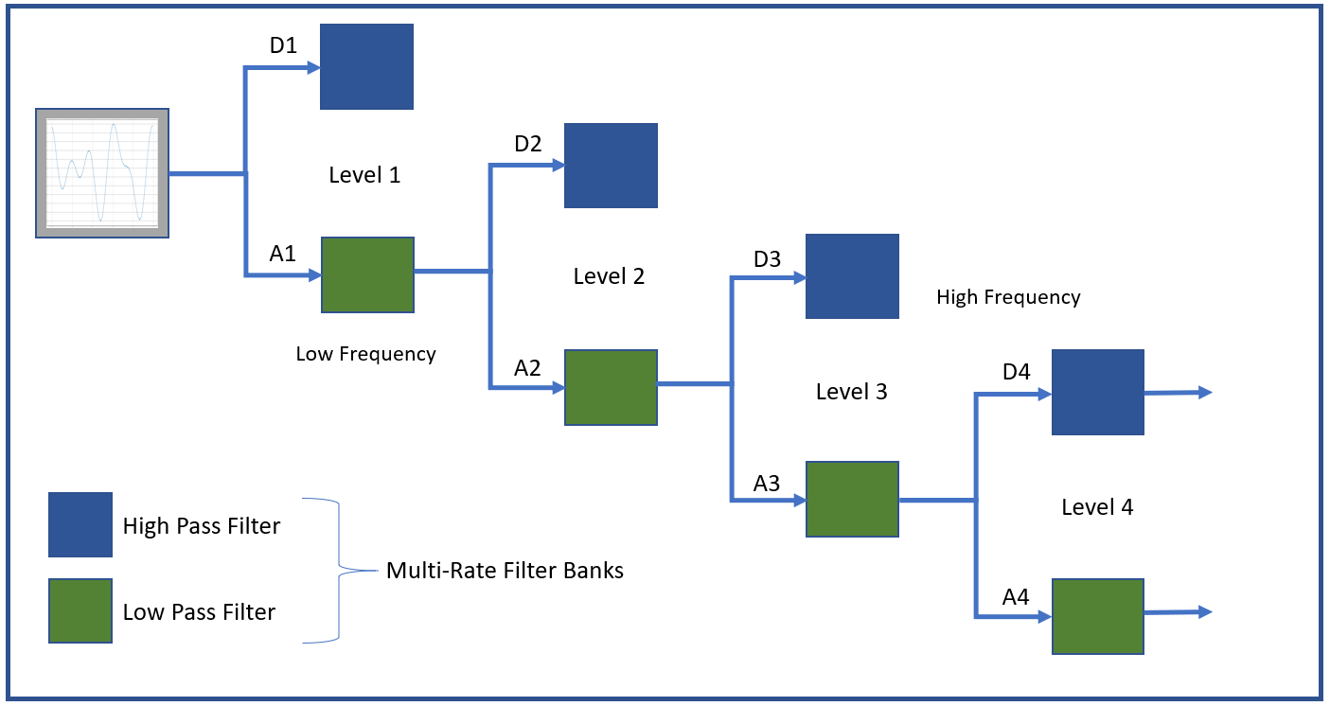
Engineered Features using DWT
Feature Extraction
Entropy
Statistics
Crossings
Coefficients for High Frequencies
at each Level
Feature Extraction
Classification
ML
Algorithms
Final Low Frequency
Coefficients

Slide 5
CNN 1D Architecture
Convolution
Pooling
s₁
s₂
ReLu Applied
Filtering
.
.
.
s₁₆
8 values
s₁₇
.
.
.
.
.
.
.
.
.
. . .
. . .
.
.
.
.
.
.
.
.
.
Pooled Results
s₁₈
Feature Map
.
.
.
.
.
.
.
.
.
.
.
.
s₃₂
.
.
.
64 Feature Maps
s₂₅₆
64 Filtered Feature Maps
Kernel Size = 16
Strides = 1
Window steps through data (256 times with padding)
Pool Size = 8
Reduces size from 256 to 256/8 = 32
Constructs a value by taking max of 8 values

Slide 6
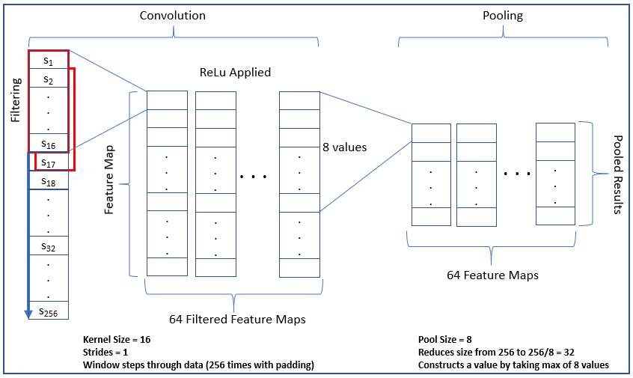
CNN 1D Architecture

Slide 7
CNN 1D Architecture – Sensor Data
1-D Convolution Neural Network Model
Results
Input
ReLu
Pooling
Convolution
ReLu
Pooling
Classification
Convolution
Flatten
Filters = 64
Kernel Size = 16
Pool Size = 8
Batch Size = 16
Activation = Relu
Filters = 256
Kernel Size = 16
Pool Size = 8
Batch Size = 16
Activation = Relu

Slide 8
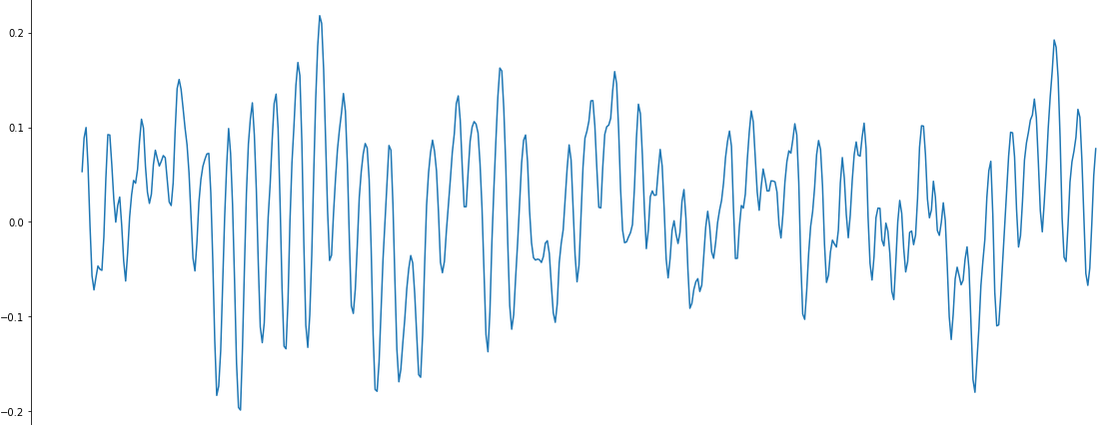
Data Preparation: Training Set
Sensor Signal (12,000 samples/second)
. . . .
v₁
v₂
v₃
v₄
v_{n}
Time
Size of v_{i} is fixed at 256.
Where n is the number of fixed sample vectors of size 256
y_{i} is the label for signal vector v_{i}. y_{i} in (0,1,2,3,4,5,6,7,8,9,10,11,12,13,14,15,16,17,18,19)

Slide 9
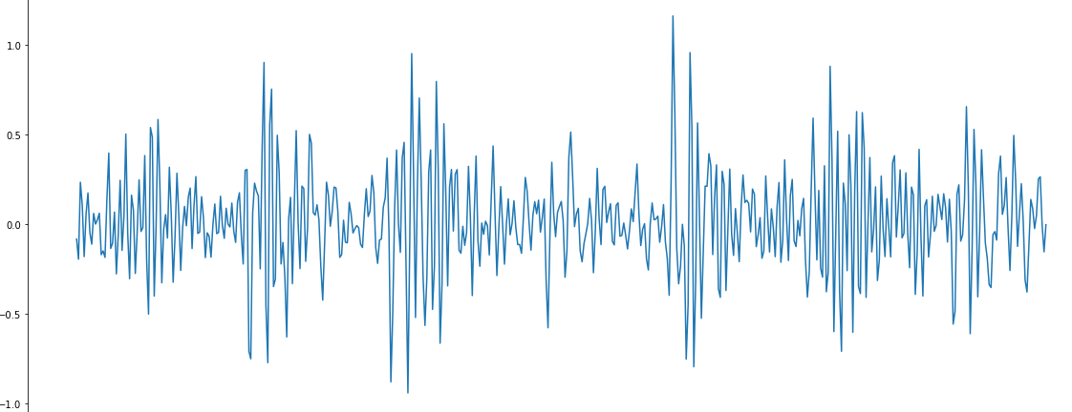
Data Preparation: Test Set
Sensor Signal (12,000 samples/second)
. . . .
v_{n+1}
v_{n+2}
v_{n+3}
v_{n+4}
v_{n+m}
Time
Size of v_{i} is fixed at 256.
Where m is the number of fixed sample vectors of size 256
y_{i} is the label for signal vector v_{i}. y_{i} in (0,1,2,3,4,5,6,7,8,9,10,11,12,13,14,15,16,17,18,19)

Slide 10
Contemporary Approach - Training
Training set is further subdivided into training and validation
. . . .
v₁
v₂
v₃
v₄
v_{n}
Signal Data Input
1-D Convolution Neural Network Model
V_{i} is fixed at 256 samples
v_{n}
v₃
v₂
v₁
. . .
Results
ReLu
Pooling
Convolution
ReLu
Pooling
Convolution
Flatten
Classification
Training Set

Slide 11
Convolutional Neural Network - Testing
. . . .
v_{n+1}
v_{n+2}
v_{n+3}
v_{n+4}
v_{n+m}
Signal Data Input
1-D Convolution Neural Network Model
v_{n+m}
v_{n+3}
v_{n+2}
v_{n+1}
. . .
Results
ReLu
Pooling
Convolution
ReLu
Pooling
Convolution
Dense
Test Set

Slide 12
Classic Approach- Training
. . . .
v₁
v₂
v₃
v₄
v_{n}
Signal Data Input
Feature Engineering and Classification
V_{i} is fixed at 256 samples
v_{n}
v₃
v₂
v₁
Feature
Extraction
(FFT and DWT)
ML Classification Algorithms
(XGB, GB, RF, SVC, Knn)
. . .
Results
Training Set

Slide 13
CNN 1D Feature Extraction
1-D Convolution Neural Network Model
Input
Feature Extraction
Results
ReLu
Pooling
Convolution
ReLu
Pooling
Convolution
Flatten
Filters = 64
Kernel Size = 16
Pool Size = 8
Batch Size = 16
Activation = Relu
Filters = 256
Kernel Size = 16
Pool Size = 8
Batch Size = 16
Activation = Relu

Slide 14
Classic and Contemporary Approach Together
. . . .
v₁
v₂
v₃
v₄
v_{n}
Signal Data Input
V_{i} is fixed at 256 samples
Feature Engineering and Classification
v_{n}
v₃
v₂
v₁
Feature
Extraction
(FFT, DWT & 1D CNN)
ML Classification using
XGBoost
. . .
Results
Training Set

Slide 15
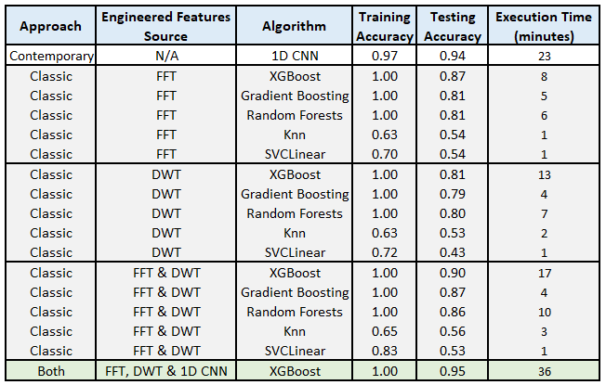
Prediction and Results using Testing Data

