Slide 1
CAESAR – GFA Piquet
Alain Bertrand :: Paul Scherrer Institut

Slide 2
CAESAR main goals
What is it
How to access it
Live monitoring
Network overview
Log in / Permissions
Restarting / Upgrading a gateway
Checking Gateway software version
Debugging EPICS
Configuration
Log view / analyze

Slide 3
What is it
CAESAR stands for:
CA EPICS Spy And Report
Goal:
1 pit stop point for all the EPICS Gateway work

Slide 4
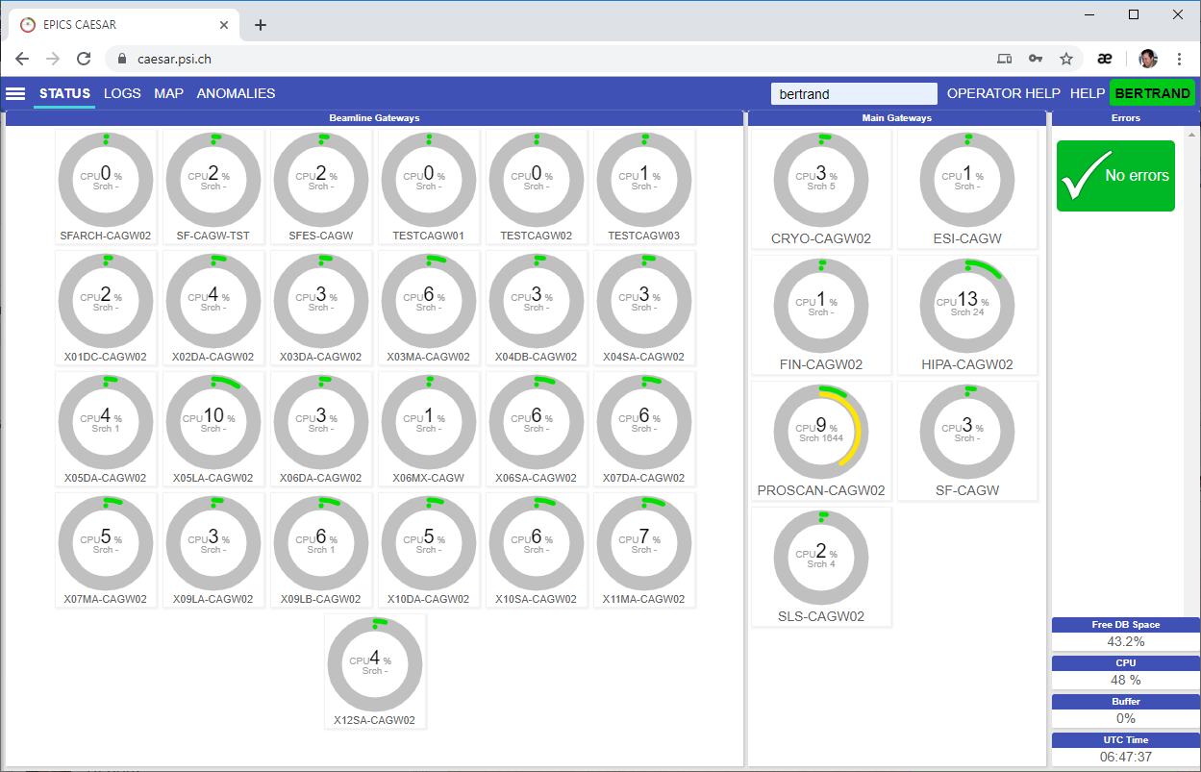
How to access it
https://caesar.psi.ch/

Slide 5

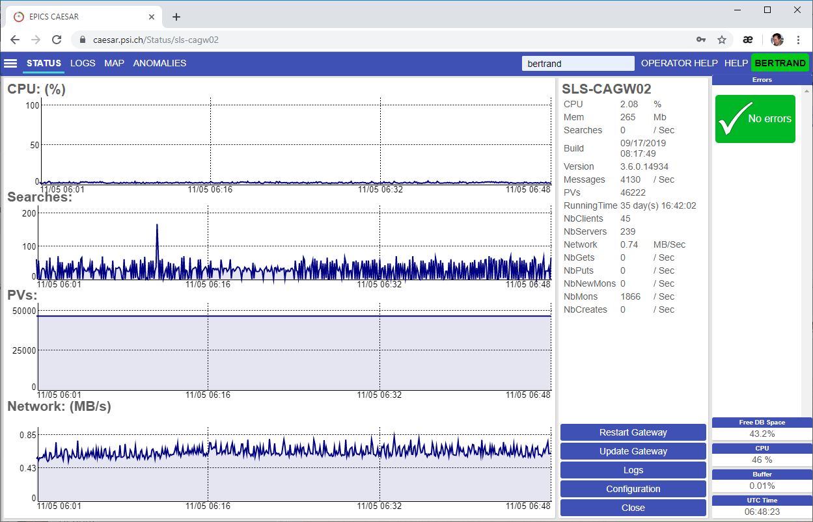
Live monitoring
From the “Status” tab click on any gateway and a detailed view will be displayed

Slide 6
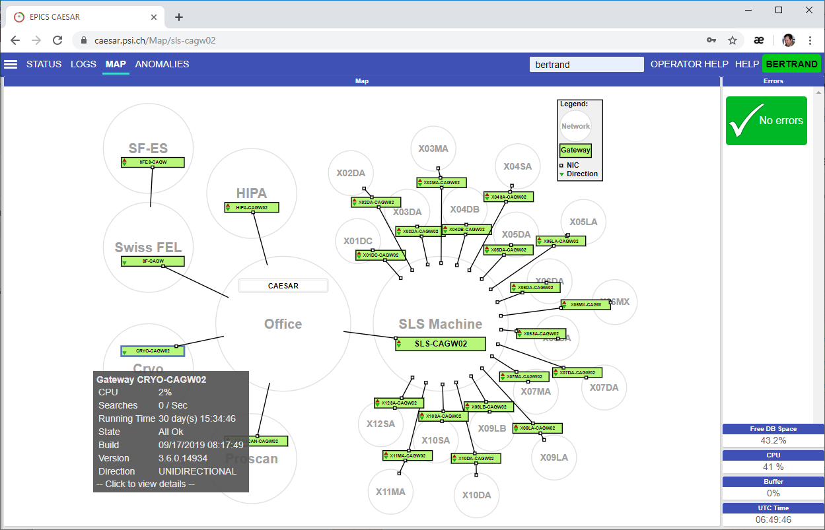

Network overview
The map tab on top shows an overview of all the gateways.
Mouse over any and more information will be displayed.

Slide 7
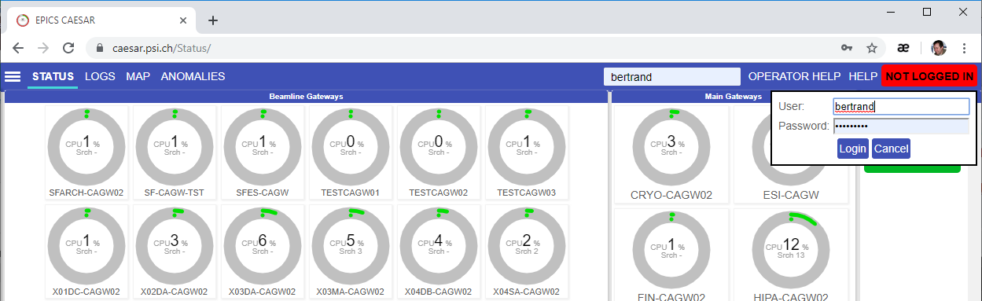
Log in / Permissions
All monitoring, checking, log analyze doesn’t require login.
Configuration change, restart a gateway do require a login.
Windows Username & Password used

Slide 8
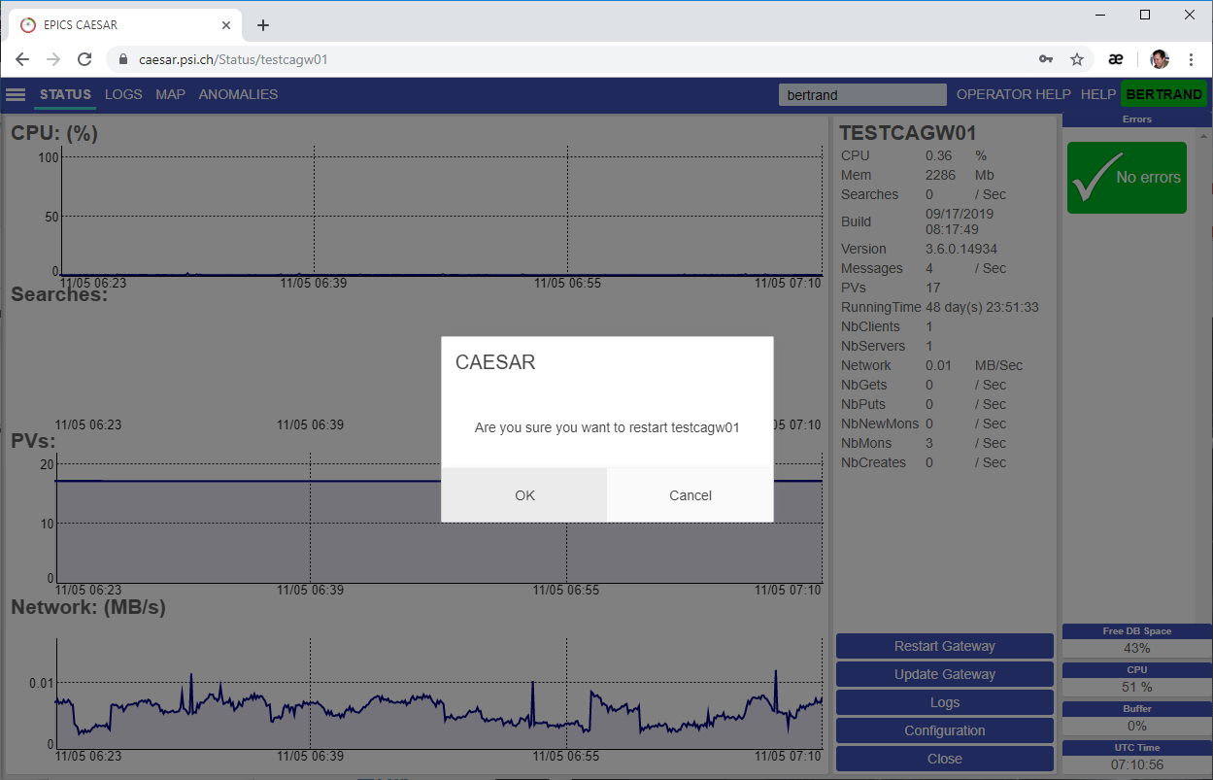
Restarting / Upgrading a gateway
In the status detail view, press “Restart” or “Upgrade”
A confirmation dialog will be displayed
Press “OK” and the gateway shall restart.

Slide 9
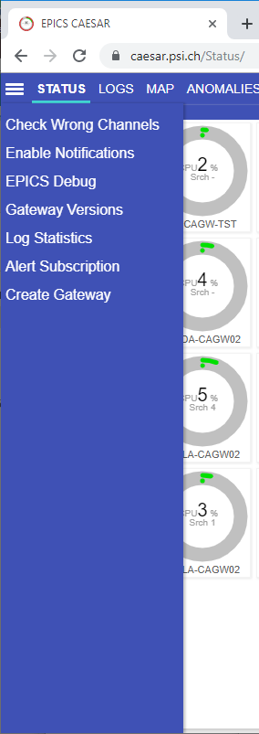
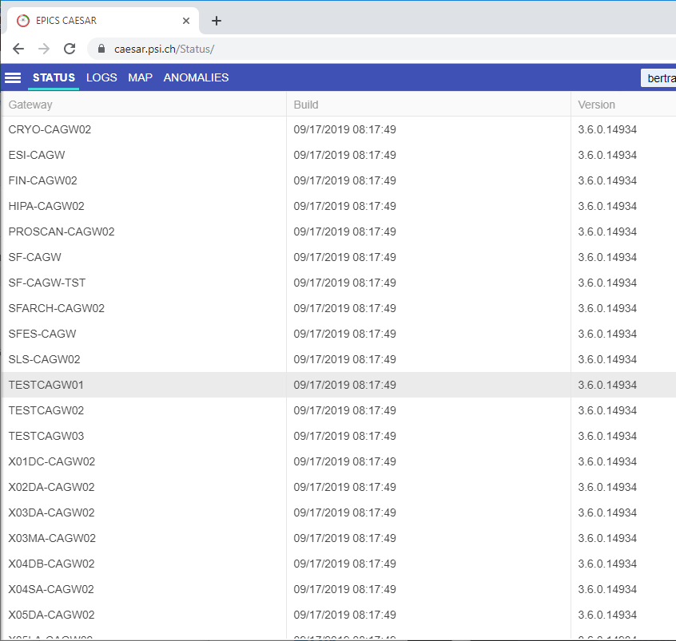
Checking Gateway software version
1
Select “Gateway Versions” in the hamburger menu
You get a list of all Gateways with the version they are running.
Old versions will be displayed with red background

Slide 10
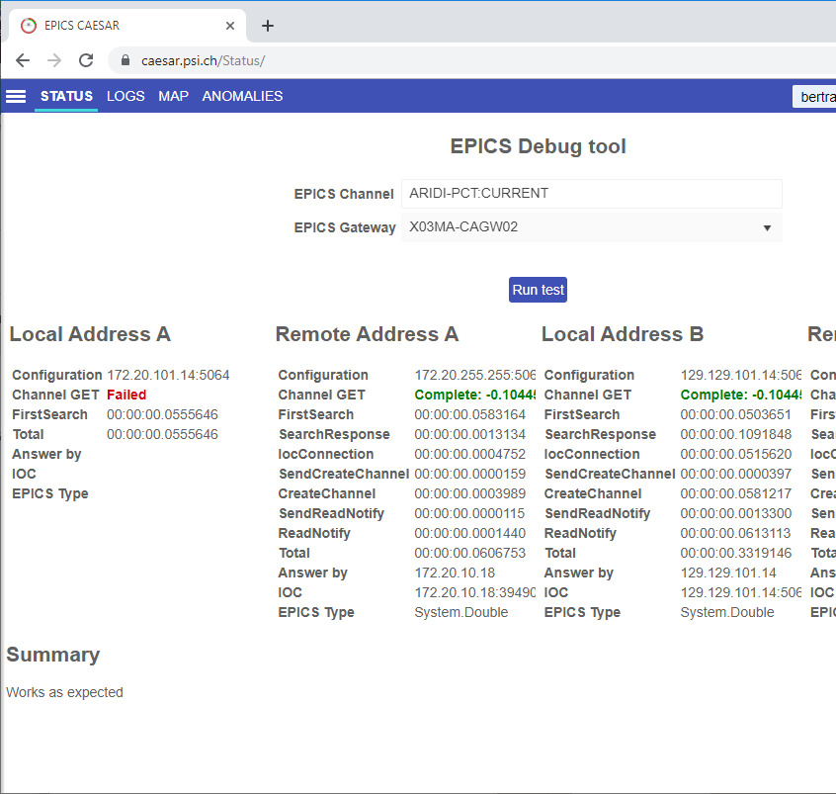
Debugging EPICS
1
2
3
4
Select “EPICS Debug” in the hamburger menu
Type in a PV you want to check
Select a gateway you want to try on
Press run and wait…
Check out the result
5

Slide 11
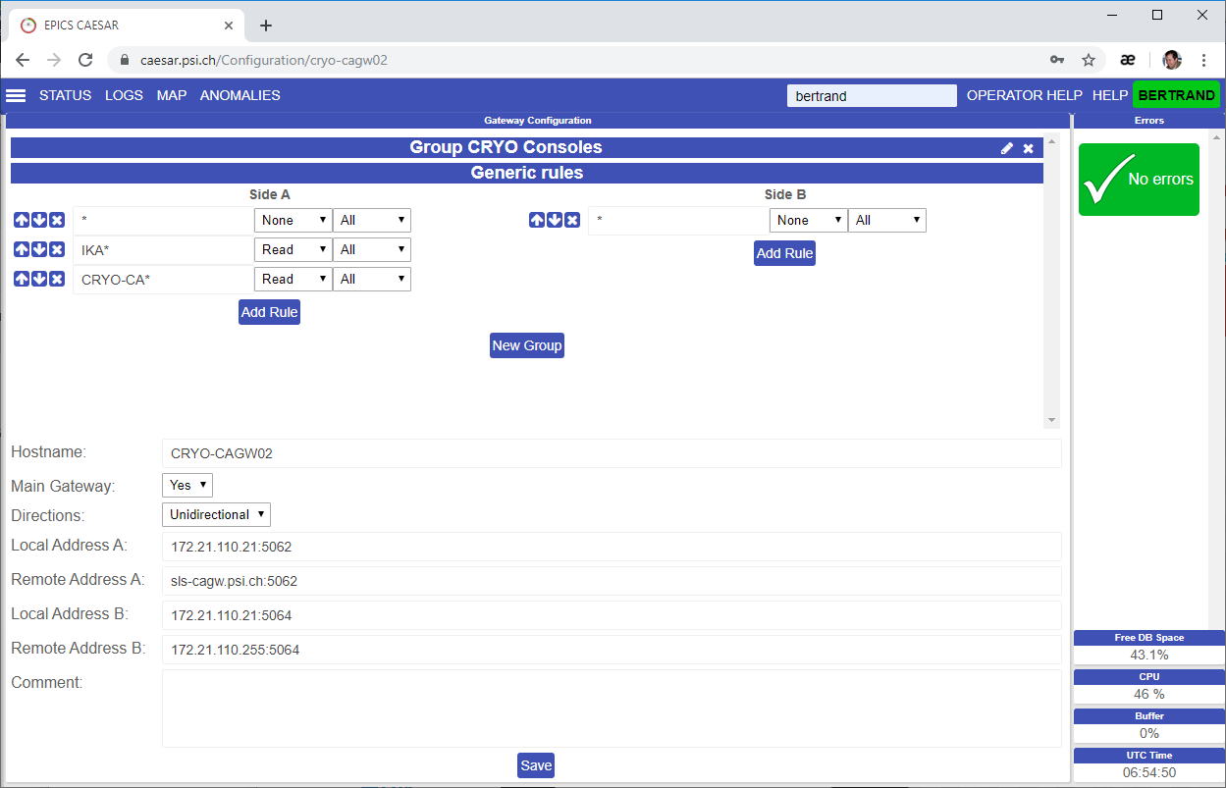
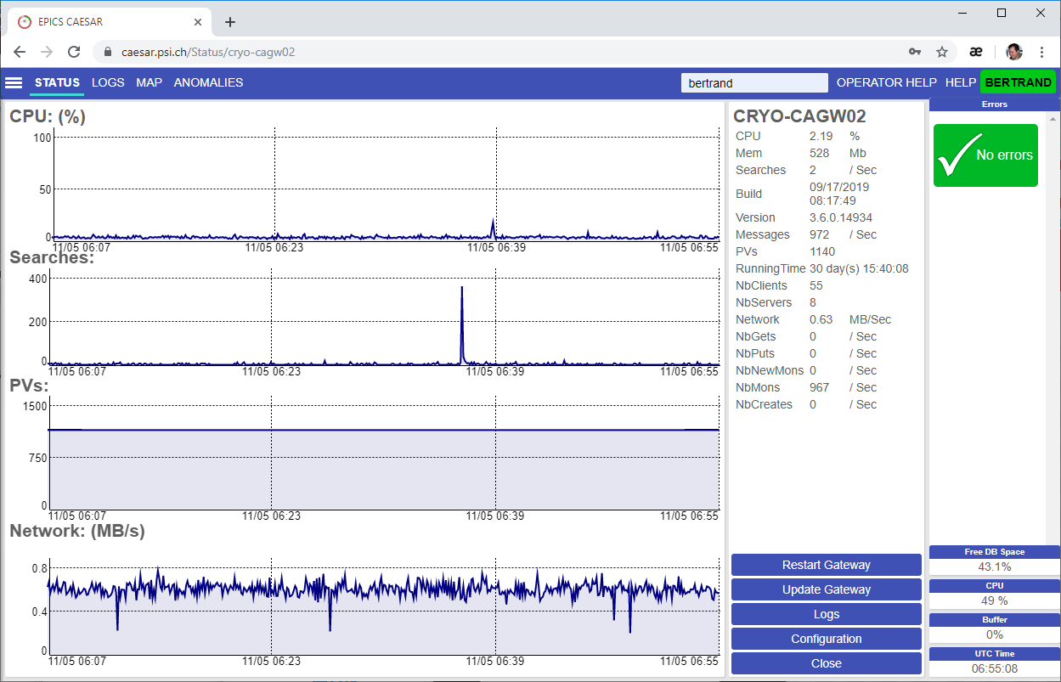
Configuration
From the detailed view click “Configuration”
And the gateway configuration will be displayed.
New configuration will be applied only after restarting the gateway.

Slide 12
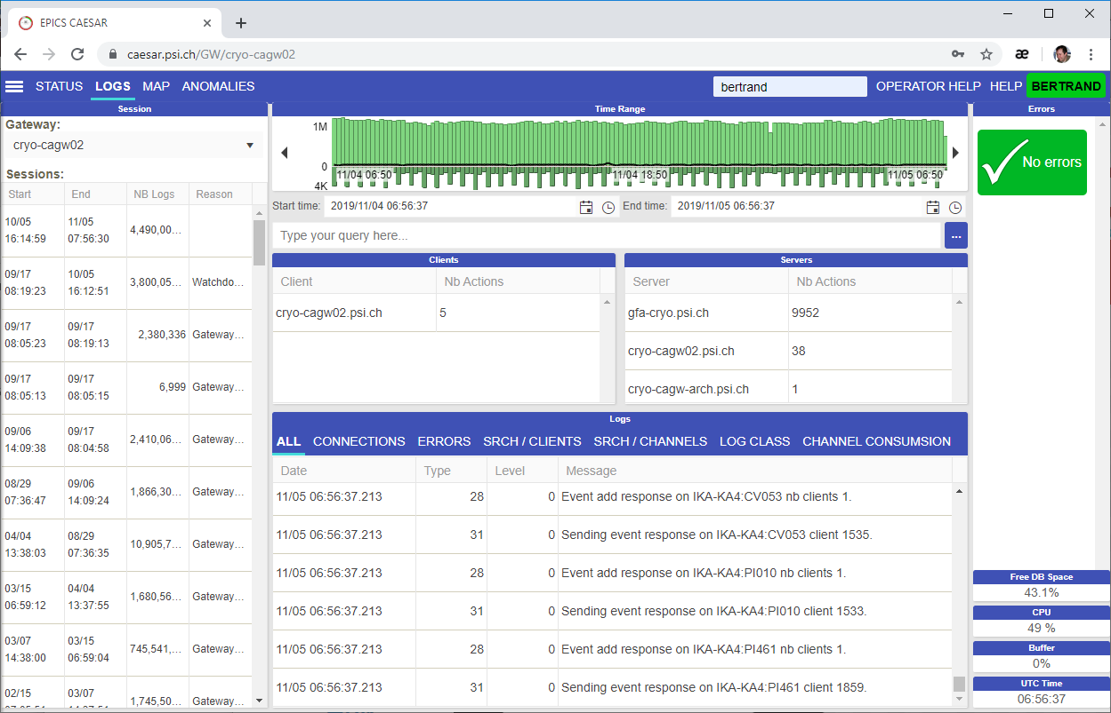
Log view / analyze
From the detailed view click “Logs”
And the gateway logs will be displayed.

Slide 13
Log view / analyze
Stat bars (10 min bars):
Top => Number of log entries
Bottom => Number of searches
Red Line => Number of errors
Black Line => CPU load
Click on any bar to start looking for logs entries at that period

Slide 14
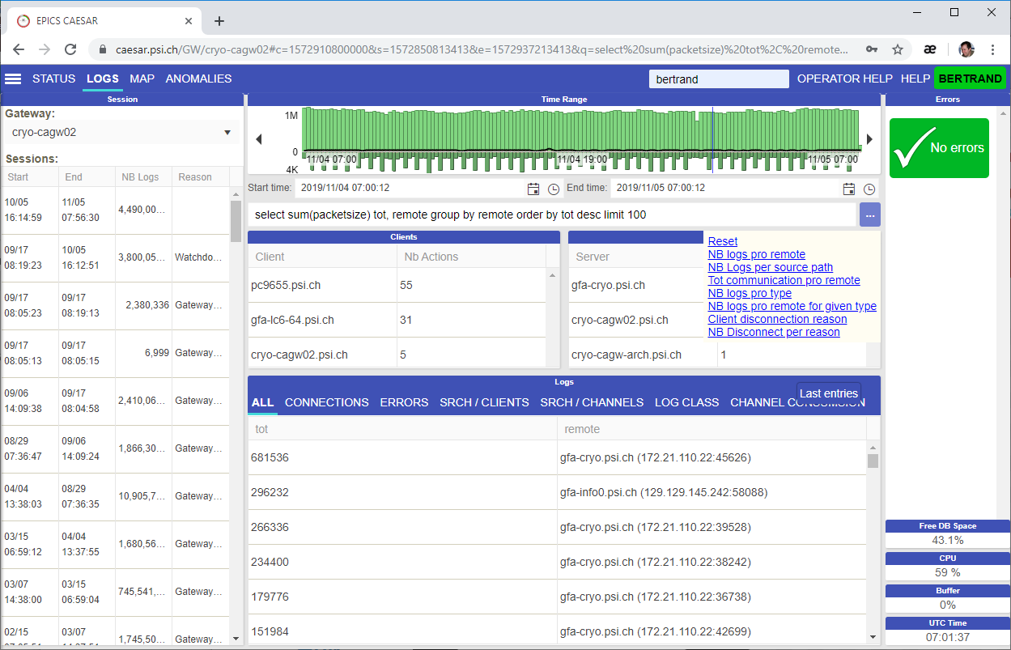
Log view / analyze
1
2
From the log view, once a 10 min slot is selected click on the small “…” button
Select one of the pre-made query
And the report shall be displayed on the bottom part
3

Slide 15
Wir schaffen Wissen – heute für morgen
Questions?
Contacts:
alain.bertrand@psi.ch

